Slide 1

FLASK

Slide 2
Typical Data Science Cycle
Data Collection
Deployment
Data Understanding
Model Building & Evaluation
Data Pre-Processing

Slide 3
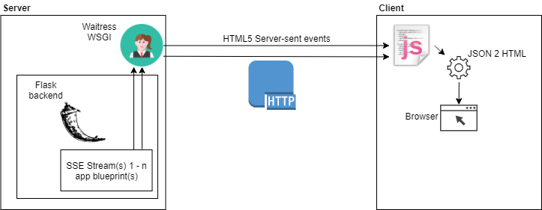
Introduction
A Web framework(WF) supports the creation, development, and
publishing of web applications and web sites.
Flask is a python based web application framework.
Flask is often referred to as a micro framework. It aims to keep the
core of an application simple yet extensible.
It is a Light-weight, extensible framework with minimalistic features.
With Flask, a simple application can be later changed to add more functionality and make it complex. It provides flexibility to expand the application quickly. Developers are free to use any plugins and libraries and build functionalities in a flexible way.
Notes:
https://hackr.io/blog/flask-vs-django

Slide 4
Introduction
Flask is a good start if you are getting into web development. There are many websites built on the flask and gain heavy traffic, but not as much compared to the ones in Django.
Flask is more open-ended and developers may or may not follow the best practices. But for Django developers are ensured to follow best practices as everything has a template.
Django is a full stack framework with ready to use customizable admin framework and built-in template engine that saves a lot of development time. Also, Django enables dividing long project into small applications which makes them easy to develop and maintain.
Flask doesn’t have any feature to handle administration tasks also each project can be a single application so for a large project handled by a large team it is not preferred over Django.
Notes:
https://hackr.io/blog/flask-vs-Django

Slide 5
Introduction
WSGI
WSGI is the Web Server Gateway Interface.
Web Server Gateway Interface (WSGI) has been adopted as a standard for Python web application development.
it is an standardized interface between Web servers and Python Web frameworks/applications.
The goal is to provide a relatively simple yet comprehensive interface capable of supporting all (or most) interactions between a Web server and a Web framework
Notes:
http://ivory.idyll.org/articles/wsgi-intro/what-is-wsgi.html
https://www.tutorialspoint.com/flask/flask_overview.htm

Slide 6
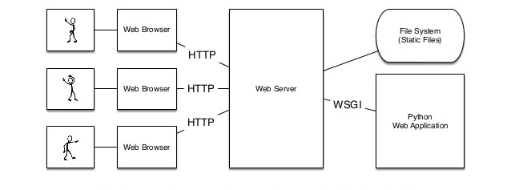
Introduction
Web Server Gateway Interface (WSGI)
Notes:
https://www.youtube.com/watch?v=4L_xAWDRs7w
https://image.slidesharecdn.com/secretsofawsgimaster-170806022036/95/secrets-of-a-wsgi-master-2-638.jpg?cb=1504852163

Slide 7
Components
1. Package flask installation and import
2. Flask app Object
Create a :class:`Flask` instance object in your main module.
The flask object implements a WSGI application and acts as the central object.
Once it is created it will act as a central registry for the view functions, the URL rules, template configuration and much more.
from flask import Flask

Slide 8
Components
2. Flask app Object (Cont…)
Flask constructor takes the name of current module (__name__) as argument.
The name of the package is used to resolve resources from inside the package or the folder the module is contained in.
from flask import Flask
app = Flask(__name__)

Slide 9
Components
3. The route() function:
The route() function of the Flask class is a decorator, which tells the application which URL should call the associated function. we use the syntax @
In above example ‘/’ (can be considered as home page) which is associated with first_function()
We can mention other urls such as app.route(‘/’) , app.route(‘/about-us’) . Hence if we will visit http://localhost:5000/about-us then output of first_function will be rendered on this url.
@app.route(‘/’)
def first_function():
return “Demo of Flask”
Notes:
A decorator in Python is a function that takes another function as its argument, and returns yet another function.

Slide 10
Components
4. run() :
run() method of Flask class runs the application on the local development server.
app.run(host, port, debug, options)
host | Hostname to listen on. Defaults to 127.0.0.1 (localhost).
port | Defaults to 5000
debug | Defaults to false. If set to true, provides a debug information
options | To be forwarded to underlying Werkzeug server. Such as use_reloader
Notes:
https://flask.palletsprojects.com/en/0.12.x/deploying/
https://stackoverflow.com/questions/38982807/are-a-wsgi-server-and-http-server-required-to-serve-a-flask-app/38982989#38982989

Slide 11
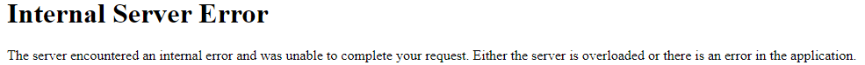
Components
4. run() cont…..
debug
if debug = True It will provide a useful debugger to track the errors if any, in the application.
In case of debug=False , it will not show cause of error but will show “Internal Server Error”
use_reloader
If use_reloader = False then app is restarted manually for each change in the code. User_reloader=True. Then app can be refreshed/reloaded on browser to accommodate new changes in code instead of restart.
NOTE: While running flask app directly from spyder IDE / Jupyter Notebook, The reloader tries to restart the process, which IPython can't handle. In that case, we need to set use_reloader=False. Or use the plain python interpreter (using prompt) to run the application if you still want to use app.run()
app.run(host, port, debug, options)
Notes:
https://stackoverflow.com/questions/49456385/running-flask-from-ipython-raises-systemexit

Slide 12
Components
4. run() cont…..
When you "run Flask" you are actually running Werkzeug's development WSGI server, and passing your Flask app as the WSGI callable.
The development server is not intended for use in production. It is not designed to be particularly efficient, stable, or secure. It does not support all the possible features of a HTTP server.
app.run(host, port, debug, options)
Notes:
https://flask.palletsprojects.com/en/0.12.x/deploying/
https://stackoverflow.com/questions/38982807/are-a-wsgi-server-and-http-server-required-to-serve-a-flask-app/38982989#38982989

Slide 13
Components
4. run() :
While lightweight and easy to use, Flask’s built-in server is not suitable for production as it doesn’t scale well and by default serves only one request at a time.
Some of the options available for properly running Flask in production are Heroku, cloud platforms such as gcp, azure, aws, pythonanywhere.
Replace the Werkzeug dev server with a production-ready WSGI server such as self-hosted options (Gunicorn / uWSGI) or other hosted servers (Heroku, cloud platforms such as gcp, azure, aws, pythonanywhere.) when moving to production, no matter where the app will be available.
DEMO : Flask_Basic.py
app.run(host, port, debug, options)
Notes:
https://flask.palletsprojects.com/en/0.12.x/deploying/
https://stackoverflow.com/questions/38982807/are-a-wsgi-server-and-http-server-required-to-serve-a-flask-app/38982989#38982989
#https://stackoverflow.com/questions/49456385/running-flask-from-ipython-raises-systemexit

Slide 14
Dynamic URL
We can create dynamic url by providing <variable_name> in route argument and passing the same into associated function.
Redirecting to Other URL:
Another method to create dynamic URL.
Application can be redirected to the other functions/url using url_for()
Demo : Flask_Route.py
@app.route('/<variable>')
def function2(variable):
return 'Show Flask Demo for %s!' % variable
@app.route('//<int:EmployeeNumber>')
def show_blog(EmployeeNumber):
return 'Show Flask Demo for employee %d' % EmployeeNumber
Notes:
https://www.tutorialspoint.com/flask/flask_variable_rules.htm

Slide 15
Methods for data communication
HTTP Requests
GET - When you get some data from URL Like name, address etc.
GET methods is only used to retrieve data from URL.
Post - When you send some data on server then use post methods.
By default, the Flask route responds to the GET requests.
However, this preference can be altered by providing methods argument to route() decorator.
We need to import request module from flask package
Notes:
https://www.tutorialspoint.com/flask/flask_http_methods.htm
https://stackoverflow.com/questions/37582815/what-is-the-difference-between-get-and-post-method-in-rest-api-ios

Slide 16
Html templates
We can display output from flask python script in the form of html content using two ways:
Write html content in python flask script inside any function. This function will render html output to associated URL
We can create an html template supported by flask jinja2 template engine.
Instead of returning html content, function will render this html file to associated URL.
NOTE: We need to keep customized html templates in template folder in the same directory where python flask script is kept.
@app.route('/')
def function1():
return '<html><body><h1>Show Flask Demo</h1></body></html>'

Slide 17
Html templates
Uses of variables , expressions in html templates:
{% ... %} for Statements (loops, if-else)
{{ ... }} for Expressions to print to the template output (variable name)
These are used to pass various types of operations such as display variable name i.e. expressions, dictionary outputs , loops or conditional statements etc.
We can pass more than 1 variables to html script
Demo : Flask_template.py
Notes:
https://www.tutorialspoint.com/flask/flask_templates.htm

Slide 18
Html templates with HTTP requests
Fill up form on a URL (URL1)
This data will be sent to a different URL (URL2) with a POST method
Function associated with this second URL (URL2) will be triggered and form data will be extracted from request.form object in dictionary format
This dictionary will be sent as an input to target template to render it on second URL (URL2)
Demo : Flask_data.py
Notes:
https://www.tutorialspoint.com/flask/flask_templates.htm

Slide 19
Session
The Session is the time between the client logs in to the server and logs out of the server
Sessions store data temporarily on the web server in a temporary directory on the server.
Temporary data is stored in cookies file in encrypted format (encrypted with the SECRET_KEY). Once session starts with unique SECRET_KEY then this temporary data is accesses throughout the session across different navigations.
It is used to remember user information from one request to another when the user is navigating in your application. Access information across different pages without using complex dynamic URL (url_for) functions.
This temporary data is deleted once user logged out. Also data deleted even we change/close our browser.
We can store our temporary data for much defined longer time as well and delete after that.
Demo = flask_session.py
Notes:
https://itnext.io/flask-sessions-what-are-they-for-how-it-works-what-options-i-have-to-persist-this-data-4ca48a34d3
https://www.youtube.com/watch?v=iIhAfX4iek0

Slide 20
Prediction Output Using Flask
Pickle Object : it's the method of converting a Python object into a byte stream (0/1) to store it in a file/database, maintain program state across sessions, or transport data over the network.
Process is called pickling or serialization.
After training and validation , machine learning model is pickled and stored.
This stored pickle object will be used for predictions in another python script without repeating all steps of model development and validation.
Flask POST requests will be used to collect new data upon which predictions will be performed.
Demo
Decision Tree.py
Decision Tree Prediction.py
Flask_Decision_Tree.py

