Slide 1
K Nearest Neighbor

Slide 2
Typical Data Science Cycle
Data Collection
Business Insights & Understanding
Data Understanding
Model Building & Evaluation
Data Pre-Processing

Slide 3
Machine Learning
Supervised ML
(Target Variables)
Classification
Regression
Linear Regression (Causal) , Decision Tree,
KNN
Logistic Regression , Decision Tree,
KNN

Slide 4
Distance Metrics
Distance Metrics-distance metrics are used in both supervised and unsupervised learning, generally to calculate the similarity between data points.
Euclidean Distance
Manhattan Distance
Minkowski Distance
Cosine Similarity

Slide 5
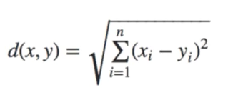
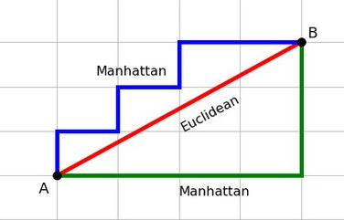
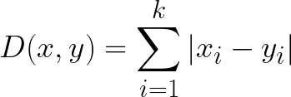
Distance Metrics
Euclidean Distance :Euclidean Distance represents the shortest distance between two points.
distance is calculated from the cartesian coordinates of the points using the Pythagorean theorem
Manhattan Distance : Manhattan Distance is the sum of absolute differences between
points across all the dimensions. Also known as Taxicab Geometry, City Block Distance.
Notes:
https://medium.com/analytics-vidhya/types-of-distances-in-machine-learning-5b1233380775

Slide 6
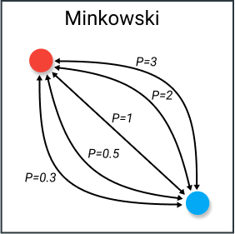
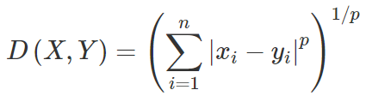
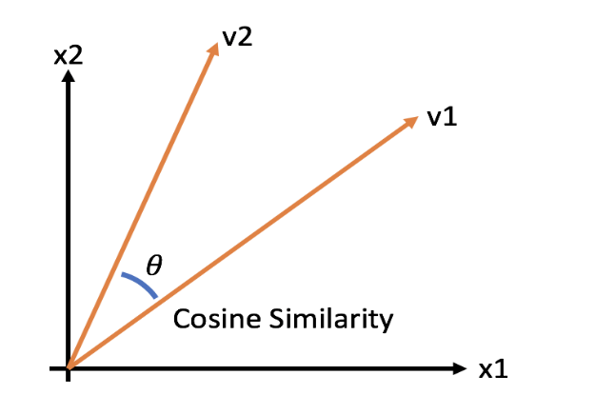

Distance Metrics
Minkowski Distance : Minkowski distance is the generalized distance metric.
we can manipulate the value of p and calculate the distance in multiple ways-
p = 1, Manhattan Distance
p = 2, Euclidean Distance
Cosine Similarity : cosine similarity is simply the cosine of the angle between two vectors. We measure direction/orientation not magnitude of vectors. Two vectors with exactly the same orientation have a cosine similarity of 1, whereas two vectors diametrically opposed to each other have a similarity of -1. Mostly used in text mining.

Slide 7
KNN - Ideation
KNN is a supervised machine learning algorithm which predicts/classifies data based upon
Closest observations.

Slide 8
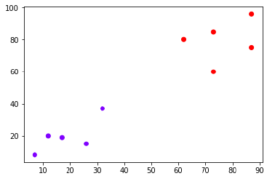
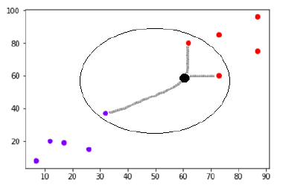
KNN - Ideation
KNN is a supervised machine learning algorithm which predicts/classifies data based upon
Closest observations.

Slide 9
Introduction
K Nearest Neighbor is a simple algorithm that stores all the available cases and classifies the new data or case based on a similarity measure.
It is used for classification as well prediction.
KNN is a lazy learning, non-parametric algorithm
KNN is non-parametric since it doesn’t make any assumptions on the data being studied, i.e., normal distribution etc
K-NN is a lazy learner because it doesn’t learn a discriminative function from the training data but “memorizes” the training dataset instead.

Slide 10
Process
Pick a number of neighbours you want to use for classification or regression (K)
Choose a method to measure distances
Keep a data set with records
For every new point, identify the number of nearest neighbours you picked using the method you chose
Let them vote if it is a classification issue or take a mean/median for regression!

Slide 11
Process
Let us play
http://sleepyheads.jp/apps/knn/knn.html
http://vision.stanford.edu/teaching/cs231n-demos/knn/

Slide 12
How KNN Works in ML projects
Load the data
We need to choose the value of K i.e. the nearest data points. K can be any integer (odd number is better)
Divide data between train and test and Iterate validation process from 1 to Training Size of rows:
Fit model on train data
Calculate the distance between test data & each row of the training set.
The metrics used are Euclidean distance/cosine similarity etc
Sort the values on ascending order based on the metric selected
Get the TOP K Rows from them
If it is classification, choose the MODE
If it is Regression, choose the mean from them
Check performance on each value of K and then decide optimum K

Slide 13
Observations
Decision surfaces created by KNN
K =1 sounds most convincing because it provides prediction based upon closest point but it might lead to overfit because a single observation is influential enough to classify/predict
Increasing K can reduce the overfit by generalizing results using more observations to calculate similarity.
There will be an optimum K
Use K that gives good results on test data. –Train, Test, Evaluation and Hold-out Analysis are your good friends
Noisy training is an issue

Slide 14
Observations
Since KNN requires to measure distance between points, scaling become very critical before modelling because Attributes with larger range can dominate
KNN does not store any model. It stores data (cases). To predict new observation, it calculates distance of new point with all the observations and provide prediction. (lazy learning)
This approach leads to consumption of more memory and time. Situation gets worse when we have high dimension data. (Curse of dimensionality )
Dimension reduction or feature selections are the solution for this.

Slide 15
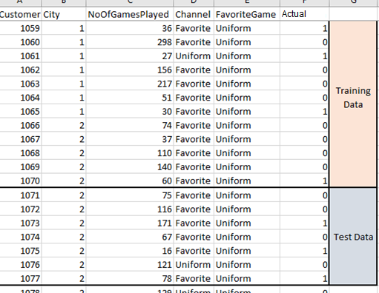
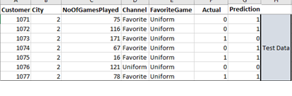
Performance Validation
Performance validation of KNN
Modelling on Training Data
Store Available data
Calculate distance for Test Data
Prediction

Slide 16
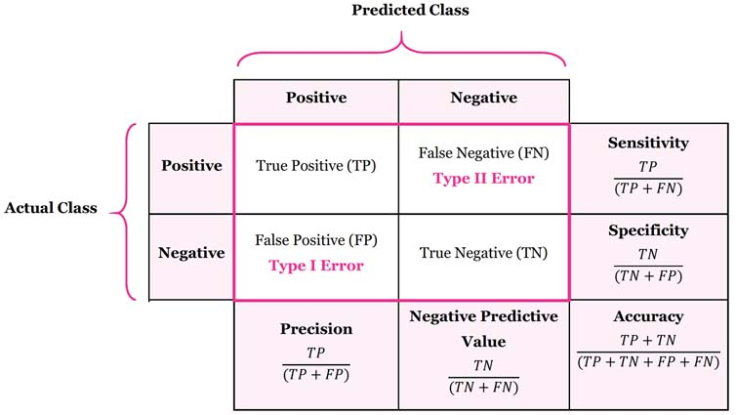
Model Evaluation Metrics
The various metrics used to evaluate the results of the prediction are :
Accuracy
Precision
Recall
Area Under ROC Curve
MAPE/ MAD/ RMSE (For Regressors)

Slide 17
Hyper parameter Tuning
n_neighbors int, default=5 –
Number of neighbors to use by default for K neighbors queries.
algorithm{‘auto’, ‘ball_tree’, ‘kd_tree’, ‘brute’}, default=’auto’
Brute, BallTree and KDTree algorithms are the ways by which nearest neighbors are looked for. The most naive neighbor search implementation involves the brute-force computation of distances between all pairs of points in the dataset. It is good only for small data set.
KDTree splits data using median of a randomly chosen independent variables and continue split until a predefined criteria such as minimum sample in leaf is reached. Speed is high but can misses nearest neighbors (specially in high dimension data). KD trees partition data along Cartesian axes, ball trees partition data in a series of nesting hyper-spheres which makes it efficient in high dimensional space

Slide 18
Hyper parameter Tuning
metricstr or callable, default=’minkowski’
the distance metric to use for the tree. The default metric is minkowski, and with p=2 is equivalent to the standard Euclidean metric.
weights{‘uniform’, ‘distance’} or callable, default=’uniform’
weight function used in prediction.
Possible values:
‘uniform’ : uniform weights. All points in each neighborhood are weighted equally.
‘distance’ : weight points by the inverse of their distance. in this case, closer neighbors of a query point will have a greater influence than neighbors which are further away.
pint, default=2
Power parameter for the Minkowski metric. When p = 1, this is equivalent to using manhattan_distance (l1), and euclidean_distance (l2) for p = 2. For arbitrary p, minkowski_distance (l_p) is used.

