Slide 1
Performance Measures

Slide 2
Typical Data Science Cycle
Data Collection
Business Insights & Understanding
Data Understanding
Model Building & Evaluation
Data Pre-Processing

Slide 3
Data Analytics
Descriptive Analytics
Predictive Analytics
What will happen in future?
Prescriptive Analytics
Recommendation to affect outcome
What has happened so far?

Slide 4
Descriptive Analytics
How business is performing or has been performing
Can be done using charts, reports, dashboards and graph
3. Approaches used :
Exploratory Data Analysis
Charts
Tables
Descriptive summary of data
b. Hypothesis Testing ( Analyzes relationship between different variables but not useful in prediction )

Slide 5
Predictive Analytics
Also called predictive modelling
These predictive models and algorithms can detect relationships of any type between the predictor variables and the outcome variables and approximate them closely to make accurate predictions about future events.
Predictive modelling have two types of variables :
Target variable / output variable / dependent variable [This variable is the one which we want to predict]
Predicator variables / input variables / Independent variables [These variables are the one which help to predict target variable]

Slide 6
Predictive Analytics
There are two types of target variables :
Continuous/Numerical : Described by numerical values. Examples of continuous variables are blood
pressure, height, weight, income, age.
Discrete/ Categorical : Categorical variables are restricted to a limited number of classes or categories or labels. Categories can vary from 2 to any number. Eg. Choice of color, Purchase decision , Match outcome (win/lose)

Slide 7
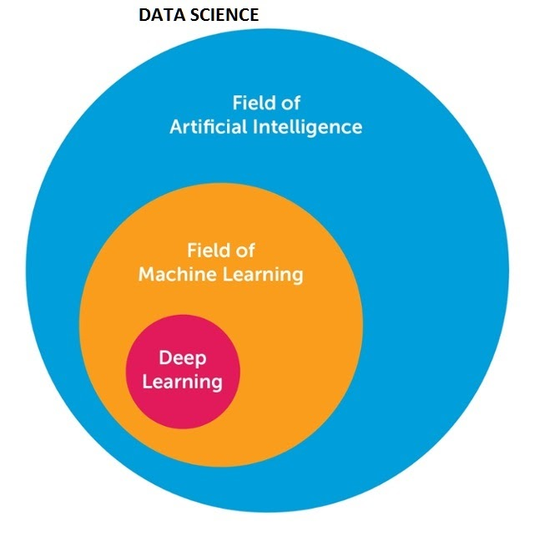
Predictive Analytics
Predictive analytics is achieved by machine learning modelling.
Machine Learning is the scientific study and analysis through statistical modelling and computing algorithms that allow systems to make autonomous decisions without explicit intervention

Slide 8
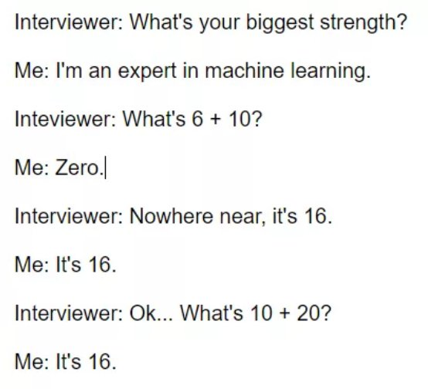
Machine Learning vs Human Learning

Slide 9
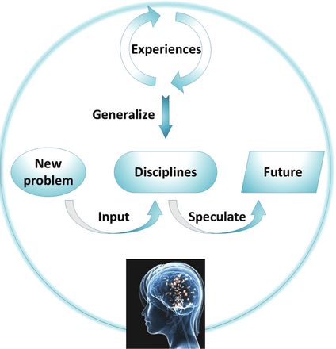
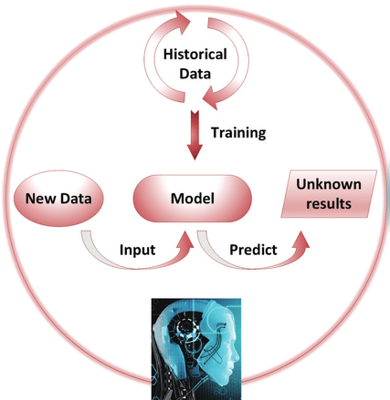
Machine Learning vs Human Learning
Humans acquire knowledge through experience either directly or shared by others.
Machines acquire knowledge through experience
shared in the form of past data.

Slide 10
Machine Learning
Machine Learning
Unsupervised ML
(No Target Variable)
Supervised ML
(Target Variables)
Reinforcement
Leaning
(Risk and Reward)
Clustering, Recommendation Engine, PCA
Regression, Classification
Deep Learning

Slide 11
Supervised Machine Learning
Supervised Machine Learning is divided in two major categories depending upon type of target variable
Classification Modelling : The goal here is to predict discrete values belonging to a particular class and evaluate on the basis of accuracy.
e.g. Whether india will win against sri-lanka if they have total 6 batsman, 5 bowler, batting average is 42 run for each batsman and bowling average is 2.2 wicket for each each bowler.
Categorical / Discrete
Target Variable
Regression Algorithm: Goal is to predict continuous variables (Integers/Float) basis upon input variables
e.g. what will be the total income of customer if age is 62,education is MBA and experience is 7 years.
Numerical/ Continuous
Target Variable

Slide 12
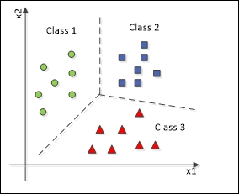
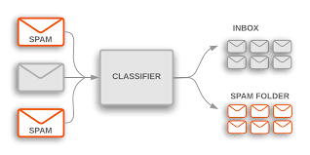
Classification Modelling
Classification is a technique where we categorize data into a given number of classes.
Classification is a task that requires the use of machine learning algorithms that learn how to assign a class label to examples from the problem domain.
An easy to understand example is classifying emails as “spam” or “not spam.”

Slide 13
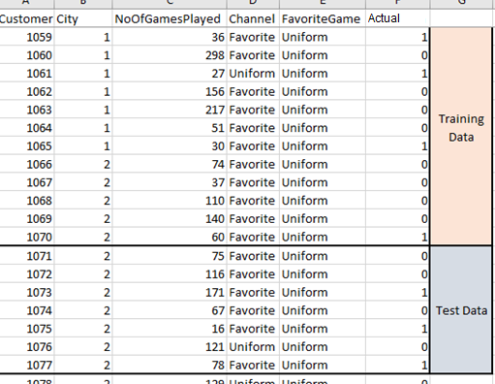
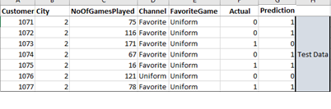
Classification Modelling
Performance validation of Classification Modelling
Modelling on Training Data
ML Model
Apply on Test Data
Prediction

Slide 14
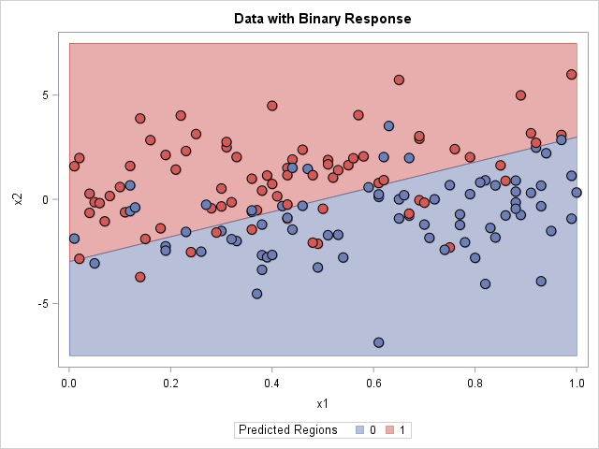
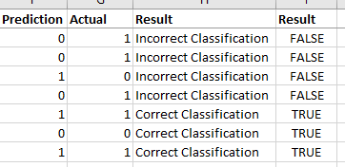
Classification Modelling
Performance validation of Classification Modelling
Accuracy = Total Accurate Classification = 3/ 7 = 42%
Total Observation

Slide 15
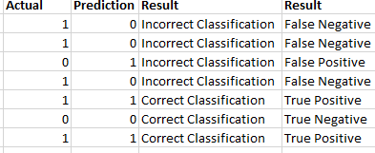

Classification Modelling
Performance validation of Classification Modelling
Considering 1 = Positive (+ve) and 0 = negative (-ve)
True Positive Rate = Total True Positive = 2/ 5 = 40%
Total Actual Positive

Slide 16
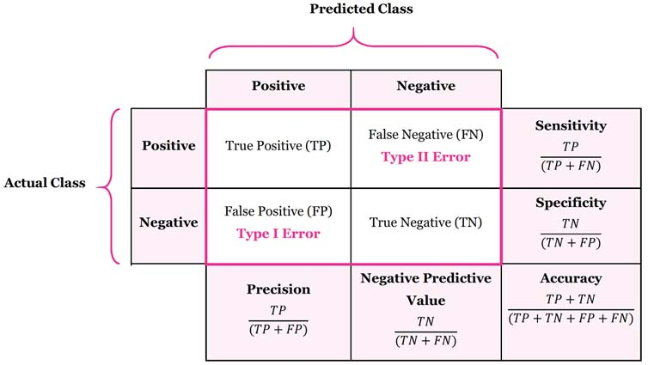
Classification Modelling
Confusion Matrix
Accuracy Total correct predictions out of total observation
Sensitivity/True Positive rate/Recall measures the proportion of positives that are correctly identified. the proportion of those who are spam and correctly identified as “Spam”.
Specificity/True Negative rate measures the proportion of negative that are correctly identified. the proportion of those emails who are non spam and correctly identified as “Non -Spam.”

Slide 17
Classification Modelling
ROC – Receiver Operating Characteristics
AUC – Area Under the ROC Curve

Slide 18
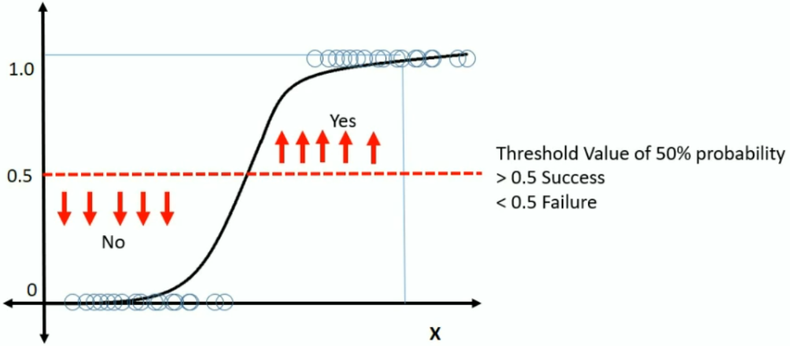
Classification Modelling
Example of Spam Vs Non-Spam Model : Total SPAM + NON-SPAM = 1092
Actual Counts
Non-Spam: 922
SPAM: 170
Probability Threshold for Discriminating Between SPAM and Non-Spam | True Positives | False Positives | True Negatives | False Negatives
0.9 | 0 | 0 | 922 | 170
0.7 | 1 | 1 | 921 | 169
0.5 | 12 | 7 | 915 | 158
0.3 | 46 | 76 | 846 | 124
0.1 | 140 | 468 | 454 | 30

Slide 19
Classification Modelling
Example of Spam Vs Non-Spam Model
Actual Counts
Non-Spam: 922
SPAM: 170
Sensitivity
Specificity
Probability Threshold for Discriminating Between SPAM and Non-Spam | True Positives | False Positives | True Negatives | False Negatives
0.9 | 0 | 0 | 922 | 170
0.7 | 1 | 1 | 921 | 169
0.5 | 12 | 7 | 915 | 158
0.3 | 46 | 76 | 846 | 124
0.1 | 140 | 468 | 454 | 30
ROC Curve

Slide 20
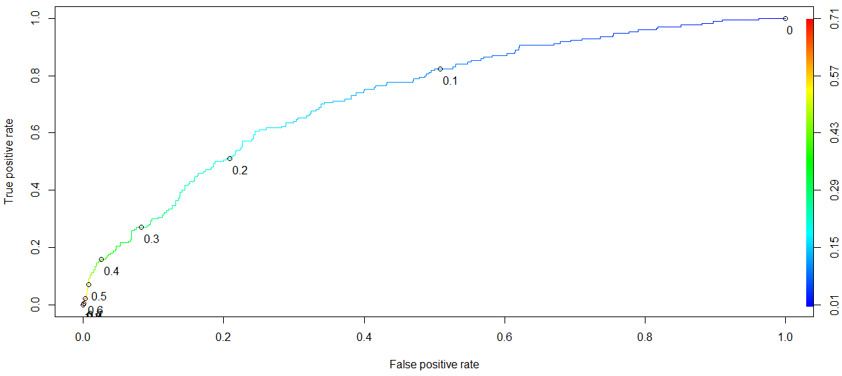
Classification Modelling
Example of Spam Vs Non-Spam Model

Slide 21
Classification Modelling
AUC – Measures discrimination, i.e., ability to correctly classify those SPAM and NON-SPAM.
AUC is the percentage of randomly drawn such pairs for which the classification is done correctly.

Slide 22
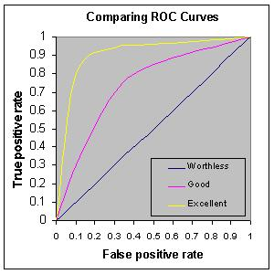
Classification Modelling
Rough rule of thumb:
0.90 -1.0 = Excellent
0.80 – 0.90 = Good
0.70 – 0.80 = Fair
0.60 – 0.70 = Poor
0.50 – 0.60 = Fail
<0.50 – You are better off doing a coin toss than working hard to build a model ☺

Slide 23
Classification Modelling
AUC = 73.2%
The model does a fair job of discrimination between high risk and low risk emails.
Useful for comparing different models.

Slide 24
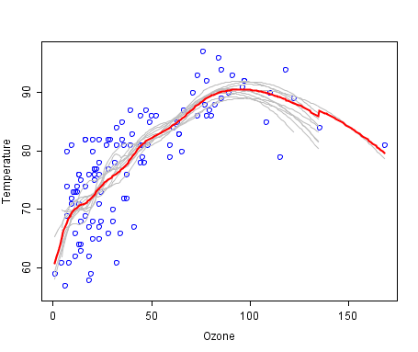
Regression Modelling
Regression analysis consists of a set of machine learning methods that allow us to predict a continuous outcome variable (y) based on the value of one or multiple predictor variables.
An easy to understand example is predicting atmosphere temperature based upon ozone concentration
Notes:
https://machinelearningmastery.com/a-tour-of-machine-learning-algorithms/

Slide 25
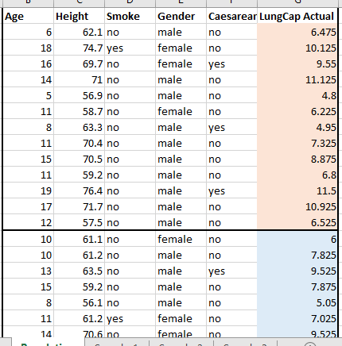
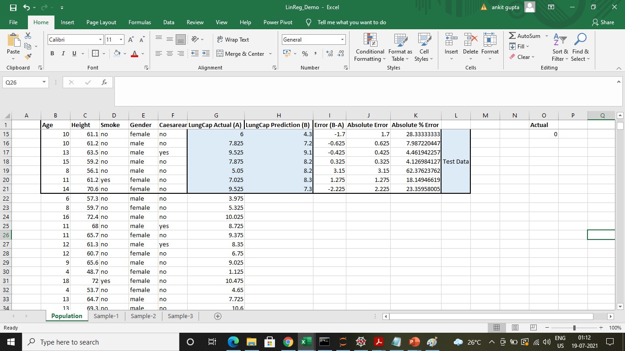
Regression Modelling
Performance validation of Regression Modelling
ML Model
Modelling on Training Data
Apply on Test Data
Prediction

Slide 26
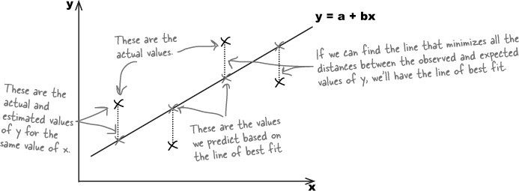
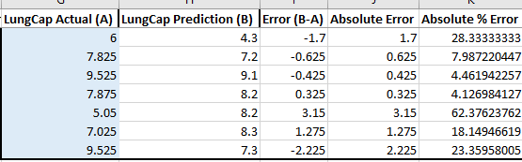
Regression Modelling
Performance validation of Regression Modelling
Actual Values
Regression Model
Mean Absolute % Error = Sum of Absolute % Error = 21%
Total Observation

Slide 27
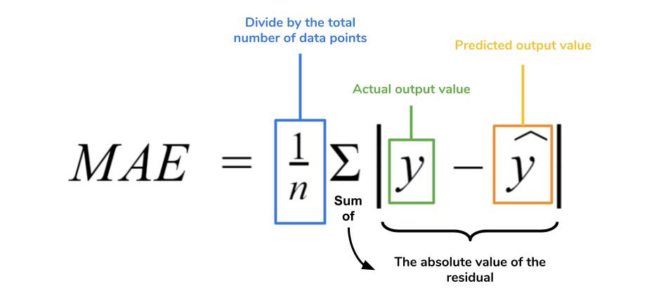
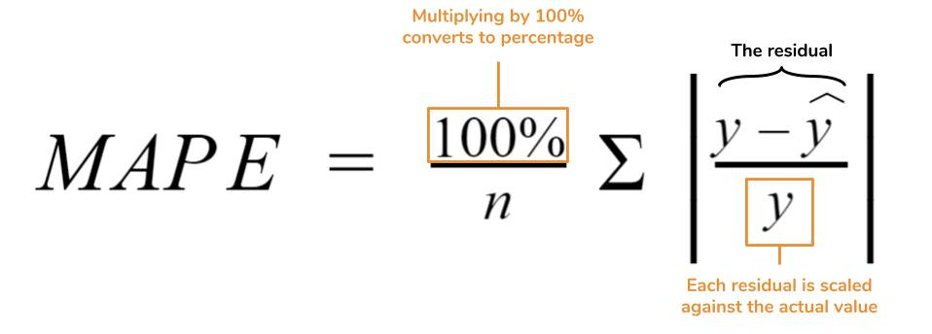
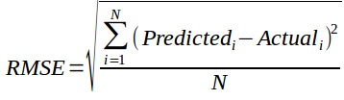
Regression Modelling
Performance validation of Regression Modelling
MAE (Mean Absolute Error): Mean of the absolute value of the
difference between the predicted and actual values.
MAPE (Mean Absolute Percentage Error): Same as above but
converted into percentages to allow for comparison across different scales
RMSE (Root Mean Square Error): Accounts for infrequent large errors,
whose impact may be understated by the mean-based error measures.

Slide 28
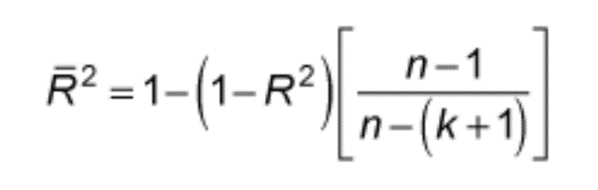
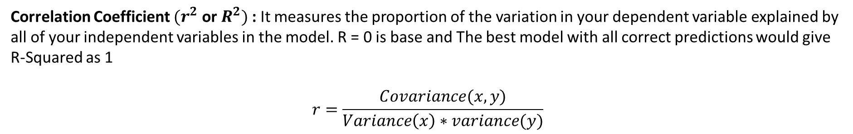
Regression Modelling
Performance validation of Regression Modelling
Correlation Coefficient ${(r}^{2}$ or $R^{2})$: It measures the proportion of the variation in your dependent variable explained by all of your independent variables in the model. R = 0 is base and The best model with all correct predictions would give R-Squared as 1
$$r=\frac{Covariance(x,y)}{Variance\left(x\right)∗variance(y)}$$
Adjusted R-Squared : on adding new features to the model, the R-Squared value either increases or remains the same. R-Squared does not penalize for adding features that add no value to the model. So an improved version over the R-Squared is the adjusted R-Squared

Slide 29
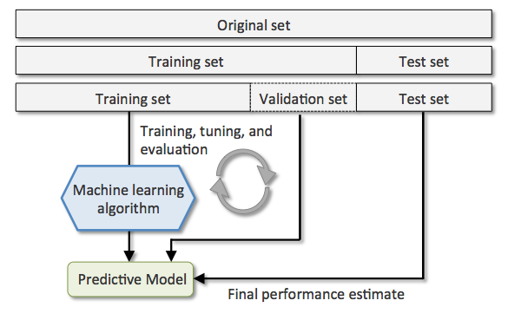
The Ultimate Test of Model Performance
Holdout set: Split data into train, validation and test sets (in 70:20:10 or 60:20:20, etc. ratios), and ensure model performance is similar.
Training Set: For fitting a model (70% of data)
Validation Set: For selecting a model based on estimated prediction errors (20% of data)
Test Set: For assessing selected model’s performance on “new” data (10 % of data)

Slide 30
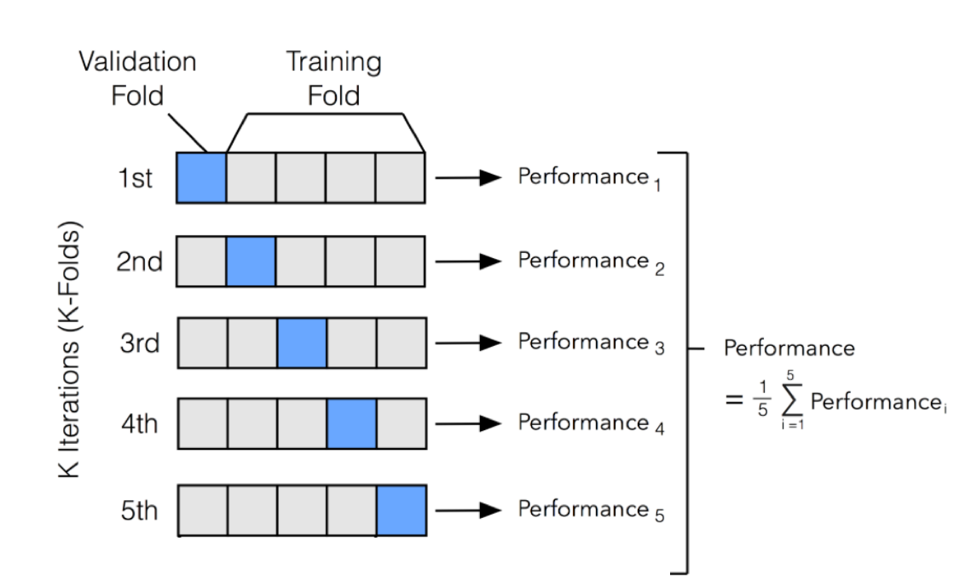
The Ultimate Test of Model Performance
k-fold cross-validation: Same as holdout but useful when the data size is small.

Slide 31
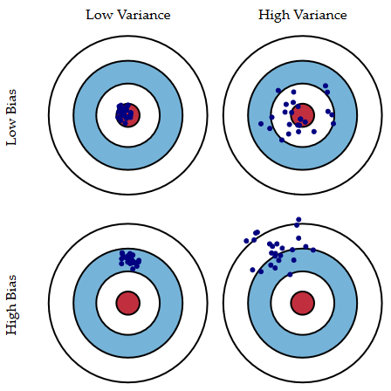
Bias-Variance Tradeoff
If the model performance on training and testing data sets is inconsistent, it indicates a problem either with Bias or Variance.

Slide 32
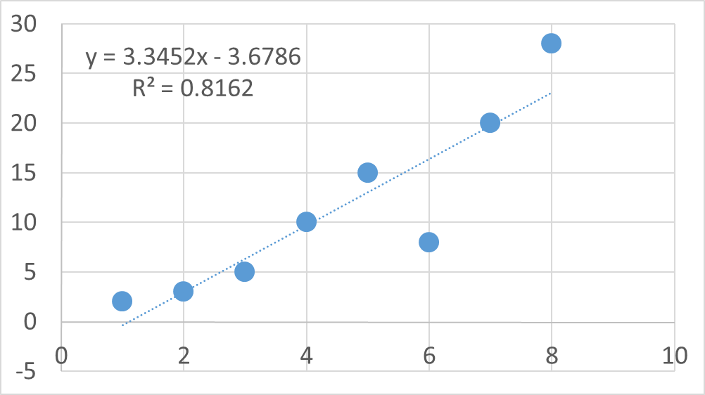
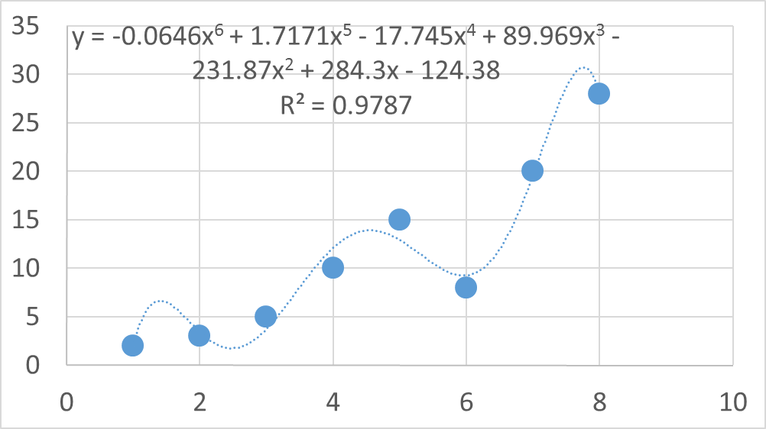
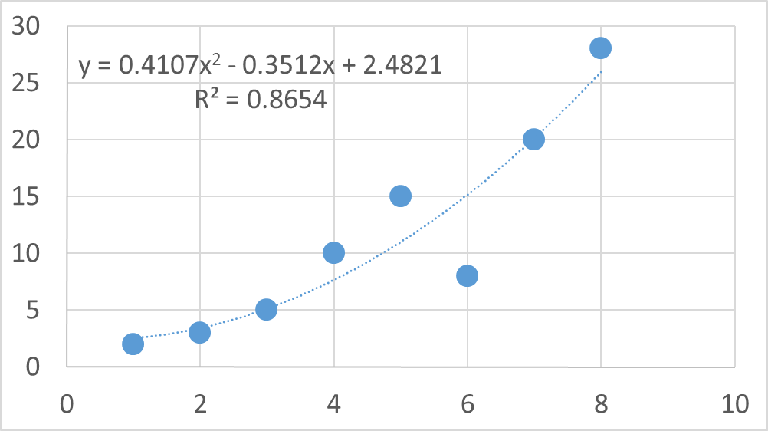
Underfitting vs Overfitting
Too Simple a Model
Underfit
Too Complex a Model
Overfit
Right Model
Reasonable fit

Slide 33


Diagnosing Bias and Variance
Underfitting (Bias)
High Bias problem
High training error
Low difference between training and test/validation errors
Validation/Test Error
Error
Training Error
Underfitting
Model Complexity
Overfitting

Slide 34
Diagnosing Bias and Variance
Overfitting (Variance)
High Variance problem
Low training error
High difference between training and test/validation errors
Validation/Test Error
Error
Training Error
Underfitting
Model Complexity
Overfitting
Underfitting

Slide 35
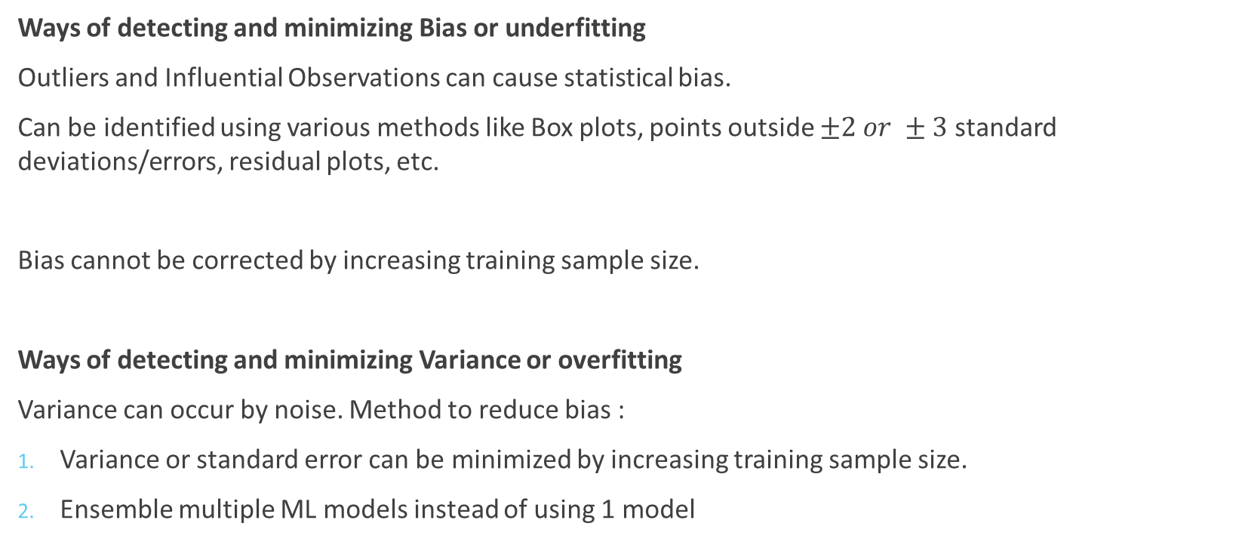
Bias-Variance Tradeoff
Ways of detecting and minimizing Bias or underfitting
Outliers and Influential Observations can cause statistical bias.
Can be identified using various methods like Box plots, points outside $±2 or ±3$ standard deviations/errors, residual plots, etc.
Bias cannot be corrected by increasing training sample size.
Ways of detecting and minimizing Variance or overfitting
Variance can occur by noise. Method to reduce bias :
Variance or standard error can be minimized by increasing training sample size.
Ensemble multiple ML models instead of using 1 model

