Slide 1
Feature Reduction

Slide 2
Typical Data Science Cycle
Data Collection
Business Insights & Understanding
Data Understanding
Model Building & Evaluation
Data Pre-Processing

Slide 3
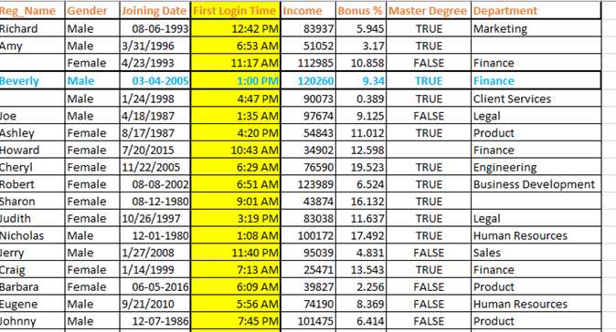
Dimensions
What is Dimension :
The number of input variables or features for a dataset is referred to as its dimensionality
Variable/Attribute/Feature
Data Point/Record/Row/Observation
Column
Notes:
https://www.cse.unr.edu/~bebis/CS479/Lectures/DimensionalityReduction.ppt

Slide 4
Dimension Reduction
Need of Dimension Reduction (Curse of Dimensionality):
Computational Requirement increases with increasing number of features (Also storage)
It is very easy to visualize low dimensional data.
Some models assumes non-corelated features i.e. absolutely zero multicollinearity (such as linear regression)
Increasing the number of features will not always improve classification accuracy. It might result into overfitting hence requirement of Number of observations is also increased with higher dimension.
Notes:
https://www.cse.unr.edu/~bebis/CS479/Lectures/DimensionalityReduction.ppt

Slide 5
Dimension Reduction Methods
Feature Selection (We studied so far) :
Selection of features based upon statistical importance.
chooses a subset of the original features
Most of the times it is supervised
It can be implemented on numerical as well as categorical data
Notes:
https://www.cse.unr.edu/~bebis/CS479/Lectures/DimensionalityReduction.ppt

Slide 6
Dimension Reduction Methods
2. New Feature extraction (Compressing Existing Features):
It refers to mapping of original high dimensional data into lower dimensional space.
It can be supervised and unsupervised
It is for numerical variables
The mapping f() could be linear or non-linear
Notes:
https://www.cse.unr.edu/~bebis/CS479/Lectures/DimensionalityReduction.ppt

Slide 7
Dimension Reduction Methods
New Feature extraction (Compressing Existing Features):
Principal Component Analysis (Unsupervised technique)
Most widely used unsupervised algorithm, easy to adopt and interpret with respect to other technique
SVD (Singular value decomposition) (Unsupervised technique)
Mostly suitable with sparse matrix and Do not provide a good explanation of variances
LDA (linear discriminant analysis)
Fisher’s LDA analysis is a Supervised technique
Notes:
https://www.cse.unr.edu/~bebis/CS479/Lectures/DimensionalityReduction.ppt

Slide 8
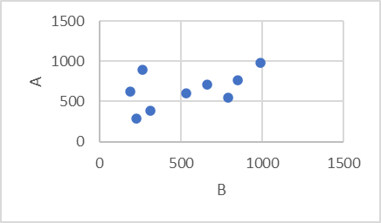
Principal Component Analysis
Ideology behind PCA
A | B
263 | 892
191 | 628
226 | 290
530 | 604
662 | 714
310 | 388
850 | 760
988 | 981
793 | 551

Slide 9
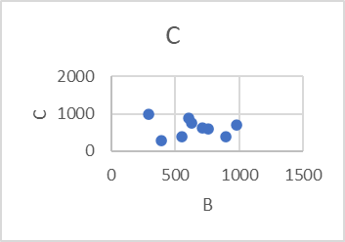
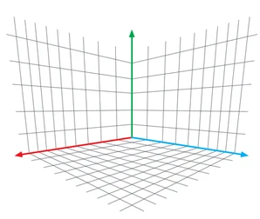
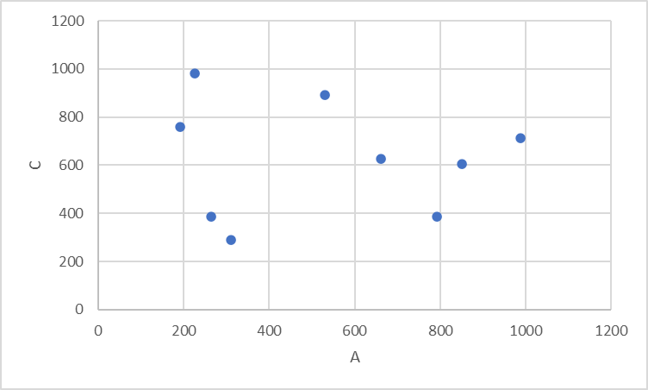
Principal Component Analysis
A | B | C
263 | 892 | 388
191 | 628 | 760
226 | 290 | 981
530 | 604 | 892
662 | 714 | 628
310 | 388 | 290
850 | 760 | 604
988 | 981 | 714
793 | 551 | 388

Slide 10
Principal Component Analysis
Not possible to add more dimensions
A | B | C | D | E | F | …....... | Z
263 | 892 | 388 | 276 | 192 | 998 | …....... | 199
191 | 628 | 760 | 839 | 661 | 654 | …....... | 647
226 | 290 | 981 | 220 | 831 | 499 | …....... | 790
530 | 604 | 892 | 516 | 821 | 753 | …....... | 319
662 | 714 | 628 | 629 | 551 | 975 | …....... | 116
310 | 388 | 290 | 713 | 144 | 540 | …....... | 627
850 | 760 | 604 | 312 | 292 | 527 | …....... | 717
988 | 981 | 714 | 631 | 350 | 340 | …....... | 695
793 | 551 | 388 | 132 | 648 | 566 | …....... | 808

Slide 11
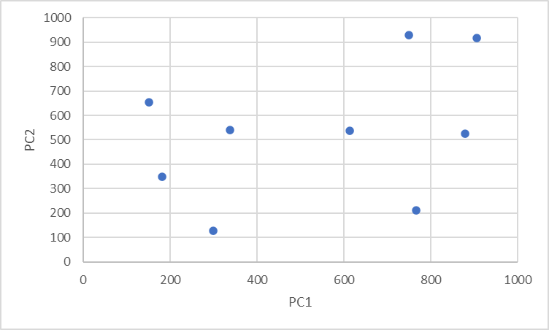
Principal Component Analysis
A | B | C | D | E | F | …....... | Z
263 | 892 | 388 | 276 | 192 | 998 | …....... | 199
191 | 628 | 760 | 839 | 661 | 654 | …....... | 647
226 | 290 | 981 | 220 | 831 | 499 | …....... | 790
530 | 604 | 892 | 516 | 821 | 753 | …....... | 319
662 | 714 | 628 | 629 | 551 | 975 | …....... | 116
310 | 388 | 290 | 713 | 144 | 540 | …....... | 627
850 | 760 | 604 | 312 | 292 | 527 | …....... | 717
988 | 981 | 714 | 631 | 350 | 340 | …....... | 695
793 | 551 | 388 | 132 | 648 | 566 | …....... | 808
PC1 | PC2
749 | 929
151 | 655
906 | 918
299 | 128
181 | 350
337 | 540
767 | 210
613 | 536
878 | 526

Slide 12
Principal Component Analysis
Reduction from 2 dimension to 1 dimension

Slide 13
Principal Component Analysis
Reduction from 2 dimension to 1 dimension
Component to capture maximum information by accounting largest possible variance of data points
(1000,1000)

Slide 14
Principal Component Analysis
Reduction from 2 dimension to 1 dimension
(1000,1000)
PCA1
(830)
Transformed values
From (1000,1000) to
(830)
Introduction of a new dimension : PCA1
From 2 Dimension X and Y to 1 Dimension

Slide 15
Principal Component Analysis
3 Dimensional Plot

Slide 16
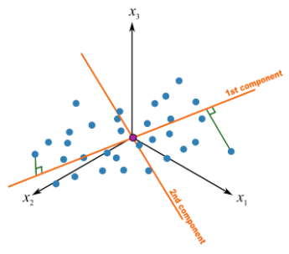
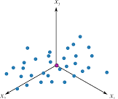
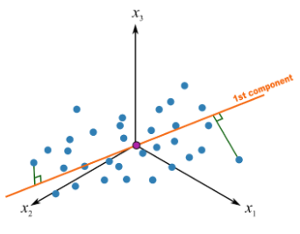
Principal Component Analysis
In case of 3 Dimension Data
Introduction of a new dimension : PCA1
From 2 Dimension X and Y to 1 Dimension by retaining maximum information and minimum multicollinearity

Slide 17
Principal Component Analysis
In case of 5 Dimensional Data
E.g.
5 Dimensional Data
2 Dimensional Data
Age
Family Size
Income
Total Investment
Saving
Age
Family Size
PCA 1 (Seniority)
Income
Total Investment
Saving
PCA 2 (Financial)

Slide 18


Process of Projection and Components Generation
$${{variance of x s}_{x}}^{2}=\frac{\sum{{(x−\overline{x})}^{2}}}{n−1}$$
x | y
33 | 78
101 | 39
87 | 52
75 | 48
76 | 79
43 | 86
116 | 90
$$Covariane s_{xy}=\frac{\sum{(x−\overline{x})(y−\overline{y})}}{n−1}$$
Sum of product of x and y coordinate

Slide 19
Process of Projection and Components Generation
Create a covariance matrix
 | x1 | x2 | x3 | x4 | x5
x1 | var(x1) | cov(X1,X2) | cov(X1,X3) | cov(X1,X4) | cov(X1,X5)
x2 | cov(X1,X2) | var(x2) | cov(X2,X3) | cov(X2,X4) | cov(X2,X5)
x3 | cov(X1,X3) | cov(X2,X3) | var(x3) | cov(X3,X4) | cov(X3,X5)
x4 | cov(X1,X4) | cov(X2,X4) | cov(X3,X4) | var(x4) | cov(X4,X5)
x5 | cov(X1,X5) | cov(X2,X5) | cov(X3,X5) | cov(X4,X5) | var(x5)
A | B | C | D | E
263 | 892 | 388 | 254 | 625
191 | 628 | 760 | 335 | 299
226 | 290 | 981 | 364 | 725
530 | 604 | 892 | 153 | 779
662 | 714 | 628 | 877 | 193
310 | 388 | 290 | 480 | 294
850 | 760 | 604 | 467 | 429
988 | 981 | 714 | 577 | 893
793 | 551 | 388 | 736 | 786
 | x1 | x2 | x3 | x4 | x5
x1 | 20 | 10 | 15 | 19 | 12
x2 | 10 | 9 | 14 | 15 | 17
x3 | 15 | 14 | 18 | 7 | 17
x4 | 19 | 15 | 7 | 8 | 20
x5 | 12 | 17 | 17 | 20 | 18
Example

Slide 20
Process of Projection and Components Generation
Create a covariance matrix
 | x1 | x2 | x3 | x4 | x5
x1 | var(x1) | cov(X1,X2) | cov(X1,X3) | cov(X1,X4) | cov(X1,X5)
x2 | cov(X1,X2) | var(x2) | cov(X2,X3) | cov(X2,X4) | cov(X2,X5)
x3 | cov(X1,X3) | cov(X2,X3) | var(x3) | cov(X3,X4) | cov(X3,X5)
x4 | cov(X1,X4) | cov(X2,X4) | cov(X3,X4) | var(x4) | cov(X4,X5)
x5 | cov(X1,X5) | cov(X2,X5) | cov(X3,X5) | cov(X4,X5) | var(x5)
Extract Eigan Values by solving determinants
Λ1, λ2, λ3, λ4, λ5
 | x1 | x2 | x3 | x4 | x5
x1 | 20 | 10 | 15 | 19 | 12
x2 | 10 | 9 | 14 | 15 | 17
x3 | 15 | 14 | 18 | 7 | 17
x4 | 19 | 15 | 7 | 8 | 20
x5 | 12 | 17 | 17 | 20 | 18
Example
Use Eigan values to solve transformation
Eigan Vector V1,v2,v3,v4,v5
(5X5 Covariance matrix)(V1,V2,V3,V4,V5) =
(Λ1)(V1,V2,V3,V4,V5)
Notes:
Principal Component Analysis (PCA) - YouTube

Slide 21
Process of Projection and Components Generation
λ1 | v1
λ2 | v2
λ3 | v3
Λ4 | v4
λ5 | v5
Increasing Order
Eigan Values
Λ1, λ2, λ3, λ4, λ5
Eigan Vector
V1,v2,v3,v4,v5
e.g. V1 = (3,4,1.2,5,32)
Each vector is orthogonal
Original 5 D Plane
Transformed 2 D Plane
V1
V2

Slide 22
Principal Component Analysis
Covariance matrix for original data
1. 5 principal components, which are orthogonal (i.e. they have zero covariations) and
have variances (called eigenvalues)
2. Each PCA will have different impact of explaining variance. first principal component
accounts for the largest possible variance in the data set
3. Total sum of variance after and before PCA will be same
4. We can summarize projects of each PCA by their loadings on individual variables.
In case of 5 variables
PCA (1) = a1.X1 +b1.X2+c1.X3+d1.X4 +e1.X5
PCA (2) = a1.X1 +b1.X2+c1.X3+d1.X4 +e1.X5
PCA (3) = a1.X1 +b1.X2+c1.X3+d1.X4 +e1.X5
PCA (4) = a1.X1 +b1.X2+c1.X3+d1.X4 +e1.X5
PCA (5) = a1.X1 +b1.X2+c1.X3+d1.X4 +e1.X5
5. Coefficients such as a1-e1 are called loadings of x1-x5 on PCA1)
 | x1 | x2 | x3 | x4 | x5
x1 | 20 | 10 | 15 | 19 | 12
x2 | 10 | 9 | 14 | 15 | 17
x3 | 15 | 14 | 18 | 7 | 17
x4 | 19 | 15 | 7 | 8 | 20
x5 | 12 | 17 | 17 | 20 | 18
 | PCA1 | PCA2 | PCA3 | PCA4 | PCA5
PCA1 | 32.6 | 0 | 0 | 0 | 0
PCA2 | 0 | 23.2 | 0 | 0 | 0
PCA3 | 0 | 0 | 9.9 | 0 | 0
PCA4 | 0 | 0 | 0 | 4.1 | 0
PCA5 | 0 | 0 | 0 | 0 | 3.2
Covariance matrix for converted PCA

Slide 23
Principal Component Analysis
Huge datasets have a variety of variables/features/patterns & it becomes difficult to decipher them before the modelling step
In order to remove that issue, we use PCA
It does not change the flavor of the variables.
It is based on the computation of Eigen Values & Eigen Vectors
PCA can be done by eigenvalue decomposition of a data covariance (or correlation) matrix usually after a normalization step of the initial data.
PCA finds a new set of dimensions (or a set of basis of views) such that all the dimensions are orthogonal (and hence linearly independent) and ranked according to the variance of data along them. It means more important principle

Slide 24
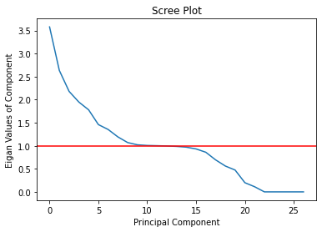
Steps to Calculate PCAs
Preprocess data (Missing value treatment, Label encode/One-Hot encode)
Perform scaling
Calculate covariance/correlation matrix
Calculate eigen vector/ eigen values
Plot Scree plot ( y axis - eigan values , x axis - total PCAs)
Decide total PCAs (for which eigen value >1)

Slide 25
Steps to Calculate PCAs
Define PCA object using sklearn
Transform data using PCA object
Rename all columns based upon PCA number
Find Loadings and decide name for PCA
 | PCA1 | PCA2
income | -0.52 | 0.1
total deposit | -0.34 | 0.02
total investment | -0.4 | 0.01
age | 0.04 | 0.45
total experience | 0.0001 | 0.43
Explained variance | 43% | 35%

Slide 26
Multicollinearity
Including two highly correlated independent variables can adversely affect the regression results
No new information provided
Coefficient signs may not match prior expectations
PCA is more than dimension reduction
Principal component analysis (PCA) is a statistical procedure that uses an orthogonal transformation to convert a set of observations of possibly correlated variables (entities each of which takes on various numerical values) into a set of values of linearly uncorrelated variables called principal components.

