Slide 1
DATA ANALYTICS PROJECT REPORT - IPL ANALYSIS , INSIGHTS AND MATCH PREDICTION
Team members
    Ankit Patange(01FB16ECS063)
    Chetan(01FB16ECS096)
    Chirag N Vijay(01FB16ECS099)
    Pradeep A(01FB16ECS253)

Slide 2
IPL MATCH ANALYSIS
Piechart used to identify whether toss win has any causation with match win.
Analysis done based on which grounds are best to bat first in and which are best grounds to chase in.
Line plot to identify periodic success of the top IPL teams
Comparision to evaluate how close IPL matches have been using bar graph.
ggplot2 package used for most visualizations
Line plot to identify average runs scored per over , to analyse distribution of runs based on overs and correlation between the two factors gave a strong positive value of 0.8.

Slide 3
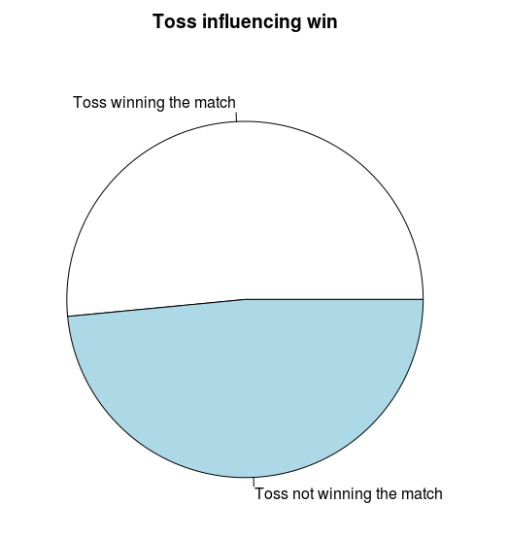
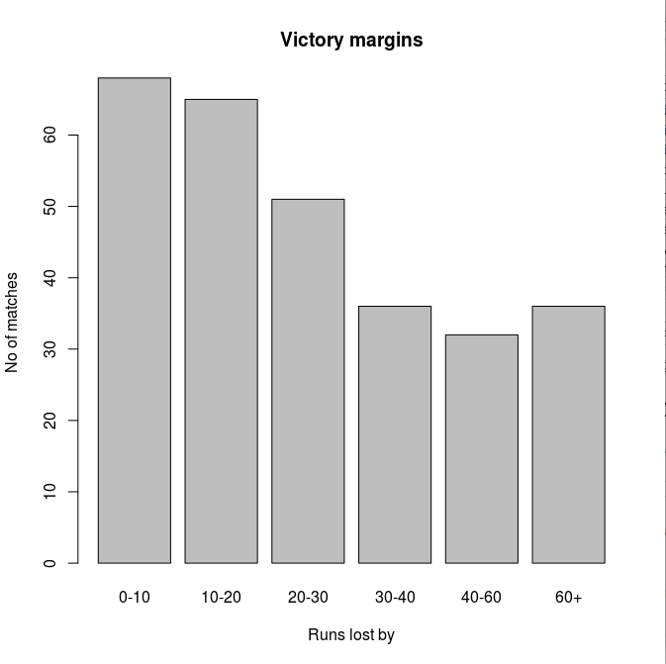
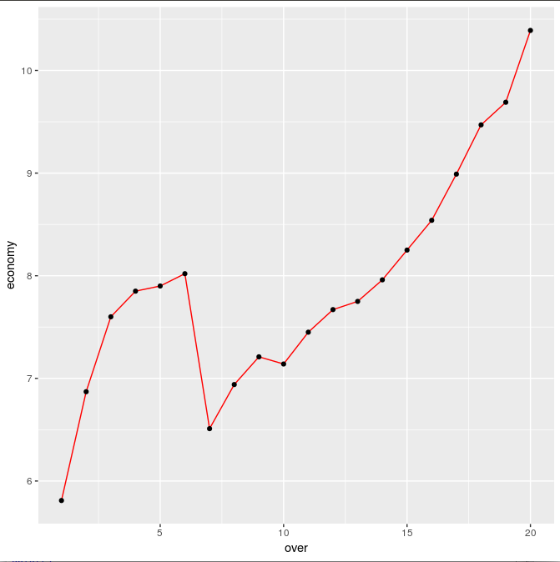
Visualizations

Slide 4
Data collection
The data collection process was divided into two parts.
    Player profile of all cricketers were scrapped from “www.espncricinfo.com” ,cleansed and pre-processed into a format suitable for the follow-up steps.
    Ball by ball data was obtained from cricsheet.

Slide 5
What is and why clustering?
In addition, player profiles were used for clustering the batsmen and bowlers to achieve a certain level of similarity and generalisation.clustering was done using K-means algorithm.
  Criteria for clustering
    Average runs and strike rate for batsmen
    Average economy rate, average strike rate and average for bowlers.
Clustering used to predict the runs and wicket taken by new pair which is not faced earlier.

Slide 6
Player-player probability
For simulating match we use the player to player probability along with cluster to cluster probability when the player to player probabilities are not available.for each batsman vs bowler instance, we predict the runs scored per ball and the probability of the batsmen getting out against that bowler.

Slide 7
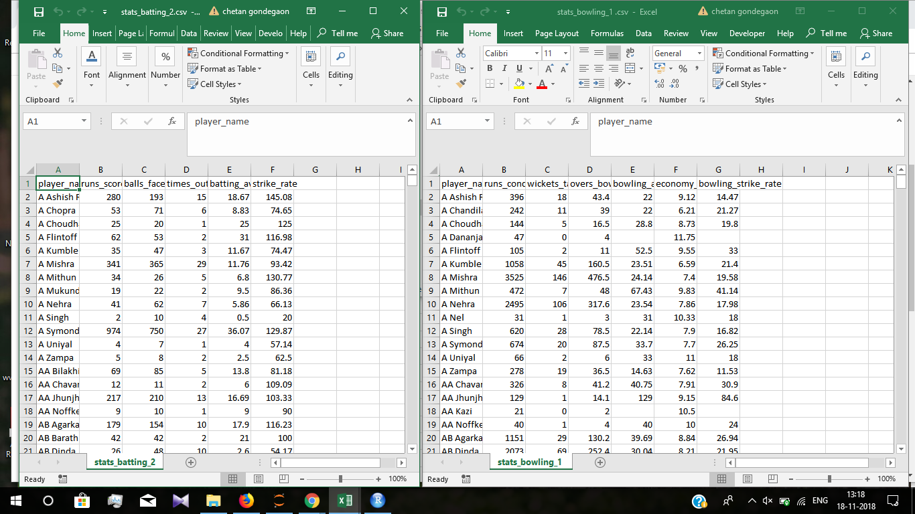
Batsmen bowler stats for clustering

Slide 8
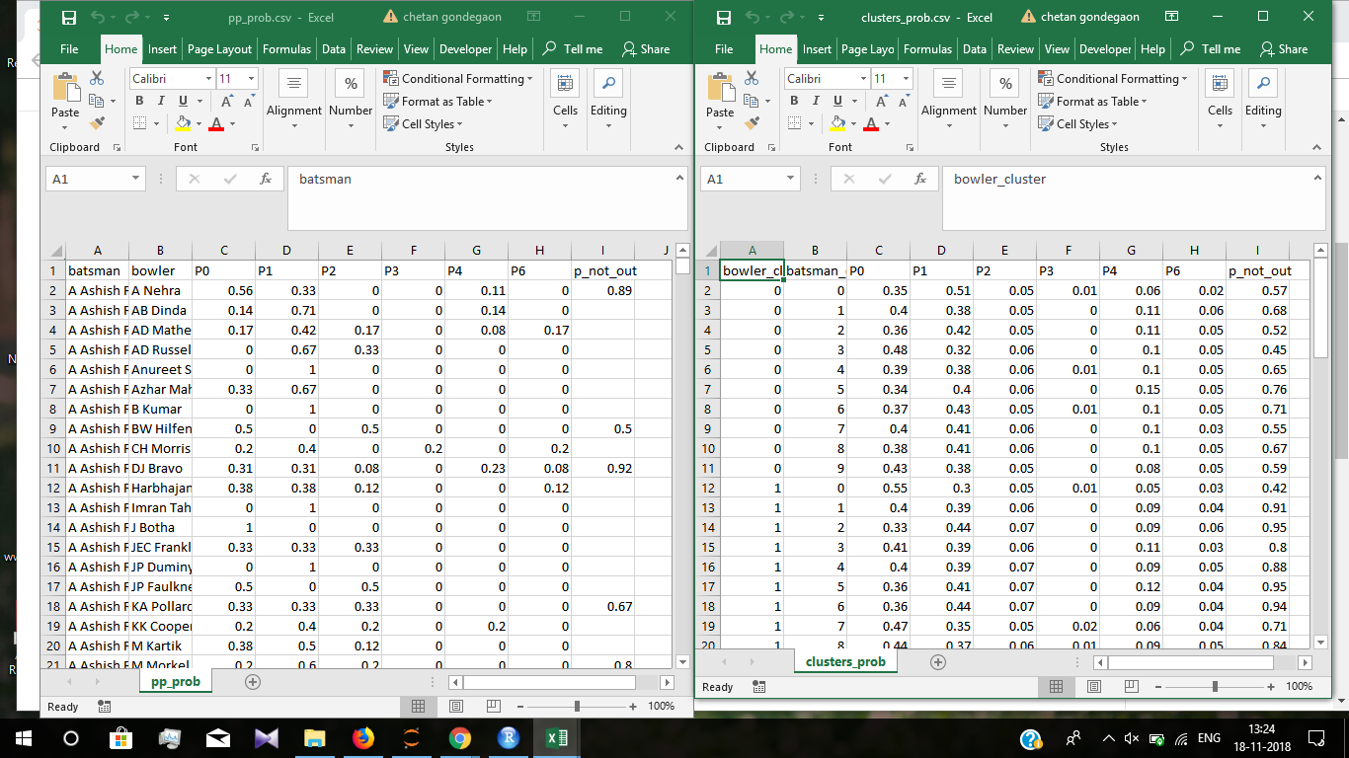
P-P and C-C probabilities

Slide 9
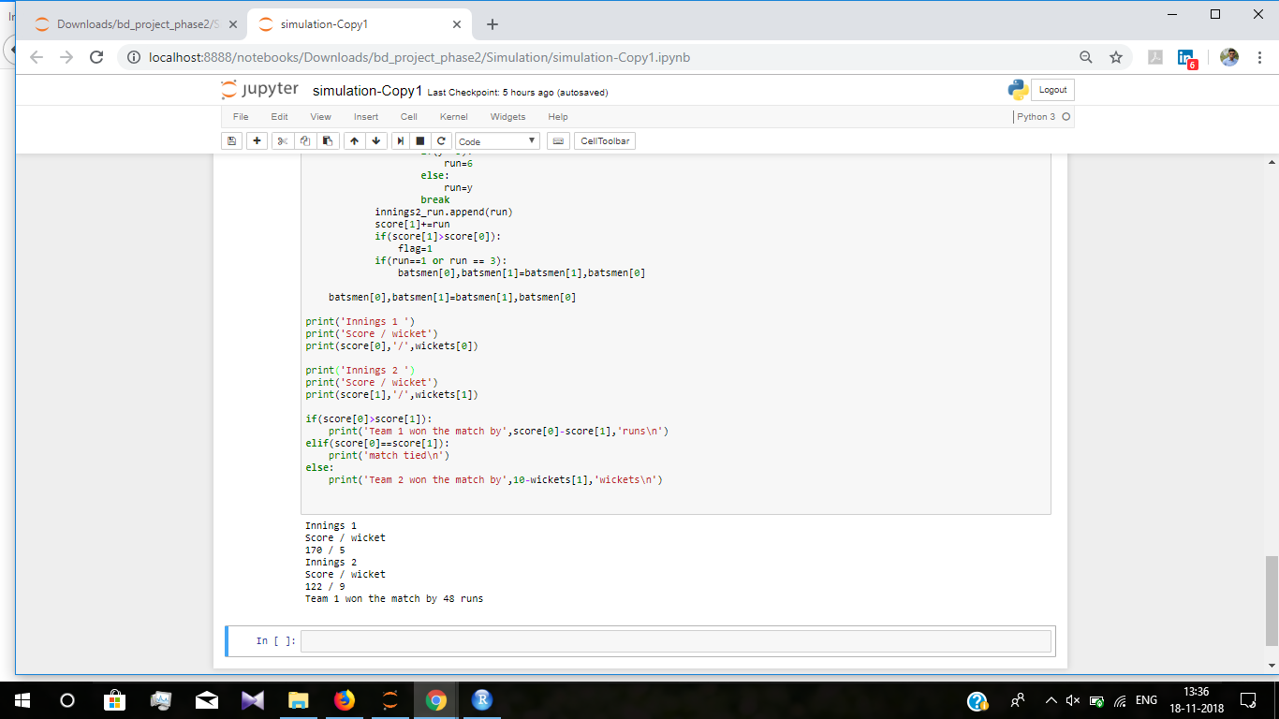
Match simulation

