Slide 1



THE ARVELLOS
CLOCKSPEED 2.0
ADARSH KUMAR GIRI
DHRUV MEHTA
KUMAR ANKIT

Slide 2





CORE PROBLEMS
After the covid era, there were times of high order to WeKnit and also times of little or no order i.e idle capacity
Excessive demand fluctuation
Idle capacity/ surpassed capacity of Weknit
Competition with e-commerce
The company was unable to make predictions about the demand from the website which saw mammoth growth
After covid times the e-commerce companies saw drastic growth due to digitalization
.
Longer lead time for Weknit
High demand growth
The irregular working mechanism of WeKnit and inefficient way of collecting the finished products as product was to be taken once every month was the cause for longer lead time.
Due to covid restrictions the production was very low but after relief there was huge growth in demand

Slide 3
SUSTAINABLE SUPPLY CHAIN STRATEGY
SHORT TERM STRATEGY (1-4 WEEKS)
Shorter Horizon forecast-poisson’s distribution method
Perfect collaboration between warehouses
Adopt Multiple period stochastic model
MID TERM STRATEGY (2-5 MONTHS)
Shifting to online shopping keeping in regard the view of the distributors.
More focus on popular fashion.
Focus on production scheduling agility
LONG TERM STRATEGY (1-5 YEARS)
More production centres for Weknit
More manufacturing partners for Flairwear
Self-reliant i.e own manufacturing centre
Finally tie up with e-commerce companies

Slide 4
EXPECTED OUTCOMES
Short horizon forecast is better and more accurate, where postponement and modularization helps. By shortening the forecasting time for demand of an end item, we will generally be more accurate in predicting the trends in sales in the next one to two weeks.
A warehouse having more stock than required should transfer it to the warehouse having less stock which will save time and money and also will lead to perfect utilisation of the stocks without wasting any.
Adoption of multiple period stochastic model will help minimize the losses as it works on variable demand and variable lead time system.
Shifting to online platform will help FlairWear to be less dependent on distributors and to be in competition with e-commerce.
Focusing on popular fashions will keep the demand high which will minimize its losses as it is a small-scale industry.
If focused on production scheduling agility it help the company to quickly shift according to the demands.
Increasing production centres for WeKnit in the area near warehouses will help reducing transportation cost and lower lead times and manage more agility in demands.
Having maximum number of options is always beneficial, so having more manufacturing partners will help FlairWear not to be completely depend on one company.
If FlairWear can have its own manufacturing centre, it will cut its dependency on other manufacturing partners.
Tying up with the e-commerce companies will be the best possible option as the company can sell its product anywhere in the world rather than in particular regions with having minimal effect of the pandemic
Expected Output for Short term (1-4 weeks)
2) Expected output for mid-term (2-5 months)
3) Expected output for long term (1-5 years)

Slide 5




Innovations to gain a competitive advantage
and
develop an intelligent supply chain
Flexiblity
Cost
Independence
Relationship
To develop a system that can bring more accurate result in identifying the warehouses where more products need to be shipped and where less products is to be shipped and on the basis of the data that is trending in the recent days.
Building more attractive and most efficient user interface website to be in competition with e-commerce companies.
To develop a real time system that keeps track of the rate at which the inventory is being stock out.
To develop AI system for influential marketing to increase its reach to the customers.

Slide 6
Keeping cost of distribution minimum
A more stable order stream from distributor to manufacturer (compared to erratic orders from each retailer) allows manufacturers to lower cost by planning production more effectively.
By observing the distance matrix between location of warehouses given, the cumulative distance was found out to be minimum when the production centre of WeKnit is located at Indore. This will reduce time and also save fuel cost.
Assuming that the products from warehouses to retail stores are delivered by trucks, Truck platooning would be a great option to save fuel thereby money.
IoT assisted power management and natural ventilation system can be designed to keep the cost of storage minimum
Managing two distributors at the same time would be hectic and also costly, so FlairWear should take initiative towards working with only one distributor.
As total cost is sum of the costs of purchase, holding, shortage, order so we have considered each stage to minimise the total distribution cost.

Slide 7
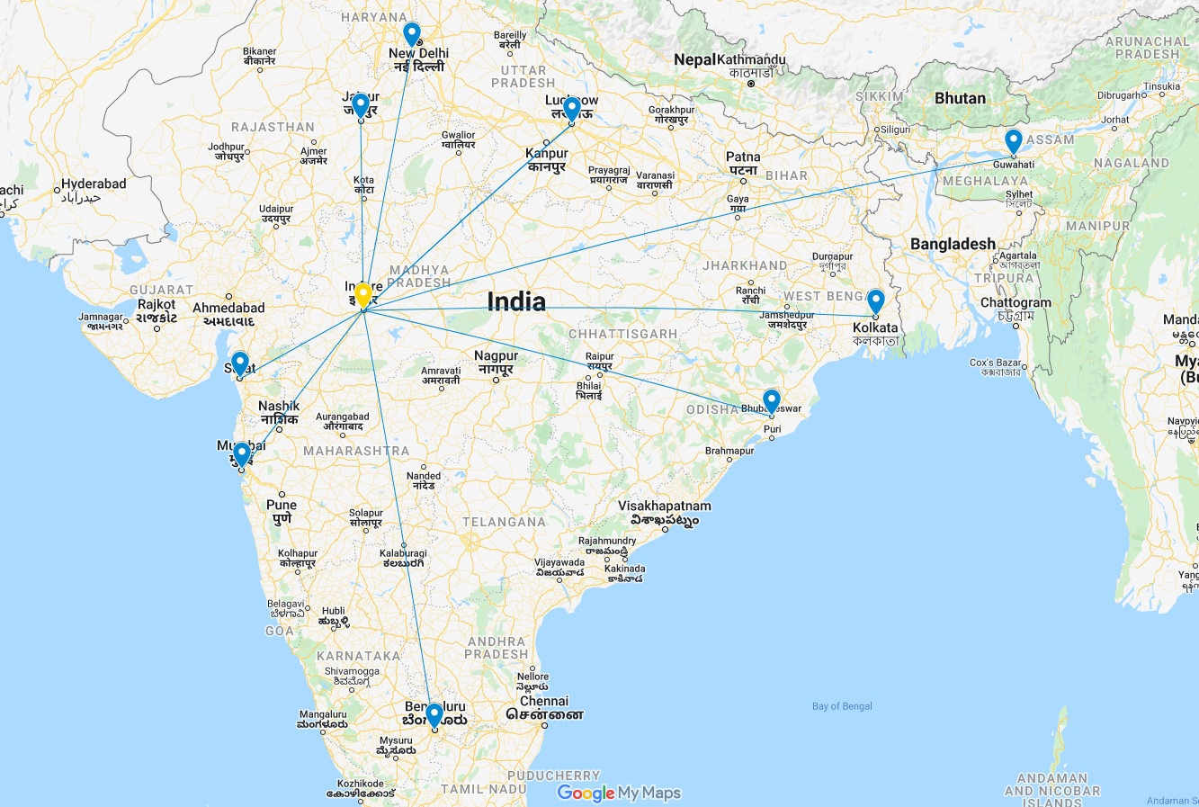
Map of India showing location of manufacturing center of WeKnit at Indore and the respective warehouses of Flairwear
https://www.google.com/maps/d/u/0/edit?mid=1qQko2LxpGuWtNwZI-igkNHuK95e1odvA&usp=sharing
THANK YOU!

