Slide 1



STELLAR SOROBAN
2026
PROTOCOL OVERVIEW
Credit Scoring
System
Decentralized On-Chain Credit Scoring on
Stellar Soroban
Built by Ankit Patel
Credit Scoring System
my-credit-scoring-1.vercel.app

Slide 2


01 / THE PROBLEM
Credit access is still permissioned
The Credit System Is Broken
1
1.7 billion people are "credit invisible" — no history, no
access to loans
CAPITAL TRAPPED BY
DISTRUST
2
Centralized bureaus (Equifax, Experian) — single points of
failure
$50B
3
Opaque algorithms — consumers can't see or dispute
scoring logic
locked as unnecessary
collateral in DeFi
4
DeFi lends billions with zero credit checks —
over-collateralization is the only safeguard
Credit Scoring System
02

Slide 3

02 / THE SOLUTION
Permissionless by default
Permissionless On-Chain Credit Scoring
01 / SUBMIT
02 / AVERAGE
03 / TRUST
Anyone submits a
→
Scores average
→
3+ evaluators =
score
on-chain
Trusted
A wallet signs an evaluator
record
The contract stores every
input
Independent signals make
the score useful
No admin, no gatekeeper — fully permissionless
Anti-gaming built in — 3+ independent evaluators
required for trust
Public & auditable — every score verifiable by
~5s finality, <$0.01 per transaction on Stellar
anyone
Credit Scoring System
03

Slide 4
03 / MARKET OPPORTUNITY
A credit gap inside open finance
The DeFi Credit Gap
METRIC
VALUE
DeFi Total Value Locked
~$100 Billion
ADDRESSABLE FRONTIER
1.7B
Unnecessary collateral waste
~$50 Billion
Potential unlocked by credit scoring
$20–50 Billion
people addressable
through a portable,
auditable reputation
layer
Unbanked population addressable
1.7 Billion
Stellar active accounts
8+ Million
Stellar gives the protocol low-cost global
reach.
Credit Scoring System
04

Slide 5

04 / ARCHITECTURE
A thin client, a verifiable core
How It Works
01 / CLIENT
Browser
CONTRACT SURFACE
Next.js + Freighter Wallet
submit_score
↓
02 / TRANSPORT
get_average_score
Soroban RPC Node
get_evaluator_count
Network relay for signed contract calls
↓
SECURITY NOTE
03 / SETTLEMENT
evaluator.require_auth()
— only the signing wallet
is recorded
Smart Contract
Rust / WASM on Stellar Soroban
Credit Scoring System
05

Slide 6
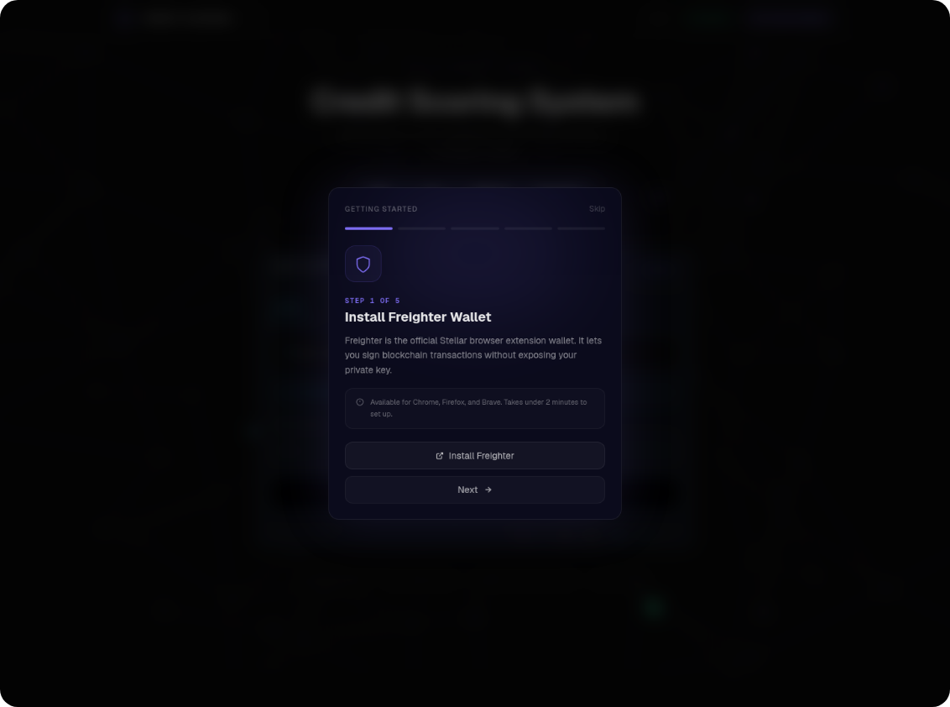
05 / PRODUCT
Live at my-credit-scoring-1.vercel.app
Live at my-credit-scoring-1.vercel.app
01 / LOOKUP
02 / SUBMIT
Lookup Tab
Submit Tab
Query any address, see avg
score + evaluator
breakdown
Visual slider 0–1000,
Freighter signing, on-chain
in ~5s
03 / HISTORY
04 / ONBOARDING
History Tab
Onboarding
5-step guided setup +
shareable Request
Evaluation links
Full evaluator list with
timestamps, avg/min/max
Credit Scoring System
06

Slide 7
06 / TRACTION
Proof in the product, not the pitch
What's Been Built
+
8
↗
8
25+
8
Smart contract unit tests (all
passing)
Meaningful GitHub commits
PostHog analytics events live
S
↔
◎
Sentry
375px
SEO
Error monitoring active
Mobile responsive tested
OpenGraph + Twitter Card SEO
Credit Scoring System
07

Slide 8

07 / GROWTH STRATEGY
From protocol proof to network effect
50 → 500 → 5000 Users
PHASE 1
50
PHASE 2
500
PHASE 3
5000
Done
30 days
60–90 days
Testnet bootstrap,
programmatic wallets, on-chain
interactions
Stellar Discord, "Rate a Friend"
campaign, leaderboard
Lending protocol pitch, Stellar
Community Fund grant,
evaluator staking
Foundation shipped
Community loop
Protocol distribution
Credit Scoring System
08

Slide 9

08 / ROADMAP
Building the DeFi credit layer
Building the DeFi Credit Layer
Q3 2026
Q4 2026
Q1 2027
Q2 2027
Q3 2027
Score badge widget
DeFi lending
Multi-chain EVM
ZK-proof of credit
DAO governance
+ evaluator staking
protocol integration
bridge
score
(privacy-preserving)
REVENUE MODEL
Protocol fee
·
Premium API
·
Evaluator staking
·
White-label licensing
Credit Scoring System
09

Slide 10
09 / CONTACT
Stellar Soroban · Next.js 16 · Rust
OPEN TO BUILDERS, PROTOCOLS, AND EVALUATORS
Let's Build the Credit Layer for DeFi
CONTACT
DETAILS
Builder
Ankit Patel
Email
ankitpatel79600@gmail.com
GitHub
github.com/ankit7960
Live App
my-credit-scoring-1.vercel.app
Contract
CAHR6ZKV...2WNR
Demo
loom.com/share/fe542c9d...
Built with Stellar Soroban · Next.js 16 · Rust · PostHog · Sentry
10

