Slide 1
GLOBAL PROTECT VPN

Slide 2
Types of VPN on mobile devices
On Demand→In a remote access (On-Demand) VPN configuration, users must manually launch the GlobalProtect app to establish the secure GlobalProtect connection. The GlobalProtect app connects to the GlobalProtect portal (upon user login) to submit user and host information and retrieve the agent configuration. After the app receives the agent configuration from the portal, it connects and establishes a VPN tunnel to the GlobalProtect gateway that was specified in the agent configuration.
Always On→In an Always-On VPN configuration, the secure GlobalProtect connection is always on. The GlobalProtect app connects to the GlobalProtect portal (upon user login) to submit user and host information and retrieve the agent configuration. After the app receives the agent configuration from the portal, it automatically connects and establishes a VPN tunnel to the GlobalProtect gateway that was specified in the agent configuration.

Slide 3
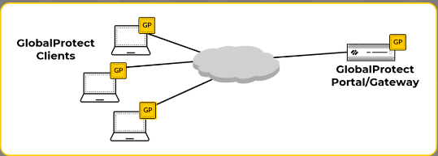
GlobalProtect Simple Topology

Slide 4
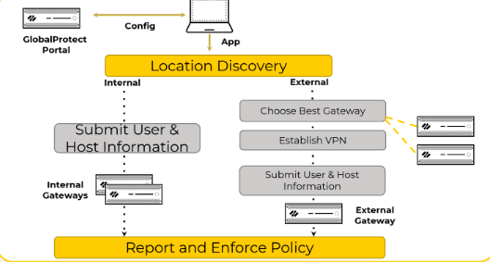
Determining Internal or External Gateways

Slide 5
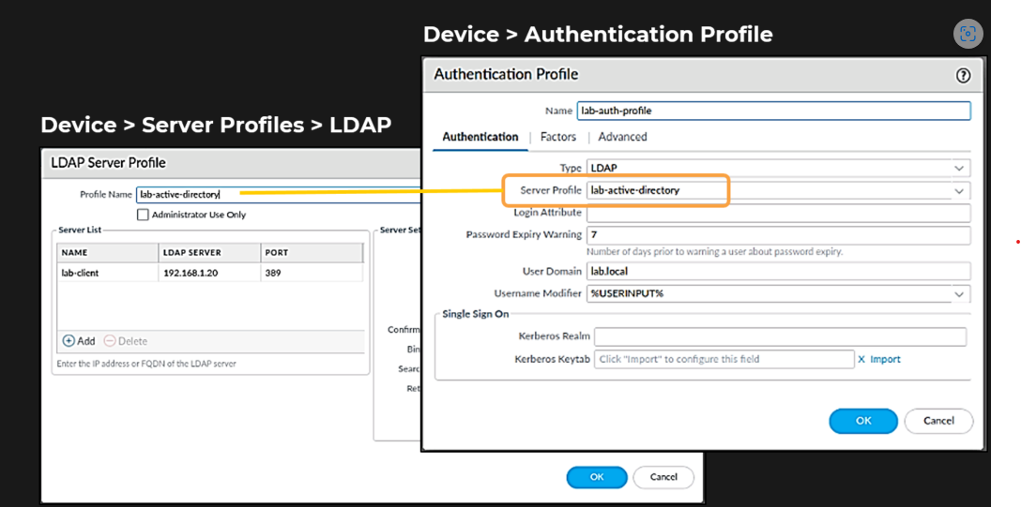
Authentication Server Profile

Slide 6
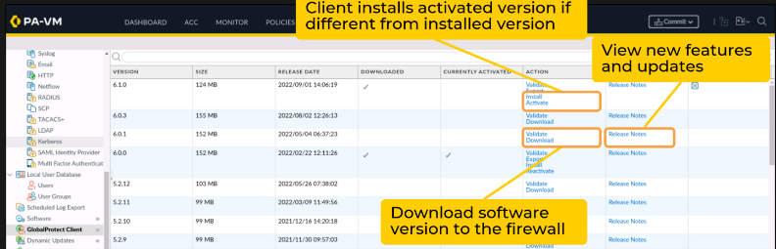
Activate Agent software on the portal

Slide 7
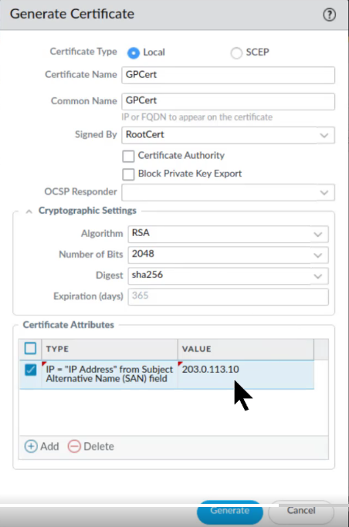
Certificate creation

Slide 8
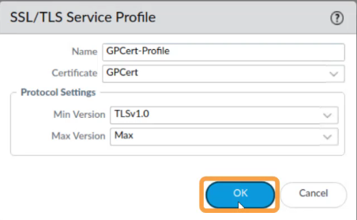
SSL/TLS service Profile

Slide 9
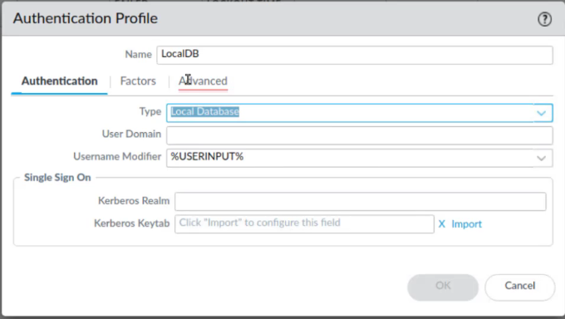
Local Authentication

Slide 10
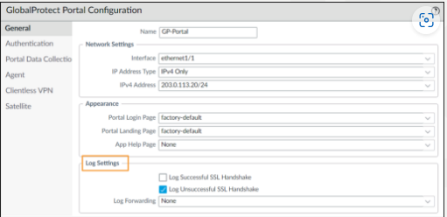
GP Portal Configuration

Slide 11
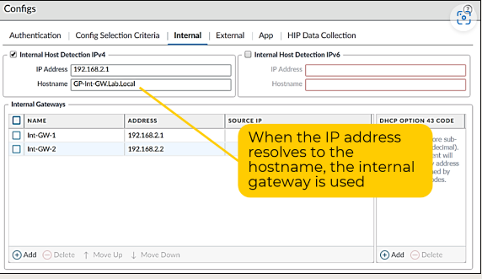
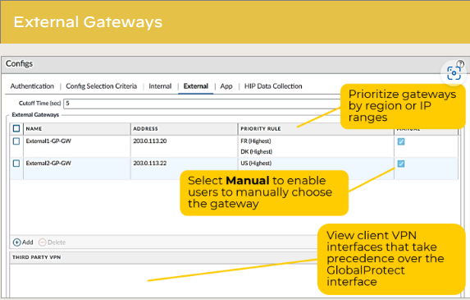
Client Configuration: Gateways Internal External

Slide 12
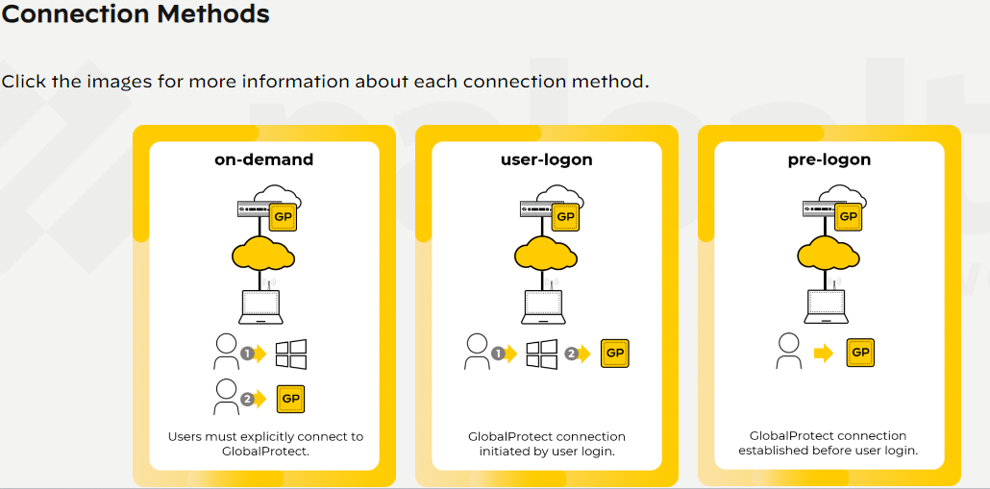
User-ID Deployments ​
For deployments using User-ID technology, pre-login conditions are marked with the user identifier of "pre-login" rather than a distinct user. After a user logs in to the client, the user information is changed to that username.
Note: Internal gateways support only always-on connection methods (user-logon or pre-logon)

Slide 13
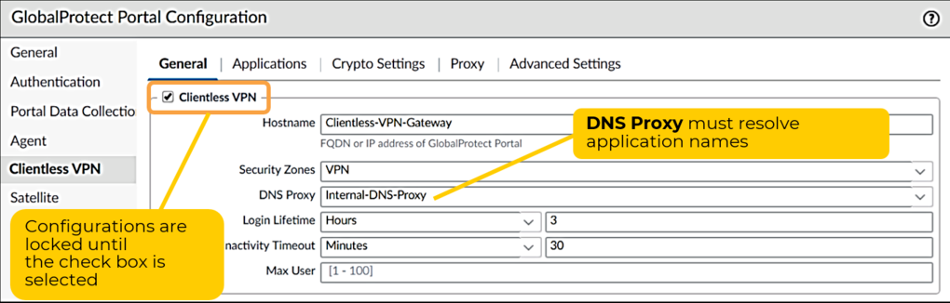
Clientless VPN

Slide 14
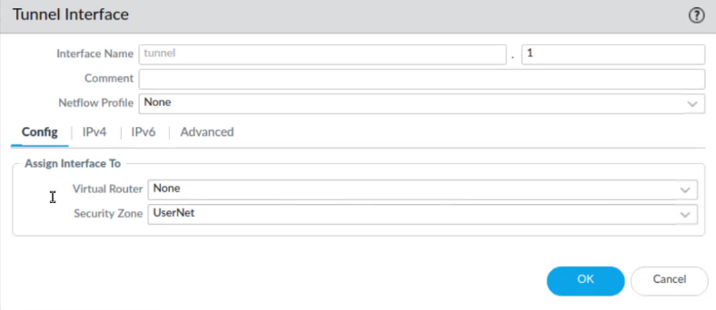
Tunnel Interface

Slide 15
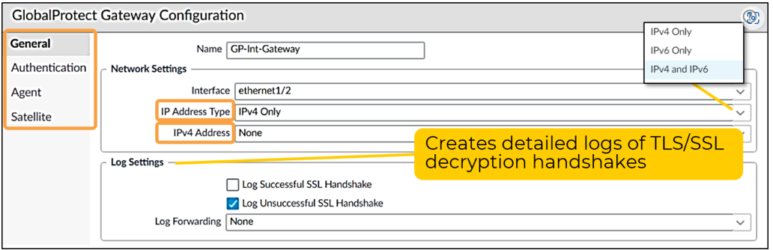
GP Gateway

Slide 16
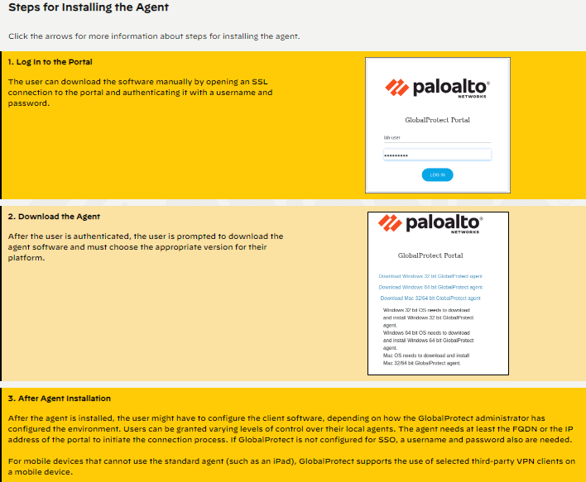

Slide 17
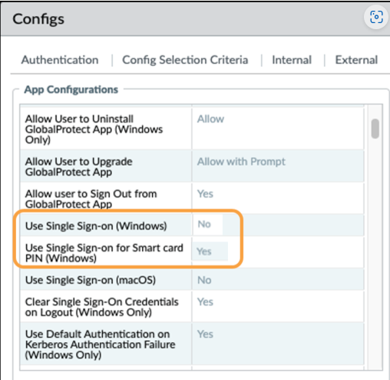
Configuring Smart Card SSO

