Slide 1
WildFire Verdict Descriptions

Slide 2
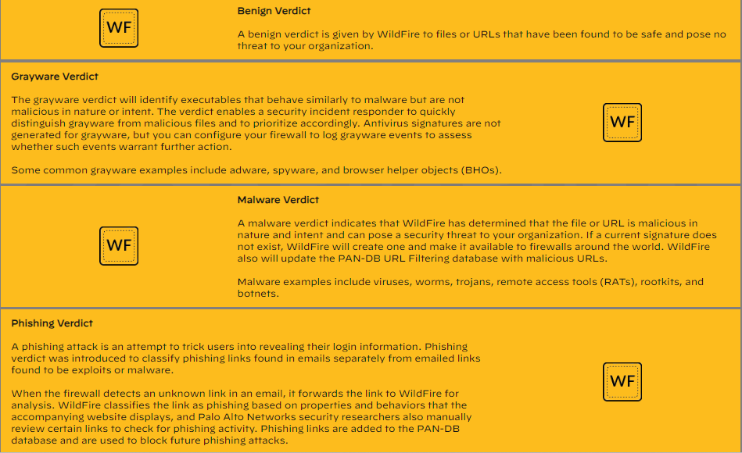

Slide 3
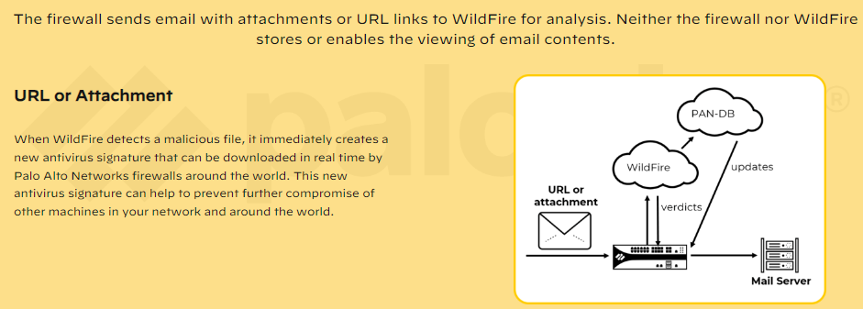
WildFire Protects Email

Slide 4
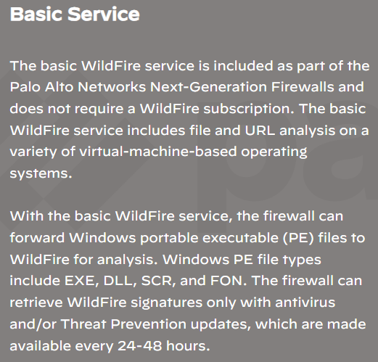
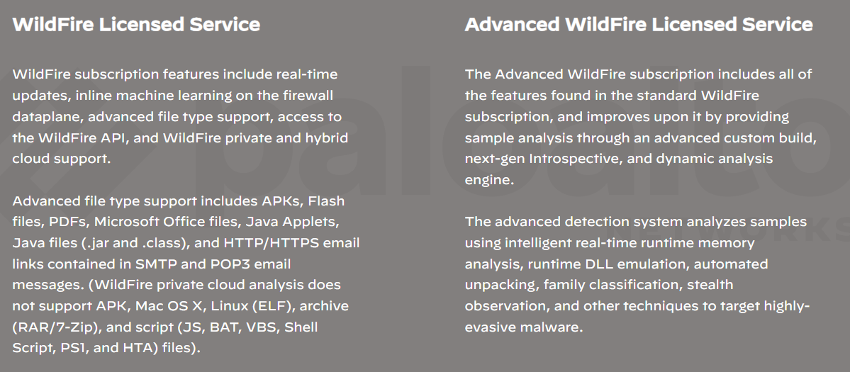
Basic and Licensed Functionality

Slide 5
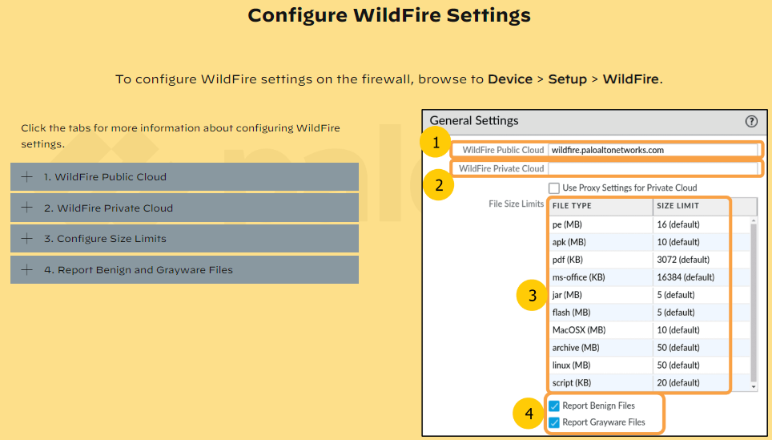

Slide 6
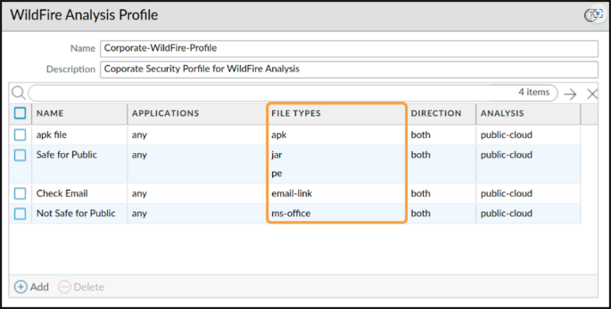
Creating a WildFire Analysis Profile

Slide 7
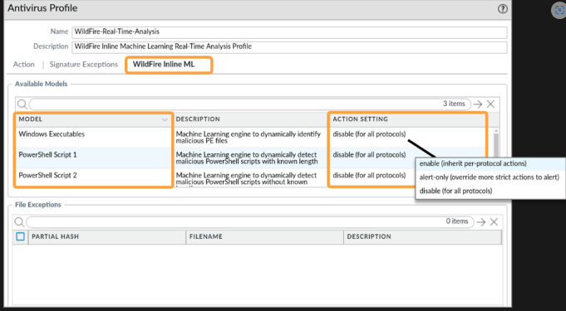
Configure Real-Time WildFire Analysis

Slide 8
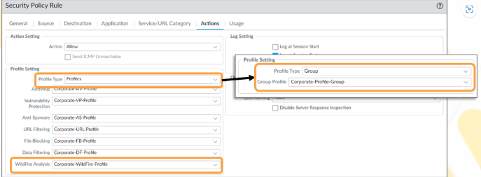
Attach WildFire Analysis Profiles to Security Rules

Slide 9
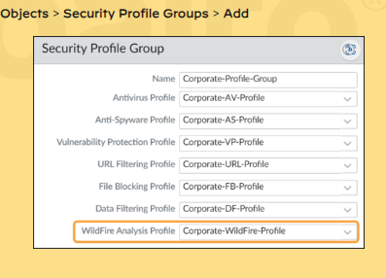
Security Profile Groups

Slide 10
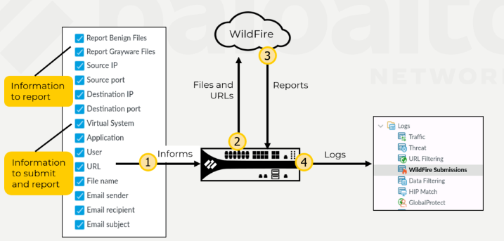
WildFire Reporting Overview

Slide 11
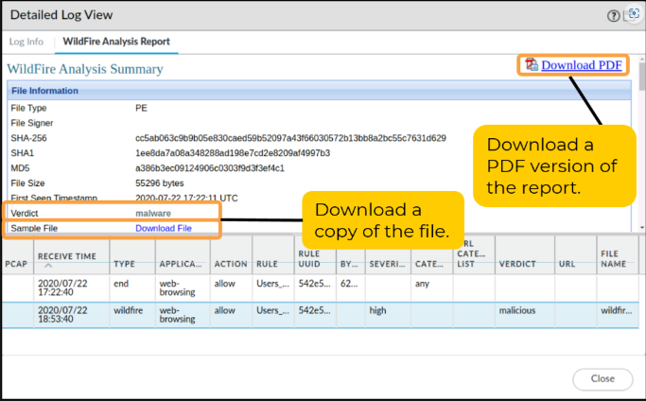
WildFire Analysis Verdict Example

Slide 12
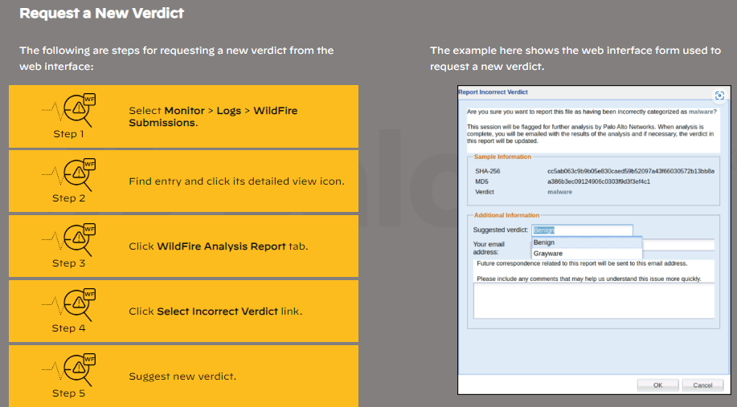
Report Incorrect Verdict: Web Interface

