Slide 1
What is Firewall
A firewall can be defined as a special type of network security device or a software program that monitors and filters incoming and outgoing network traffic based on a defined set of security rules.

Slide 2
Why firewall
Open access
Compromised data
Network crashes

Slide 3
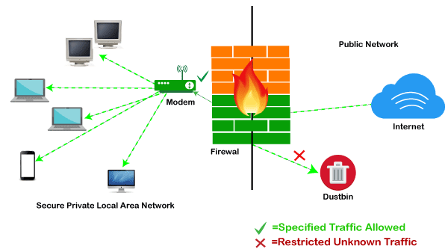
How does firewall work

Slide 4
Features of firewall
Url filtering
Sandboxing
App filtering
Threat prevention
Monitoring

Slide 5
Limitations of firewall
Misuse of credentials
Already infected
Rules misconfigured

