Slide 1
International Seminar on Revitalising Indigenous Knowledge Systems · ICSSR · 11–12 September 2026
Sub-theme: Digital Preservation, Artificial Intelligence, and Documentation of Indigenous Knowledge
An IKS-Grounded Multimodal Advisory System
Connecting Image-Based Plant Diagnosis with Classical Indian Agricultural Texts
वृक्षायुर्वेद · बृहत्संहिता · कृषिपराशर · उपवनविनोद · काश्यपीयकृषिसूक्ति · विश्ववल्लभ
Ankit Pawar · Dr. Akshay Pandey (Supervisor)
Department of Computer Science & Engineering, PDPM Indian Institute of Information Technology, Design and Manufacturing, Jabalpur
Notes:
[0:00-0:15] Good evening, everyone. I'm Ankit Pawar from IIITDM Jabalpur; this work is with my supervisor, Dr. Akshay Pandey. In five minutes I'll show you a system that lets a farmer consult India's classical agricultural texts from a photograph of a sick plant - built so that the AI can never put words in those texts' mouths.

Slide 2
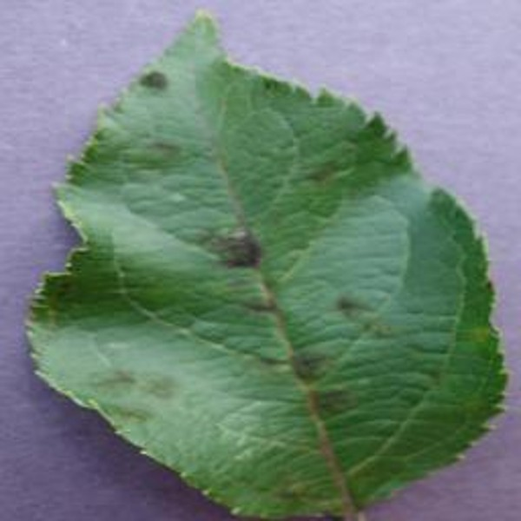
THE PROBLEM
Centuries of plant-care knowledge — locked on the shelf
Six classical treatises hold the knowledge…
A farmer sees
dark, scabby patches
on apple leaves.
Vriksha-
yurveda
Brihat
Samhita
Krishi
Parashara
Upavana-
vinoda
Kashyapiya
Krishisukti
Vishva-
vallabha
Where does advice come from today?
…but three locks keep it on the shelf
• A chemical dealer
• An AI chatbot ↓
1 Language
Sanskrit, or rare scattered translations
THE HALLUCINATION PROBLEM
Chatbots answer confidently even when they do not know — and invent facts and sources. For indigenous knowledge that few people can verify, that is dangerous.
2 No digital form
Nothing structured or searchable
3 Symptom, not name
The texts say “dark scabby patches spreading” — never “apple scab”. Modern labels do not exist in them.
Ankit Pawar · Dr. Akshay Pandey | PDPM IIITDM Jabalpur
Notes:
[0:15-1:00] Here is the real situation. A farmer sees dark, scabby patches on apple leaves. Where does advice come from today? A chemical dealer - or an AI chatbot. And chatbots have a known flaw called hallucination: they answer confidently even when they don't know, and they invent facts and sources. For indigenous knowledge that few people can verify, that is dangerous. Meanwhile, six classical treatises hold centuries of organic remedies - but three locks keep them on the shelf: Sanskrit or rare translations; no searchable digital form; and they describe problems by symptom, never by a modern disease name.

Slide 3
THE SOURCES, IN ONE LINE EACH
The six texts — what each one contains
Vrikshayurveda
Surapala, c. 10th c.
The science of plant life — planting, nourishing, and treating sick trees
Brihat Samhita
Varahamihira, 6th c.
Encyclopaedia — rain, finding underground water, crop growth, tree treatment
Krishi Parashara
Parashara
The farming almanac — rain forecasting, sowing calendar, seed storage
Upavanavinoda
Sarngadhara
Garden and orchard care — planting, grafting, watering, protection
Kashyapiya Krishisukti
Kashyapa, before 800 CE
Cultivation from land to harvest — land, water, seeds, sowing, grain, vegetables
Vishvavallabha
Chakrapani Mishra, 1577
Water-finding, horticulture, plant disease and pests — being added next
ONE REAL LINE, AS PUBLISHED
Vrikshayurveda v.193 — “To remove insects from the roots and branches of the trees, wise men should water the trees with cold water for seven days.” → symptom, then remedy, numbered: that is what makes the texts searchable.
Ankit Pawar · Dr. Akshay Pandey | PDPM IIITDM Jabalpur
Notes:
[1:00-1:25] The six texts, very briefly. Vrikshayurveda - plant life and treating sick trees. Brihat Samhita - rain, finding water, crops, tree treatment. Krishi Parashara - the farming almanac. Upavanavinoda - garden and tree care. Kashyapiya Krishisukti - cultivation from land to harvest. Vishvavallabha - water, horticulture and plant disease, the one we add next. And here is one real line, Vrikshayurveda verse 193: to remove insects from the roots and branches, water the tree with cold water for seven days. Symptom, then remedy, numbered - that is what makes these texts searchable.

Slide 4
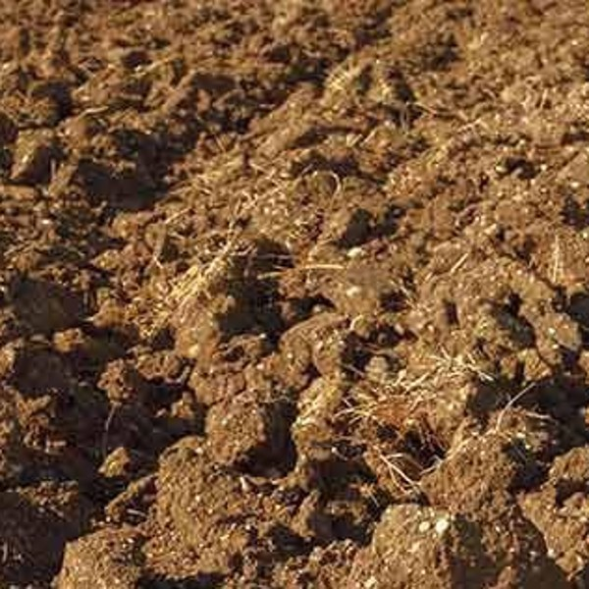
ARCHITECTURE · PRESS → TO ADVANCE
How it works — from photo to cited advice
MODEL 1 · Plant disease
KNOWLEDGE BASE
leaf photo → disease name, healthy/diseased, confidence, heat-map
six classical texts → 327 numbered passages
search by meaning + by keyword
symptom question
disease · confidence
5 best passages
FARMER
leaf + soil photo, crop, cause
THE COMBINER
ANSWER WRITER
leaf photo
soil photo
crop · suspected cause
the hub: routes the photos,
writes the question,
delivers the answer
language model — may use ONLY the passages found;
every line cites the verse; refuses if nothing fits
cited advice · or honest refusal
soil type · moisture · texture
EXPLAIN & DELIVER
MODEL 2 · Soil
heat-map of the leaf region used
+ the passages, so anyone can verify
soil photo → soil type, moisture, texture (visual only)
advice + verse + heat-map + passages
Step 1 of 5 - the farmer sends two photos, the crop and a suspected cause
Notes:
[1:25-2:55] (frame 1/5) [CLICK 1] The farmer sends a leaf photo and a soil photo, names the crop, and may add a suspected cause. All of it goes to the combiner - the hub of the system. [CLICK 2] The combiner passes the leaf to the disease model, which returns the disease name and a confidence - here, apple scab at 0.86 - and the soil photo to the soil model, which returns soil type, moisture and texture. [CLICK 3] Now the key step. The combiner writes one question in the language the texts use - not 'apple scab', but 'dark, rough, scabby patches spreading over the leaf of a tree in moist alluvial soil'. [CLICK 4] That question searches the knowledge base - the six texts cut into 327 numbered passages - and the five best-matching passages come back. [CLICK 5] The answer writer composes the advice using only those five passages and cites the verse - or refuses if nothing fits. The farmer receives the advice, the source verse, a heat-map of where the model looked, and the passages themselves.

Slide 5
ARCHITECTURE · PRESS → TO ADVANCE
How it works — from photo to cited advice
MODEL 1 · Plant disease
KNOWLEDGE BASE
leaf photo → disease name, healthy/diseased, confidence, heat-map
six classical texts → 327 numbered passages
search by meaning + by keyword
symptom question
disease · confidence
apple scab · 0.86
5 best passages
FARMER
leaf + soil photo, crop, cause
THE COMBINER
ANSWER WRITER
leaf photo
soil photo
crop · suspected cause
the hub: routes the photos,
writes the question,
delivers the answer
language model — may use ONLY the passages found;
every line cites the verse; refuses if nothing fits
cited advice · or honest refusal
soil type · moisture · texture
alluvial · moist · medium
EXPLAIN & DELIVER
MODEL 2 · Soil
heat-map of the leaf region used
+ the passages, so anyone can verify
soil photo → soil type, moisture, texture (visual only)
advice + verse + heat-map + passages
Step 2 of 5 - two models read the leaf and the soil, and report back
Notes:
[1:25-2:55] (frame 2/5) [CLICK 1] The farmer sends a leaf photo and a soil photo, names the crop, and may add a suspected cause. All of it goes to the combiner - the hub of the system. [CLICK 2] The combiner passes the leaf to the disease model, which returns the disease name and a confidence - here, apple scab at 0.86 - and the soil photo to the soil model, which returns soil type, moisture and texture. [CLICK 3] Now the key step. The combiner writes one question in the language the texts use - not 'apple scab', but 'dark, rough, scabby patches spreading over the leaf of a tree in moist alluvial soil'. [CLICK 4] That question searches the knowledge base - the six texts cut into 327 numbered passages - and the five best-matching passages come back. [CLICK 5] The answer writer composes the advice using only those five passages and cites the verse - or refuses if nothing fits. The farmer receives the advice, the source verse, a heat-map of where the model looked, and the passages themselves.

Slide 6
ARCHITECTURE · PRESS → TO ADVANCE
How it works — from photo to cited advice
MODEL 1 · Plant disease
KNOWLEDGE BASE
leaf photo → disease name, healthy/diseased, confidence, heat-map
six classical texts → 327 numbered passages
search by meaning + by keyword
symptom question
“dark, rough, scabby patches spreading over the leaf of a tree in moist alluvial soil”
disease · confidence
5 best passages
FARMER
leaf + soil photo, crop, cause
THE COMBINER
ANSWER WRITER
leaf photo
soil photo
crop · suspected cause
the hub: routes the photos,
writes the question,
delivers the answer
language model — may use ONLY the passages found;
every line cites the verse; refuses if nothing fits
cited advice · or honest refusal
soil type · moisture · texture
EXPLAIN & DELIVER
MODEL 2 · Soil
heat-map of the leaf region used
+ the passages, so anyone can verify
soil photo → soil type, moisture, texture (visual only)
advice + verse + heat-map + passages
Step 3 of 5 - the combiner writes one question in the texts' own language
Notes:
[1:25-2:55] (frame 3/5) [CLICK 1] The farmer sends a leaf photo and a soil photo, names the crop, and may add a suspected cause. All of it goes to the combiner - the hub of the system. [CLICK 2] The combiner passes the leaf to the disease model, which returns the disease name and a confidence - here, apple scab at 0.86 - and the soil photo to the soil model, which returns soil type, moisture and texture. [CLICK 3] Now the key step. The combiner writes one question in the language the texts use - not 'apple scab', but 'dark, rough, scabby patches spreading over the leaf of a tree in moist alluvial soil'. [CLICK 4] That question searches the knowledge base - the six texts cut into 327 numbered passages - and the five best-matching passages come back. [CLICK 5] The answer writer composes the advice using only those five passages and cites the verse - or refuses if nothing fits. The farmer receives the advice, the source verse, a heat-map of where the model looked, and the passages themselves.

Slide 7
ARCHITECTURE · PRESS → TO ADVANCE
How it works — from photo to cited advice
MODEL 1 · Plant disease
KNOWLEDGE BASE
leaf photo → disease name, healthy/diseased, confidence, heat-map
six classical texts → 327 numbered passages
search by meaning + by keyword
symptom question
disease · confidence
Vrikshayurveda v.173, 191, 193, 194 · Upavanavinoda …
5 best passages
FARMER
leaf + soil photo, crop, cause
THE COMBINER
ANSWER WRITER
leaf photo
soil photo
crop · suspected cause
the hub: routes the photos,
writes the question,
delivers the answer
language model — may use ONLY the passages found;
every line cites the verse; refuses if nothing fits
cited advice · or honest refusal
soil type · moisture · texture
EXPLAIN & DELIVER
MODEL 2 · Soil
heat-map of the leaf region used
+ the passages, so anyone can verify
soil photo → soil type, moisture, texture (visual only)
advice + verse + heat-map + passages
Step 4 of 5 - the question searches 327 numbered passages; the 5 best come back
Notes:
[1:25-2:55] (frame 4/5) [CLICK 1] The farmer sends a leaf photo and a soil photo, names the crop, and may add a suspected cause. All of it goes to the combiner - the hub of the system. [CLICK 2] The combiner passes the leaf to the disease model, which returns the disease name and a confidence - here, apple scab at 0.86 - and the soil photo to the soil model, which returns soil type, moisture and texture. [CLICK 3] Now the key step. The combiner writes one question in the language the texts use - not 'apple scab', but 'dark, rough, scabby patches spreading over the leaf of a tree in moist alluvial soil'. [CLICK 4] That question searches the knowledge base - the six texts cut into 327 numbered passages - and the five best-matching passages come back. [CLICK 5] The answer writer composes the advice using only those five passages and cites the verse - or refuses if nothing fits. The farmer receives the advice, the source verse, a heat-map of where the model looked, and the passages themselves.

Slide 8
ARCHITECTURE · PRESS → TO ADVANCE
How it works — from photo to cited advice
MODEL 1 · Plant disease
KNOWLEDGE BASE
leaf photo → disease name, healthy/diseased, confidence, heat-map
six classical texts → 327 numbered passages
search by meaning + by keyword
symptom question
disease · confidence
5 best passages
FARMER
leaf + soil photo, crop, cause
THE COMBINER
ANSWER WRITER
leaf photo
soil photo
crop · suspected cause
the hub: routes the photos,
writes the question,
delivers the answer
“water with cold water for seven days…” [Vrikshayurveda v.193]
language model — may use ONLY the passages found;
every line cites the verse; refuses if nothing fits
cited advice · or honest refusal
soil type · moisture · texture
EXPLAIN & DELIVER
MODEL 2 · Soil
heat-map of the leaf region used
+ the passages, so anyone can verify
soil photo → soil type, moisture, texture (visual only)
advice + verse + heat-map + passages
Step 5 of 5 - advice is written only from those passages, cited, and returned with the heat-map
Notes:
[1:25-2:55] (frame 5/5) [CLICK 1] The farmer sends a leaf photo and a soil photo, names the crop, and may add a suspected cause. All of it goes to the combiner - the hub of the system. [CLICK 2] The combiner passes the leaf to the disease model, which returns the disease name and a confidence - here, apple scab at 0.86 - and the soil photo to the soil model, which returns soil type, moisture and texture. [CLICK 3] Now the key step. The combiner writes one question in the language the texts use - not 'apple scab', but 'dark, rough, scabby patches spreading over the leaf of a tree in moist alluvial soil'. [CLICK 4] That question searches the knowledge base - the six texts cut into 327 numbered passages - and the five best-matching passages come back. [CLICK 5] The answer writer composes the advice using only those five passages and cites the verse - or refuses if nothing fits. The farmer receives the advice, the source verse, a heat-map of where the model looked, and the passages themselves.

Slide 9
WHY THE COMBINER IS THE KEY IDEA
The contribution: search by symptom, not by name
SEARCH WITH THE MODERN LABEL
RE-DESCRIBE AS THE SYMPTOM
“Apple scab”
“dark, rough, scabby patches spreading over the leaf”
→ the texts return almost nothing. The phrase does not exist in them.
→ strong matches — the texts speak this language.
relevance 0.01 – 0.04
relevance 0.59 – 0.96
How the rewriting is done
What this unlocks
A language model is given the diagnosis and asked to describe the visible symptoms in plain words — the way a cultivator would describe them. The crop becomes context; the symptom leads.
• Searching by meaning beats searching by keywords: 0.94 vs 0.70
• A symptom carries across plants → cautious advice even for untrained crops, with a confidence figure
• Matches how the texts themselves prescribe — by symptom, not by crop
Ankit Pawar · Dr. Akshay Pandey | PDPM IIITDM Jabalpur
Notes:
[2:55-3:35] Why is that rewriting the contribution? Search the texts for 'apple scab' and you get almost nothing - relevance 0.01 to 0.04 - because the phrase does not exist in classical literature. Search for 'dark, rough, scabby patches spreading over the leaf' and relevance jumps to 0.59 to 0.96. The texts prescribe by symptom, not by crop. And because a symptom carries across plants, the system can advise - cautiously, with a confidence figure - even on a crop it was never trained for.

Slide 10
USER INTERFACE
What the farmer sees — the interface
IKS Agricultural Advisory · prototype
INPUTS
RESULT
Leaf photo
Soil photo
Diagnosis
Where the model looked
Apple — scab · confidence 0.86
heat-map on the lesion — not the background
Soil: alluvial · moist · medium texture
Recommendation (from the texts only)
Cut away the affected parts and sprinkle the spots with water mixed with milk; feed the roots with kunapa water and cow-dung paste. Water with cold water for seven days.
Source: [Vrikshayurveda, v. 193–194] · [Vrikshayurveda, v. 191]
Crop
Apple ▾
Suspected cause (optional)
Not sure ▾
Retrieved passages (so anyone can verify)
v.193 “To remove insects from the roots and branches … water the trees with cold water for seven days.”
v.194 “The worms can be overcome by the paste of milk, kunapa water, and cow dung …”
Get advice
Illustrative screen with real corpus passages. If the texts are silent, the result panel states: “The classical texts do not contain enough information for this case.”
Ankit Pawar · Dr. Akshay Pandey | PDPM IIITDM Jabalpur
Notes:
[3:35-4:10] This is the interface. On the left, the inputs: leaf photo, soil photo, the crop, an optional suspected cause. On the right: the diagnosis with a confidence, a heat-map of the leaf region the model examined, the recommendation with its citation from Vrikshayurveda, and the retrieved passages themselves so anyone can check the source. If the texts are silent, this panel says so honestly.

Slide 11
SAFETY FOR INDIGENOUS KNOWLEDGE
Trust by design — four guarantees against fabrication
Cites the verse
Refuses when silent
Attention verified
Human in the loop
Every recommendation is composed only from retrieved passages.
[Vrikshayurveda, v. 193]
If the texts do not cover a case, it says so instead of inventing.
100% honest refusal
0% fabricated citations
The heat-map must sit on the lesion. Early on it sat on the background of field photos — we retrained until it did not.
Uncertain or out-of-scope cases are collected for an agronomist to review.
No silent self-learning from unverified guesses
0.01–0.04 → 0.59–0.96
100% · 0%
0.94 vs 0.70
relevance: modern label vs symptom rewriting
honest refusal · fabricated citations
search by meaning vs by keyword
For a plant the model was never trained on, it still advises — with a confidence figure and an explicit caution. Always “confidence”, never “accuracy”.
Ankit Pawar · Dr. Akshay Pandey | PDPM IIITDM Jabalpur
Notes:
[4:10-4:40] Four guarantees make this safe for indigenous knowledge. It cites the verse. It refuses when the texts are silent - in our evaluation, one hundred percent honest refusal and zero fabricated citations. Its attention is verified - early on the heat-map showed the model reading the background of field photos, and we retrained until it reads the lesion. And uncertain cases go to an agricultural expert - a human in the loop.

Slide 12
WHY THIS MATTERS FOR REVITALISING IKS
A text that is cited every day is preserved — and alive.
• Documentation and use reinforce each other — retrieval is preservation in practice
• Verifiable, not distorted — every answer traces to its source verse
• In the farmer’s hands, not only in archives — a template for AI on Indigenous knowledge beyond agriculture
NEXT STEPS
• Validation with agronomists · add Vishvavallabha · expert-built evaluation set
Thank you
Ankit Pawar · Dr. Akshay Pandey · PDPM IIITDM Jabalpur
Notes:
[4:40-5:00] Why this matters for revitalising IKS: a verse that is retrieved and cited in a farmer's advisory is preserved, transmitted and validated at once - and nothing is distorted, because everything traces to its source. Next: validation with agronomists, adding Vishvavallabha, and an expert-built evaluation set. Thank you - happy to take questions.

