Slide 1

Master of Applied Computing
Networking & Data Security COMP-8677-3 Group: Hackers 27

Slide 2
Team Members
Ankit (110026647)
Gurjit Vohra (110030757)
Mehul Kohli (110058778)

Slide 3
Content
Attacks discussed in this presentation are:
TCP SYN Flood Attack
Mitnick Attack
ARP Poisoning & MITM Attack

Slide 4
TCP SYN FLOOD ATTACK
TCP SYN flood is a sort of Distributed Denial of Service (DDoS) attack that uses a portion of the standard TCP three-way handshake to consume resources on the targeted server and cause it to become unusable. In this, the attacker sends multiple TCP connection requests to the target server than it can process causing the network to slow down or completely stop.

Slide 5
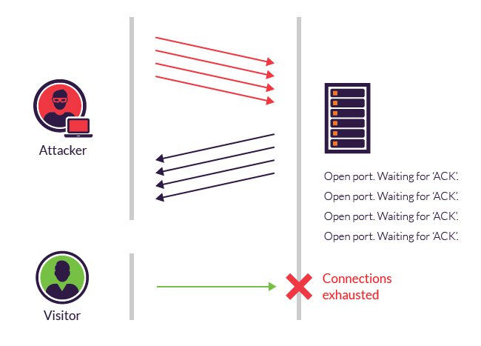
How does TCP SYN FLOOD ATTACK works ?
Using fake IP addresses, the attacker sends SYN packets to every port on the targeted server. Unaware of the attack, the server receives many requests for communication. Each open port sends a SYN-ACK packet in response to each attempt. With that, the target server will wait for ACK from the fake IP addresses causing the connection to stay open and before timeout the server receives another SYN request generating large number of half-open connections. With large amount of traffic coming in, the server crashes causing the legit connection requests to be denied.

Slide 6

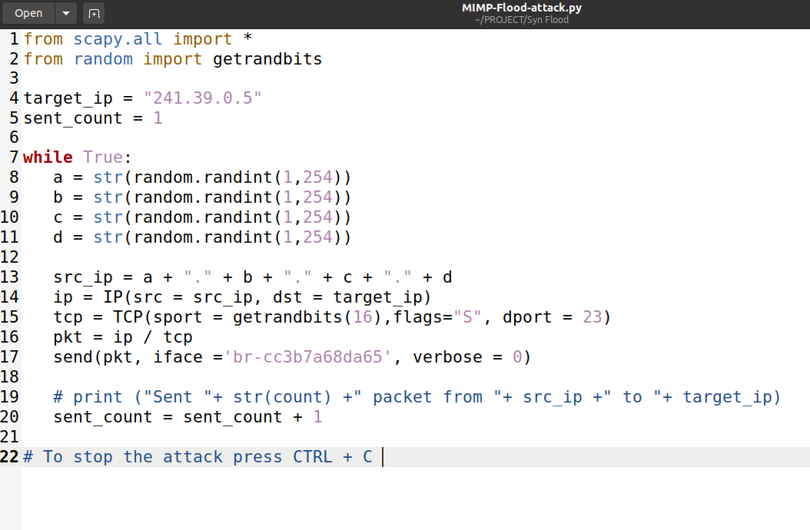
CODE

Slide 7
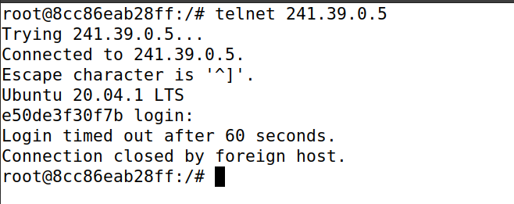
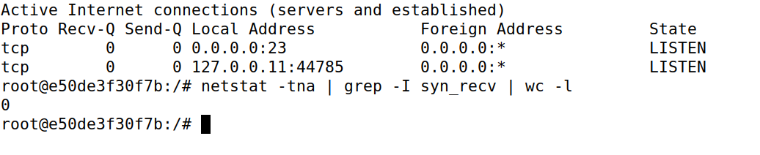
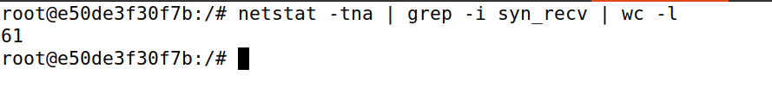
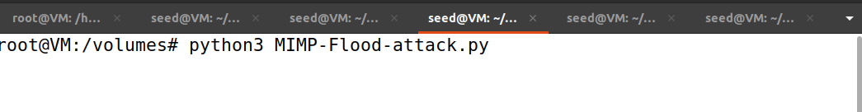
Attack Demo

Slide 8
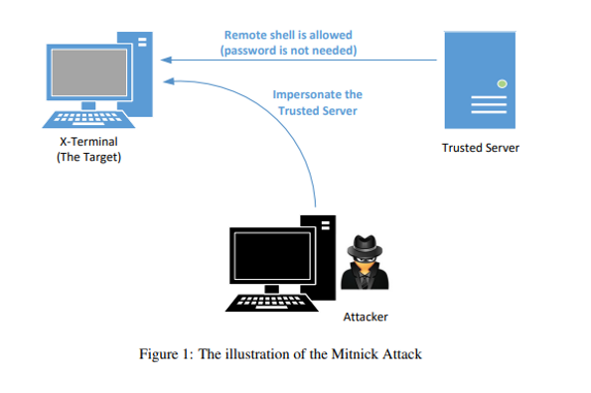
Mitnick Attack
The Mitnick attack is a type of TCP session hijacking that takes use of flaws in the TCP protocol as well as the trust between two machines. The Mitnick attack creates a TCP connection between the victim client and the victim server on their behalf, which it subsequently hijacks. Mitnick was able to deduce X-TCP Terminal's sequence number generator behaviour as well as the existence of a trusted relationship between X-Terminal and Server by sniffing the packets exchanged for establishing the connection. Then it impersonates a server and uses rsh to get access to the client's machine, where it instals a backdoor that allows it to access the client at any time by corrupting the.rhosts file.

Slide 9
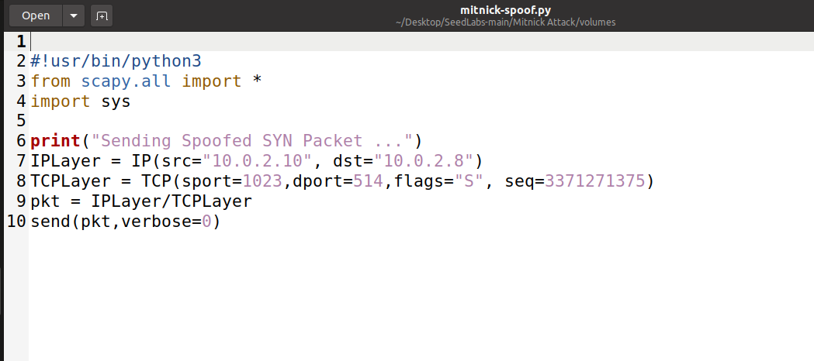
CODE

Slide 10
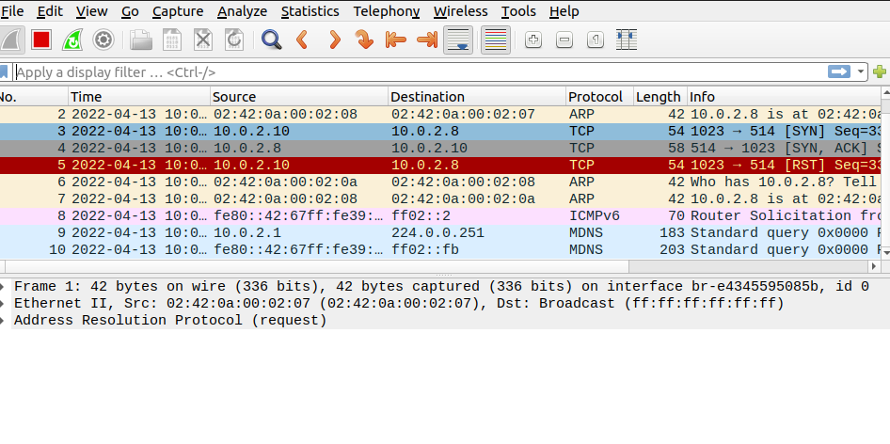
Attack Demo

Slide 11
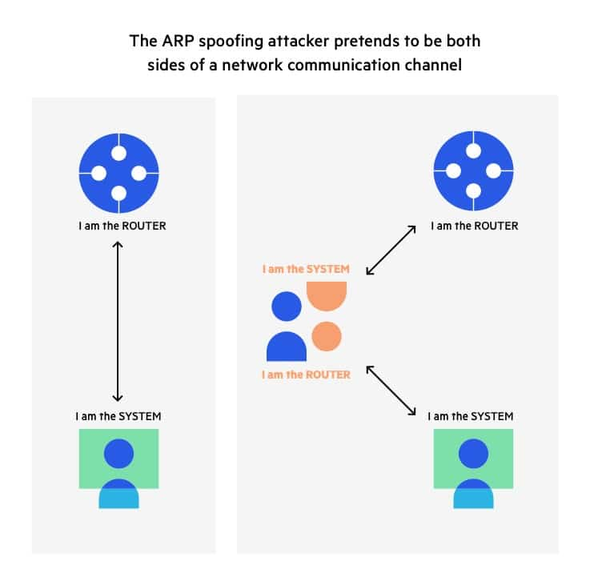
ARP Poisoning Attack
Given an IP address, the Address Resolution Protocol (ARP) is a communication protocol for determining the link layer address, such as the MAC address.
The ARP cache poisoning attack is a typical ARP protocol exploit. Attackers can use this technique to trick the victim into adopting counterfeit IP-to-MAC mappings. This can lead to traffic being routed to the machine with the falsified MAC address, thus exposing the victim to man-in-the-middle attacks.

Slide 12
ARP Man-In-The-Middle Attack
ARP Poisoning is a type of MITM attack. Man-In-The-Middle attacks are one of the most prevalent and hazardous attacks. A MITM attack is a form of eavesdropping assault in which an attacker listens in on two parties’ communication. The attackers pretend to be both legitimate participants in the communication after they have gained access to it. In this method, neither of the original parties is aware that an attacker is present, and they communicate as if they are directly connected. But, without their knowledge, both parties communicate with the attacker rather than directly with each other.

Slide 13
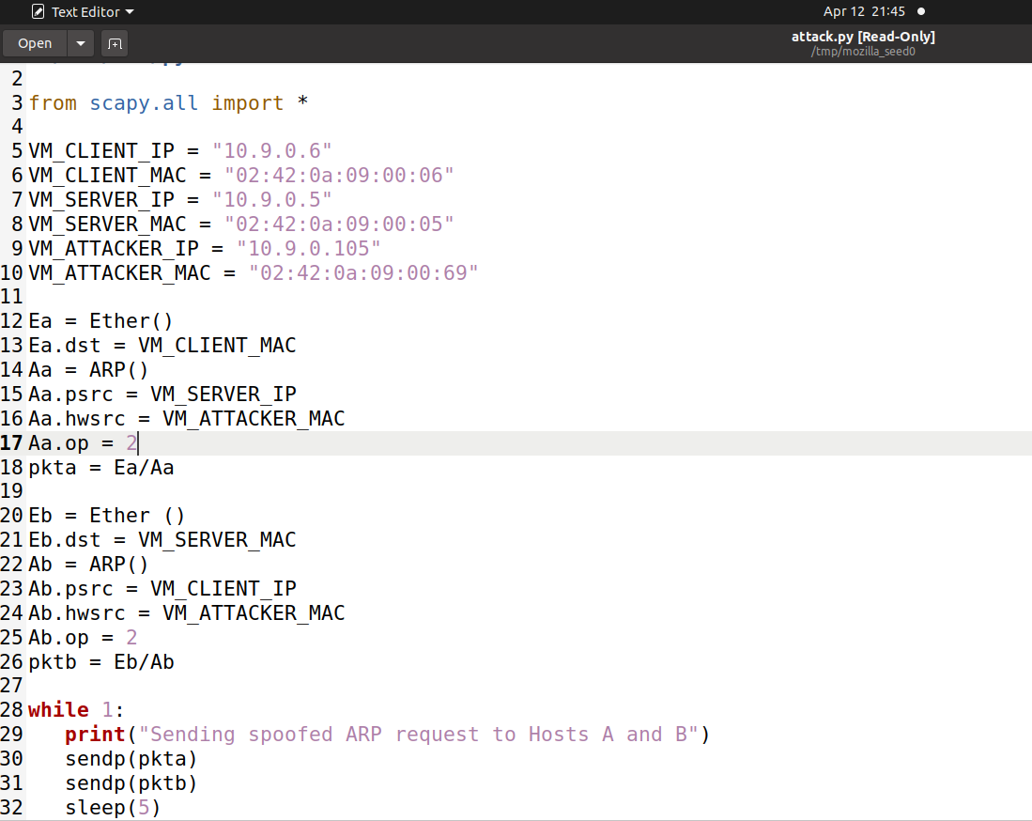
CODE

Slide 14
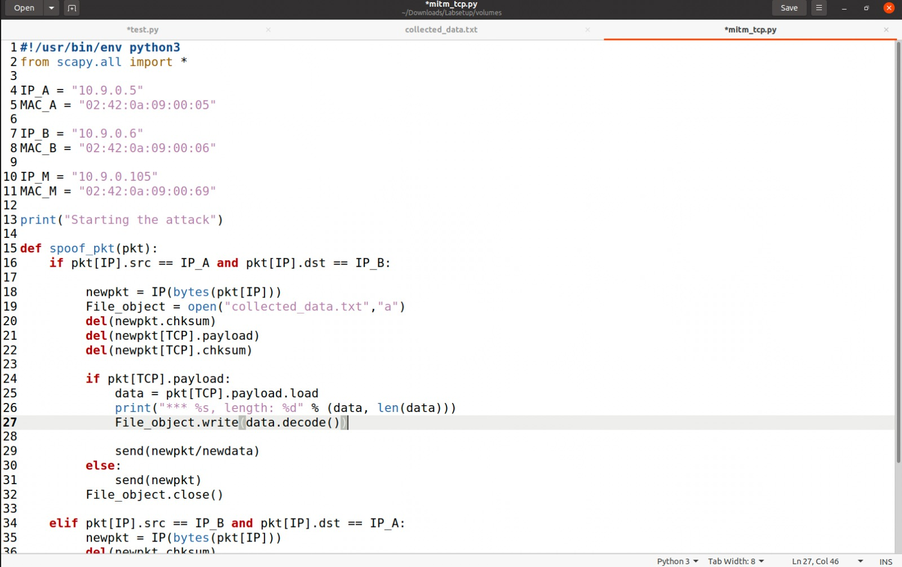
CODE

Slide 15
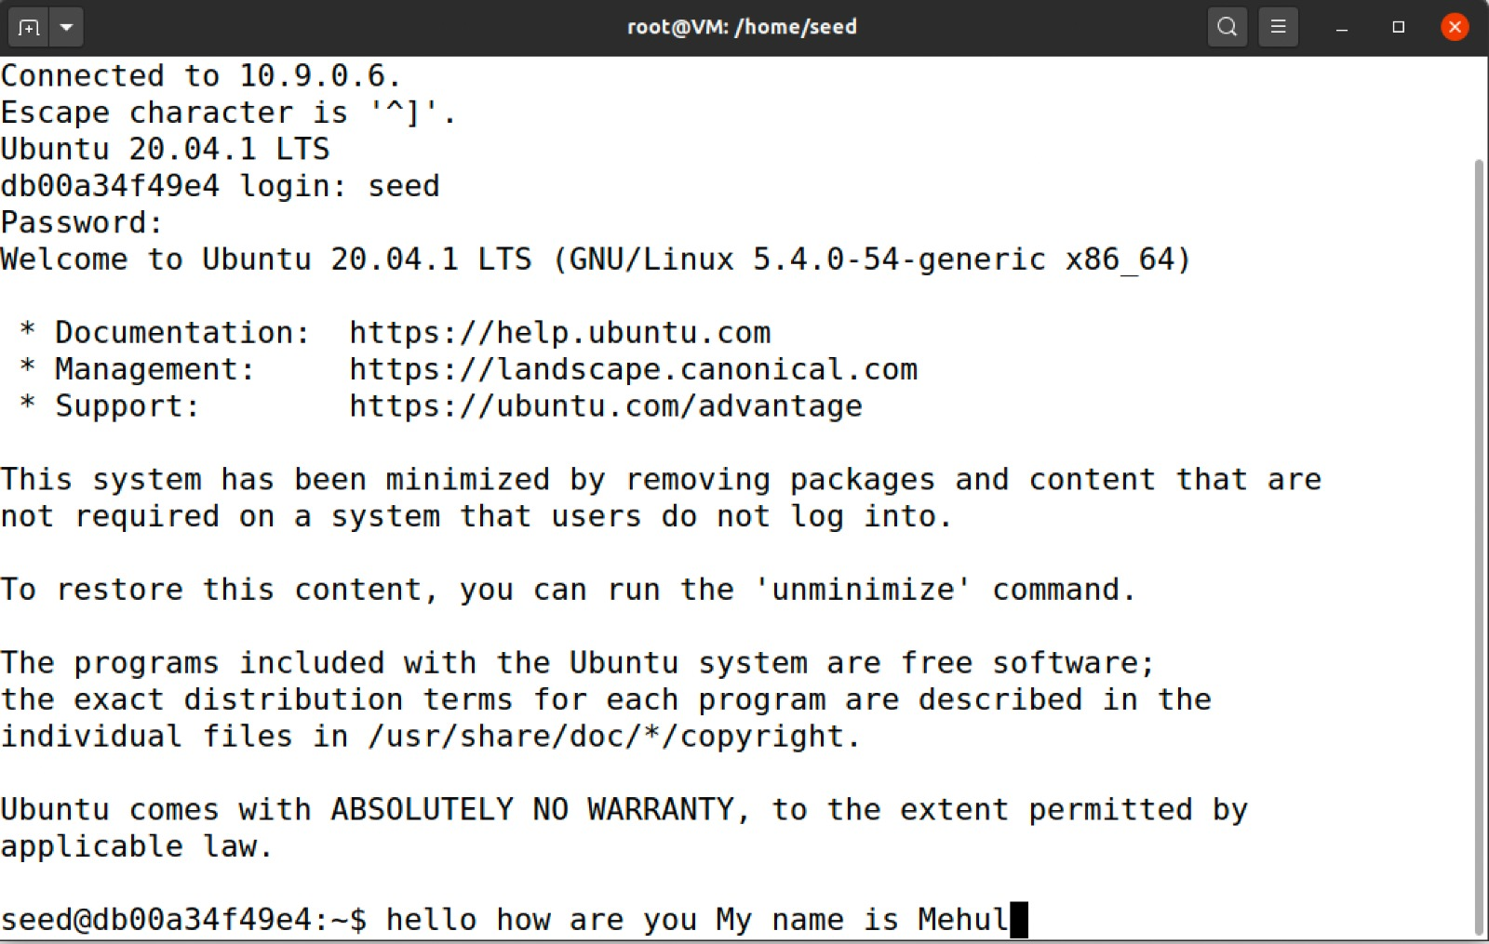
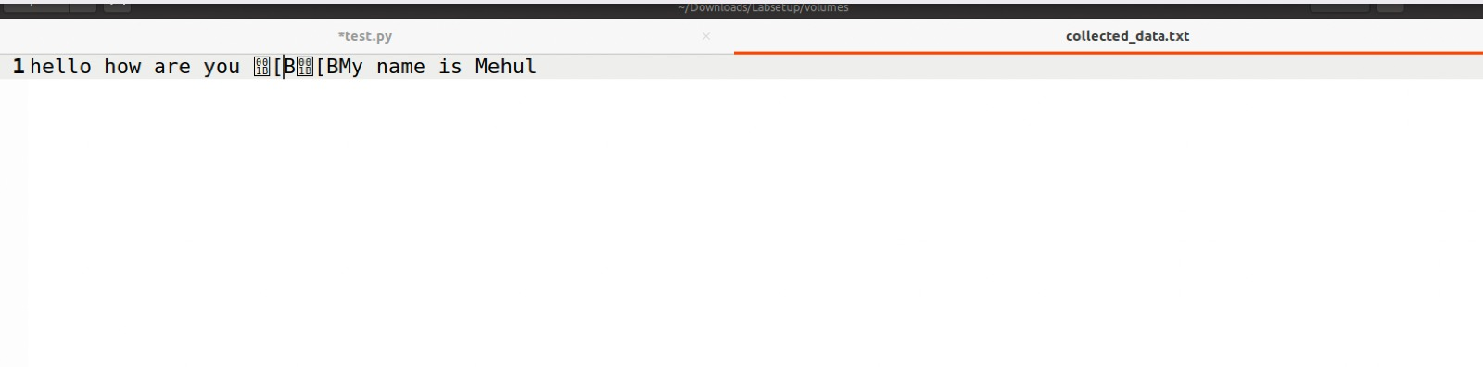
Attack Demo

Slide 16
Thank You

