Slide 1

Master of Applied Computing
Networking & Data Security COMP-8677-3 Group: Hackers 27

Slide 2
Team Members
Ankit (110026647)
Gurjit Vohra (110030757)
Mehul Kohli (110058778)

Slide 3
Content
Attacks discussed in this presentation are:
TCP SYN Flood Attack
ARP Poisoning Attack
ARP Man-in-the-middle(MITM) Attack

Slide 4
TCP SYN FLOOD ATTACK
TCP SYN flood is a sort of Distributed Denial of Service (DDoS) attack that uses a portion of the standard TCP three-way handshake to consume resources on the targeted server and cause it to become unusable. In this, the attacker sends multiple TCP connection requests to the target server than it can process causing the network to slow down or completely stop.

Slide 5
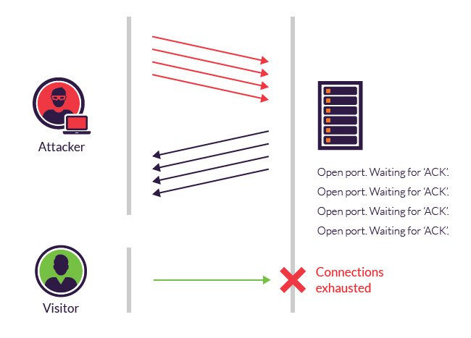
How does TCP SYN FLOOD ATTACK works ?
Using fake IP addresses, the attacker sends SYN packets to every port on the targeted server. Unaware of the attack, the server receives many requests for communication. Each open port sends a SYN-ACK packet in response to each attempt. With that, the target server will wait for ACK from the fake IP addresses causing the connection to stay open and before timeout the server receives another SYN request generating large number of half-open connections. With large amount of traffic coming in, the server crashes causing the legit connection requests to be denied.

Slide 6

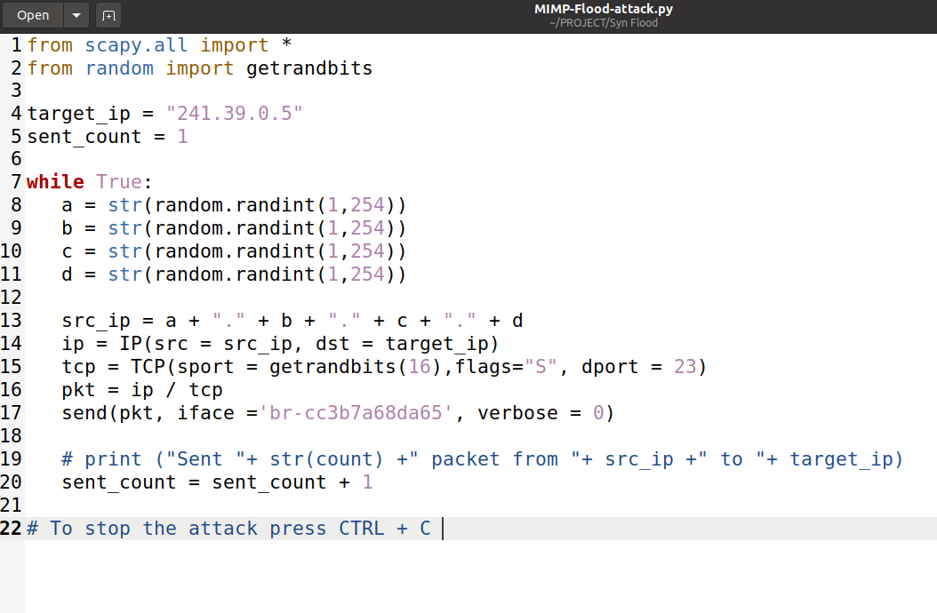
CODE

Slide 7
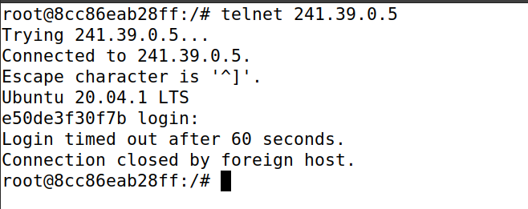
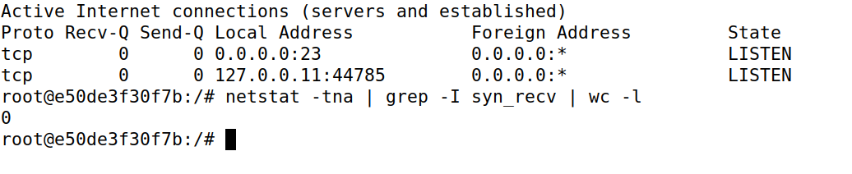
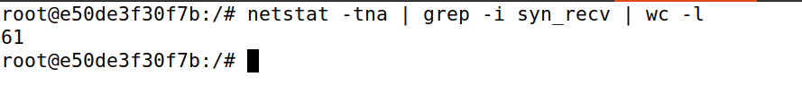
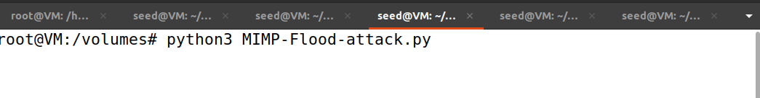
Attack Demo

Slide 8
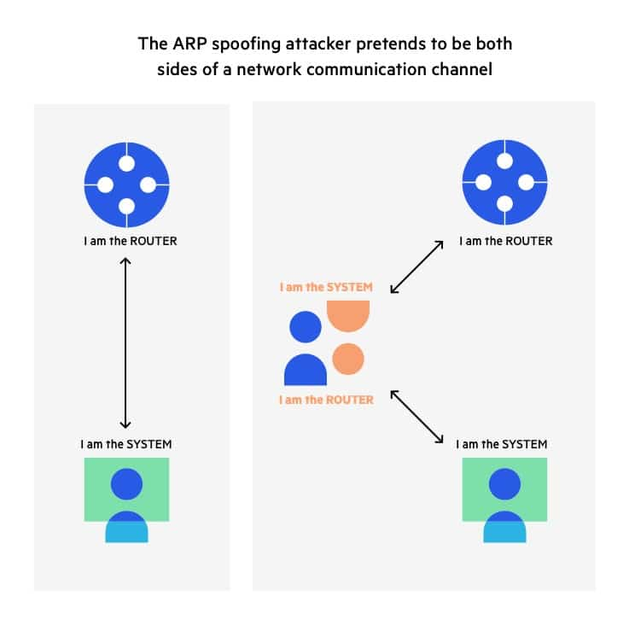
ARP Poisoning Attack
Given an IP address, the Address Resolution Protocol (ARP) is a communication protocol for determining the link layer address, such as the MAC address.
The ARP cache poisoning attack is a typical ARP protocol exploit. Attackers can use this technique to trick the victim into adopting counterfeit IP-to-MAC mappings. This can lead to traffic being routed to the machine with the falsified MAC address, thus exposing the victim to man-in-the-middle attacks.

Slide 9
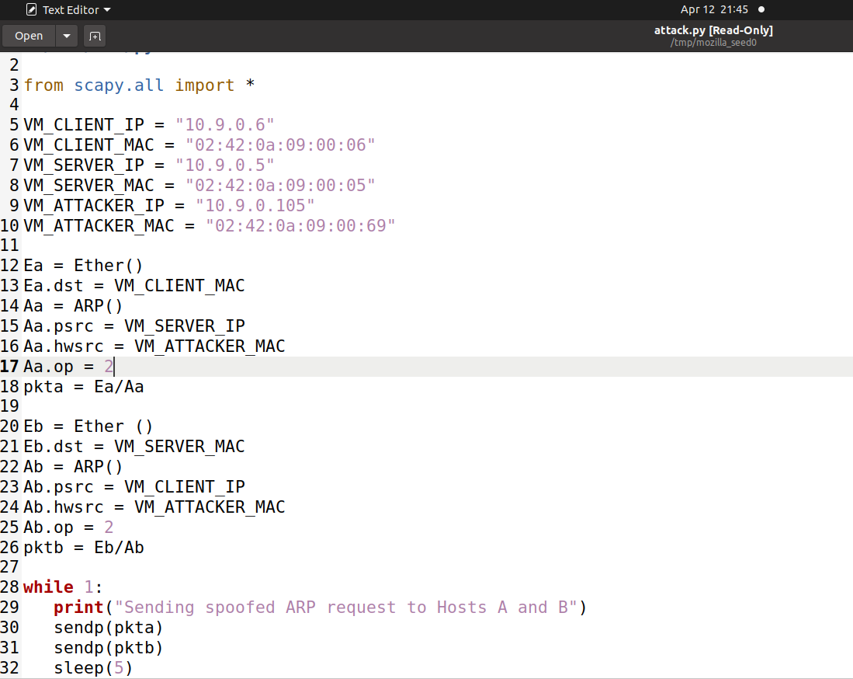
CODE

Slide 10
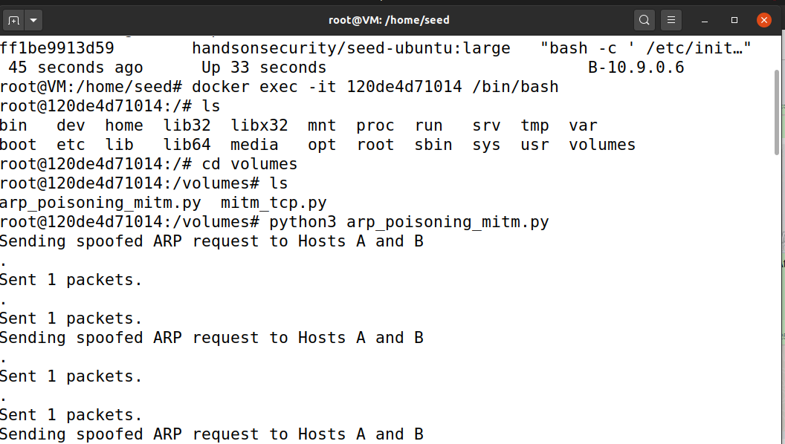
Attack Demo

Slide 11
ARP Man-In-The-Middle Attack
ARP Poisoning is a type of MITM attack. Man-In-The-Middle attacks are one of the most prevalent and hazardous attacks. A MITM attack is a form of eavesdropping assault in which an attacker listens in on two parties’ communication. The attackers pretend to be both legitimate participants in the communication after they have gained access to it. In this method, neither of the original parties is aware that an attacker is present, and they communicate as if they are directly connected. But, without their knowledge, both parties communicate with the attacker rather than directly with each other.

Slide 12
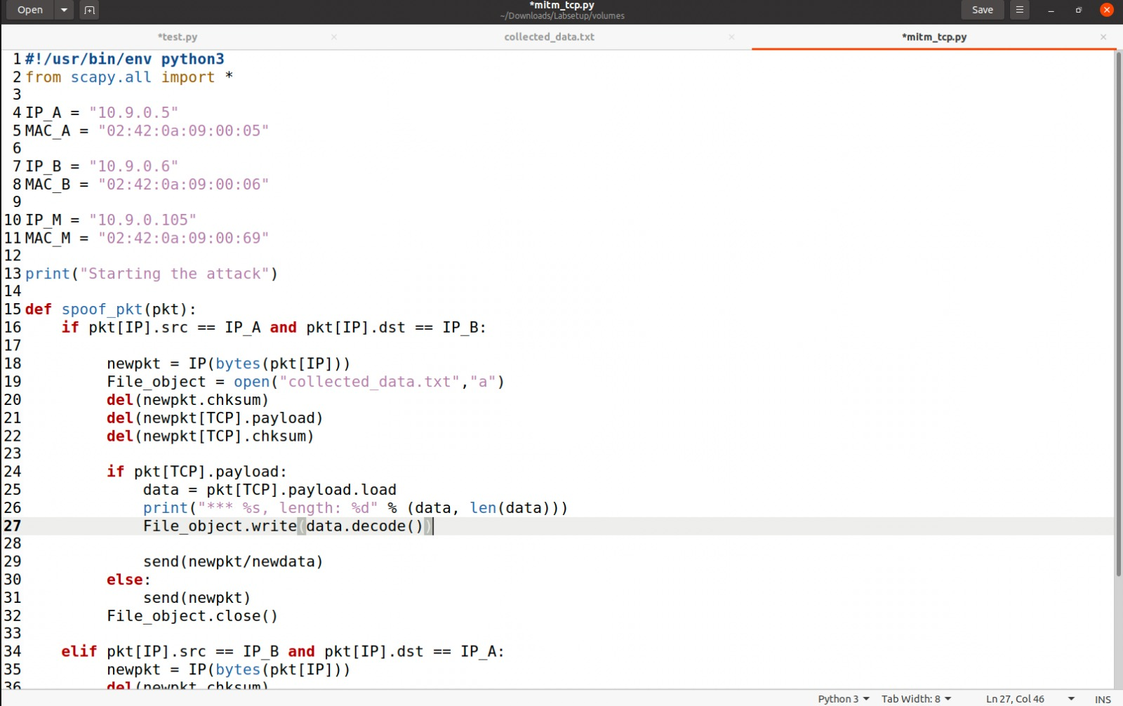
CODE

Slide 13
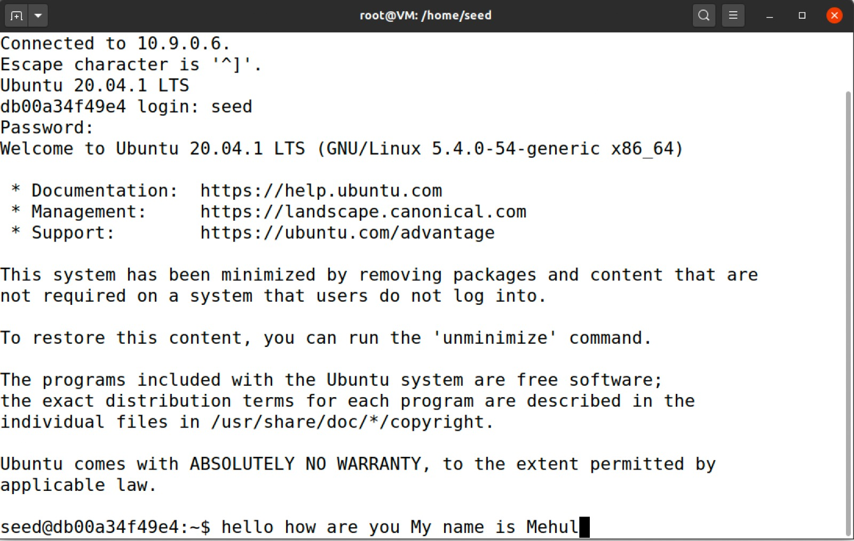
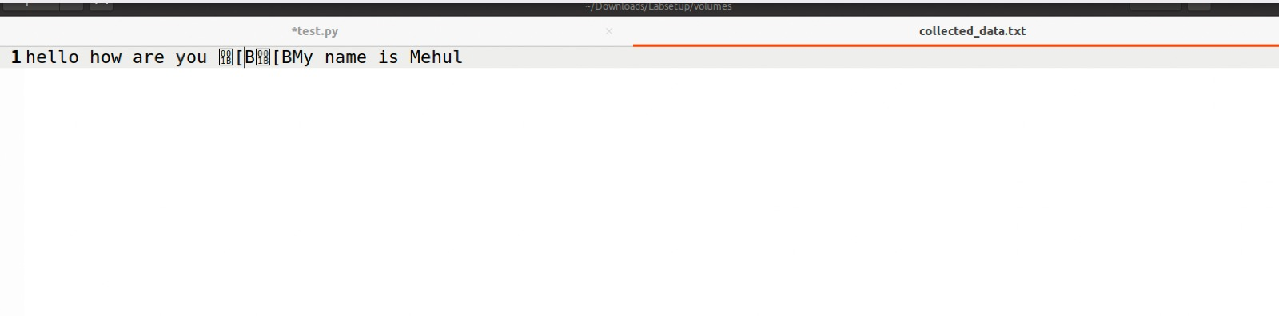
Attack Demo

Slide 14
Thank You

