Slide 1

Department of computer science & engineering FACULTY OF ENGINEERING AND TECHNOLOGY GURUKUL KANGRI UNIVERSITY 2017-2018
Topic: An Overview of Machine Learning

Slide 2
Speaker : Ankit Gupta Adviser : mr. nishant MUNJAL
DATE:11/10/2017
Notes:
Example

Slide 3
What is Machine Learning? Arthur Samuel in 1959: “[Machine Learning is the] field of study that gives computers the ability to learn without being explicitly programmed.” And more recently, in 1997, Tom Mitchel : “A computer program is said to learn from experience E with respect to some task T and some performance measure P, if its performance on T, as measured by P, improves with experience E.” -- Tom Mitchell, Carnegie Mellon University:

Slide 4
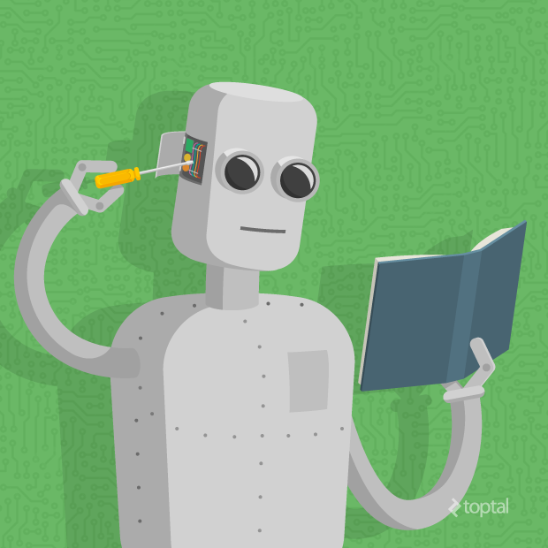
ML provides potential solutions in all these domains and more, and is set to be a pillar of our future civilization.
ML can play a key role in a wide range of critical applications, such as: 1.data mining, 2.natural language processing, 3.image recognition, and 4.expert systems.

Slide 5
Algorithm by learning Style:
There are different ways an algorithm can model a problem based on its interaction with the experience or environment or whatever we count to call the input data.
Three different styles in machine learning algorithm:
1.Semi-Supervised Learning
Input data is a mixture of labeled and unlabelled examples.
There is a desired prediction problem but the model must learn the structures to organize the data as well as make predictions.
Example problems are classification and regression.
Example algorithms are extensions to other flexible methods that make assumptions about how to model the unlabeled data.
2. Supervised Learning
Input data is called training data and has a known label or result such as spam/not-spam or a stock price at a time.
A model is prepared through a training process in which it is required to make predictions and is corrected when those predictions are wrong. The training process continues until the model achieves a desired level of accuracy on the training data.
Example problems are classification and regression.
Supervised learning
Semi-supervised learning

Slide 6
3.Unsupervised Learning
Input data is not labeled and does not have a known result.
A model is prepared by deducing structures present in the input data. This may be to extract general rules. It may be through a mathematical process to systematically reduce redundancy, or it may be to organize data by similarity.
Example problems are clustering, dimensionality reduction and association rule learning.
Example algorithms include: the Apriori algorithm and k-Means.
Unsupervised learning

Slide 7
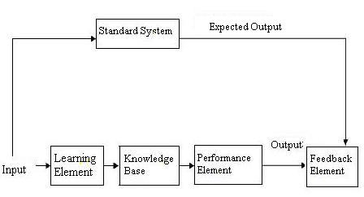
The figure shown besides is a typical learning system model. It consists of the following components.
Learning system model:
1. Learning element 2. Knowledge base 3. Performance element 4. Feedback element 5. Standard system.
Machine learning refers to a system capable of acquiring and integrating the knowledge automatically. The capability of the systems to learn from experience, training, analytical observation, and other means, results in a system that can continuously self-improve and thereby exhibit efficiency and effectiveness.
A machine learning system usually starts with some knowledge and a corresponding knowledge organization so that it can interpret, analyze, and test the knowledge acquired.

Slide 8
Training data: Training data means having a response variable in our data. means for training data we can say the result directly. we will make our algorithms to learn from our train data.
Test data: some time test data will be used to check the accuracy of algorithm and some times to predict the things. on test data we will apply our algorithms which we make learn from our train data.
Training and testing:
Data acquisition
Practical usage
Universal set
(unobserved)
Training set (observed)
Testing set
(unobserved)

Slide 9
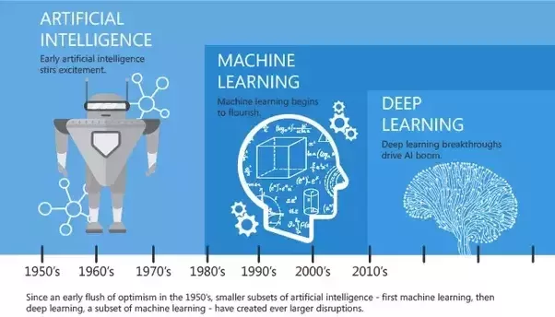
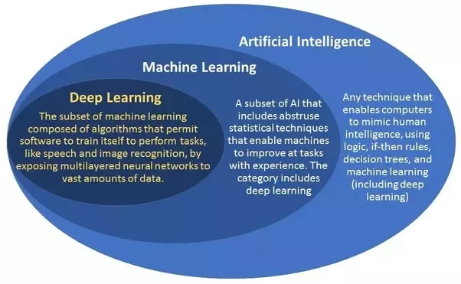
Artificial Intelligence vs Machine Learning vs Deep Learning

Slide 10
Some points on Artificial Intelligence vs Machine Learning vs Deep Learning
Artificial intelligence is a broader concept than machine learning, which addresses the use of computers to mimic the cognitive functions of humans. When machines carry out tasks based on algorithms in an “intelligent” manner, that is AI.
Machine learning is a subset of AI and focuses on the ability of machines to receive a set of data and learn for themselves, changing algorithms as they learn more about the information they are processing.
Deep learning goes yet another level deeper and can be considered a subset of machine learning. The concept of deep learning is sometimes just referred to as "deep neural networks," referring to the many layers involved. A neural network may only have a single layer of data, while a deep neural network has two or more. The layers can be seen as a nested hierarchy of related concepts or decision trees.

Slide 11



In This picture Anaconda is Big reptiles but in Computer Science, Anaconda is also known as a Python Notebook . In computer science Anaconda is a freemium open source distribution of the Python and R programming languages for large-scale data processing, predictive analytics, and scientific computing, that aims to simplify package management and deployment. Package versions are managed by the package management system conda.

Slide 12
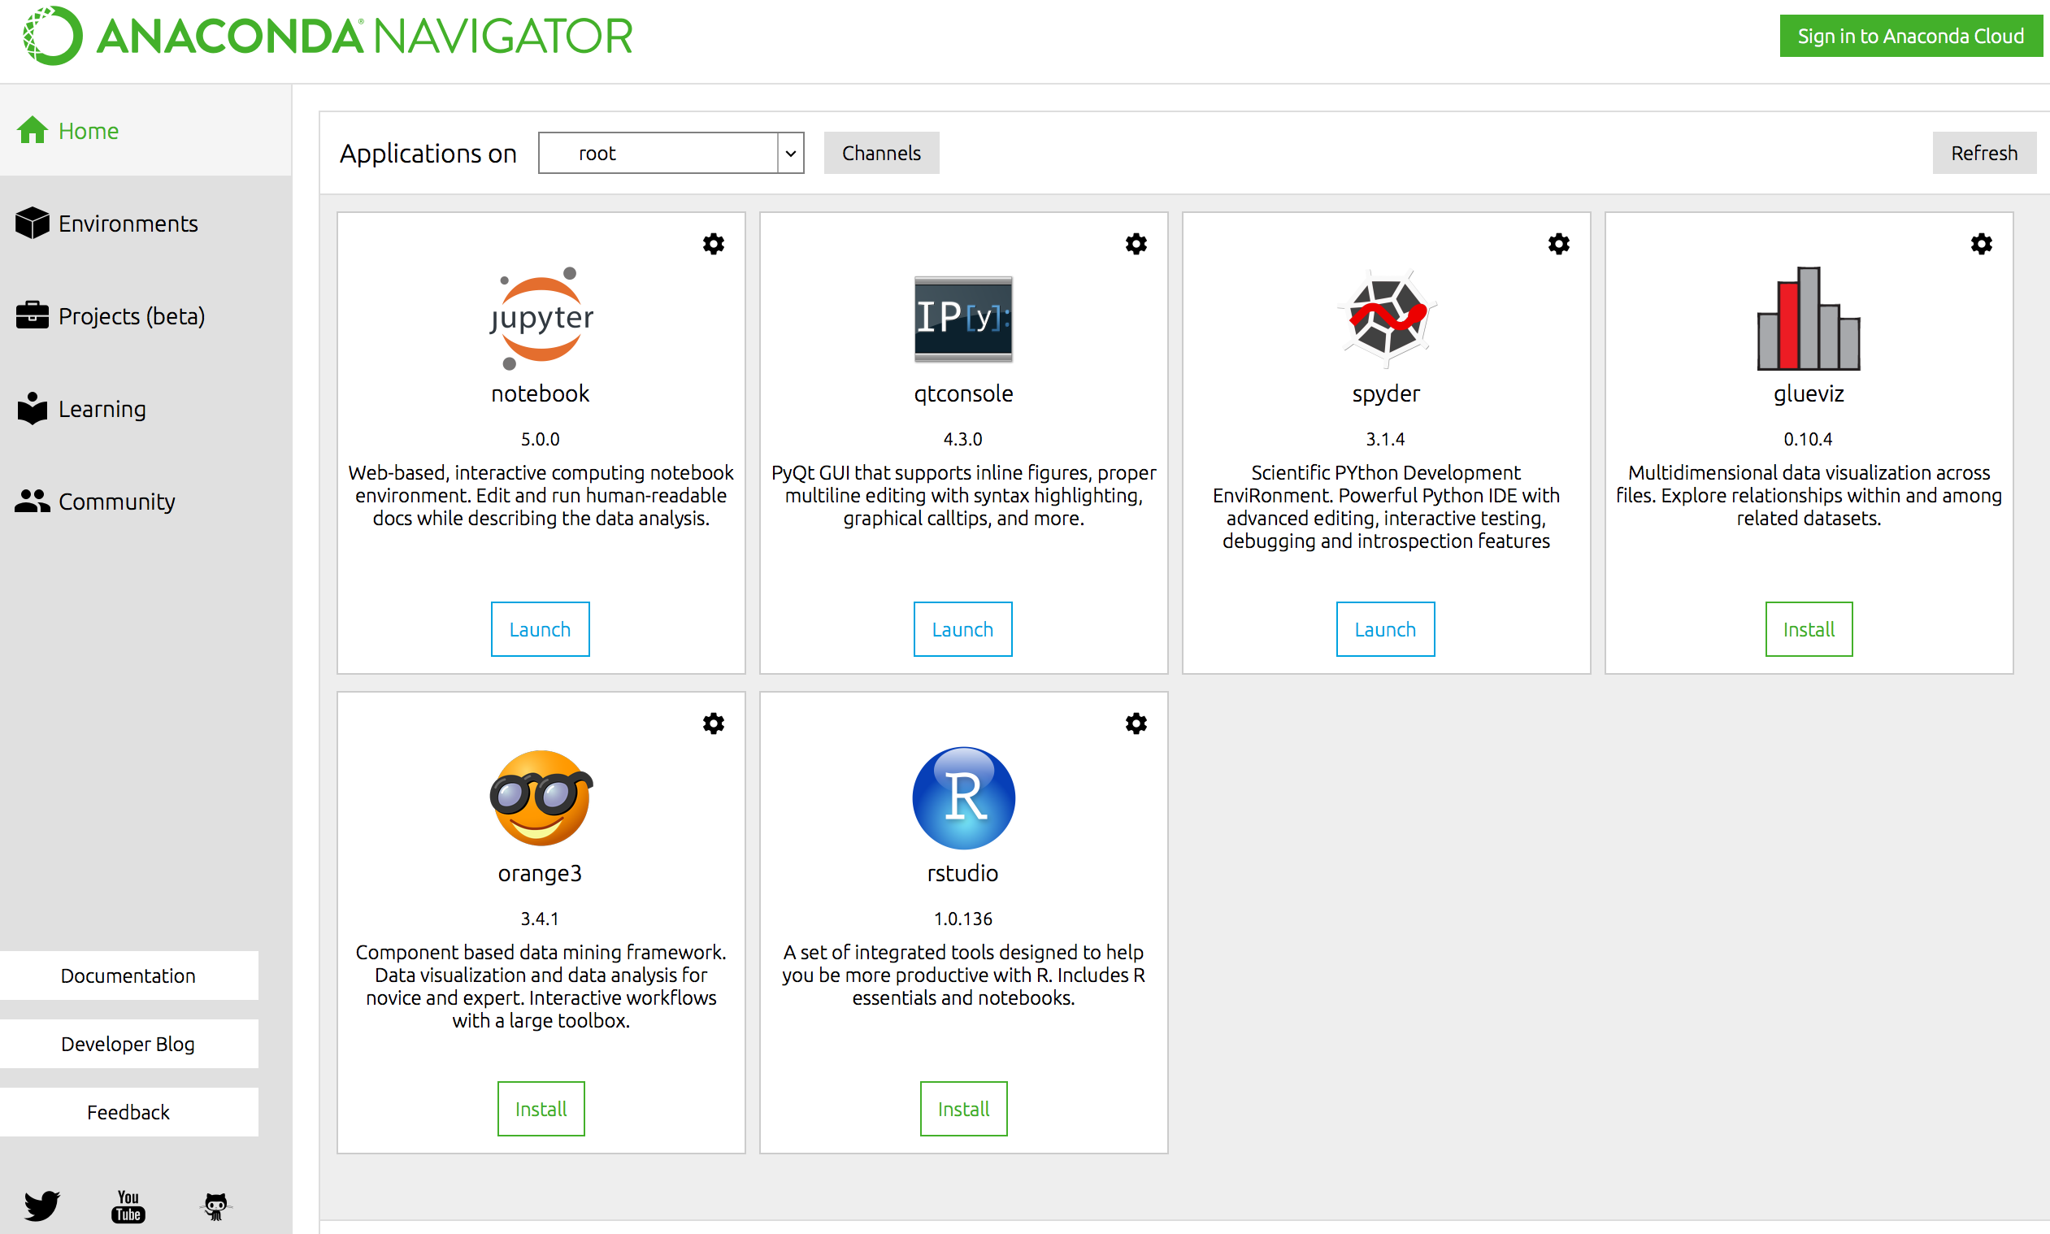

The Jupyter Notebook is an interactive computing environment that enables users to author notebook documents that include: - Live code - Interactive widgets - Plots - Narrative text - Equations - Images - Video

Slide 13
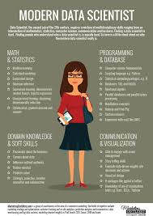
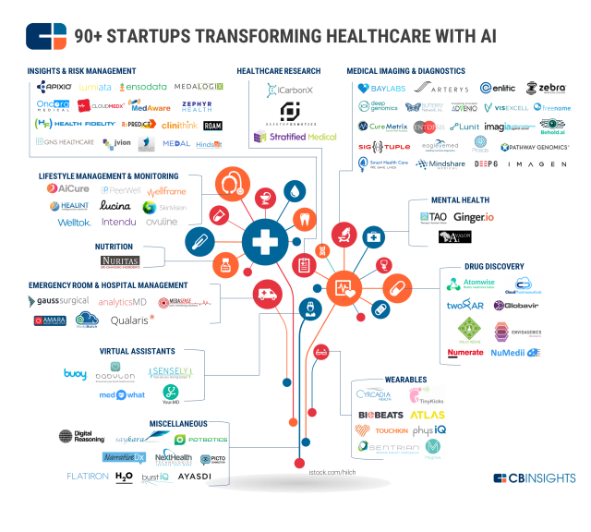
90+ STARTUPS TRANSFORMING HEALTHCARE AI

Slide 14

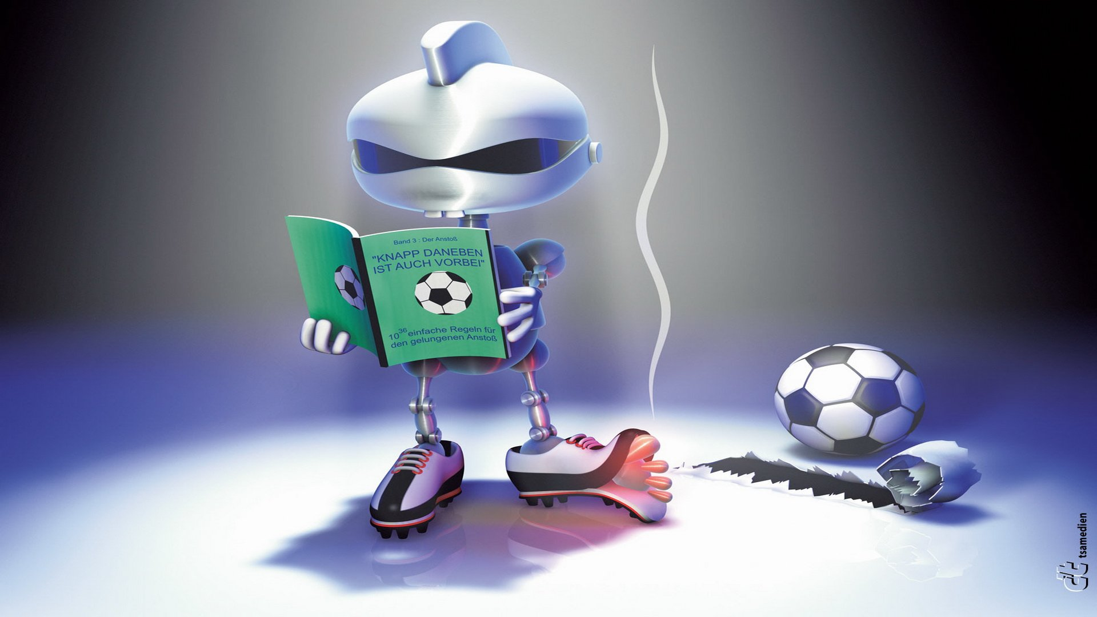
Everyday Examples of Artificial Intelligence and Machine Learning are :
1 – Google’s AI-Powered Predictions (analyze the speed of movement of traffic at any given time).
2 – Ridesharing Apps Like Uber and Lyft.
3 -Commercial Flights Use an AI Autopilot.
4 – Spam Filters.
5 – Smart Email Categorization(the learning behind Gmail priority inbox).
6 – Facebook (Image Recogintion).
7 –Search Engine(searching).
8 –Recommendations(Amazon).
9 –Voice-to-Text.
10 – Medical field.

Slide 15
CONCLUSION :
We have a simple overview of some techniques and algorithms in machine learning. Furthermore, there are more and more techniques apply machine learning as a solution. In the future, machine learning will play an important role in our daily life.

Slide 16
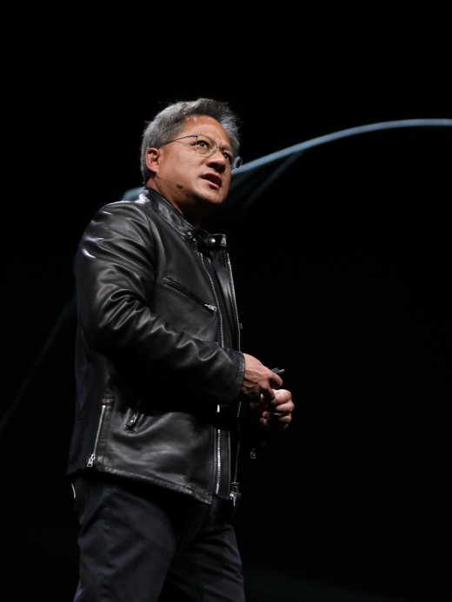
Nvidia CEO: Software Is Eating the World, but AI Is Going to Eat Software
Jensen Huang at the company’s developer conference in San Jose, California

