Slide 1
DATA STRUCTURES II UNIT 3 – Advance TREES
SUYASH BHARDWAJ
FACULTY OF ENGINEERING AND TECHNOLOGY
GURUKUL KANGRI VISHWAVIDYALAYA, HARIDWAR

Slide 2
In this Unit
Advanced Trees:
Definitions, Operations on Weight Balanced Trees (Huffman Trees),
2-3 Trees and Red-Black Trees.
Augmenting Red-Black Trees to Dynamic Order Statics and Interval Tree Applications.
Operations on Disjoint sets and its union-find problem Implementing Sets.
Dictionaries, Priority Queues and Concatenable Queues.

Slide 3
Balanced Trees Abs(depth(leftChild) – depth(rightChild)) <= 1 Depth of a tree is it’s longest path length
Red-black trees – Restructure the tree when rules among nodes of the tree are violated as we follow the path from root to the insertion point.
AVL Trees – Maintain a three way flag at each node (-1,0,1) determining whether the left sub-tree is longer, shorter or the same length. Restructure the tree when the flag would go to –2 or +2.
Splay Trees – Don’t require complete balance. However, N inserts and deletes can be done in NlgN time. Rotations are done to move accessed nodes to the top of the tree.

Slide 4
Rotations Analyze possible tree depths after rotation
LL, RR Rotation
Child node is raised one level
RL, LR Rotation
Child node is raised two levels in two steps
Splay Tree Rotation
Outer nodes of grandparent nodes are raised two levels.

Slide 5
Outer R and L rotation
L
R
X
Y
X
Y
X
C
C
A
Y
A
Y
X
B
B
C
A
B
B
C
A
Note: The squares are subtrees, the circles are nodes

Slide 6
Inner LR and RL rotation
X
Z
A
Y
X
Y
RL
Z
D
A
B
C
D
B
C
Note: LR is the mirror image

Slide 7
Outer Splay Rotation
X
Z
Y
D
A
Y
X
C
B
Z
A
B
C
D
Note: There is also a rotate for the mirror image

Slide 8
Weight Balanced Trees
weight-balanced binary trees (WBTs) are a type of self-balancing binary search trees that can be used to implement dynamic sets, dictionaries (maps) and sequences.
These trees were introduced by Nievergelt and Reingold in the 1970s as trees of bounded balance, or BB[α] trees. Their more common name is due to Knuth.

Slide 9
Weight Balanced Trees
A weight-balanced tree is a binary search tree that stores the sizes of subtrees in the nodes. That is, a node has fields
key, of any ordered type
value (optional, only for mappings)
left, right, pointer to node
size, of type integer.
By definition, the size of a leaf (typically represented by a NULL pointer) is zero. The size of an internal node is the sum of sizes of its two children, plus one (size[n] = size[n.left] + size[n.right] + 1). Based on the size, one defines the weight as weight[n] = size[n] + 1.^{[a]}

Slide 10
Weight Balanced Trees
Operations that modify the tree must make sure that the weight of the left and right subtrees of every node remain within some factor α of each other, using the same rebalancing operations used in AVL trees: rotations and double rotations. Formally, node balance is defined as follows:
A node is α-weight-balanced if
weight[n.left] ≥ α·weight[n] >weight[n.right]
Here, α is a numerical parameter to be determined when implementing weight balanced trees.

Slide 11


Weight Balanced Trees
Lower values of α produce "more balanced" trees, but not all values of α are appropriate; Nievergelt and Reingold proved that
is a necessary condition for the balancing algorithm to work
Applying balancing correctly guarantees a tree of n elements will have height^{[7]}

Slide 12
Huffman Tree
JUMP
A Huffman tree represents Huffman codes for characters that might appear in a text file
As opposed to ASCII or Unicode, Huffman code uses different numbers of bits to encode letters
More common characters use fewer bits
Many programs that compress files use Huffman codes

Slide 13
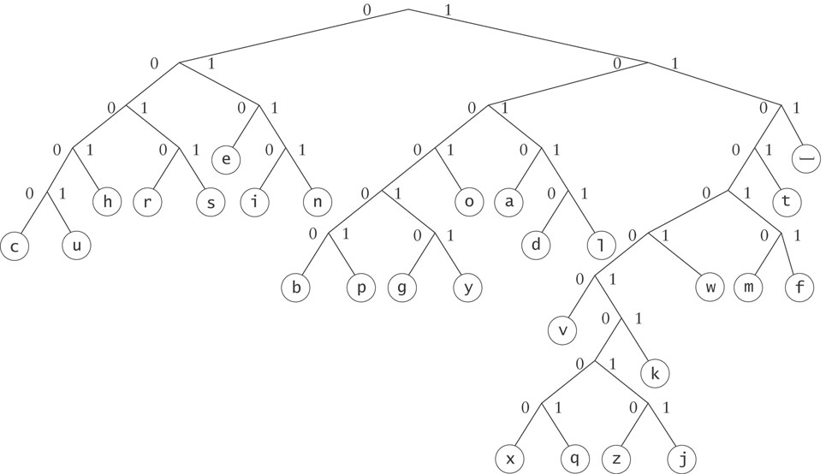
Huffman Tree (cont.)
To form a code, traverse the tree from the root to the chosen character, appending 0 if you turn left, and 1 if you turn right.

Slide 14
Huffman Tree (cont.)
Examples:
d : 10110
e : 010

Slide 15
Huffman Trees
Implemented using a binary tree and a PriorityQueue
Unique binary number to each symbol in the alphabet
Unicode is an example of such a coding
The message “go eagles” requires 144 bits in Unicode but only 38 bits using Huffman coding

Slide 16
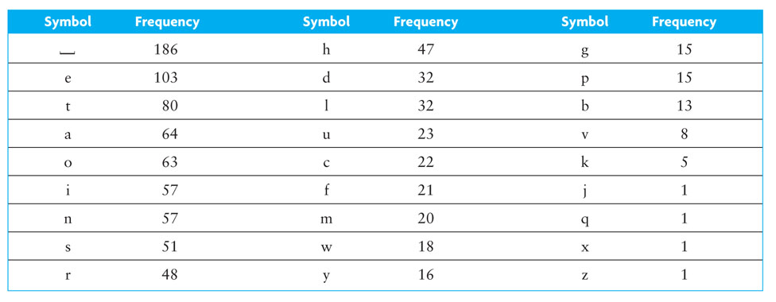
Huffman Trees (cont.)

Slide 17
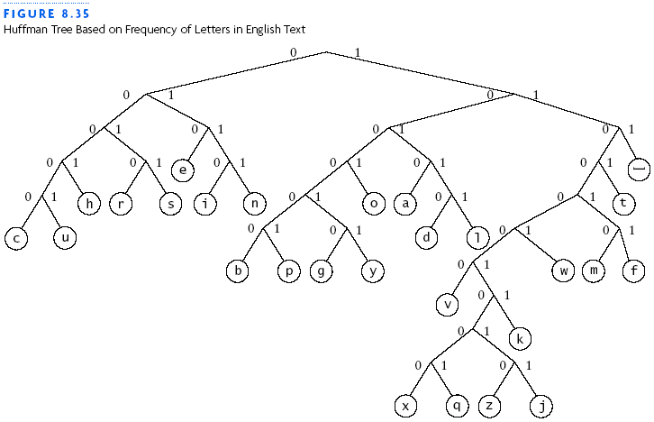
Huffman Trees (cont.)

Slide 18
Building a Custom Huffman Tree
18
Input: an array of objects such that each object contains
a reference to a symbol occurring in that file
the frequency of occurrence (weight) for the symbol in that file

Slide 19
Building a Custom Huffman Tree (cont.)
19
Analysis:
Each node will have storage for two data items:
the weight of the node and
the symbol associated with the node
All symbols will be stored in leaf nodes
For nodes that are not leaf nodes, the symbol part has no meaning
Notes:
The weight of a leaf node will be the frequency of the symbol stored at that node
The weight of an interior node will be the sum of frequencies of all nodes in the subtree rooted at the interior node

Slide 20
Design
20
Algorithm for Building a Huffman Tree
1. Construct a set of trees with root nodes that contain each of the individual symbols and their weights.
2. Place the set of trees into a priority queue.
3. while the priority queue has more than one item
4. Remove the two trees with the smallest weights.
5. Combine them into a new binary tree in which the weight of the tree root is the sum of the weights of its children.
6. Insert the newly created tree back into the priority queue.

Slide 21
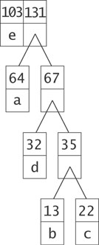
Building a Custom Huffman Tree (cont.)
21

Slide 22
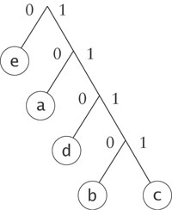
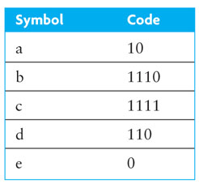
Building a Custom Huffman Tree (cont.)
22

Slide 23
Huffman Coding: An Application of Binary Trees and Priority Queues
SKIP to RED BLACK TREE

Slide 24
Encoding and Compression of Data
Fax Machines
ASCII
Variations on ASCII
min number of bits needed
cost of savings
patterns
modifications

Slide 25
Purpose of Huffman Coding
Proposed by Dr. David A. Huffman in 1952
“A Method for the Construction of Minimum Redundancy Codes”
Applicable to many forms of data transmission
Our example: text files

Slide 26
The Basic Algorithm
Huffman coding is a form of statistical coding
Not all characters occur with the same frequency!
Yet all characters are allocated the same amount of space
1 char = 1 byte, be it e or x

Slide 27
The Basic Algorithm
Any savings in tailoring codes to frequency of character?
Code word lengths are no longer fixed like ASCII.
Code word lengths vary and will be shorter for the more frequently used characters.

Slide 28
The (Real) Basic Algorithm
1. Scan text to be compressed and tally occurrence of all characters.
2. Sort or prioritize characters based on number of occurrences in text.
3. Build Huffman code tree based on prioritized list.
4. Perform a traversal of tree to determine all code words.
5. Scan text again and create new file using the Huffman codes.

Slide 29
Building a Tree Scan the original text
Consider the following short text:
Eerie eyes seen near lake.
Count up the occurrences of all characters in the text

Slide 30
Building a Tree Scan the original text
Eerie eyes seen near lake.
What characters are present?
E e r i space
y s n a r l k .

Slide 31
Building a Tree Scan the original text
Eerie eyes seen near lake.
What is the frequency of each character in the text?
Char Freq. Char Freq. Char Freq.
E 1 y 1 k 1
e 8 s 2 . 1
r 2 n 2
i 1 a 2
space 4 l 1

Slide 32
Building a Tree Prioritize characters
Create binary tree nodes with character and frequency of each character
Place nodes in a priority queue
The lower the occurrence, the higher the priority in the queue

Slide 33
Building a Tree Prioritize characters
Uses binary tree nodes
public class HuffNode
{
public char myChar;
public int myFrequency;
public HuffNode myLeft, myRight;
}
priorityQueue myQueue;

Slide 34
Building a Tree
The queue after inserting all nodes
Null Pointers are not shown
E
1
i
1
y
1
l
1
k
1
.
1
r
2
s
2
n
2
a
2
sp
4
e
8

Slide 35
Building a Tree
While priority queue contains two or more nodes
Create new node
Dequeue node and make it left subtree
Dequeue next node and make it right subtree
Frequency of new node equals sum of frequency of left and right children
Enqueue new node back into queue

Slide 36
Building a Tree
E
1
i
1
y
1
l
1
k
1
.
1
r
2
s
2
n
2
a
2
sp
4
e
8

Slide 37
Building a Tree
y
1
l
1
k
1
.
1
r
2
s
2
n
2
a
2
sp
4
e
8
2
E
1
i
1

Slide 38
Building a Tree
y
1
l
1
k
1
.
1
r
2
s
2
n
2
a
2
2
sp
4
e
8
E
1
i
1

Slide 39
Building a Tree
k
1
.
1
r
2
s
2
n
2
a
2
2
sp
4
e
8
E
1
i
1
2
y
1
l
1

Slide 40
Building a Tree
k
1
.
1
r
2
s
2
n
2
a
2
2
2
sp
4
e
8
y
1
l
1
E
1
i
1

Slide 41
Building a Tree
r
2
s
2
n
2
a
2
2
2
sp
4
e
8
y
1
l
1
E
1
i
1
2
k
1
.
1

Slide 42
Building a Tree
r
2
s
2
n
2
a
2
2
2
sp
4
e
8
2
E
1
i
1
y
1
l
1
k
1
.
1

Slide 43
Building a Tree
n
2
a
2
2
sp
4
e
8
2
2
E
1
i
1
y
1
l
1
k
1
.
1
4
r
2
s
2

Slide 44
Building a Tree
n
2
a
2
2
sp
4
e
8
2
2
4
E
1
i
1
y
1
l
1
k
1
.
1
r
2
s
2

Slide 45
Building a Tree
2
4
e
8
2
2
sp
4
y
1
l
1
k
1
.
1
r
2
s
2
E
1
i
1
4
n
2
a
2

Slide 46
Building a Tree
2
4
4
e
8
2
2
sp
4
y
1
l
1
k
1
.
1
r
2
s
2
n
2
a
2
E
1
i
1

Slide 47
Building a Tree
4
4
e
8
2
sp
4
k
1
.
1
r
2
s
2
n
2
a
2
4
2
2
E
1
i
1
y
1
l
1

Slide 48
Building a Tree
2
4
4
4
sp
4
e
8
2
2
k
1
.
1
r
2
s
2
n
2
a
2
E
1
i
1
y
1
l
1

Slide 49
Building a Tree
4
4
4
e
8
2
2
r
2
s
2
n
2
a
2
E
1
i
1
y
1
l
1
6
2
sp
4
k
1
.
1

Slide 50
Building a Tree
4
4
4
6
e
8
2
sp
4
r
2
s
2
n
2
a
2
2
2
k
1
.
1
E
1
i
1
y
1
l
1
What is happening to the characters with a low number of occurrences?

Slide 51
Building a Tree
4
6
e
8
2
2
2
sp
4
E
1
i
1
y
1
l
1
k
1
.
1
8
4
4
r
2
s
2
n
2
a
2

Slide 52
Building a Tree
4
6
e
8
8
2
2
2
sp
4
4
4
E
1
i
1
y
1
l
1
k
1
.
1
r
2
s
2
n
2
a
2

Slide 53
Building a Tree
e
8
8
4
4
10
r
2
s
2
n
2
a
2
4
6
2
2
2
sp
4
E
1
i
1
y
1
l
1
k
1
.
1

Slide 54
Building a Tree
e
8
8
10
4
4
4
6
n
2
a
2
2
2
2
r
2
s
2
sp
4
E
1
i
1
y
1
l
1
k
1
.
1

Slide 55
Building a Tree
10
16
4
6
2
2
2
e
8
8
sp
4
E
1
i
1
y
1
l
1
k
1
.
1
4
4
r
2
s
2
n
2
a
2

Slide 56
Building a Tree
10
16
4
6
e
8
8
2
2
2
sp
4
4
4
E
1
i
1
y
1
l
1
k
1
.
1
r
2
s
2
n
2
a
2

Slide 57
Building a Tree
26
16
10
4
e
8
8
6
2
2
2
sp
4
4
4
E
1
i
1
y
1
l
1
k
1
.
1
r
2
s
2
n
2
a
2

Slide 58
Building a Tree
After enqueueing this node there is only one node left in priority queue.
26
16
10
4
e
8
8
6
2
2
2
sp
4
4
4
E
1
i
1
y
1
l
1
k
1
.
1
r
2
s
2
n
2
a
2

Slide 59
Building a Tree
Dequeue the single node left in the queue.
This tree contains the new code words for each character.
Frequency of root node should equal number of characters in text.
26
16
10
4
e
8
8
6
2
2
2
4
sp
4
4
E
1
i
1
y
1
l
1
k
1
.
1
r
2
s
2
n
2
a
2
Eerie eyes seen near lake.  26 characters

Slide 60
Encoding the File Traverse Tree for Codes
Perform a traversal of the tree to obtain new code words
Going left is a 0 going right is a 1
code word is only completed when a leaf node is reached
26
16
10
4
e
8
8
6
2
2
2
4
sp
4
4
E
1
i
1
y
1
l
1
k
1
.
1
r
2
s
2
n
2
a
2

Slide 61
Encoding the File Traverse Tree for Codes
Char Code
E 0000
i 0001
y 0010
l 0011
k 0100
. 0101
space 011
e 10
r 1100
s 1101
n 1110
a 1111
26
16
10
4
e
8
8
6
2
2
2
4
sp
4
4
E
1
i
1
y
1
l
1
k
1
.
1
r
2
s
2
n
2
a
2

Slide 62
Encoding the File
Rescan text and encode file using new code words
Eerie eyes seen near lake.
Char Code
E 0000
i 0001
y 0010
l 0011
k 0100
. 0101
space 011
e 10
r 1100
s 1101
n 1110
a 1111
0000101100000110011100010101101101001111101011111100011001111110100100101
Why is there no need for a separator character?
.

Slide 63
Encoding the File Results
Have we made things any better?
73 bits to encode the text
ASCII would take 8 * 26 = 208 bits
0000101100000110011100010101101101001111101011111100011001111110100100101
If modified code used 4 bits per
character are needed. Total bits
4 * 26 = 104. Savings not as great.

Slide 64
Decoding the File
How does receiver know what the codes are?
Tree constructed for each text file.
Considers frequency for each file
Big hit on compression, especially for smaller files
Tree predetermined
based on statistical analysis of text files or file types
Data transmission is bit based versus byte based

Slide 65
Decoding the File
Once receiver has tree it scans incoming bit stream
0 ⇒ go left
1 ⇒ go right
26
16
10
4
e
8
8
6
2
2
2
4
sp
4
4
10100011011110111101111110000110101
E
1
i
1
y
1
l
1
k
1
.
1
r
2
s
2
n
2
a
2

Slide 66
2-3 Tree
Definition: A 2-3 tree is a tree in which each internal node(nonleaf) has either 2 or 3 children, and all leaves are at the same level.
a node may contain 1 or 2 keys
all leaf nodes are at the same depth
all non-leaf nodes (except the root) have either 1 key and two subtrees, or 2 keys and three subtrees
insertion is at the leaf: if the leaf overflows, split it into two leaves, insert them into the parent, which may also overflow
deletion is at the leaf: if the leaf underflows (has no items), merge it with a sibling, removing a value and subtree from the parent, which may also underflow
the only changes in depth are when the root splits or underflows

Slide 67
A 2-3 Tree of height 3

Slide 68
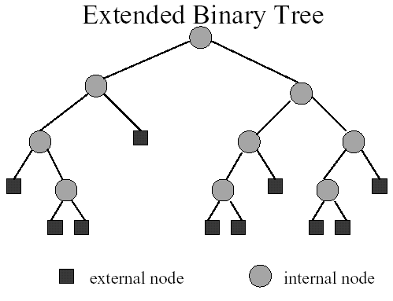

Slide 69
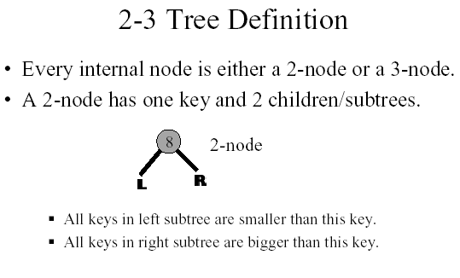

Slide 70
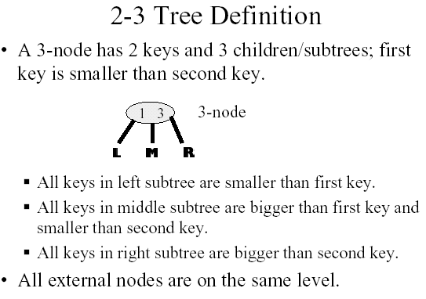

Slide 71
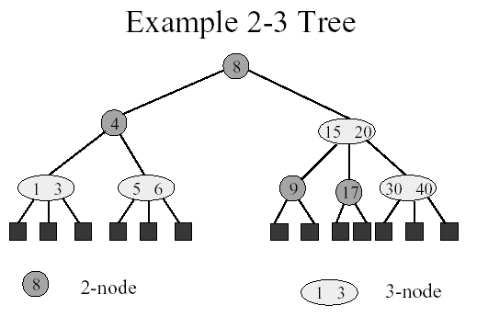

Slide 72
2-3 Tree vs. Binary Tree
A 2-3 tree is not a binary tree since a node in the 2-3 tree can have three children.
A 2-3 tree does resemble a full binary tree.
If a 2-3 tree does not contain 3-nodes, it is like a full binary tree since all its internal nodes have two children and all its leaves are at the same level.

Slide 73
Cont.
If a 2-3 tree does have three children, the tree will contain more nodes than a full binary tree of the same height.
Therefore, a 2-3 tree of height h has at least 2^h - 1 nodes.
In other words, a 2-3 tree with N nodes never has height greater then log (N+1), the minimum height of a binary tree with N nodes.

Slide 74
Example of a 2-3 Tree
The items in the 2-3 are ordered by their search keys.
50 90
20
70
120 150
10
30 40
60
80
100 110
160

Slide 75
Node Representation of 2-3 Trees
Using a typedef statement
typedef treeNode* ptrType;
struct treeNode
{ treeItemType SmallItem,LargeItem;
ptrType LChildPtr, MChildPtr,
RChildPtr;
};

Slide 76
Node Representation of 2-3 Tree (cont.)
When a node contains only one data item, you can place it in Small-Item and use LChildPtr and MChildPtr to point to the node’s children.
To be safe, you can place NULL in RChildPtr.

Slide 77
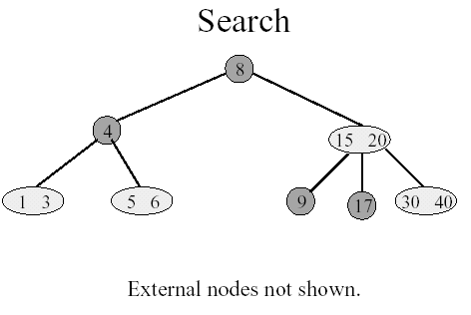

Slide 78
The Advantages of the 2-3 trees
Even though searching a 2-3 tree is not more efficient than searching a binary search tree, by allowing the node of a 2-3 tree to have three children, a 2-3 tree might be shorter than the shortest possible binary search tree.
Maintaining the balance of a 2-3 tree is relatively simple than maintaining the balance of a binary search tree .

Slide 79
Consider the two trees contain the same data items.
50
60
30
90
30
70 90
10
50
80
100
10 20
40
60
80
100
20
40
70
A balanced binary search tree
A 2-3 tree

Slide 80
Inserting into a 2-3 Tree
Perform a sequence of insertions on a 2-3 tree is more easilier to maintain the balance than in binary search tree.
Example:

Slide 81
60
30
90
10
50
80
100
20
40
70
110
39
38
37
36
35
1) The binary search tree after a sequence of
insertions
34

Slide 82
38
34
60
20
36
40
80 100
10
30
35
37
39
50
70
90
110
2) The 2-3 tree after the same insertions.

Slide 83
Inserting into a 2-3 Tree (cont.)
Insert 39. The search for 39 terminates at the leaf <40>. Since this node contains only one item, can siply inser the new item into this node
50
30
70 90
10 20
39
40
60
80
100

Slide 84
Inserting into a 2-3 Tree (cont.)
Insert 38: The search terminates at <39 40>. Since a node cannot have three values, we divide these three values into smallest(38), middle(39), and largest(40) values. Now, we move the (39) up to the node’s parent.
30
39
10 20
38
40

Slide 85
Inserting into a 2-3 Tree (cont.)
Insert 37: It’s easy since 37 belongs in a leaf that currently contains only one values, 38.
30 39
10 20
37
38
40

Slide 86
The Insertion Algorithm
To insert an item I into a 2-3 tree, first locate the leaf at which the search for I would terminate.
Insert the new item I into the leaf.
If the leaf now contains only two items, you are done. If the leaf contains three items, you must split it.

Slide 87
The Insertion Algorithm (cont.)
Spliting a leaf
a)
P
M P
S M L
S
L
b)
P
P M
S M L
S
L

Slide 88
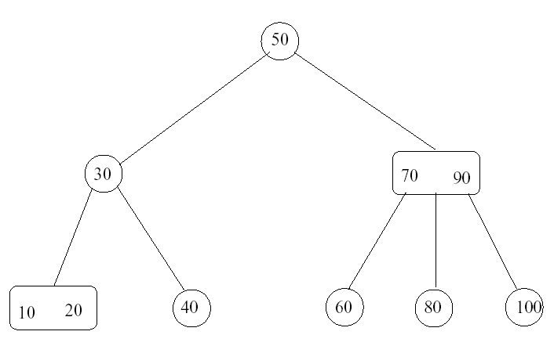
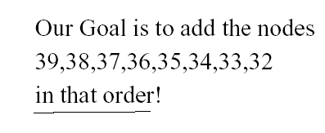

Slide 89
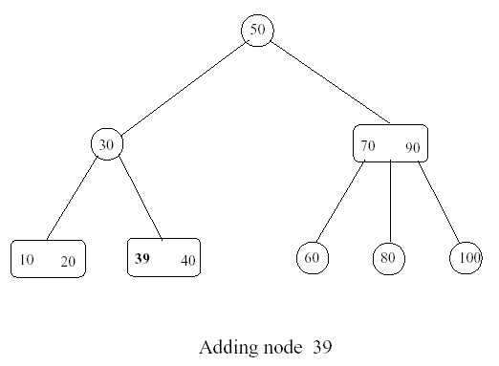
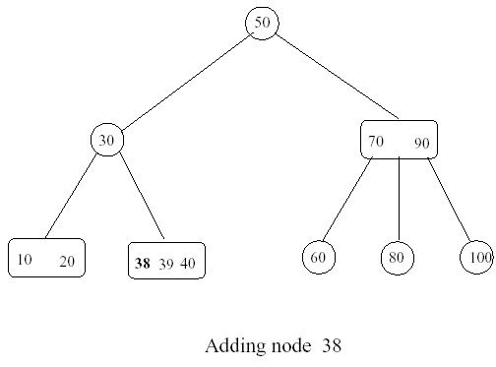

Slide 90
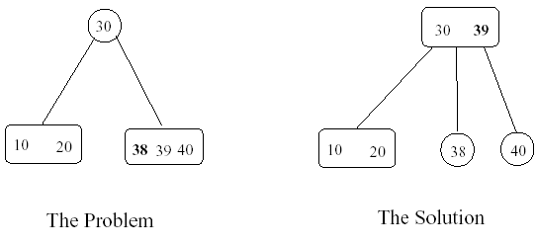
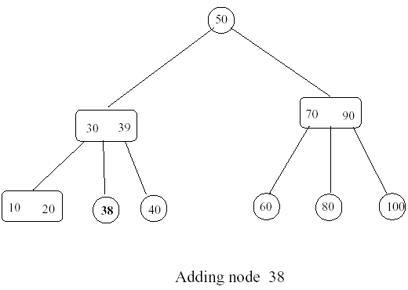

Slide 91
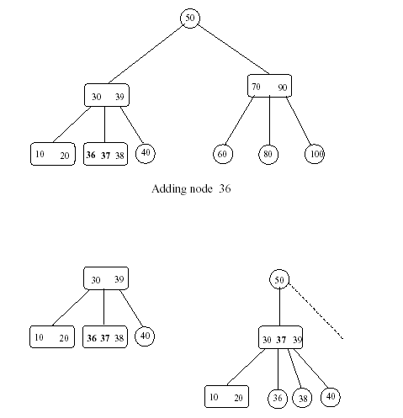

Slide 92
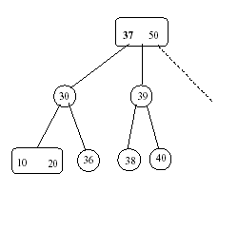
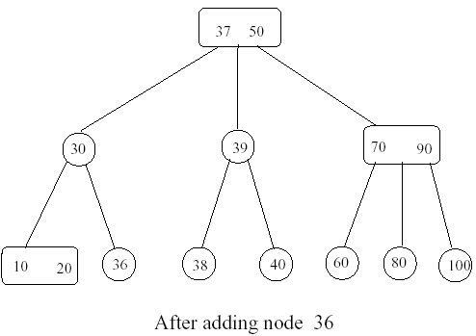

Slide 93
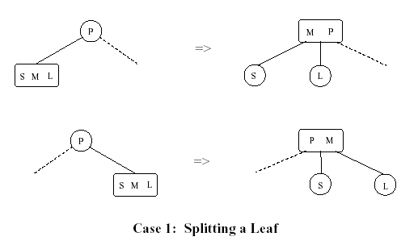

Slide 94
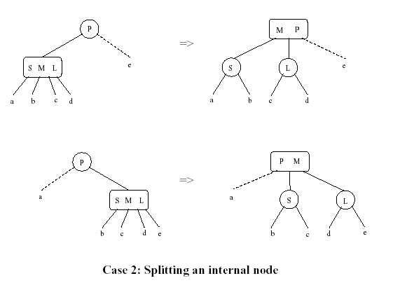

Slide 95
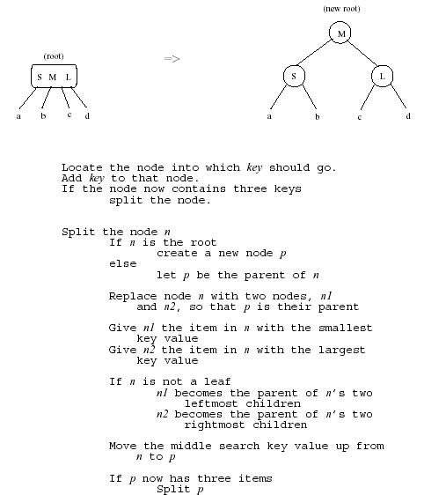

Slide 96
Deleting from a 2-3 Tree
The deletion strategy for a 2-3 tree is the inverse of its insertion strategy. Just as a 2-3 tree spreads insertions throughout the tree by splitting nodes when they become too full, it spreads deletions throughout the tree by merging nodes when they become empty.
Example:

Slide 97
Deleting from a 2-3 Tree (cont.)
Delete 70
80 90
80 90
60
70
100
60
-
100
Swap with inorder successor
Delete value from leaf
80 90
90
60
100
60 80
100
Merge nodes by deleting empty leaf and moving 80 down

Slide 98
Deleting from 2-3 Tree (cont.)
Delete 70
50
30
90
40
60 80
100
10 20

Slide 99
Deleting from 2-3 Tree (cont.)
Delete 100
90
90
80
60 80
--
60
80
60
90
60 80
Delete value from leaf
Doesn’t work
Redistribute

Slide 100
Red Black Trees
Red-black trees are tress that conform to the following rules:
Every node is colored (either red or black)
The root is always black
If a node is red, its children must be black
Every path from the root to leaf, or to a null child, must contain the same number of black nodes.
Every path from the root to leaf, cannot have two consecutive red nodes
During insertions and deletions, these rules must be maintained

Slide 101
Example Red Black Tree
10
7
40
45
3
8
30
35
60
1
5
20
25

Slide 102
Example Red Black Tree
10
7
40
45
3
8
30
35
60
1
5
20
25

Slide 103
Red-black Insertion Algorithm
current node = root node
parent = grandParent = null
While current <> null
If current is black, and current’s children are red
Change current to red (If current<>root) and current’s children to black
Call rotateTree()
grandParent = parent
parent = current
current is set to the child node in the binary search sequence
If parent is null
root = node to insert; color it black
Else Connect the node to insert to the leaf node; color it red
Call rotateTree()

Slide 104
Rotate Tree() Algorithm
If current <> root and Parent is red
If current is an outer child of the grandParent node
Set color of grandParent node to red
Set color of parent node to black
Raise current by rotating parent with grandParent
If current is an inner child of the grandParent node
Set color of grandParent node to red
Set color of current to black
Raise current by rotating current with parent
Raise current by rotating current with grandParent node

Slide 105
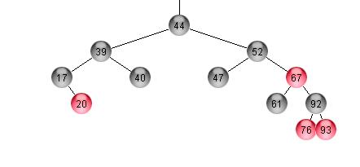
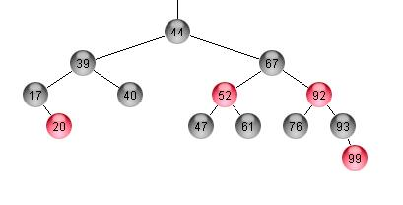
Red Black Example
Before adding 99
After adding 99
Note: Color change at 92 led to an outer rotation involving 52, 67, 92

Slide 106
Red Black Deletion
A standard Binary Search Tree removal reduces to removing a node with less than two children
If a node with a single child is black, change the child’s color to black. Then simply connect the child to the parent
Leafs can be red or black. If red, simply remove it. If black, removal causes an imbalance of black nodes, which must be restored.
Weapons at our disposal
Color flips
Traversal upward
Rotations

Slide 107
Red Black Deletion (cont.)
Explanation
The general case
X, Y, Z represent sub-trees
Path from P to the left has K black nodes; the path to the right has K+1 black nodes
P is the parent node, S is the sibling node (A sibling must exist, because of step 2)
To restore balance
Case A: IF Head of X is red; turn it black
Case B: IF S black with red children; rotate
Case C: IF S black with no red children
IF P red, set P black and S red
ELSE color S red restoring balance. Traversal up because both paths now have only K black nodes
Case D: IF S red, perform one rotate, two if one or three of S's grandchildren are red.
P
K black nodes
K+1 black nodes
X
S
Y
Z

Slide 108
Example
Case B (Balance Restored)
P
S
S
X
P
G
G
Y
X
Y
Z
Q
Z
Q
Note: P=parent, S=sibling, G = grandchild, Green node can be either black or red

Slide 109
Case D Examples
Case D (An S grandchild is red)
Case D (An S grandchild is red)
P
S
G
P
P
G
P
S
S
S
X
X
X
A
X
Y
G
G
G
B
G
G
G
Z
Q
Y
Z
Q
Q
A
B
Q
Y
Z
Y
Z
A
B
A
B
Note: These examples require another rotation because a double red occurs

Slide 110
Another Case D Example
Case D (All of S's Grandchildren are Red)
Balance has been restored
P
G
S
P
S
X
G
G
X
G
B
A
C
D
A
B
E
F
G
H
C
D
E
F
G
H

Slide 111
Which algorithm is best?
Advantages
AVL: relatively easy to program. Insert requires only one rotation.
Splay: No extra storage, high frequency nodes near the top
RedBlack: Fastest in practice, no traversal back up the tree on insert
Disadvantages
AVL: Repeated rotations are needed on deletion, must traverse back up the tree.
SPLAY: Can occasionally have O(N) finds, multiple rotates on every search
RedBlack: Multiple rotates on insertion, delete algorithm difficult to understand and program

Slide 112
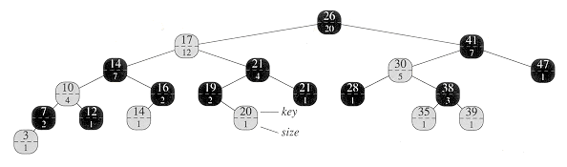
Augmenting Red Black Tree
augmented red-black tree is an order-statistic tree. Shaded nodes are red, and darkened nodes are black. In addition to its usual fields, each node x has a field size[x], which is the number of nodes in the subtree rooted at x.

Slide 113
Determining the rank of an element
OS-RANK(T,x)
1 r = size[left[x]] + 1
2 y = x
3 while y != root[T]
4 do if y = right[p[y]]
5 then r = r + size[left[p[y]]] + 1
6 y = p[y]
7 return r

Slide 114
Retrieving an element with a given rank
OS-SELECT(x,i) //x is start node i is rank
1 r = size[left[x]] + 1 // r is rank of current node
2 if i = r
3 then return x
4 elseif i < r
5 then return OS-SELECT(left[x],i)
6 else return OS-SELECT(right[x],i - r)

Slide 115
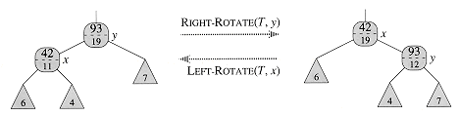
Maintaining subtree sizes
Updating subtree sizes during rotations. The two size fields that need to be updated are the ones incident on the link around which the rotation is performed. The updates are local, requiring only the size information stored in x, y, and the roots of the subtrees shown as triangles.

Slide 116
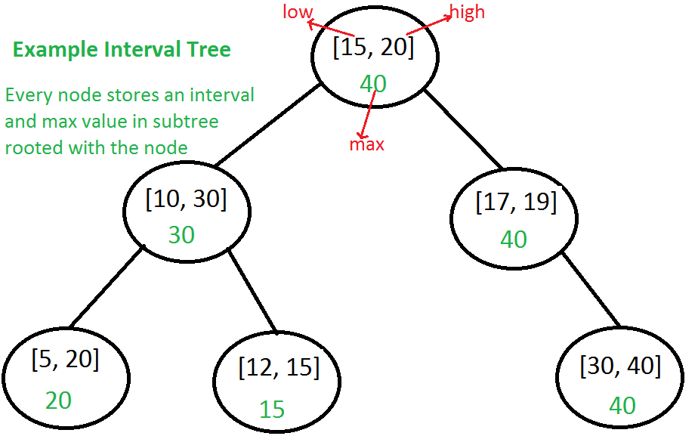
Interval tree
Every node of Interval Tree stores following information. a) i: An interval which is represented as a pair [low, high] b) max: Maximum high value in subtree rooted with this node.

Slide 117
Interval tree algo
Case 1: When we go to right subtree, one of the following must be true. a) There is an overlap in right subtree: This is fine as we need to return one overlapping interval. b) There is no overlap in either subtree: We go to right subtree only when either left is NULL or maximum value in left is smaller than x.low. So the interval cannot be present in left subtree.
Case 2: When we go to left subtree, one of the following must be true. a) There is an overlap in left subtree: This is fine as we need to return one overlapping interval. b) There is no overlap in either subtree: This is the most important part. We need to consider following facts. … We went to left subtree because x.low <= max in left subtree …. max in left subtree is a high of one of the intervals let us say [a, max] in left subtree. …. Since x doesn’t overlap with any node in left subtree x.low must be smaller than ‘a‘. …. All nodes in BST are ordered by low value, so all nodes in right subtree must have low value greater than ‘a‘. …. From above two facts, we can say all intervals in right subtree have low value greater than x.low. So x cannot overlap with any interval in right subtree.

Slide 118
Applications of Interval Tree:
Interval tree is mainly a geometric data structure and often used for windowing queries, for instance, to find all roads on a computerized map inside a rectangular viewport, or to find all visible elements inside a three-dimensional scene

Slide 119
Disjoint-set data structure
a disjoint-set data structure, also called a union–find data structure or merge–find set, is a data structure that keeps track of a set of elements partitioned into a number of disjoint (nonoverlapping) subsets. It supports two useful operations:
Find: Determine which subset a particular element is in. Find typically returns an item from this set that serves as its "representative"; by comparing the result of two Find operations, one can determine whether two elements are in the same subset.
Union: Join two subsets into a single subset.
MakeSet, which makes a set containing only a given element (a singleton), is generally trivial. With these three operations, many practical partitioning problems can be solved

Slide 120
Disjoint Sets
Suppose we have N distinct items. We want to partition the items into a collection of sets such that:
each item is in a set
no item is in more than one set
Examples
B.Tech students according to majors, or
B.Tech students according to GPA, or
The resulting sets are said to be disjoint sets.
Notes:
Example: student records
s1 = set of students with 0< GPA <= 1
s2 = set of students with 1 < GPA <= 2
etc
Question: Are x and y in the same set? Yes, if find(x) == find(y).

Slide 121
Disjoint sets
Set : a collection of (distinguishable) elements
Two sets are disjoint if they have no common elements
Disjoint-set data structure:
maintains a collection of disjoint sets
each set has a representative element
supported operations:
MakeSet(x)
Find(x)
Union(x,y)

Slide 122
Disjoint sets
MakeSet(x)
Given object x, create a new set whose only element (and representative) is pointed to by x
Find(x)
Given object x, return (a pointer to) the representative of the set containing x
Assumption: there is a pointer to each x so we never have to look for an element in the structure

Slide 123
Disjoint sets
Union(x,y)
Given two elements x, y, merge the disjoint sets containing them.
The original sets are destroyed.
The new set has a new representative (usually one of the representatives of the original sets)
At most n-1 Unions can be performed where n is the number of elements (why?)

Slide 124
Union-Find Problem
Given a set {1, 2, …, n} of n elements
Initially each element is in a different set
{1}, {2}, …, {n}
An intermixed sequence of union and find operations is performed
A union operation combines two sets into one
Each of the n elements is in exactly one set at any time
Can be proven by induction
A find operation identifies the set that contains a particular element
Notes:
Application of trees (not binary trees) and simulated pointers. Simple application of simulated pointers; one that does not require an explicit storage management system.
In this application we are concerned with the time taken to perform an intermixed sequence of operations rather than the time for an individual operation.

Slide 125
Set representation : Disjoint-set linked lists
A simple disjoint-set data structure uses a linked list for each set.
MakeSet creates a list of one element. Union appends the two lists
The drawback of this implementation is that Find requires O(n) or linear time to traverse the list backwards from a given element to the head of the list.
This can be avoided by including a pointer to the head of the list; then Find takes constant time
However, Union now has to update each element of the list being appended to make it point to the head of the new combined list, requiring Ω(n) time.
When the length of each list is tracked, the required time can be improved by always appending the smaller list to the longer.
Using this weighted-union heuristic, a sequence of m MakeSet, Union, and Find operations on n elements requires O(m + nlog n) time.

Slide 126
Disjoint Sets:Implementation #1
Using linked lists:
The first element of the list is the representative
Each node contains:
an element
a pointer to the next node in the list
a pointer to the representative

Slide 127
Disjoint Sets: Implementation#1
Using linked lists:
MakeSet(x)
Create a list with only one node, for x
Time O(1)
Find(x)
Return the pointer to the representative (assuming you are pointing at the x node)
Time O(1)

Slide 128
Disjoint Sets:Implementation#1
Using linked lists:
Union(x,y)
. Append y’s list to x’s list.
. Pick x as a representative
. Update y’s “representative” pointers
A sequence of m operations may take O(m²) time
Improvement: let each representative keep track of the length of its list and always append the shorter list to the longer one.
Now, a sequence of m operations takes O(m+nlgn) time (why?)

Slide 129
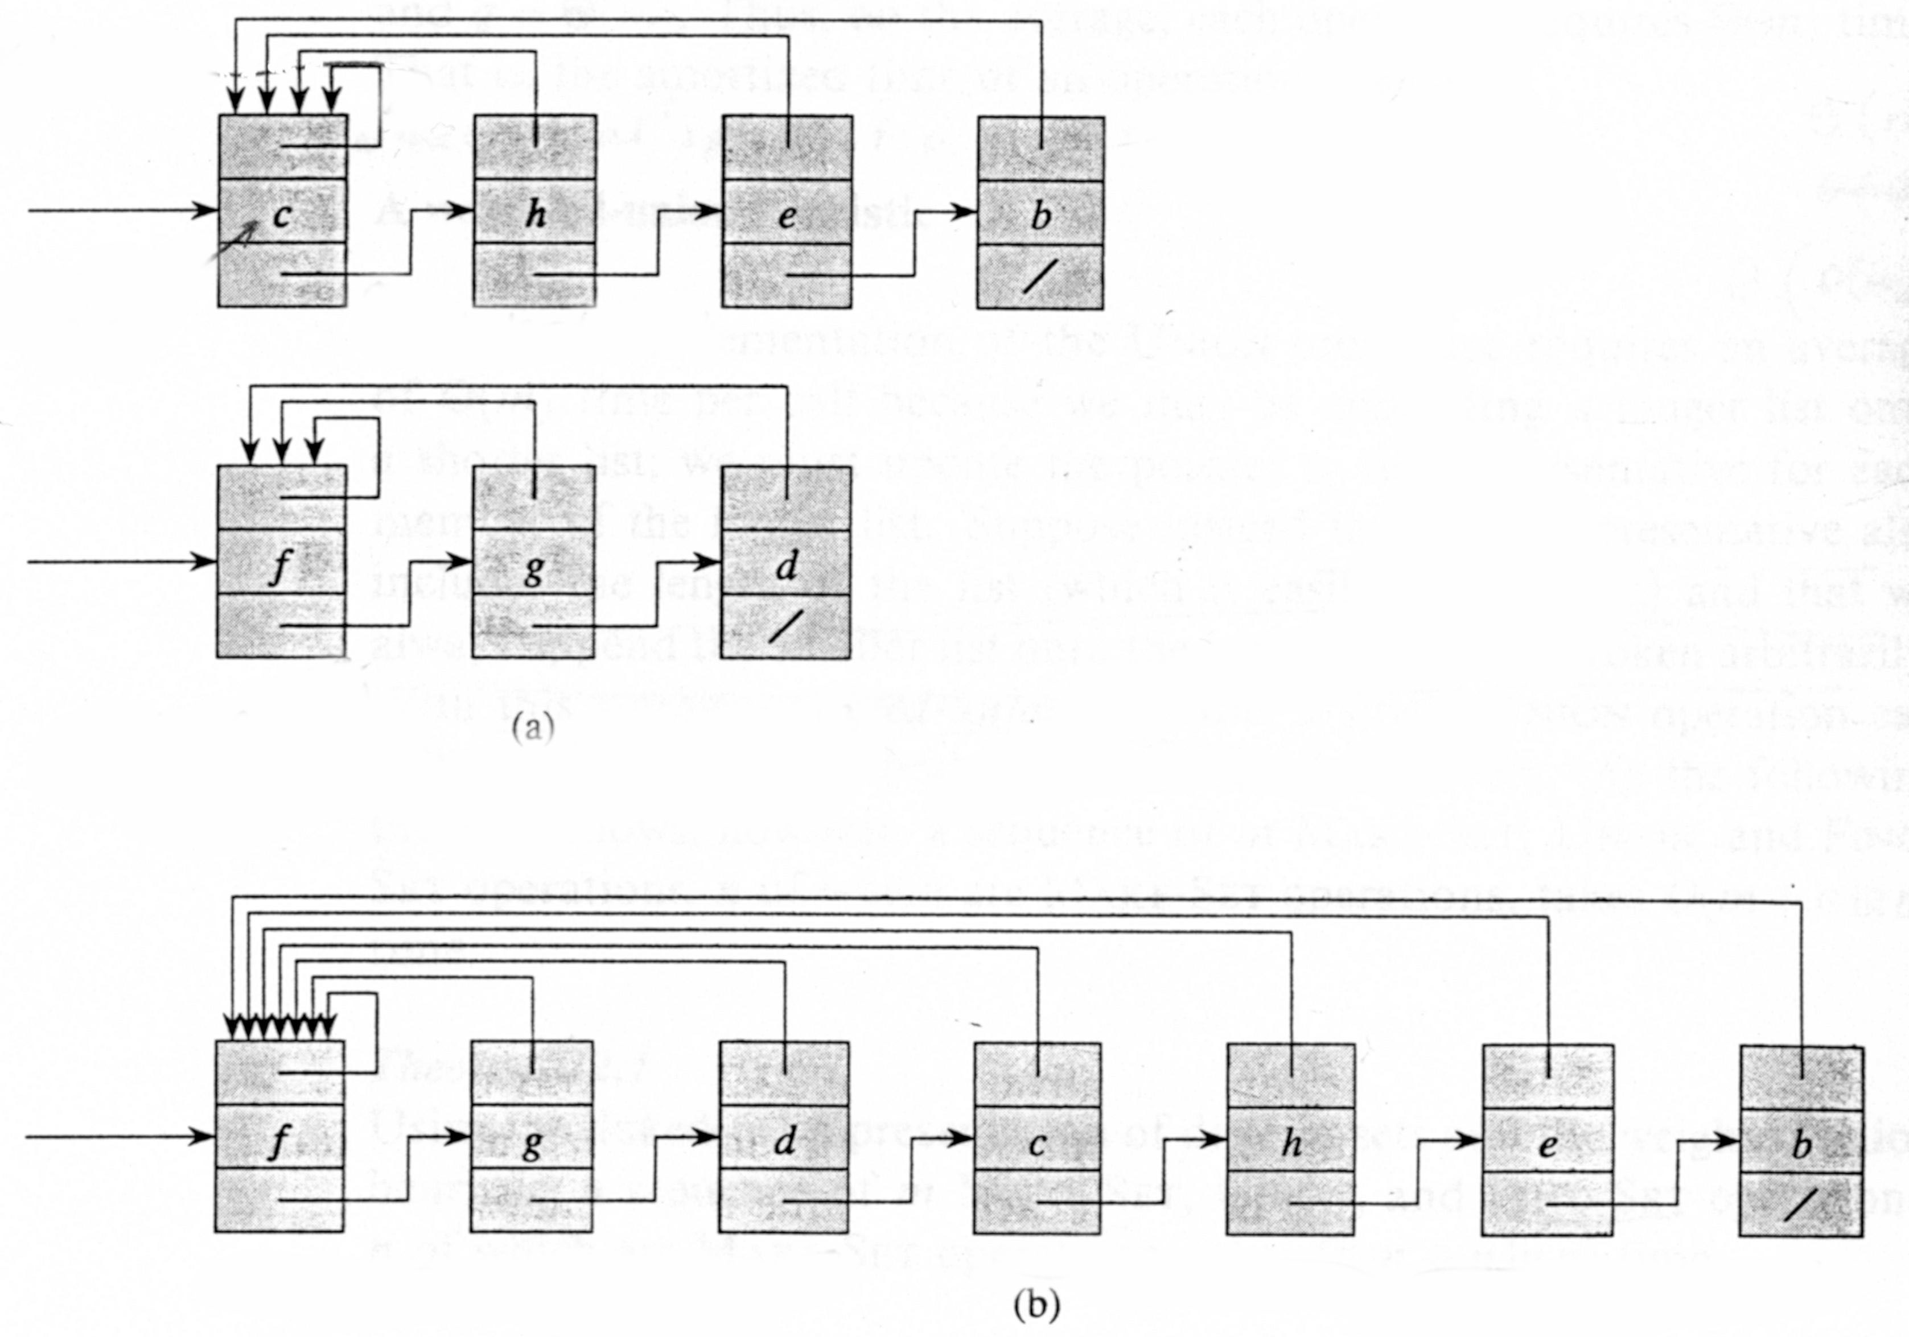
Linked-list Representation Of Disjoint Sets
It’s a simple way to implement a disjoint-set data structure by representing each set, in this case set x, and set y, by a linked list.
Set x
Set y
The total time spent using this representation is Theta(m^2).
Result of UNION (x,y)

Slide 130
Disjoint Sets:Implementation#1 An Improvement
Let each representative keep track of the length of its list and always append the shorter list to the longer one.
Theorem: Any sequence of m operations takes O(m+n log n) time.

Slide 131
Disjoint Sets:Implementation#2
Using arrays:
Keep an array of size n
Cell i of the array holds the representative of the set containing i.
Similar to lists, simpler to implement.

Slide 132
Set representation : Disjoint-set forests
Disjoint-set forests are data structures where each set is represented by a tree data structure, in which each node holds a reference to its parent node
In a disjoint-set forest, the representative of each set is the root of that set's tree.
Find follows parent nodes until it reaches the root.
Union combines two trees into one by attaching the root of one to the root of the other.

Slide 133
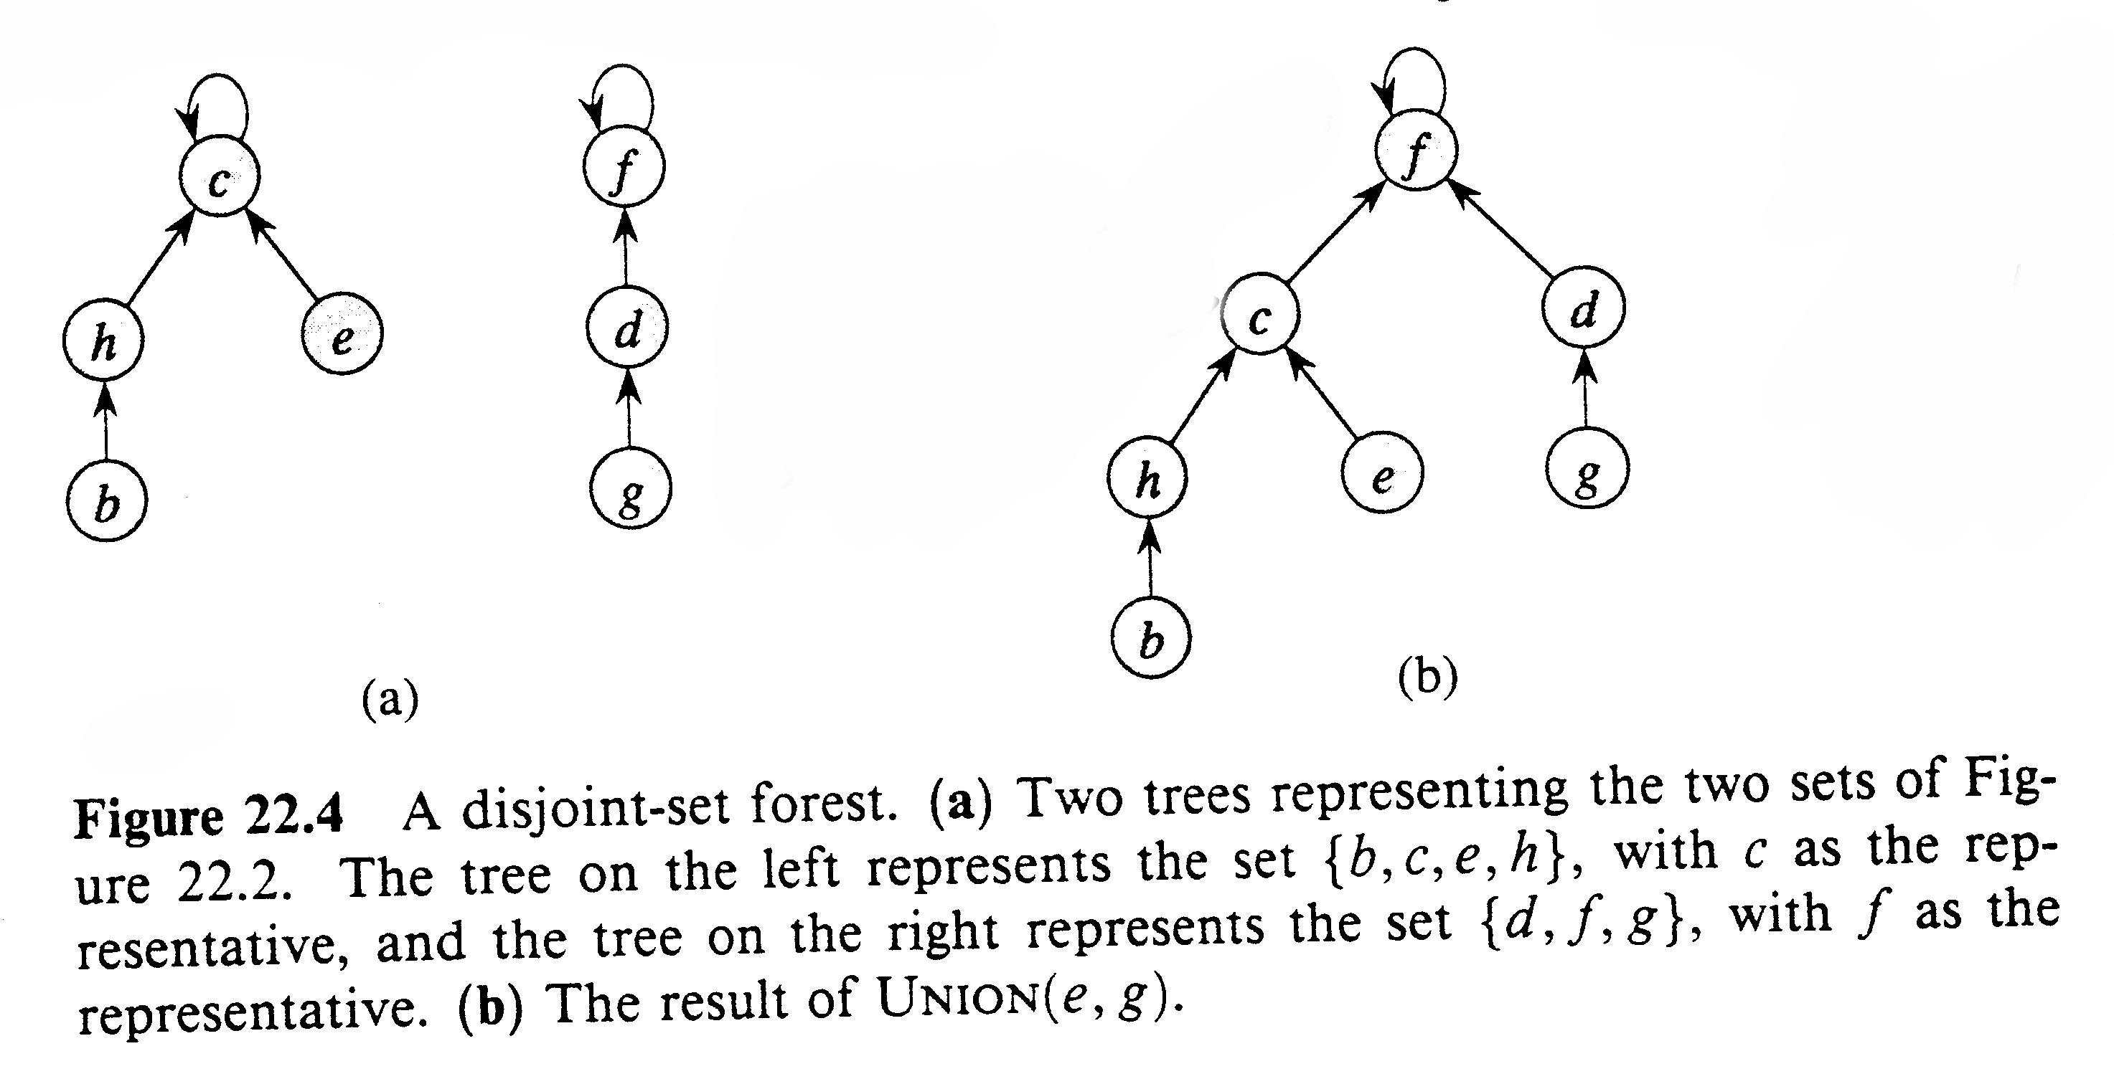
Disjoint-set Forest Representation
It’s a way of representing sets by rooted trees, with each node containing one member, and each tree representing one set.
The running time using this representation is linear for all practical purposes but is theoretically superlinear.

Slide 134
Up-Trees
A simple data structure for implementing disjoint sets forests is the up-tree.
H
X
A
W
F
B
R
H, A and W belong to the same set. H is the representative
X, B, R and F are in the same set. X is the representative

Slide 135
A Set As A Tree
S = {2, 4, 5, 9, 11, 13, 30}
Some possible tree representations:
4
5
13
2
9
11
30
5
13
4
11
13
2
4
5
9
9
11
30
30
2

Slide 136
Operations in Up-Trees
Find is easy. Just follow pointer to representative element. The representative has no parent.
find(x)
if (parent(x) exists)// not the root return(find(parent(x));
else return (x);
Worst case, height of the tree
Notes:
Example:
V={a,b,c,d}, E ={}
union(a,b)
union(c,a)
union(d,c)

Slide 137
Steps For find(i)
13
4
5
9
11
30
2
Start at the node that represents element i and climb up the tree until the root is reached
Return the element in the root
To climb the tree, each node must have a parent pointer

Slide 138
Result Of A Find Operation
find(i) is to identify the set that contains element i
In most applications of the union-find problem, the user does not provide set identifiers
The requirement is that find(i) and find(j) return the same value iff elements i and j are in the same set
4
2
9
11
30
5
13
find(i) will return the element that is in the tree root

Slide 139
Possible Node Structure
Use nodes that have two fields: element and parent
Use an array table[] such that table[i] is a pointer to the node whose element is i
To do a find(i) operation, start at the node given by table[i] and follow parent fields until a node whose parent field is null is reached
Return element in this root node

Slide 140
Example
13
4
5
9
11
30
2
1
table[]
0
5
10
15
(Only some table entries are shown.)

Slide 141
Better Representation
Use an integer array parent[] such that parent[i] is the element that is the parent of element i
13
4
5
9
11
30
2
1
parent[]
2
9
13
13
4
5
0
0
5
10
15

Slide 142
Union
Union is more complicated.
Make one representative element point to the other, but which way? Does it matter?
In the example, some elements are now deeper away from the root

Slide 143
Union(H, X)
H
X
F
X points to H
B, R and F are now deeper
A
W
B
R
H
X
F
H points to X
A and W are now deeper
A
W
B
R

Slide 144
Union
public union(rootA, rootB)
{parent[rootB] = rootA;}
Time Complexity: O(1)

Slide 145
A worse case for Union
Union can be done in O(1), but may cause find to become O(n)
A
B
C
D
E
Consider the result of the following sequence of operations:
Union (A, B) Union (C, A) Union (D, C) Union (E, D)

Slide 146
Two Heuristics
There are two heuristics that improve the performance of union-find.
Union by weight or height
Path compression on find

Slide 147
Height Rule
Make tree with smaller height a subtree of the other tree
Break ties arbitrarily
13
7
4
5
8
3
22
6
9
11
30
2
10
1
union(7,13)
20
16
14
12

Slide 148
Weight Rule
Make tree with fewer number of elements a subtree of the other tree
Break ties arbitrarily
7
13
8
3
22
6
4
5
9
10
11
30
2
20
16
14
12
1
union(7,13)

Slide 149
Implementation
Root of each tree must record either its height or the number of elements in the tree.
When a union is done using the height rule, the height increases only when two trees of equal height are united.
When the weight rule is used, the weight of the new tree is the sum of the weights of the trees that are united.

Slide 150
Height Of A Tree
If we start with single element trees and perform unions using either the height or the weight rule. The height of a tree with p elements is at most floor (log₂p) + 1.
Proof is by induction on p.

Slide 151
Union by Weight Heuristic
Always attach smaller tree to larger.
union(x,y)
rep_x = find(x);
rep_y = find(y);
if (weight[rep_x] < weight[rep_y])
A[rep_x] = rep_y;
weight[rep_y] += weight[rep_x];
else
A[rep_y] = rep_x;
weight[rep_x] += weight[rep_y];
Notes:
Example:
before: -1, 0, 0, -1, 3
union(0,3)
after: -1, 0, 0, 0, 3

Slide 152
Performance w/ Union by Weight
If unions are done by weight, the depth of any element is never greater than log n + 1.
Inductive Proof:
Initially, ever element is at depth zero.
When its depth increases as a result of a union operation (it’s in the smaller tree), it is placed in a tree that becomes at least twice as large as before (union of two equal size trees).
How often can each union be done? -- lg n times, because after at most lg n unions, the tree will contain all n elements.
Therefore, find becomes O(log n) when union by weight is used -- even without path compression.
Notes:
Mathematical proof available in Tom A’s notes

Slide 153
Path Compression
Each time we do a find on an element E, we make all elements on path from root to E be immediate children of root by making each element’s parent be the representative.
find(x)
if (A[x]<0)
return(x);
A[x] = find(A[x]);
return (A[x]);
When path compression is done, a sequence of m operations takes O(m log n) time. Amortized time is O(log n) per operation.
Notes:
Example:
Starting array: -1, -1, -1, -1, -1, 4, 4, 6
find(7)
find(6)
find(4)
resulting array: -1, -1, -1, -1, -1, 4, 4, 4

Slide 154
Path Compression
7
13
8
3
22
6
4
5
9
f
g
10
11
30
2
e
d
20
16
14
12
1
a, b, c, d, e, f, and g are subtrees
a
b
c
find(1)
Do additional work to make future finds easier

Slide 155
Path Compression
Make all nodes on find path point to tree root.
find(1)
7
13
8
3
22
6
4
5
9
g
10
f
11
30
e
2
20
16
14
12
d
1
a, b, c, d, e, f, and g are subtrees
a
b
c
Makes two passes up the tree

Slide 156
Ackermann’s Functions
The Ackermann’s function is the simplest example of a well-defined total function which is computable but not primitive recursive.
"A function to end all functions" -- Gunter Dötzel.
1. If m = 0 then A(m, m) = m + 1
2. If n = 0 then A(m, n) = A(m-1, 1)
3. Otherwise, A(m, n) = A(m-1, A(m, n-1))
The function f(n) = A(n, n) grows much faster than polynomials or exponentials or any function that you can imagine

Slide 157
Ackermann’s Function
Ackermann’s function.
A(m,n) = 2^{n}, m = 1 and n >= 1
A(m,n) = A(m-1,2), m>= 2 and n = 1
A(m,n) = A(m-1,A(m,n-1)), m,n >= 2
Ackermann’s function grows very rapidly as m and n increase
A(2,4) = 2^{65,536}

Slide 158
Time Complexity
Inverse of Ackermann’s function.
α(n) = min{k>=1 | A(k,1) > n},
The inverse function grows very slowly
α(n) < 5 until n = 2^{A(4,1)} + 1
A(4,1) >> 10⁸⁰
For all practical purposes, α (n) < 5

Slide 159
Time Complexity
Theorem 12.2 [Tarjan and Van Leeuwen]
Let T(n,m) be the maximum time required to process any intermixed sequence of n finds and unions.
T(n,m) = O(m α (n))
when we start with singleton sets and use either the weight or height rule for unions and any one of the path compression methods for a find.

Slide 160
Applications
Disjoint-set data structures model the partitioning of a set, for example to keep track of the connected components of an undirected graph.
This model can then be used to determine whether two vertices belong to the same component, or whether adding an edge between them would result in a cycle.
The Union–Find algorithm is used in high-performance implementations of unification.
This data structure is used by the Boost Graph Library to implement its Incremental Connected Components functionality. It is also used for implementing Kruskal's algorithm to find the minimum spanning tree of a graph.
Note that the implementation as disjoint-set forests doesn't allow deletion of edges—even without path compression or the rank heuristic.

Slide 161
The Dictionary ADT
Definition A dictionary is an ordered or unordered list of key-element pairs,
where keys are used to locate elements in the list.
Example: consider a data structure that stores bank accounts; it can be viewed as a dictionary, where account numbers serve as keys for identification of account objects.

Slide 162
Operations (methods) on dictionaries:
size () Returns the size of the dictionary
empty () Returns true is the dictionary is empty
findItem (key) Locates the item with the specified key. If no such key exists, sentinel value NO_SUCH_KEY is returned. If more than one item with the specified key exists, an arbitrary item is returned.
findAllItems (key) Locates all items with the specified key. If no such key exists, sentinel value NO_SUCH_KEY is returned.
removeItem (key) Removes the item with the specified key
removeAllItems (key) Removes all items with the specified key
insertItem (key, element) Inserts a new key-element pair

Slide 163
Additional methods for ordered dictionaries
closestKeyBefore (key) Returns the key of the item with largest key
less than or equal to key
closestElemBefore (key) Returns the element for the item with largest
key less than or equal to key
closestKeyAfter (key) Returns the key of the item with smallest
key greater than or equal to key
closestElemAfter (key) Returns the element for the item with smallest
key greater than or equal to key
Sentinel value NO_SUCH_KEY is always returned if no item in the dictionary
satisfies the query.
Note Java has a built-in abstract class java.util.Dictionary In this class,
however, having two items with the same key is not allowed. If an application
assumes more than one item with the same key, an extended version of the
Dictionary class is required.

Slide 164
Example of unordered dictionary
Consider an empty unordered dictionary and the following set of operations:
Operation Dictionary Output
insertItem(5,A) {(5,A)}
insertItem(7,B) {(5,A), (7,B)}
insertItem(2,C) {(5,A), (7,B), (2,C)}
insertItem(8,D) {(5,A), (7,B), (2,C), (8,D)}
insertItem(2,E) {(5,A), (7,B), (2,C), (8,D), (2,E)}
findItem(7) {(5,A), (7,B), (2,C), (8,D), (2,E)} B
findItem(4) {(5,A), (7,B), (2,C), (8,D), (2,E)} NO_SUCH_KEY
findItem(2) {(5,A), (7,B), (2,C), (8,D), (2,E)} C
findAllItems(2) {(5,A), (7,B), (2,C), (8,D), (2,E)} C, E
size() {(5,A), (7,B), (2,C), (8,D), (2,E)} 5
removeItem(5) {(7,B), (2,C), (8,D), (2,E)} A
removeAllItems(2) {(7,B), (8,D)} C, E
findItem(4) {(7,B), (8,D)} NO_SUCH_KEY

Slide 165
Example of ordered dictionary
Consider an empty ordered dictionary and the following set of operations:
Operation Dictionary Output
insertItem(5,A) {(5,A)}
insertItem(7,B) {(5,A), (7,B)}
insertItem(2,C) {(2,C), (5,A), (7,B)}
insertItem(8,D) {(2,C), (5,A), (7,B), (8,D)}
insertItem(2,E) {(2,C), (2,E), (5,A), (7,B), (8,D)}
findItem(7) {(2,C), (2,E), (5,A), (7,B), (8,D)} B
findItem(4) {(2,C), (2,E), (5,A), (7,B), (8,D)} NO_SUCH_KEY
findItem(2) {(2,C), (2,E), (5,A), (7,B), (8,D)} C
findAllItems(2) {(2,C), (2,E), (5,A), (7,B), (8,D)} C, E
size() {(2,C), (2,E), (5,A), (7,B), (8,D)} 5
removeItem(5) {(2,C), (2,E), (7,B), (8,D)} A
removeAllItems(2) {(7,B), (8,D)} C, E
findItem(4) {(7,B), (8,D)} NO_SUCH_KEY

Slide 166
Implementations of the Dictionary ADT
Dictionaries are ordered or unordered lists.
The easiest way to implement a list is by means of an ordered or unordered sequence.

Slide 167
Unordered sequence implementation
Items are added to the initially empty dictionary as they arrive. insertItem(key, element) method is O(1) no matter whether the new item is added at the beginning or at the end of the dictionary.
findItem(key), findAllItems(key), removeItem(key) and removeAllItems(key) methods, however, have O(n) efficiency. Therefore, this implementation is appropriate in applications where the number of insertions is very large in comparison to the number of searches and removals.

Slide 168
Ordered sequence implementation
Items are added to the initially empty
Dictionary in non decreasing order of their keys.
insertItem(key, element) method is O(n), because a search for the proper place of the item is required. If the sequence is implemented as an ordered array,
removeItem(key) and removeAllItems(key) take O(n) time, because all items following the item removed must be shifted to fill in the gap. If the sequence is implemented as a doubly linked list , all methods involving search also take O(n) time.
Therefore, this implementation is inferior compared to unordered sequence implementation. However, the efficiency of the search operation can be considerably improved, in which case an ordered sequence implementation will become a better choice.

Slide 169
Implementations of the Dictionary ADT (contd.)
Array-based ranked sequence implementation
A search for an item in a sequence by its rank takes O(1) time. We can improve search efficiency in an ordered dictionary by using binary search; thus improving the run time efficiency of
insertItem(key, element),
removeItem(key) and
removeAllItems(key) to O(log n).

Slide 170
Implementations of the Dictionary ADT (contd.)
More efficient implementations of an ordered dictionary are
binary search trees
AVL trees
hash table

Slide 171
AVL trees
Definition An AVL tree is a binary tree with an ordering property where the
heights of the children of every internal node differ by at most 1.
Example
44 (4)
17 (2) 78 (3)
32 (1) 50 (2) 88 (1)
48 (1) 62 (1)
Note: 1. Every subtree of an AVL tree is also an AVL tree.
2. The height of an AVL tree storing n keys is O(log n).

Slide 172
Insertion of new nodes in AVL trees
Assume you want to insert 54 in our example tree.
Step 1: Search for 54 (as if it were a binary search tree), and find where the
search terminates unsuccessfully
44 (5)
17 (2) 78 (4)
These two children
32 (1) 50 (3) 88 (1) are unbalanced
48 (1) 62 (2)
54 (1)
Step 2: Restore the balance of the tree.

Slide 173
Rotation of AVL tree nodes
To restore the balance of the tree, we perform the following restructuring. Let z be the first
“unbalanced” node on the path from the newly inserted node to the root, y be the child of z
with higher height, and x be the child of y (x may be the newly inserted node). Since z became
unbalanced because of the insertion in the subtree rooted at its child y, the height of y is 2
greater than its sibling.
Let us rename nodes x, y, and z as a, b, and c, such that a precedes b and b precedes c in
inorder traversal of the currently unbalanced tree. There are 4 ways to map x, y, and z to
a, b, and c, as follows:
z = a
y = b y = b
T0
x = c z = a x = c
T1
T2 T3 T0 T1 T2 T3

Slide 174
Rotation of AVL tree nodes (contd.)
z = c
y = b y = b
x = a T3 x = a z = c
T2
T0 T1 T0 T1 T2 T3
z = a
y = c x = b
T0 x = b z = a y = c
T3
T1 T2 T0 T1 T2 T3

Slide 175
Rotation of AVL tree nodes (contd.)
z = c
y = a x = b
x = b T3 y = a z = c
T0
T1 T2 T0 T1 T2 T3
Replace the subtree rooted at z with a new subtree rooted at b.

Slide 176
The restructure algorithm
Algorithm restructure(x):
Input: A node x that has a parent node y, and a grandparent node z.
Output: Tree involving nodes x, y and z restructured.
1. Let (a,b,c) be inorder listing of nodes x, y and z, and let (T0, T1, T2, T3) be
inorder listing of the four children subtrees of x,y, and z.
2. Replace the subtree rooted at z with a new subtree rooted at b.
3. Let a be the left child of b and let T0 and T1 be the left and right subtrees of
a, respectively.
4. Let c be the right child of b and let T2 and T3 be the left and right subtrees of
c, respectively.
If y = b, we have a single rotation, where y is rotated over z. If x = b, we have a
double rotation, where x is first rotated over y, and then over z.

Slide 177
Deletion of AVL tree nodes
Consider our example tree and assume that we want to delete 62.
44 (4)
17 (1) 78 (3)
50 (2) 88 (1)
48 (1) 62 (1)
Note: Search for the node to delete 62 is performed as in the binary search tree.
To restore the balance of the tree, we may have to perform more than one rotation
when we move towards the root (one rotation may not be sufficient here).

Slide 178
Deletion of AVL tree nodes (contd.)
After the restructuring of the tree rooted in node 44:
44 (4) z=a 50
17 (1) 78 (3) y=c 44 78
x=b 50 (2) 88 (1) 17 48 62 88
48 (1) 62 (1)

Slide 179
Implementation of unordered dictionaries: hash tables
Hashing is a method for directly referencing an element in a table by performing
arithmetic transformations on keys into table addresses. This is carried out in two
steps:
Step 1: Computing the so-called hash function H: K -> A.
Step 2: Collision resolution, which handles cases where two or more different keys
hash to the same table address.
K1
K2
K3
...
Kn
A1
A2
...
An

Slide 180
Implementation of hash tables
Hash tables consist of two components: a bucket array and a hash function.
Consider a dictionary, where keys are integers in the range [0, N-1]. Then, an array of size N can be used to represent the dictionary.
Each entry in this array is thought of as a “bucket”. An element e with key k is inserted in A[k]. Bucket entries associated with keys not present in the dictionary contain a special NO_SUCH_KEY object.
If the dictionary contains elements with the same key, then two or more different elements may be mapped to the same bucket of A. In this case, we say that a collision between these elements has occurred. One easy way to deal with collisions is to allow a sequence of elements with the same key, k, to be stored in A[k].
Assuming that an arbitrary element with key k satisfies queries findItem(k) and removeItem(k), these operations are now performed in O(1) time, while insertItem(k, e) needs only to find where on the existing list A[k] to insert the new item, e. The drawback of this is that the size of the bucket array is the size of the set from which key are drawn, which may be huge.

Slide 181
Hash functions
We can limit the size of the bucket array to almost any size; however, we must
provide a way to map key values into array index values. This is done by an
appropriately selected hash function, h(k). The simplest hash function is
h(k) = k mod N
where k can be very large, while N can be as small as we want it to be. That is,
the hush function converts a large number (the key) into a smaller number
serving as an index in the bucket array.
Example. Consider the following list of keys: 10, 20, 30, 40,..., 220.
Let us consider two different sizes of the bucket array:
(1) a bucket array of size 10, and
(2) a bucket array of size 11.

Slide 182
Example (contd.)
Case 1: Case 2:
Position Key Position Key
0 10, 20, 30,..., 220 0 110, 220
1 1 100, 210
2 2 90, 200
3 3 80, 190
4 4 70, 180
5 5 60, 170
6 6 50, 160
7 7 40, 150
8 8 30, 140
9 9 20, 130
10 10, 120

Slide 183
Example 2
Consider a dictionary of strings of characters from a to z. Assume that each
character is encoded by means of 5 bits, i.e.
character code
a 00001
b 00010
c 00011
d 00100
e 00101
......
k 01011
......
y 11001
Then, the string akey has the following code
(00001 01011 00101 11001)₂ = (44217)₁₀
Assume that our hash table has 101 buckets. Then,
h(44217) = 44217 mod 101 = 80
That is, the key of the string akey hashes to position 80. If you do the same with
the string barh, you will see that it hashes to the same position, 80.

Slide 184
Hash functions (contd.)
These examples suggest that if N is a prime number, the hash function helps spread out the distribution of hashed values.
If dictionary elements are spread fairly evenly in the hash table, the expected running times of operations findItem, insertItem and removeItem are O(n/N), where n is the number of elements in the dictionary, and N is the size of the bucket array.
These efficiencies are ever better, O(1), if no collision occurs (in which case only a call to the hash function and a single array reference are needed to insert or find an item).

Slide 185
Collision resolution
There are 2 main ways to perform collision resolution:
Open addressing.
Chaining.
In our examples, we have assumed that collision resolution is performed by
chaining, i.e. traversing the linked list holding items with the same key in order to
find the one we are searching for, or insert a new item with that key.
In open addressing we deal with collision by finding another, unoccupied location
elsewhere in the array. The easiest way to find such a location is called linear
probing. The idea is the following. If a collision occurs when we are inserting a
new item into a table, we simply probe forward in the array, one step at a time,
until we find an empty slot where to store the new item. When we remove an item,
we start by calculating the hash function and test the identified index location. If
the item is not there, we examine each array entry from the index location until:
(1) the item is found; (2) an empty location is encountered, or (3) the array end is
reached.

