Slide 1

United States Health Rankings Dashboard
Presented by: Manuel Cervantes, Ankita Gautam, Stephen Lane, Lorena Martinez, Joel Navarro

Slide 2
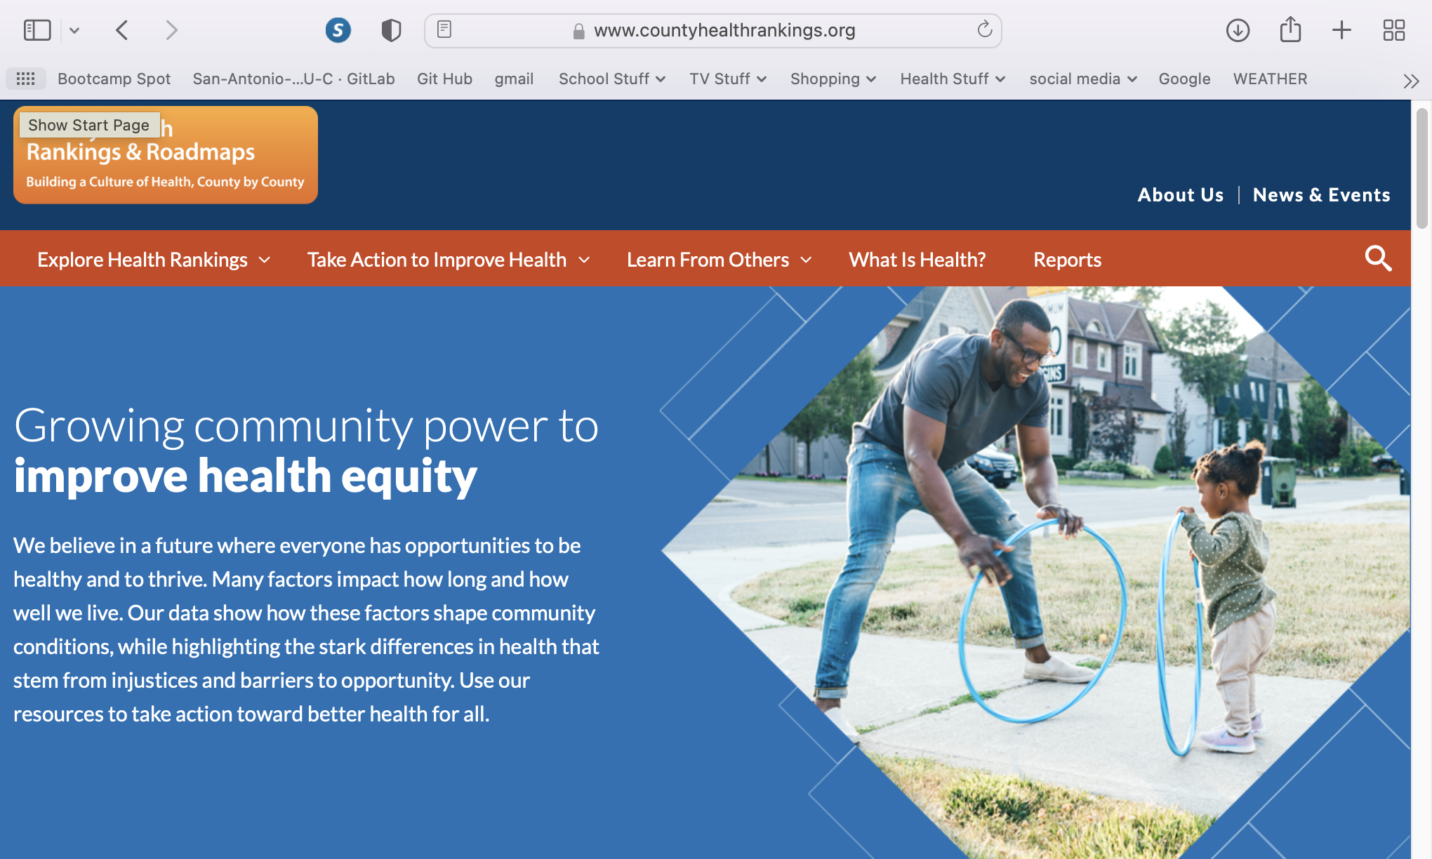
Data Source
County Health Rankings by University of Wisconsin Population Health Institute
https://www.countyhealthrankings.org/

Slide 3
Data munging techniques
Scraped data from website
Cleaned data using python
Extracted clean data to CSV files

Slide 4
Coding approach
CSV imported to Mongo DB to create Database and collection
Created API using Flask
HTML5 / CSS to create containers and elements
Javascript used to create visualizations
d3
AOS

Slide 5

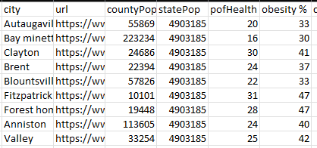

Slide 6
visualizations

Slide 7
User driven Interaction

Slide 8
Questions?

