Slide 1

United States Health Rankings Dashboard
Presented by: Manuel Cervantes, Ankita Gautam, Stephen Lane, Lorena Martinez, Joel Navarro

Slide 2
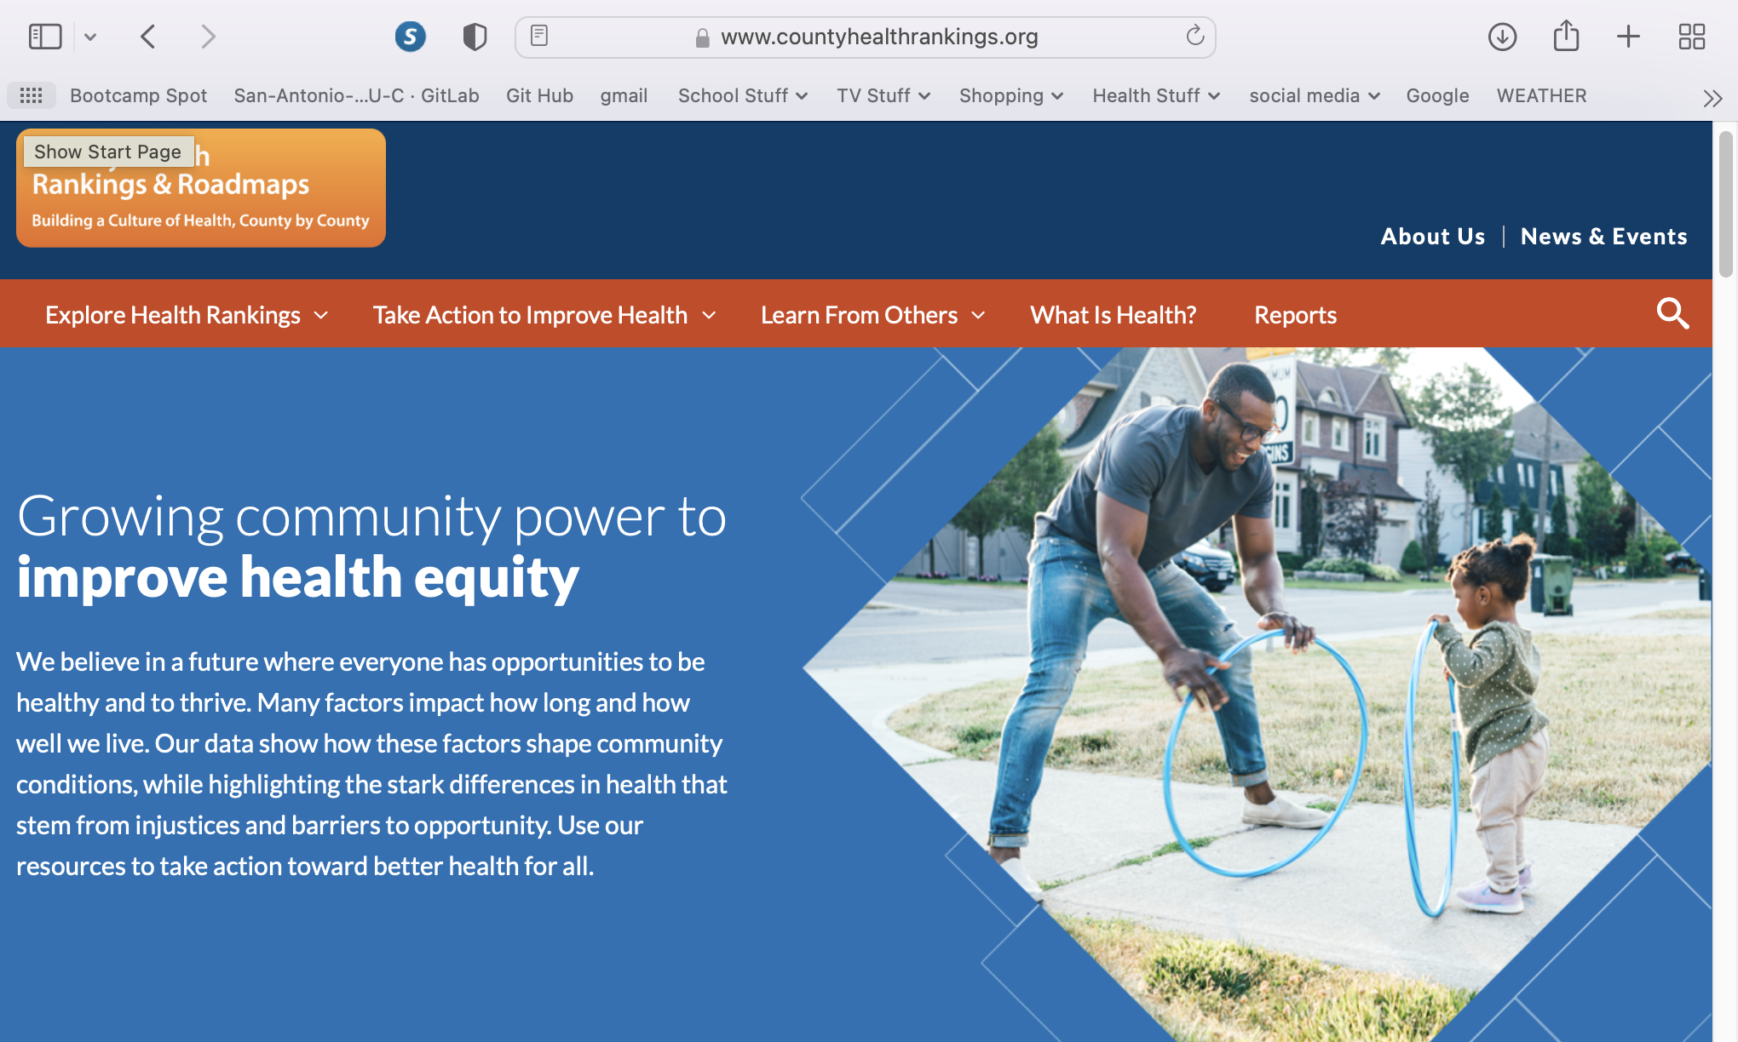
Data Source
County Health Rankings by University of Wisconsin Population Health Institute
https://www.countyhealthrankings.org/

Slide 3
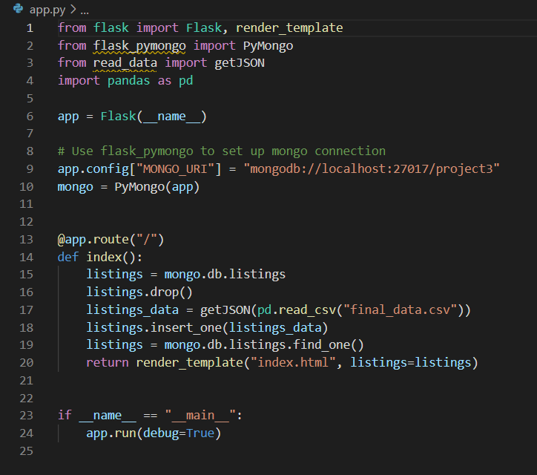
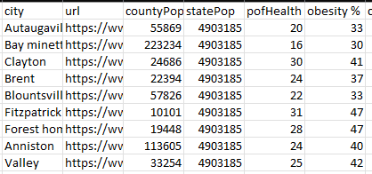
Data munging techniques
Scraped data from website
Cleaned data using python
Extracted clean data to CSV files

Slide 4
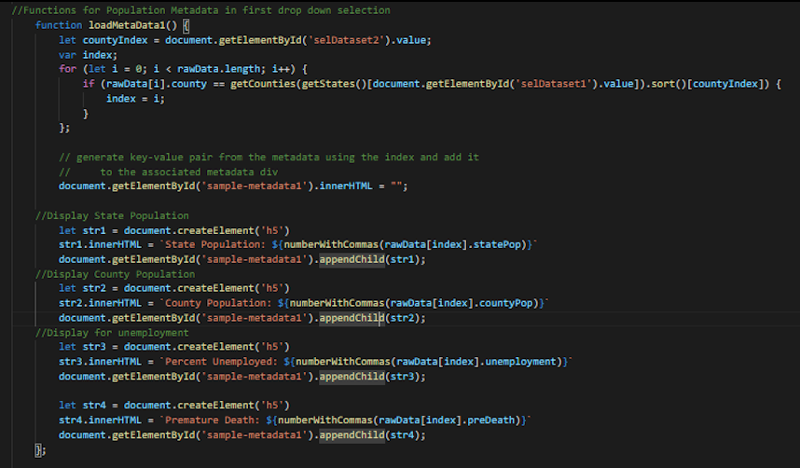
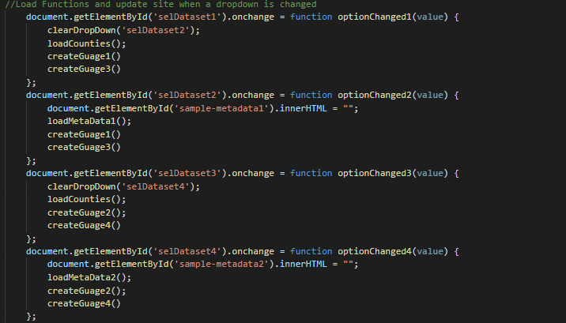
Coding approach
CSV imported to Mongo DB to create Database and Collections
Created API using Flask
HTML5 / CSS to create containers and elements
Javascript used to create visualizations
d3
plot.ly

Slide 5
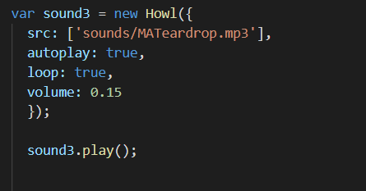
Howler.js
Provides a modern audio library with support for the Web Audio API and a fallback mechanism for HTML5 Audio.
Offers a consistent API for using audio with JavaScript, with control over common audio patterns including play, pause, seek to rate, fade and loop

Slide 6

Visualization Demo

Slide 7
Q & A

