Slide 1
Secure data hiding in images using steganography
Secure the Data to Prevent Hacker
Presented By: Ankita Kumari
Department: Computer Science Department
College Name: Arya College of Engineering, Jaipur

Slide 2
OUTLINE
Problem Statement
Technology used
Wow factor
End users
Result
Conclusion
Git-hub Link
Future scope

Slide 3
Problem Statement
With the rise of cybersecurity threats, protecting sensitive data is crucial. This project combines image steganography and AES encryption to securely hide messages in images, ensuring confidentiality. The system provides a user-friendly interface for seamless encryption and decryption of hidden messages.

Slide 4
Technology used
Programming Language: Python
GUI Framework: Tkinter
Image Processing: OpenCV, PIL (Pillow)
Cryptography: PyCryptodome (AES Encryption)
Data Handling: NumPy
Platform: Windows, VSCode

Slide 5
Wow factors
1. Dual-Layer Security
2. Undetectable Communication
3. User-friendly GUI
4. Custom Passcode Protection
5. Lightweight & Efficient
6. Error Detection & Handling
7. Cross-Platform Compatibility

Slide 6
End users
1. Cybersecurity Professionals & Ethical Hackers
2. Journalists & Whistleblowers
3. Government & Intelligence Agencies
4. Privacy-Conscious Individuals
5. Forensic Investigators & Law Enforcement
6. Developers & Cryptography Enthusiasts
7. Academia & Research Scholars

Slide 7
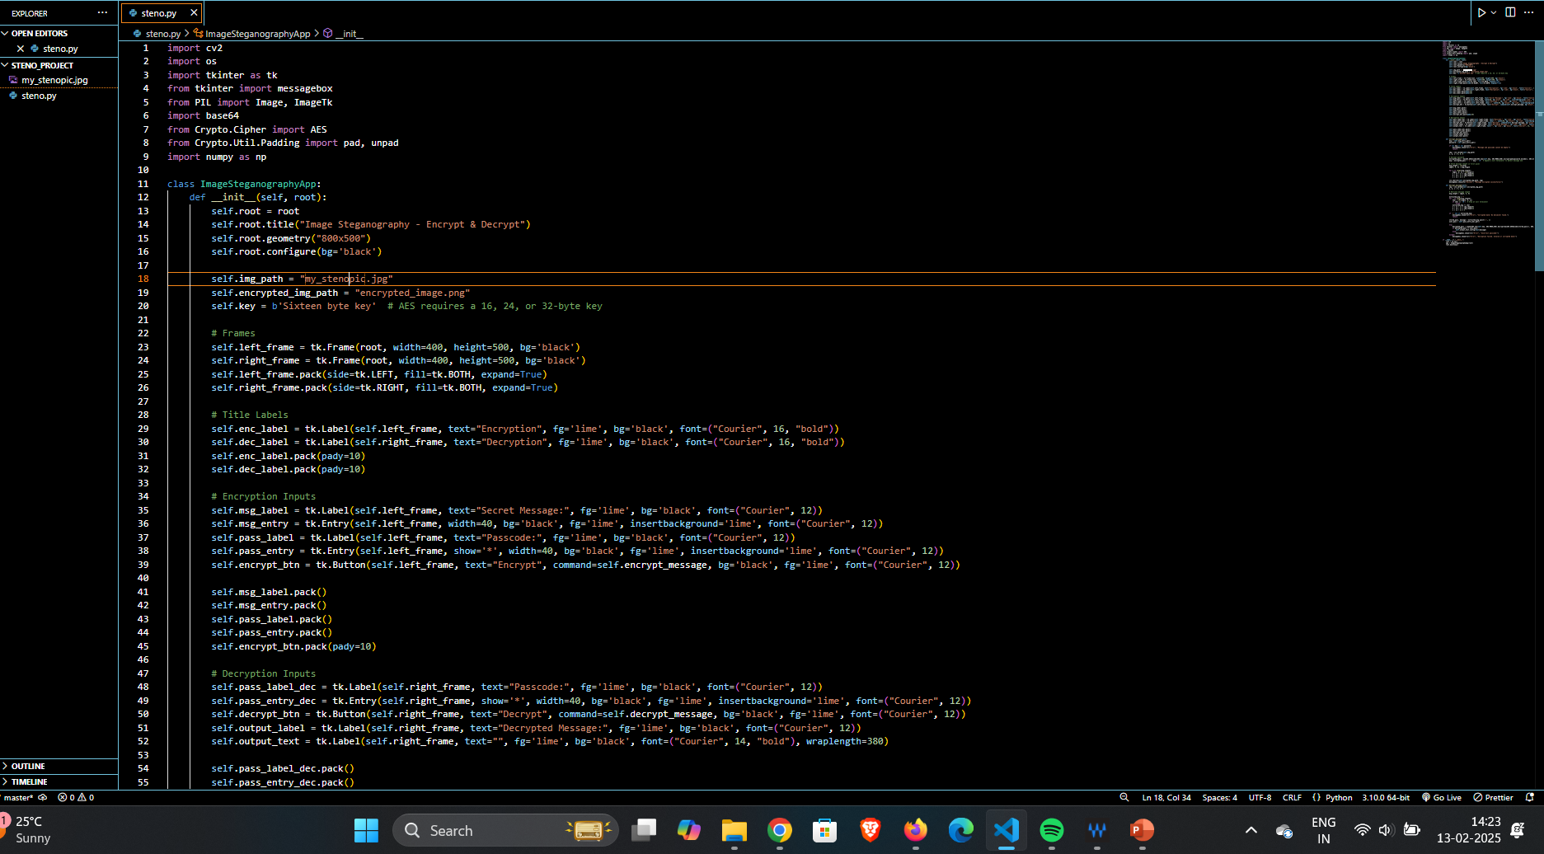
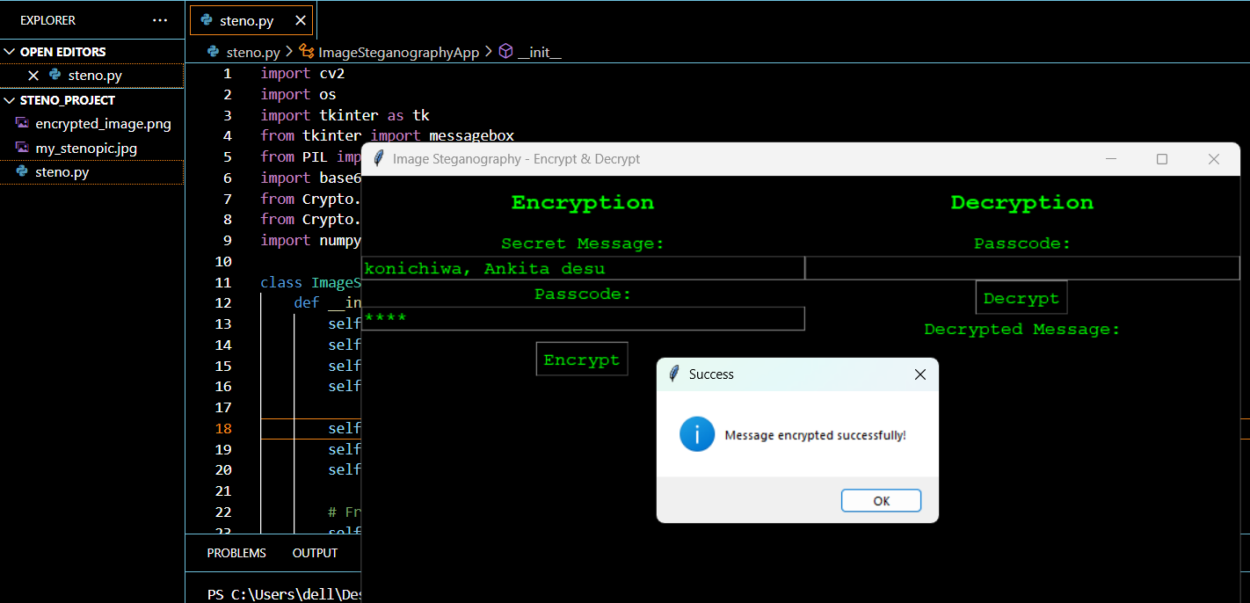

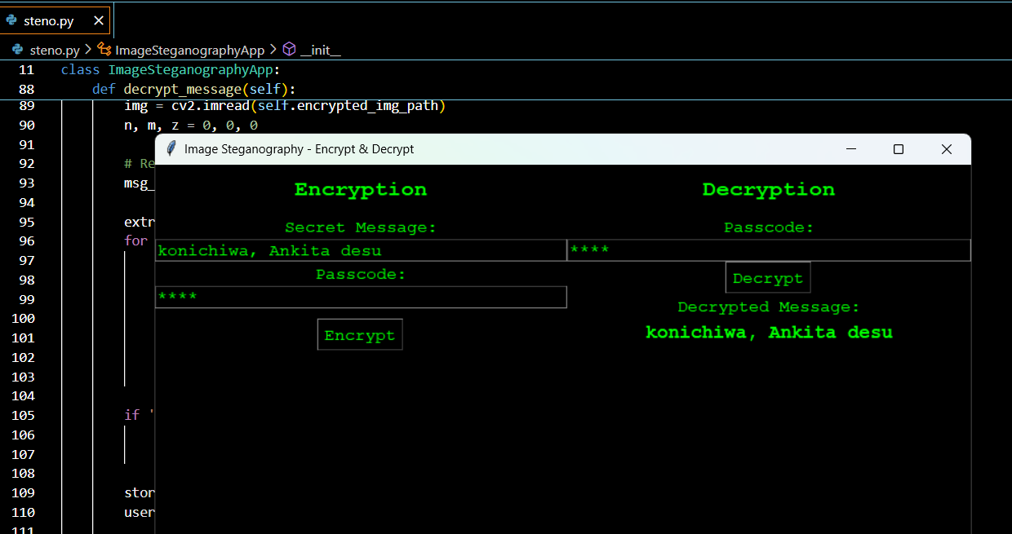
Results

Slide 8
Conclusion
With the increasing risks of cyber threats, ensuring secure and covert communication is more critical than ever. This project successfully integrates image steganography with AES encryption, allowing sensitive information to be securely embedded within images. Unlike traditional encryption methods that may attract attention, this approach ensures confidentiality while remaining undetectable.
The user-friendly interface simplifies the encryption and decryption process, making it accessible to both cybersecurity professionals and privacy-conscious individuals.
By combining cryptographic security with steganographic techniques, this project provides an innovative, efficient, and discreet solution for secure communication in the digital era.

Slide 9
GitHub Link
Here’s My Github Link for this Project--
https://github.com/ankita-Git2/aicte_steno_projectt

Slide 10
Future scope
1. Multi-Format Steganography
2. Cloud Integration
3. Mobile Application
4. AI-Powered Optimization
5. Blockchain for Integrity

Slide 11


