Slide 1
Medisyn Labs: Reviews Analytics Case Study
Sentiment • Effectiveness • Cohorts • Recommendations (10‑minute brief)
Ankita SINHA – August, 2025

Slide 2
Objectives & Use Cases
Business Objective:
- Turn unstructured medicine reviews into insights for product, marketing, and support.
Use Cases:
1) Classify sentiment (positive/negative)
2) Predict 5‑step effectiveness rating
3) Discover patient cohorts (clustering)
4) Recommend medicines from symptoms/conditions

Slide 3
Data & Preprocessing
Data: train/test TSV • Fields: id, medicine, rating (1–10), effectiveness (5‑step), side‑effects (5‑step), condition, 3 review texts.
Preprocessing:
- Robust TSV parsing (handled quotes/newlines), column standardization, NA handling, dedupes, rating numeric range checks.
- Non-critical stopwords removal. Lowercasing.
- Train/test schema validation.

Slide 4
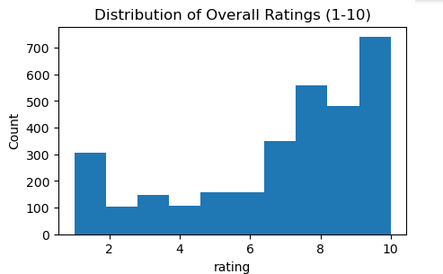
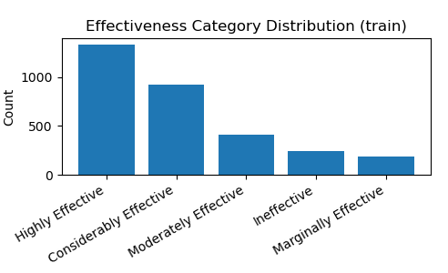
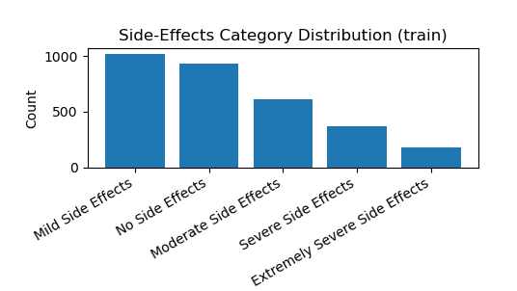
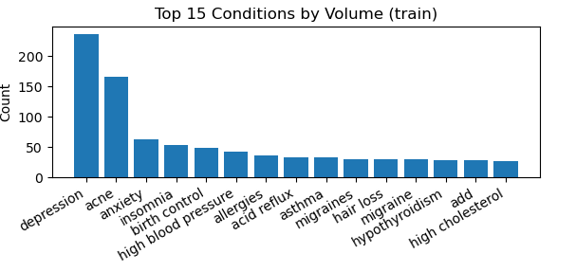
Exploratory Data Analysis

Slide 5
Modeling Strategy (at a glance)
Features:
Text → TF‑IDF (for sentiment) and SentenceTransformer embeddings (for cohorts)
Algorithms:
- Sentiment: Linear SVC (baseline, fast & interpretable)
- Effectiveness: Multiclass Logistic/Linear SVM (ordinal)
- Cohorts: MiniBatchKMeans on normalized embeddings (k via silhouette)
- Recs: Content‑based cosine similarity over embeddings (+ simple CF roadmap)

Slide 6
Use Case 1 — Sentiment Classification
Approach:
- Compared TF‑IDF + Logistic Regression vs SentenceTransformer embeddings + LR.
- Selected TF‑IDF + Linear SVC for this task.
- StratifiedCV for class-balance
Why this choice:
- Reviews are short/keyword‑heavy → TF‑IDF captures explicit polarity words ('not', 'effective', 'nausea').
- Higher F1/accuracy on validation than embeddings.

Slide 7
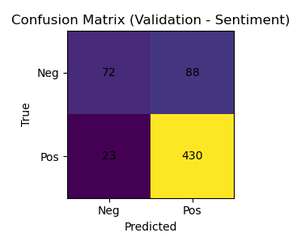
Use Case 1 — Sentiment Model Results
Accuracy: 81.9%
F1 (Positive): 0.886
F1 (Negative): 0.565
Insights (bullets):
- Model strong at detecting positive reviews (high recall: 95%).
- Struggles with negative reviews (low recall: 45%).
Overall F1: 0.80
Further Action - Needs improvement in handling class imbalance.

Slide 8
Use Case 2 — Effectiveness Rating (5‑class)
Problem: Predict 5‑step effectiveness from reviews + context.
Approach:
- TF-IDF+ Multiclass Linear SVC
- Features: overall review + benefits review + side effects review + (condition/medicine)
- Rating feature excluded to avoid leakage.
- Metric: macro‑F1 (class balance), accuracy as secondary.
Alternatives considered:
- Gradient Boosting (XGBoost/LightGBM) – Compute Heavy
- SMOTE Oversampling Technique (works best for numerical values, not textual)
Rationale:
- Stick with simple linear baseline model Like SVC (Robust with imbalanced data) class weight as ‘balanced’.

Slide 9
Use Case 2 — Effectiveness Rating Results
Problem: Predict 5‑step effectiveness from reviews + context.
Insight: The model is biased toward majority/clearer classes (e.g., “highly effective”) but fails on smaller/ambiguous ones (“marginally/moderately effective”). The system is better at detecting strong positive feedback.
Class-wise Performance
Highly effective is predicted best (F1 ≈ 0.60), meaning the model reliably identifies strong positive cases.
Considerably effective shows moderate performance (F1 ≈ 0.38).
Ineffective is partially captured (F1 ≈ 0.40)
Marginally effective is very poorly captured (F1 ≈ 0.10) (low no. of samples)
Moderately effective also weak (F1 ≈ 0.23). q
Overall Model Performance - Validation Accuracy = 45.7% & Macro-F1 = 0.345
Risk - under-reporting low/mid effectiveness feedback missing nuanced dissatisfaction

Slide 10
Use Case 3 — Cohort Discovery (Clustering)
Approach:
- SentenceTransformer embeddings of combined text (all-MiniLM-L6-v2)
- MiniBatchKMeans; k chosen by silhouette (cosine) measures
separation and cohesion.
- 2D visualization via PCA.
- Cluster Interpretation via top conditions/avg rating and sample
reviews.
Why embeddings over TF‑IDF:
- Groups by semantic meaning (hypertension ≈ high blood pressure), not just exact words.

Slide 11
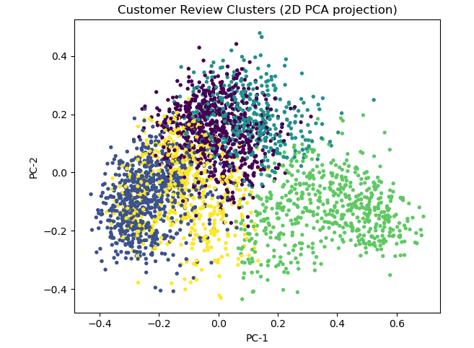
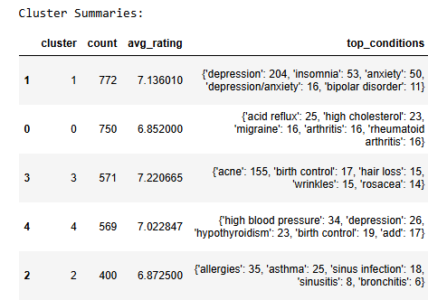
Use Case 3 — Cohort Discovery (Clustering) - Results
Silhouette Score - 0.0514 (k=5)
Results:
- Spherical clustering provides clean, non-overlapping groups.
- Clusters Overlap but k=5 provides the most interpretable structure.
Cluster 0 (750 users, avg rating ~6.8)
Cluster 1 (772 users, avg rating ~7.1)
Cluster 2 (400 users, avg rating ~6.9)
Cluster 3 (571 users, avg rating ~7.2)
Cluster 4 (569 users, avg rating ~7.0)
cosine clustering produces more coherent semantic clusters in NLP tasks.
-

Slide 12
Use Case 3 — Cohort Discovery (Clustering) –Actionable Insights
Key Business Takeaways (Effectiveness Prediction Cohort Discovery)
Customer segments emerge around conditions
Cluster 1 (Depression/Anxiety-related) and Cluster 3 (Acne/Birth Control-related) highlight clear medical-condition cohorts.
This allows targeted engagement (e.g., condition-specific educational campaigns or product bundling).
Ratings differ slightly across cohorts
Average ratings per cluster hover around 6.8–7.2, suggesting generally positive but not very high satisfaction.
Identifying why certain cohorts (e.g., allergies/asthma cluster ~6.87) rate lower can guide product improvement priorities.
Cohorts differ in volume (market size proxy)
The Depression/Anxiety cluster (772 reviews) is the largest — meaning mental health is the dominant concern in your dataset.
Business impact: This segment deserves priority for personalization, service improvements, or partnerships.
Silhouette score is low (0.0514)
Indicates clusters are not sharply separated, suggesting customers often report multiple overlapping conditions.
Business takeaway: customers may require holistic solutions

Slide 13
Use Case 4 — Medicine Recommendations
Goal: Recommend the most suitable medicine for a patient’s symptoms/condition using past reviews & ratings.
Approach
Balance medical relevance (condition-based) and personalization (user similarity).
- Hybrid Recommender System
- Content-Based Filtering (CBF): Matches symptoms with medicine reviews.
- Collaborative Filtering (CF): Leverages patient–medicine rating patterns.
- Hybrid Score: Weighted combination of CBF + CF.

Slide 14
Use Case 4 — Medicine Recommendations (Methodology)
Methodology
Content-Based (CBF):
TF–IDF embeddings of aggregated reviews per medicine.
Cosine similarity between query (symptoms) & medicine reviews.
Minimum reviews threshold for robustness.
Collaborative Filtering (CF):
Build Customer × Medicine rating matrix.
Compute patient similarity via cosine similarity.
Recommend medicines rated highly by similar patients.
Advantages of using Hybrid System:
- Combines medicine/condition relevance better with personalization - Handles new user issues better - More diverse & patient-specific recommendations - Less Risk associated with irrelevant recommendation

Slide 15
Assumptions, Risks & Controls
Assumptions:
- Reviews reflect real outcomes.
- Labeling for Sentiment** uses `Rating >= 6` as a proxy for positivity.
Risks & Mitigations:
- Class imbalance → stratified splits, class weights, macro‑F1.
- Noisy text/newlines → robust TSV parsing, NA/length filters, dedupes.
- Data leakage → exclude rating when predicting effectiveness.
- Bias/representativeness → manual audit of clusters and
recommendations.

Slide 16
Key Insights & Next Steps
Insights:
- TF‑IDF best for sentiment; embeddings best for cohorts.
- Clusters align with conditions and review; actionable for product/support.
Next Steps:
- Fine‑tune domain models (BERT).
- Build monitoring (data drift)
- Handle Robust class balance & cohort clear boundary separation.

