Slide 1
Team Details
Team Name : Error404
Team Members’ Name : Akriti Verma, Ankita Das and Soumya Rathore
College Name : SRM Institute Of Science & Technology (KTR Campus)

Slide 2
PROBLEM DETAILS
Problem Statement :- To create an application that enables contributors to freely donate their subsidiaries to those in need and is easily accessible anywhere and everywhere
Problem Description :-
Many people usually face the lack to access basic necessities.
Many organisations offer low quality materials in a variety of price ranges in order to increase their donation profits without considering the product's quality.
Knowing this, we attempt to solve it by directly connecting customers to products and utilities through our platform, closing the gap and establishing trust.

Slide 3
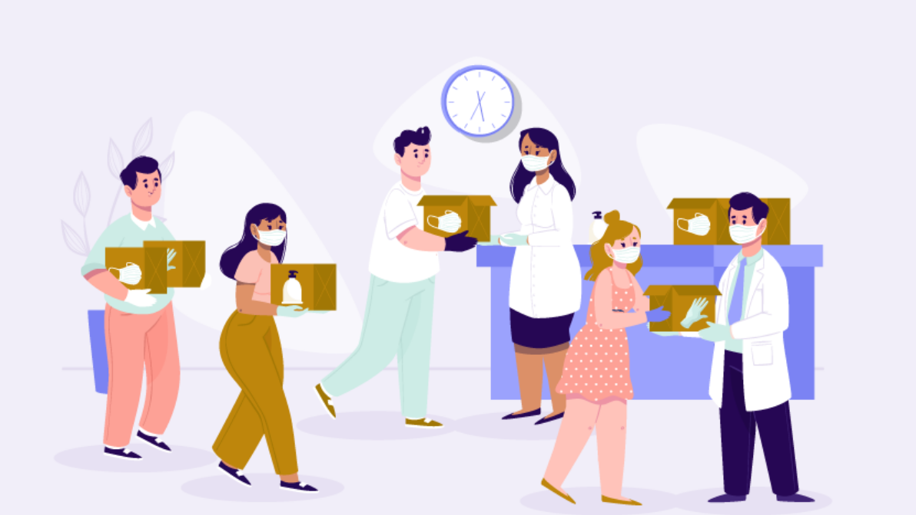
INSPIRATION
The intention of creating this platform is to enable easy contact between contributor and those in need. We took our very own examples where we as students, have many spare things which can be useful for others and can be donated.
Usually, the offered items by the corporations are of higher rate with trust issues and we try to solve this problem by providing a direct contact between the contributor and the consumer.

Slide 4
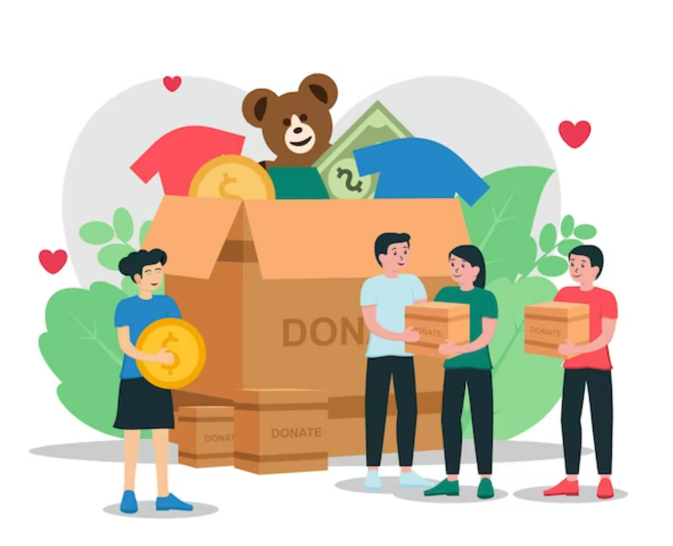
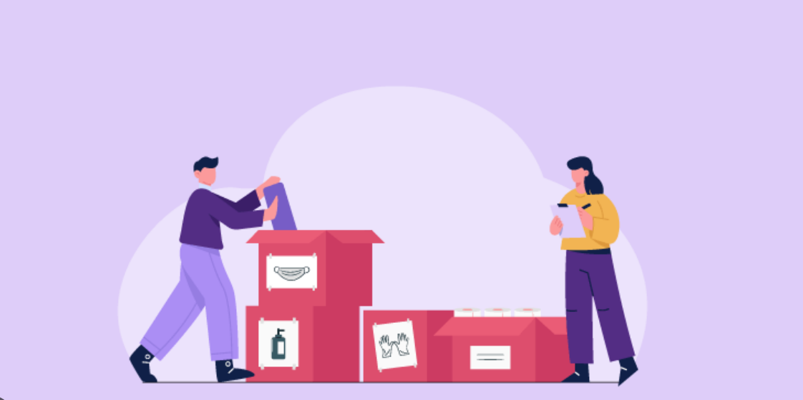
THEME
The problem which is usually faced by many people is that they don’t have basic utilities. Hence, we aim to become a bridge of communication to those who need basic utilities and those who want to share those utilities.
Our aim is to build a platform in which anyone and everyone may contribute, whether it is a small or substantial contribution. As intermediaries, we would then transfer it as desired by the consumer.
All of these large and small contributions are provided via appropriate and trusted organisations.The effectiveness of this application is that it would allow groups in need, to quickly order relevant supplies like books, clothing, and medicines with just a single click.

Slide 5
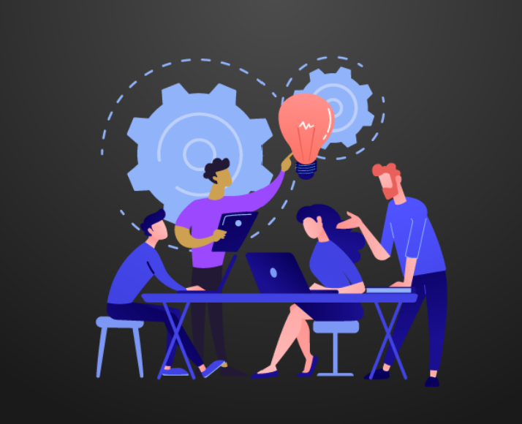
APPROACH
Our main goal is to create a communication channel through our application, where everyone may list its subsidiaries and it will be accessible to all the registered and verified firms/organizations.
Any verified provider can use our application to list their commodities for donation from anywhere. Even student, regardless of age, may participate in this initiative and help improve society.
Also we have planned to utilize the geolocation feature of mobile devices to connect users to a database of listings and maps of things available around them at the nearest.
The application is versatile as it offers free delivery up to a distance of around 5 km, after which it the consumer may be decided whether to pay for the delivery or to pick up the item from the credible seller in person.

Slide 6
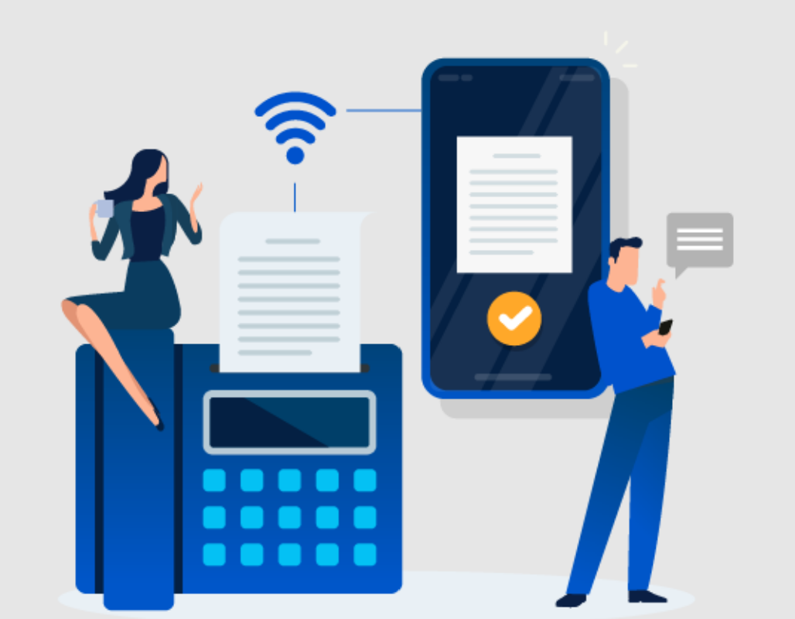
FEATURES
The donation application should have the following features:
User Registration: A user-friendly registration process that allows contributors to sign up and create a profile.
Donation Management: A simple and secure platform for managing donations. Contributors should be able to make a donation in the form of their subsidiaries, such as money, goods, or services.
Recipient Management: A system for managing recipients and ensuring that their needs are met. Recipients should be able to provide information about their needs, such as food, shelter, or healthcare.
Mobile-Friendly Design: The application should have a mobile-friendly design, making it accessible to a larger audience

Slide 7
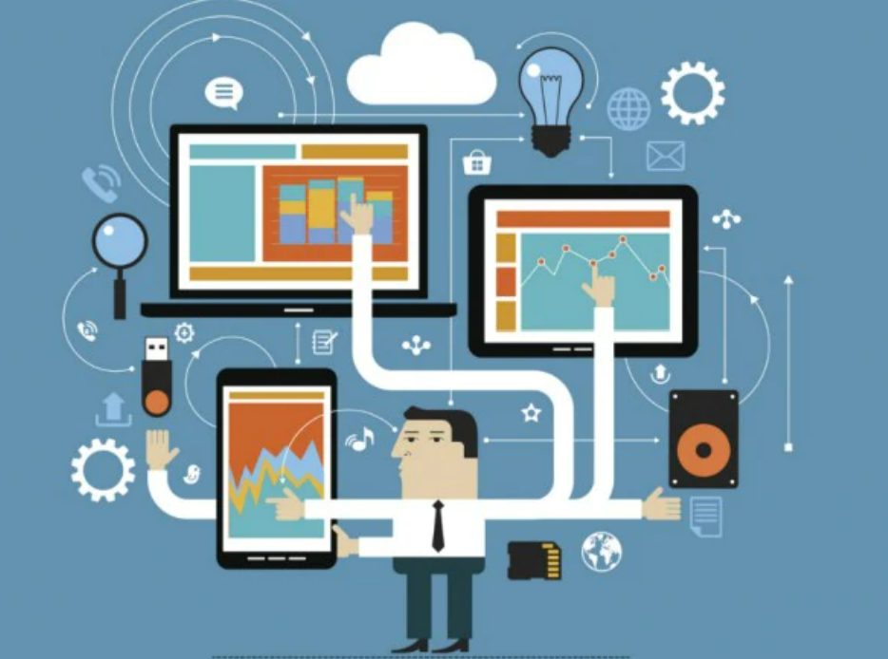
TECHNOLOGY STACK
Our goal is to create an Online application that can run on Windows, Android, and other operating systems.
Therefore, for a website, we would use react as our framework and HTML, CSS, and javascript as our front-end languages.
Additionally, we would probably employ NoSQL and SQL for database,which would be stored with the use of MongoDB as a cluster format in a data storage space.
To create a functional application for the specified use-case, we would mostly work using flutter and dart for a mobile-based application.

Slide 8

FUTURE SCOPE
Further, we will increase our range to provide the necessities by considering a larger geological location which connects the provider and the consumer.
To reduce the time barrier, we will create an algorithm which gives the information about the nearest provider.
To encourage the donors, we will also provide them with the donation points which will further be redeem by the user.
In order to grow this as a business we could also introduce a subscription based model in order to promote our platform.

Slide 9
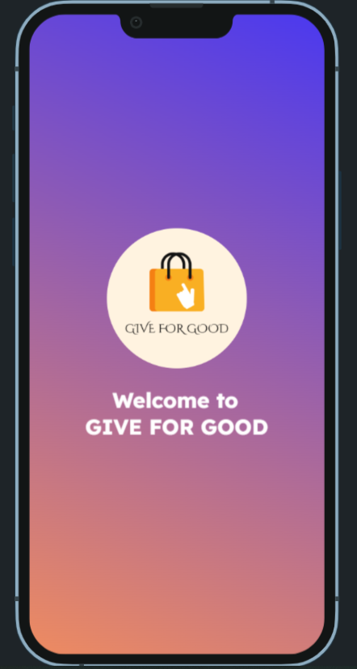
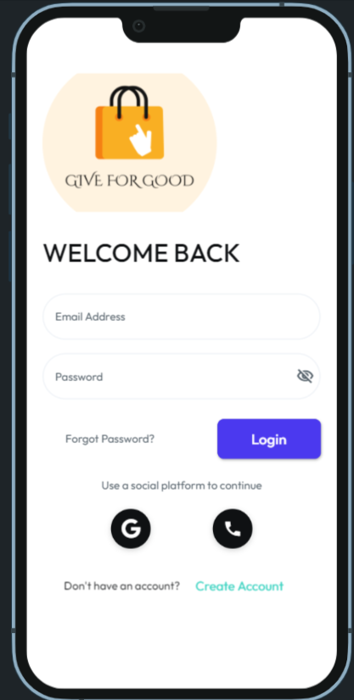
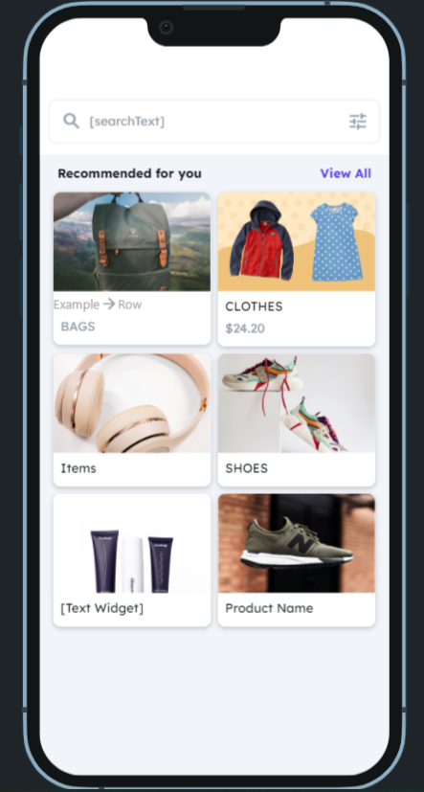
Application

Slide 10
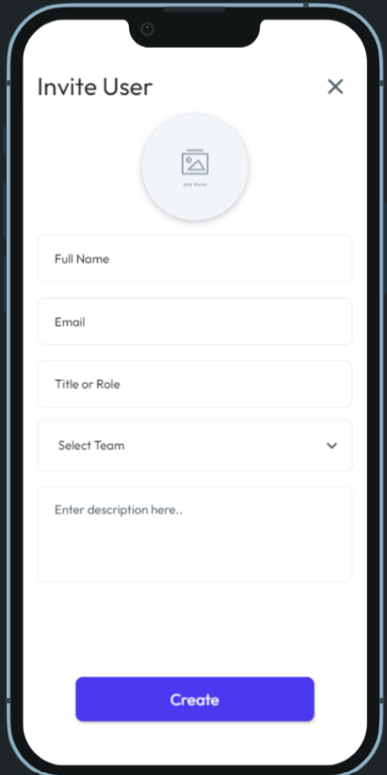
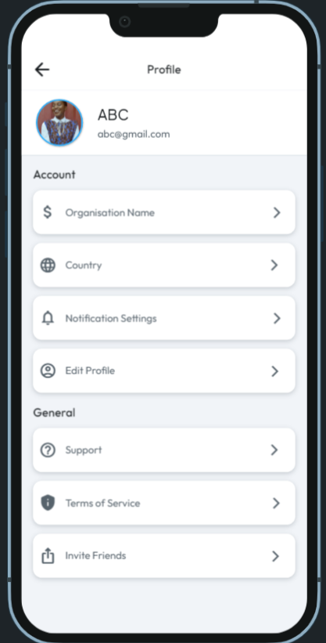

Slide 11

THANK YOU!!

