Slide 1
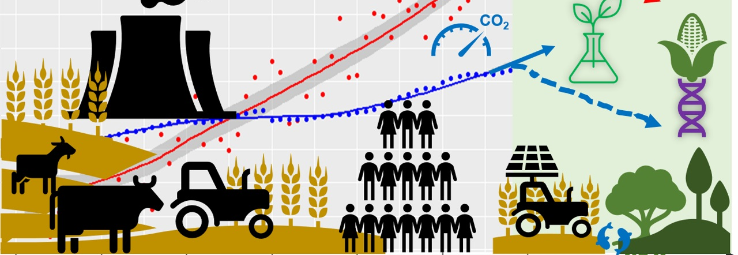
Greenhouse Gas Emissions by Agrifood System
Ankita Gondkar
BANA 7380 Spring 2024

Slide 2
Objective
The objective of this project is to analyze the relationship between agrifood systems and greenhouse gas emissions. We aim to identify factors contributing to carbon footprints within the agrifood system by examining agricultural practices like manure and fertilizers, alongside transportation and distribution channels. Through this analysis, we seek to uncover opportunities to reduce emissions across the agri-food supply chain.

Slide 3
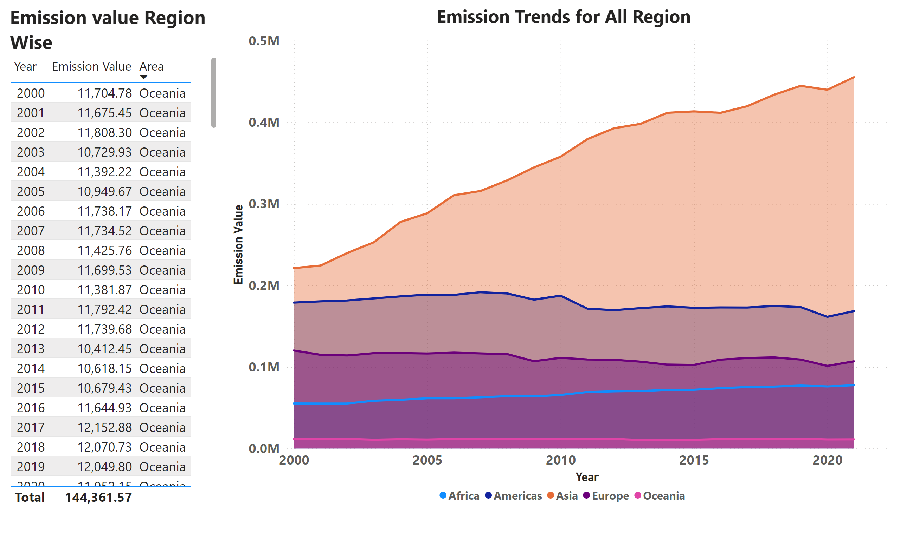
Annual Emission Region wise
Oceania remains consistently at the bottom with minimal fluctuations in emission value
Notes:
Emission value Region Wise
No alt text provided
Emission Trends for All Region
No alt text provided

Slide 4
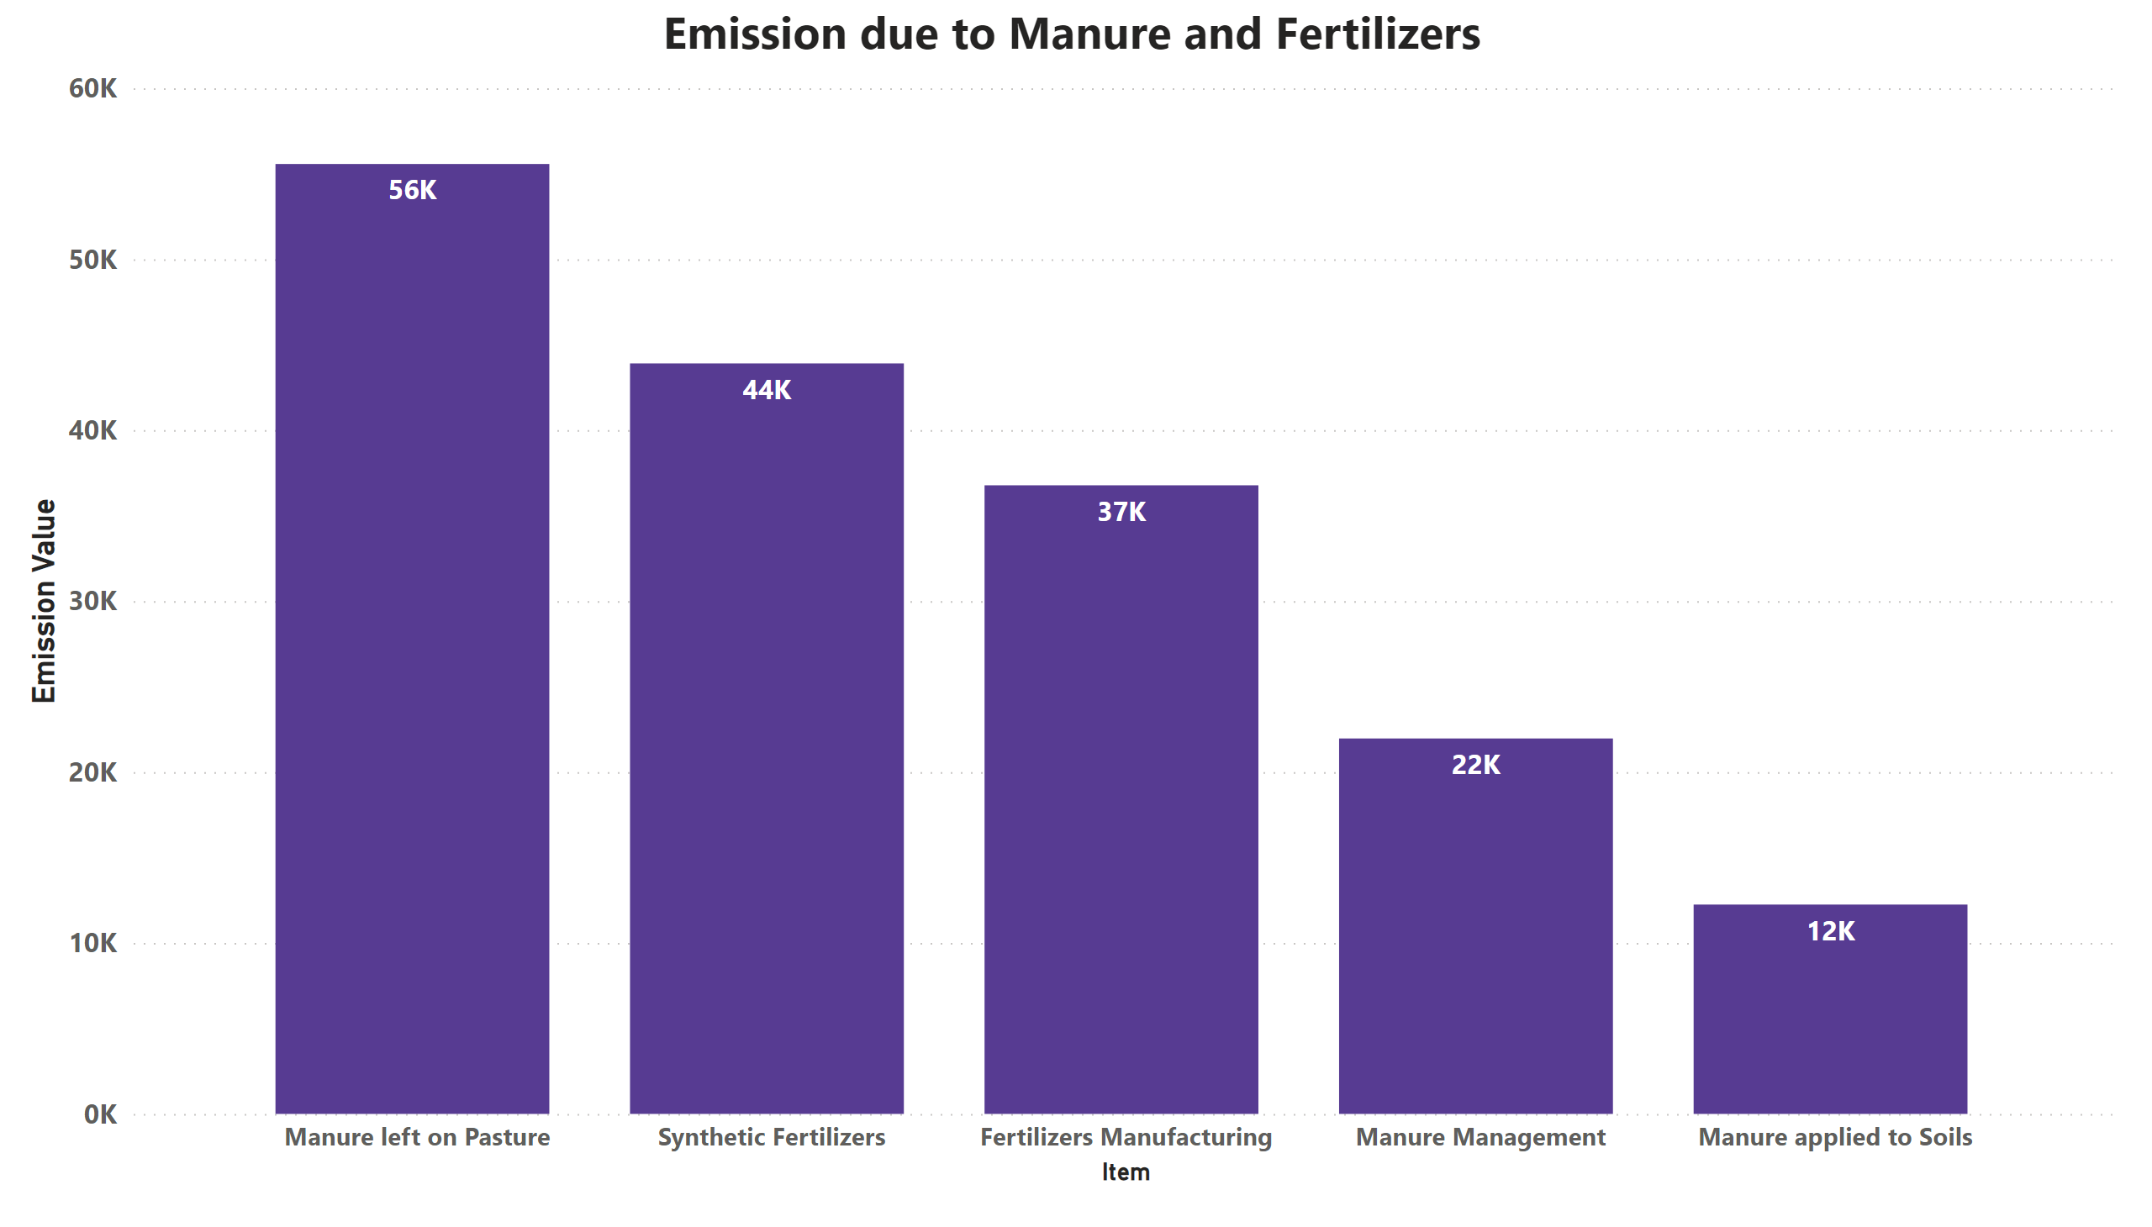
Manure Emission
Manure left on Pasteur is a significant driver of heightened greenhouse gas emission
Notes:
Emission due to Manure and Fertilizers
No alt text provided

Slide 5
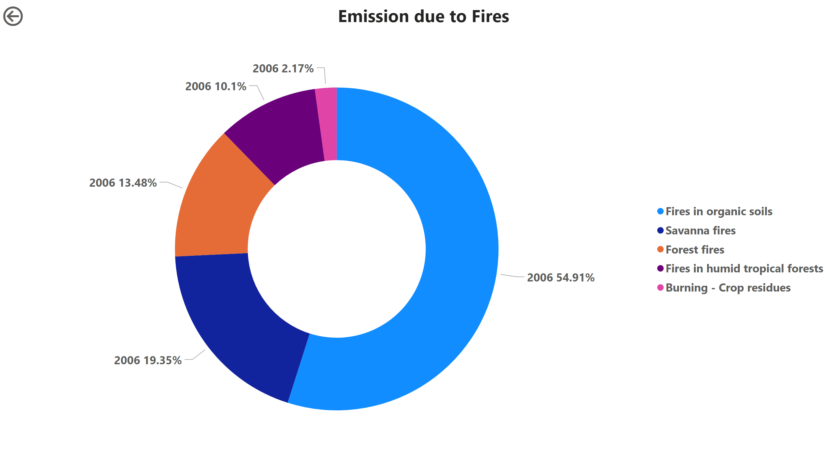
Deforestation Trends
Fires in organic soil accounted for 55% of total fire emissions in 2006
Notes:
Emission due to Fires
No alt text provided
actionButton
No alt text provided

Slide 6
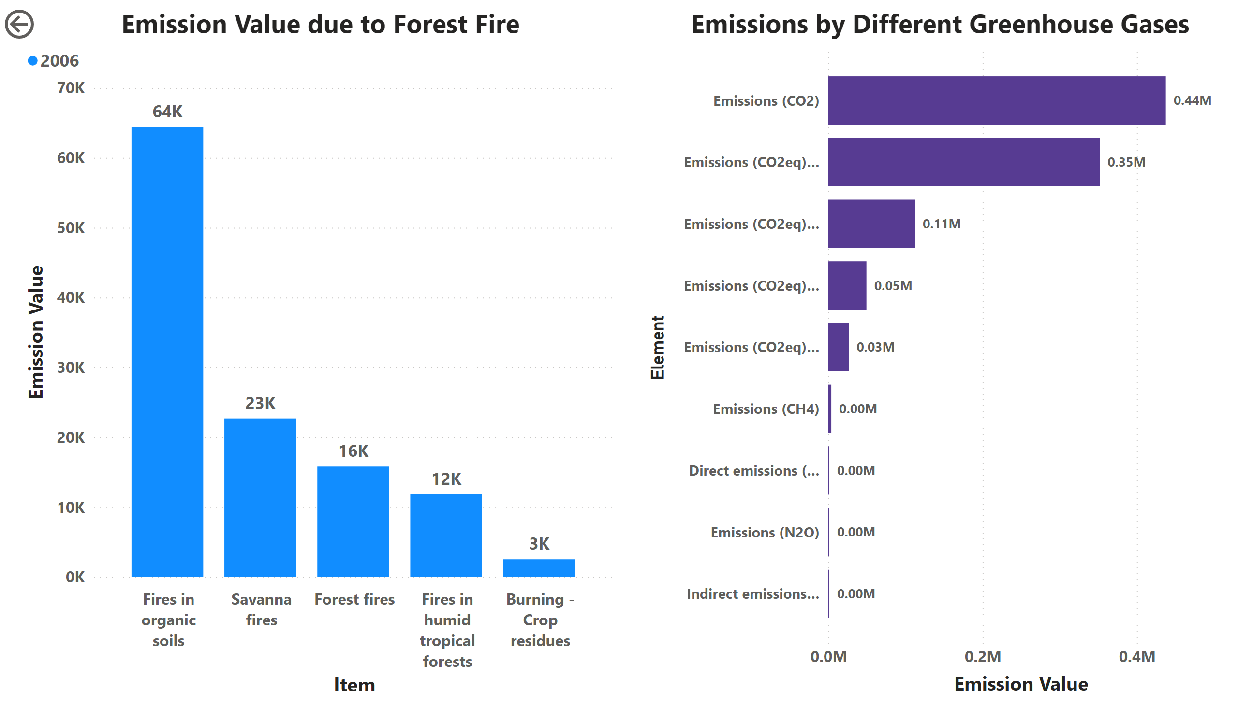
Deforestation Trends with different greenhouse gases
Fires in organic soil led to a 48% higher CO2 emission compared to other fires average emissions.
Notes:
Emission Value due to Forest Fire
No alt text provided
actionButton
No alt text provided
Emissions by Different Greenhouse Gases
No alt text provided

Slide 7
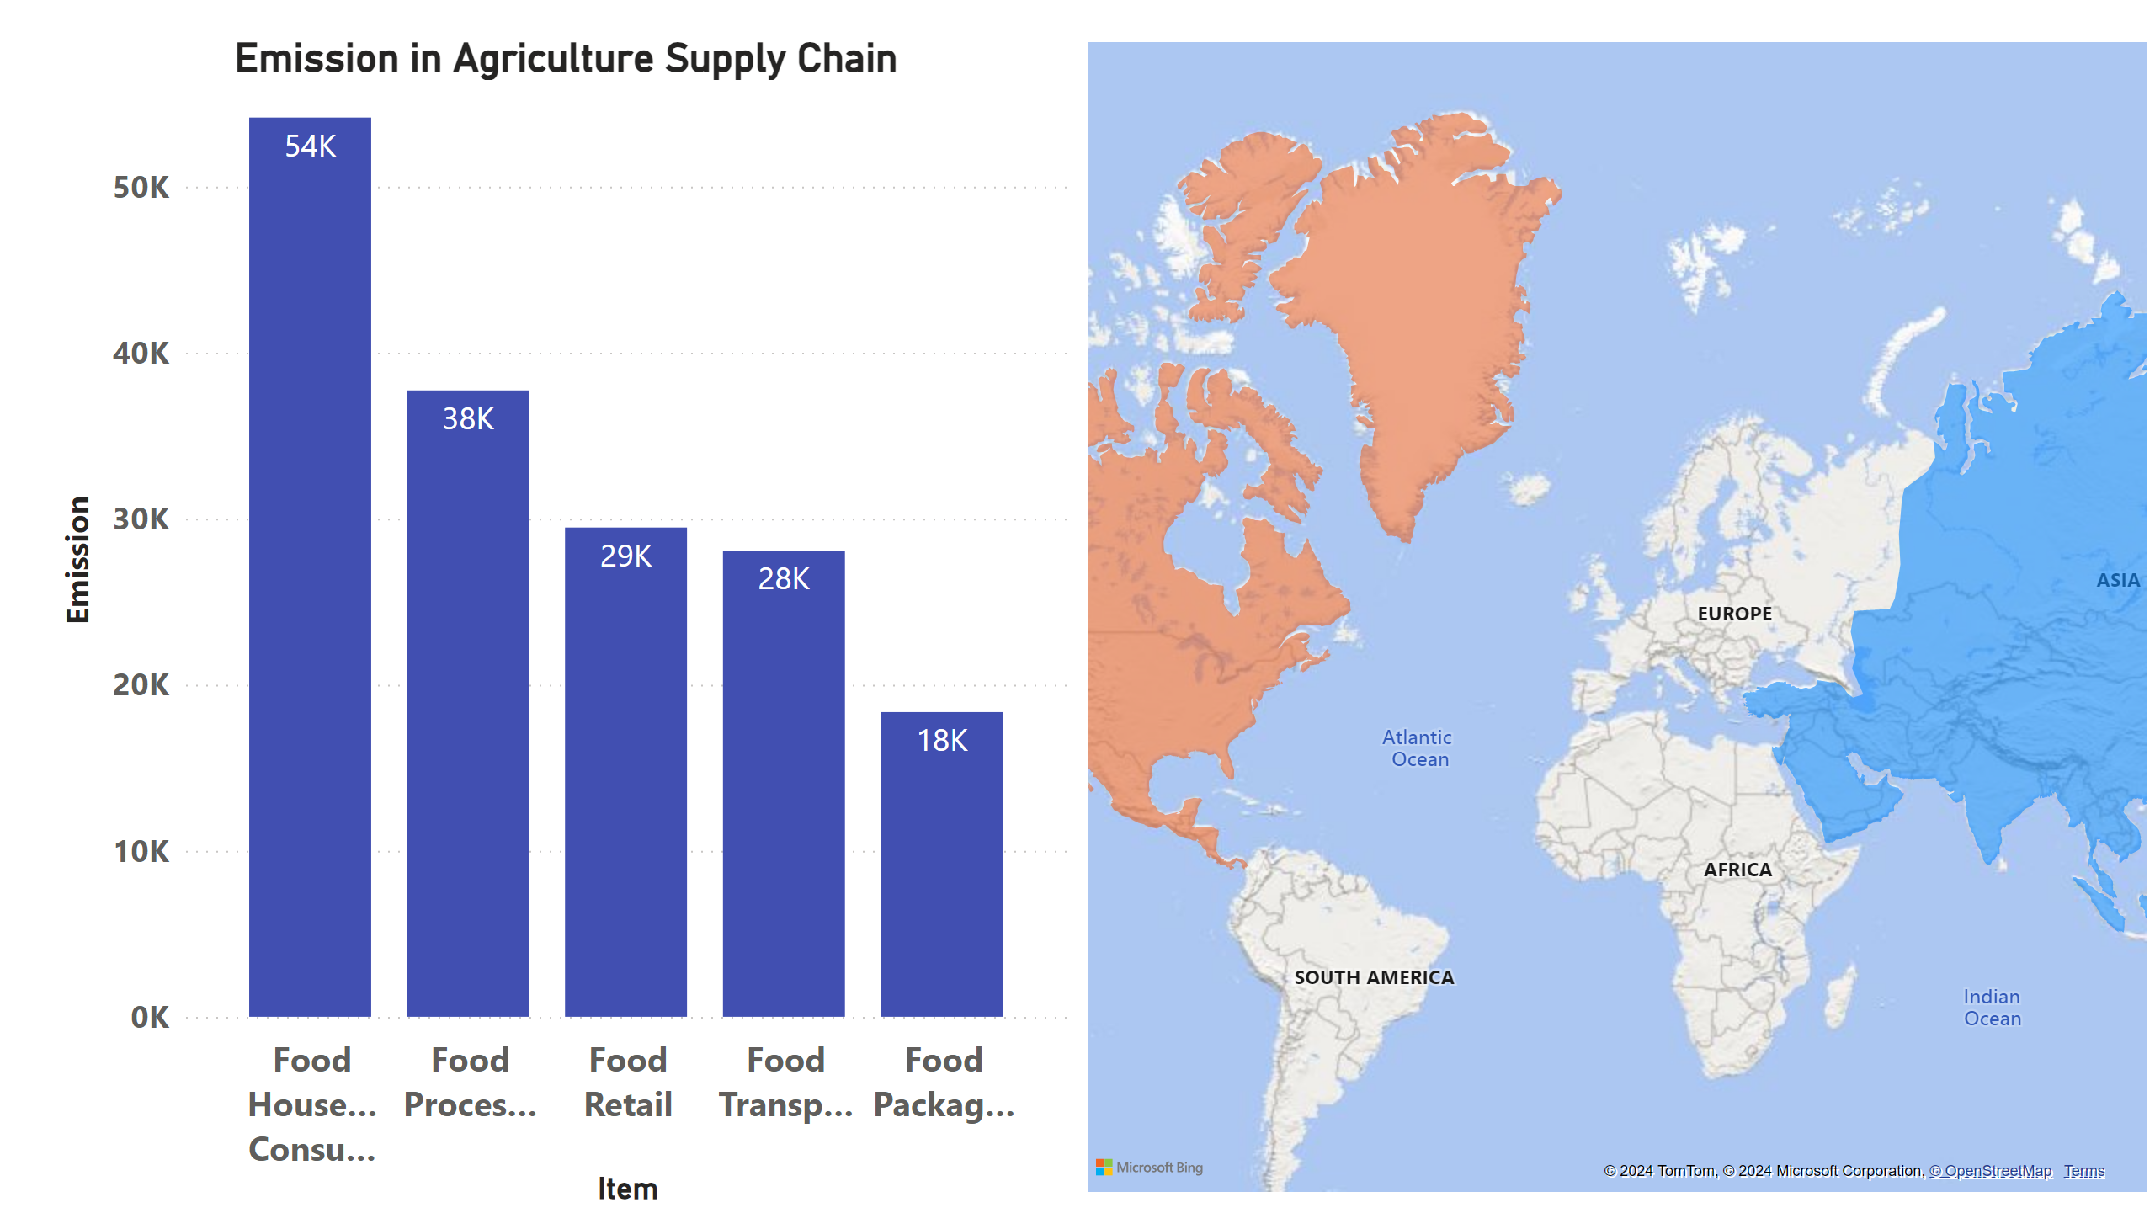
Agrifood Supply Chain
Food Household consumption emits the maximum greenhouse gases in the agriculture supply chain
Notes:
Emission in Agriculture Supply Chain
No alt text provided
Emission in Agriculture Supply Chain
No alt text provided

Slide 8
Conclusion
Oceania consistently maintains a lower emission profile with minimal fluctuations, indicating potential environmental sustainability efforts in the region.
The significant impact of manure left on pasture underscores the necessity for improved manure management practices to mitigate greenhouse gas emissions effectively.
Fires in organic soil, responsible for a majority of total fire emissions in 2006, require targeted interventions to prevent and manage these events and reduce their environmental impact.
Fires in organic soil contribute to a disproportionately higher CO2 emission compared to other fire types, emphasizing the urgency for focused efforts to address this issue and mitigate environmental effects.
Food household consumption emerges as a major contributor to greenhouse gas emissions within the agriculture supply chain, highlighting the need for promoting sustainable food choices and reducing food waste to minimize emissions at the consumption stage.

Slide 9


