Slide 1
Capstone
2/15/2018
Ziyan Wang

Slide 2
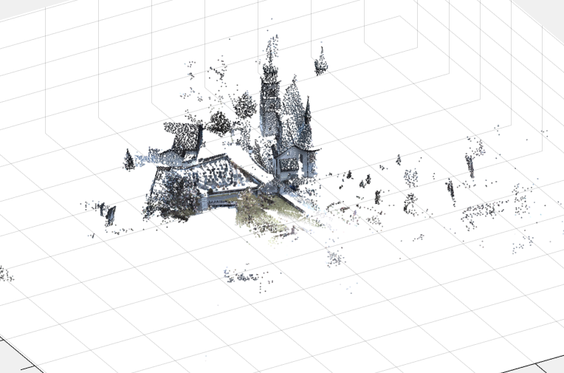
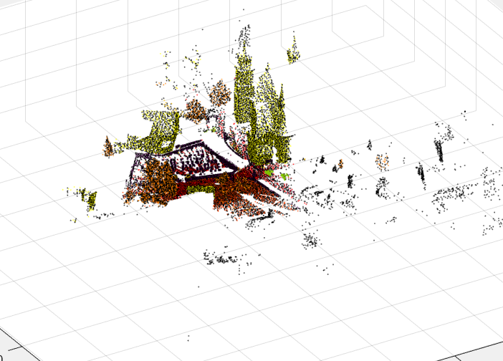
Point cloud visualization
RGB
Semantic label
Notes:
Last week, I tried to load one of the scene from semantic3D into matlab and visualize it. As there are too many points, I have to down-sample it.

Slide 3
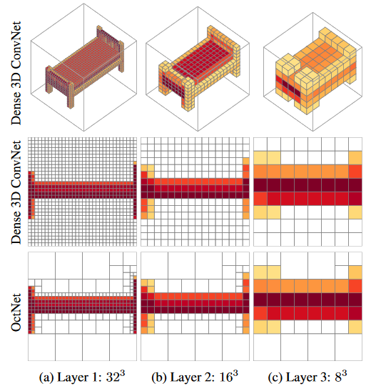
OctNet
Insights
3D data are sparse
Direct 3D convolution are costly
Octree -> OctNet
Convolution on Octree
Pooling/unpooling on Octree
Strengths
Finer resolution
Lower memory consumption
Notes:
In the OctNet paper, the authors focused on the observation that most 3D data for object are sparse, therefore using conventional voxel representation are very costly both in time and space. For 3D data representation, octree is an efficient data structure. So in this paper, they use octree as a main feature to design the 3D representation which will not only provides high resolution 3D model but also requires low computation and memory, and invented a CNN that takes octree data as input.

Slide 4
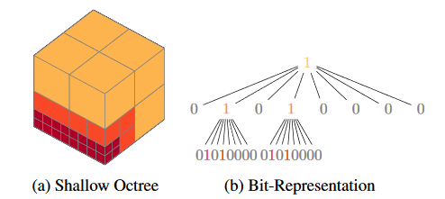
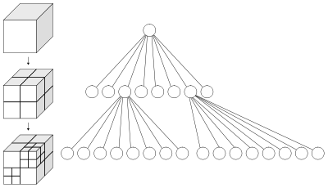
Octree
Sparse representation for voxel
Notes:
An octree is a tree data structure where each node has eight children. This data structure is a good substitution for voxel as it does not encode the space occupancy for each partition at the finest resolution. Therefore, unbalanced octree results in lower memory consumption. Octree subdivide only occupied cells. As shown in the right figure, regions with higher point density is assigned with higher probability while region with lower point density are summarized as larger cell.

Slide 5
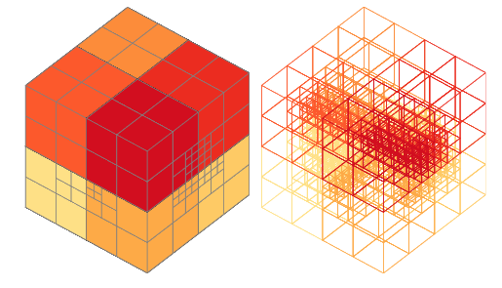
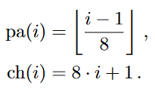
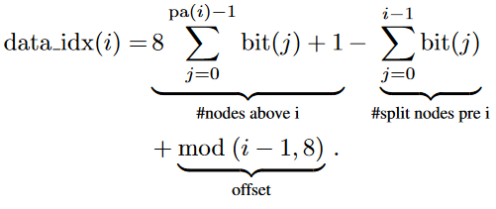
OctNet
Hybrid Grid-Octree Data Structure
Restrict maximal length
Bit representation
73bit: 1bit+8bit+8x8bit
Parent/child indexing
Feature array fast indexing
Notes:
Although original octree representation reduces the memory consumption, it is not efficient to access neighbors of each node in octree, which is bad for convolutional operation. To remedy this, they use several shallow octree to restrict the maximal depth for the whole tree which they called as hybrid grid-octree. In this way, indexing of the neighbor node will be more simple. What they do is to arrange those shallow octrees into a spatial grids. For each shallow octree, 73 bits are used for a shallow tree. For parent and child nodes, indexing on that tree can be performed by a simple calculation. Features for each of those nodes are stored in a continuous data array.

Slide 6


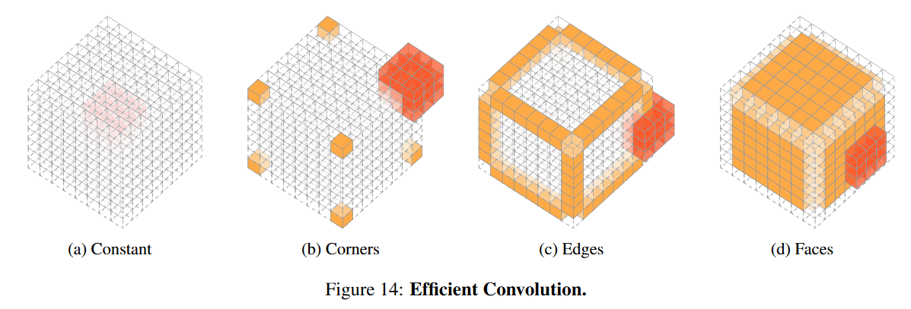
Network Operation
Convolution
Feature array fast indexing
3x3x3 kernel, 8x8x8 node
8x(27-8)
+
+
12x(6-3+1)x(27-2x2x3)
6x16x(27-2x3x3)
1x27
+
<(3x3x3)x(8x8x8)
Notes:
For each data, they keep two copy. One for tree indexing and one for feature array of each node. To transfer between 3D tensor and grid-octree, they use the fast indexing method of octree to do that. Pooling function finds the smallest cell that comprise the voxels in T. Instead of directly performing convolutional operation on redundant 3D tensor, they proposed to perform convolution on grid-octree O so that larger cells will not be convolved for multiple times when using a small kernel. For example, the results of computing convolution inside the cell will be constant. And different values will only occur when the kernel is applied to the corner or edge or surface or a cell. In this way, computation time is greatly reduced.

Slide 7
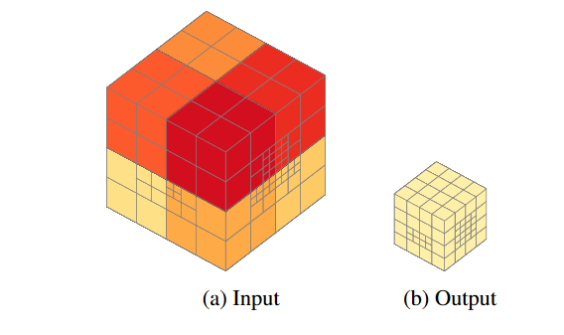
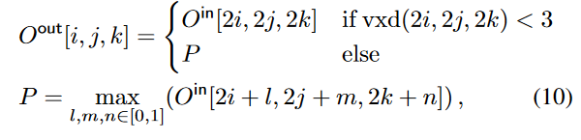
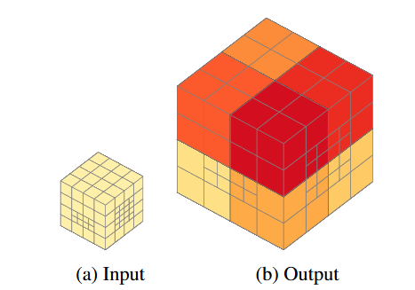

Network Operation
Pooling
Up-pooling
Notes:
Pooling operation on grid-octree data just aggregate several shallow octrees into one which will reduce the number of shallow octrees. The uppooling operation just use nearest neighbor interpolation.

Slide 8
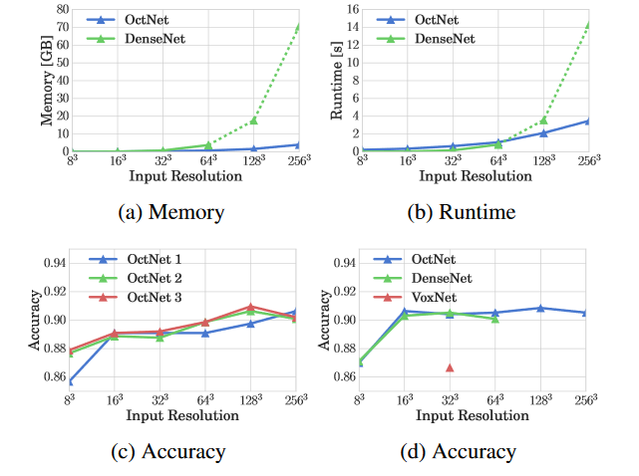
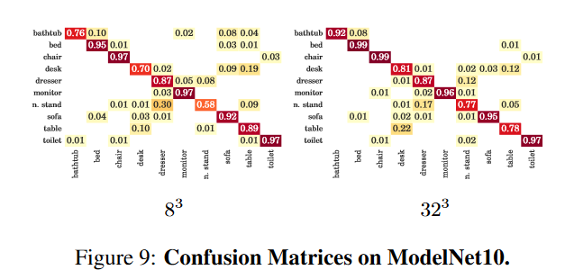
Experiment
3D classification
Notes:
In experiments, We can see that using octnet, both runtime and memory increase swiftly with respect to input resolution. And the accuracy of octnet is compatible with other 3D convolutional network when input resolution is small and excels at higher resolution input.

Slide 9
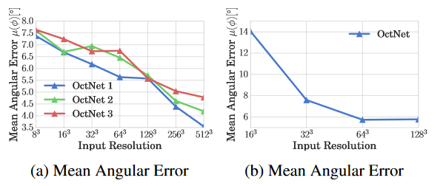
Experiment
Orientation Estimation
Notes:
These are the results on orientation estimation.

Slide 10
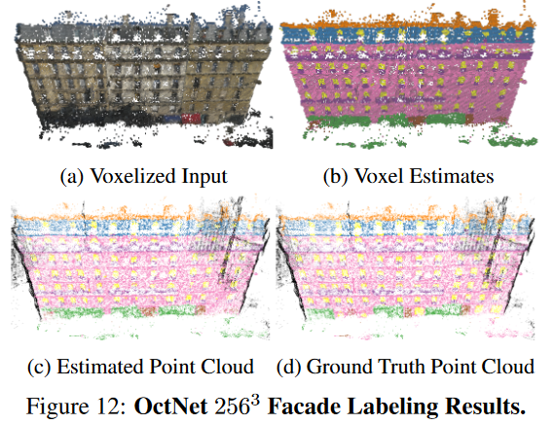
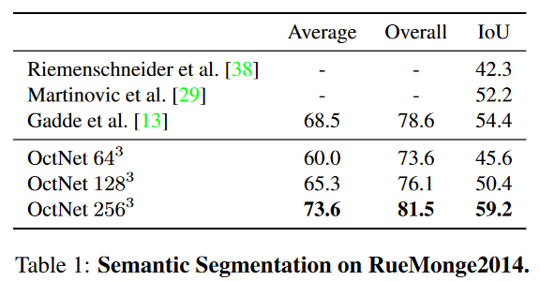
Experiment
3D semantic labeling
Notes:
These are the results semantic segmentation on façade dataset.

