Slide 1
Capstone Midway Report
Ziyan Wang
Ankita

Slide 2
Problem setup
3D detection using point cloud data
Large scale scene
Dense point cloud model
Fast search

Slide 3
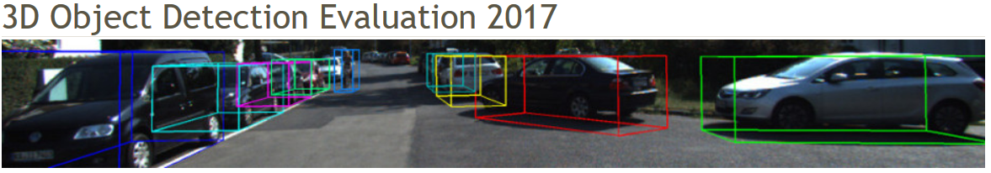
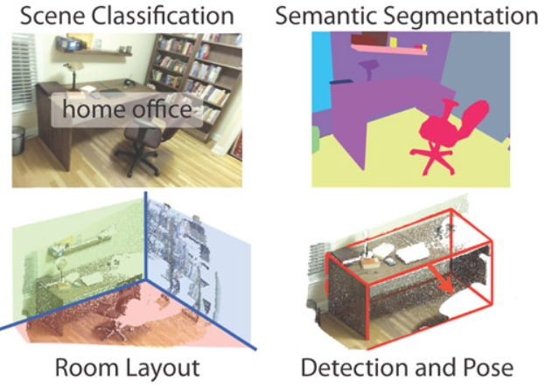
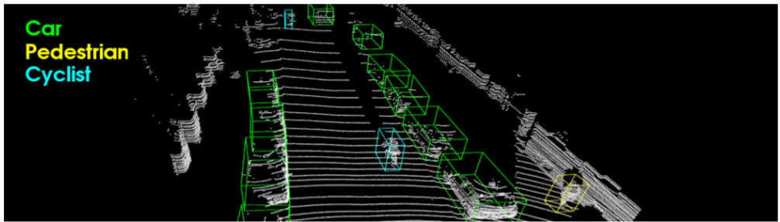
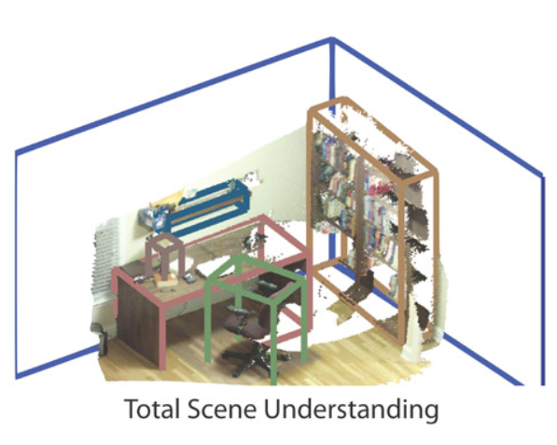
Benchmarks and Datasets
Kitti 3D detection
SUN RGB-D

Slide 4
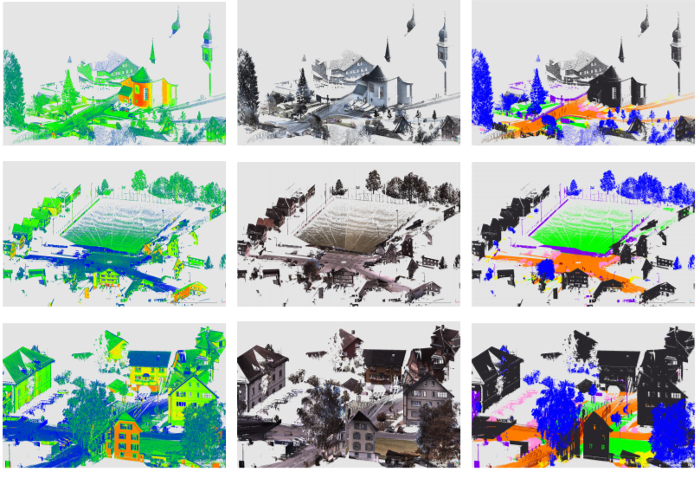
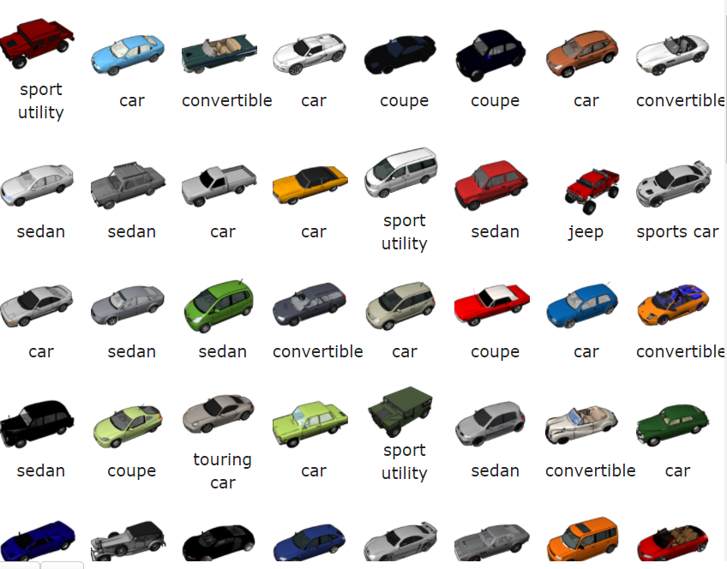
Benchmarks and Datasets
Semantic 3D
Dense scene
Large scale point cloud
ShapeNet
Numerous objects
Accurate 3D models

Slide 5
Methods
Deep learning
Generalizability
Data hungry
Large computation budget
Geometric
Generalizability
Data hungry
Large computation budget
https://vision.deis.unibo.it/fede/papers/psivt10.pdf

