Slide 1
Capstone Meeting
1/25/2018

Slide 2
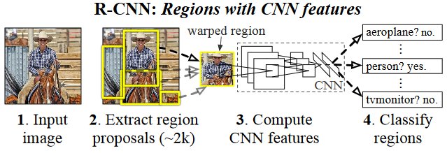
3D detection
3D detection v.s. 2D detection
RGB-D(2.5D)/RGB, geometric data(3D) v.s. RGB data
3D position/orientation v.s. 2D position
Detection pipeline
Region proposal
(detection)
Classifier
(recognition)
Region proposal
Object
classification
Notes:
Recently years, there are great successes in the field of 2D detection. There are some similarities and discrepancies between 2D and 3D detection which are mostly caused by rise of dimension. For example, in 3D detection, we take both RGB and 3D or 2.5D data as input and predict 3D position as well as orientation of interested objects while, in 2D detection, we only take RGB as input data and only interested in 2D positions. Recent works on detection basically share a common hierarchy pipeline: region proposals for objectness area and a classifier built upon those proposals for recognition.

Slide 3
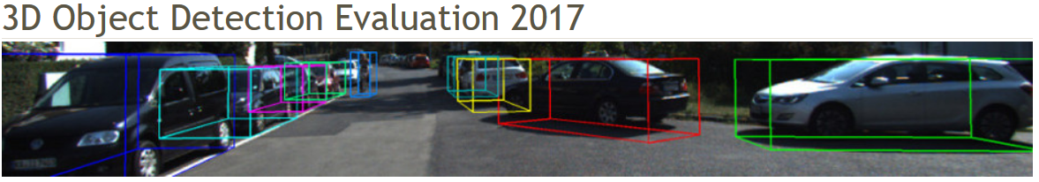
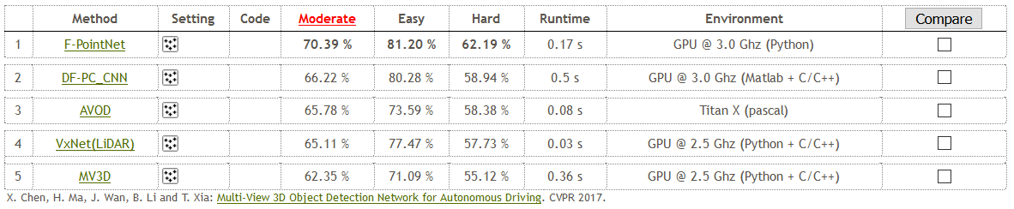
3D detection
3D detection benchmark
7481 training images and 7518 test images/point clouds/80256 labeled objects
Notes:
One of the most popular 3D detection benchmark is Kitti which contains 7481 training images, 7518 test images with corresponding point cloud, comprising a total of 80256 objects.

Slide 4
State-of-the-arts on Kitti 3D detection
Point Cloud Understanding
Frustum-PointNet
VoxelNet
Multimodal Fusion Methods
AVOD
SqueezeSeg
MV3D
PointFusion
Notes:
Several methods are proposed for kitti 3D detection challenge and here are some of the top methods that I roughly separate into two categories: methods based on point cloud understanding and multimodal fusion methods. I will, from my understanding, briefly cover the ideas of those papers.

Slide 5
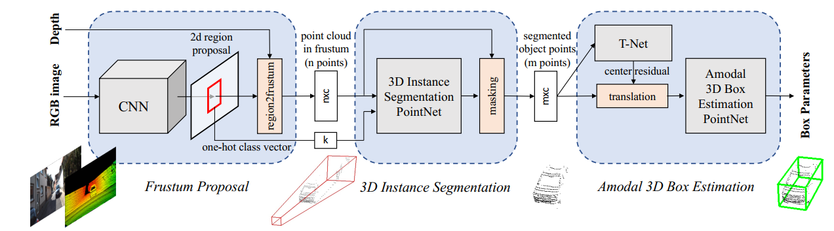
Frustum-pointnet
Hierarchical architecture
Fast-rcnn for 2d detection
2d bbox -> 3d frustum using depth
3d segmentation & 3d box regression using pointnet
Notes:
This paper proposed a hierarchical pipeline for 3D detection using both RGB data and corresponding point cloud. There are 3 stages. In the first stage, they utilize off the shell method like faster-rcnn to get 2d proposals/detection. Then the 2D bbox are lifted to a frustum given the camera intrinsic and extrinsic.

Slide 6


Frustum-pointnet
3D instance segmentation
Binary classification per point
3D box estimation
Distance between predicted and GT corners
Classification Loss (recognition)
Both classification &
Regression Loss
(localization)
Joint optimization for box parameters
Notes:
In the second stage, instance segmentation is performed on the points in that frustum and finally a pointnet is introduced to regress the parameters of 3D boxes from points which are labeled as object.

Slide 7
Frustum-pointnet
Shortcomings
Strong reliance on 2D detection results
Using only semantics information(RGB) on extracting region proposals
Notes:
One of the main drawbacks of f-pointnet is that once the 2D detection failed, the whole pipeline are not able to work. And it only considers semantic information on generating proposals.

Slide 8
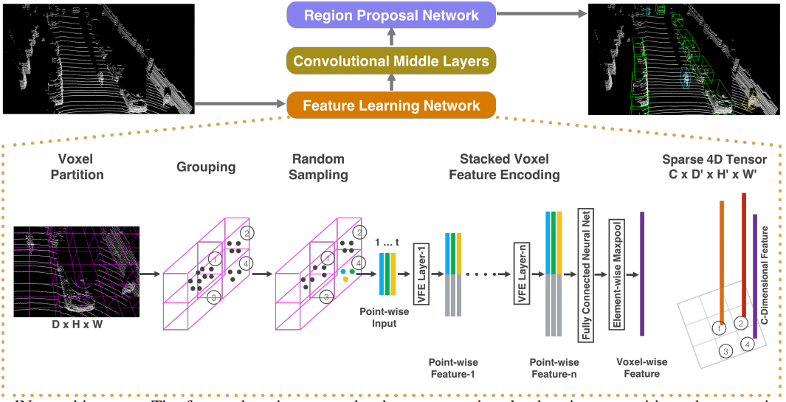
VoxelNet
Hierarchical architecture(only Lidar point)
Encode dense point clouds into sparse voxel-wise feature
Perform 3D box regression upon that feature using CNN
Notes:
The second method in this class is voxelnet. The main features of this method are that it only use lidar data as input and this method is very fast. Unlike f-pointnet, voxelnet directly generate 3D proposals from raw point cloud.

Slide 9
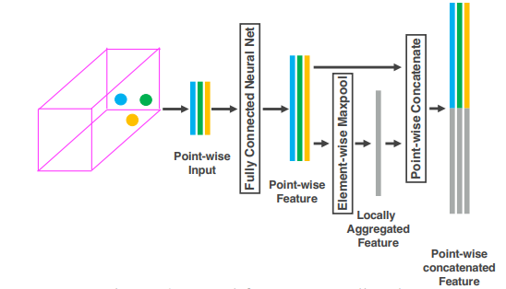
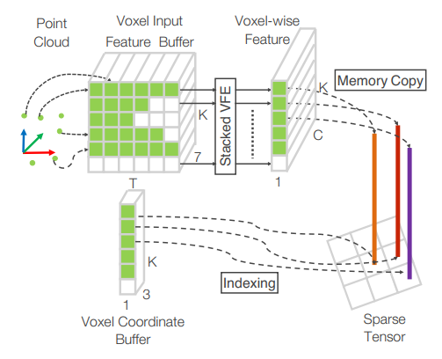
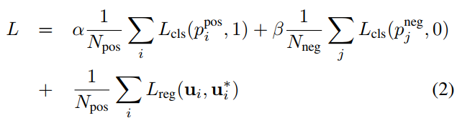
VoxelNet
Pointwise feature->voxel feature
3D box regression +
binary classification
Sparse tensor
Notes:
More specifically, voxelnet first separate the whole space evenly into grids and adopt a pointnet to learn feature for each bin. In this way, point-wise features are transferred into voxelized features which are more compact. Then a conventional CNN is applied to perform 3D box regression on voxelized features. Despite those improvements on algorithm, they implemented a sparse tensor representation from engineering aspect which greatly accelerate the whole procedure.

Slide 10
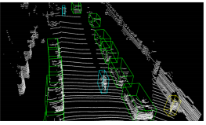
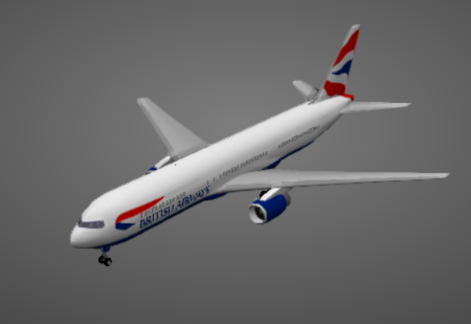
VoxelNet
Shortcomings
Misalignment of voxels -> fractions
No attention module
Notes:
The main drawbacks come from two folds. First, misalignment is inevitable in their method and might cause fractions of objects and further jeopardize the intrinsic structure of interested objects. On the other hand, more efficient learning method for proposal generating using point cloud is still remained to be proposed.

Slide 11
Multimodal Late Fusion
MV3D (RGB+FV+BV)
AVOD (RGB+BEV)
PointFusion (RGB+point cloud)
Notes:
Except for the first class of method, there are some methods based on multimodal learning. These method all use a multi-channel CNN or neural network as backbone for 3D detection.

Slide 12
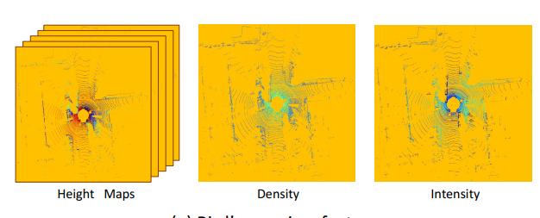
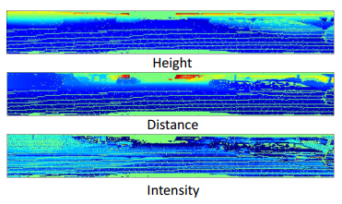
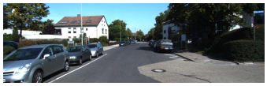
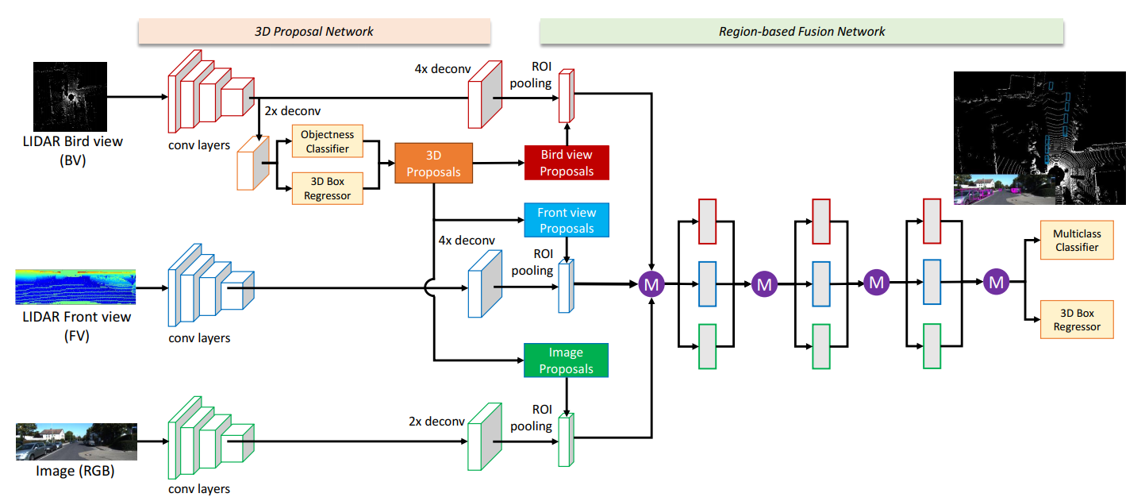
MV3D
Inputs:
RGB
front view
bird view
Notes:
This is one of the early work. They take RGB, front view depth geometric data and bird view data as inputs.

Slide 13
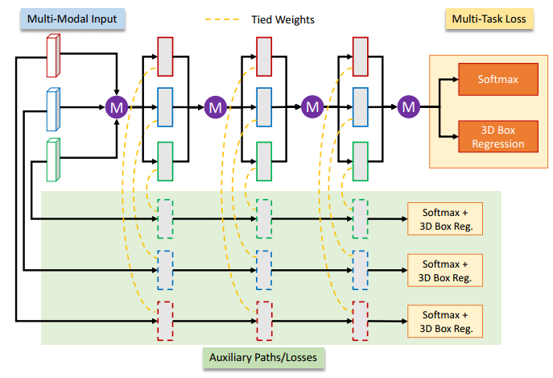
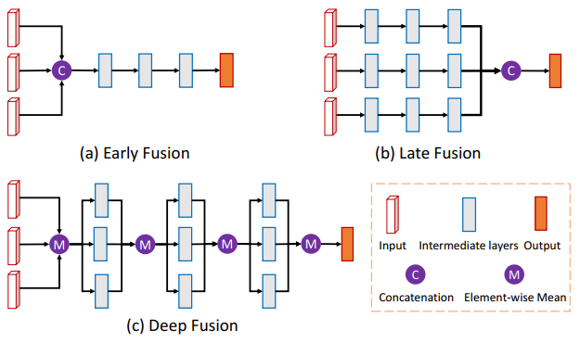
MV3D
Deep fusion
Fusion at each layer
Modal specific regularization
Notes:
And they proposed a deep fuse architecture to utilize the information from different modalities and preserve individual property in different channels by weights sharing between deep fuse network and modal-specific network that performs the same task.

Slide 14
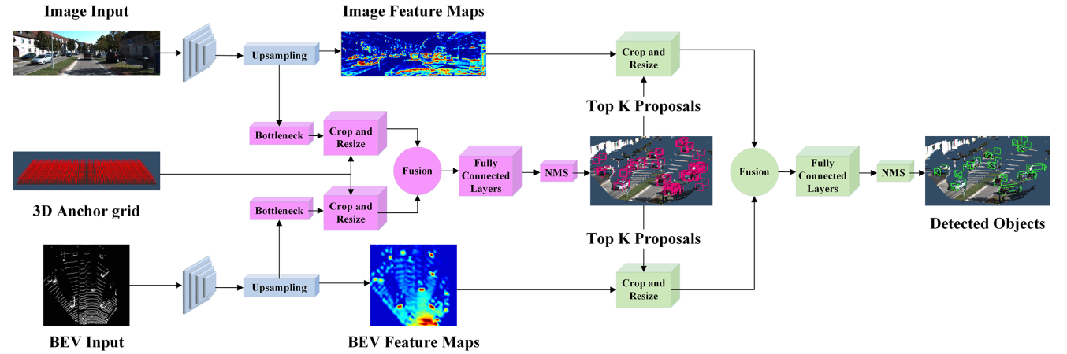
AVOD
Naïve late fusion + NMS
Notes:
In some recent works like AVOD, are very similar to MV3D, but achieve better performance on kitti.

Slide 15
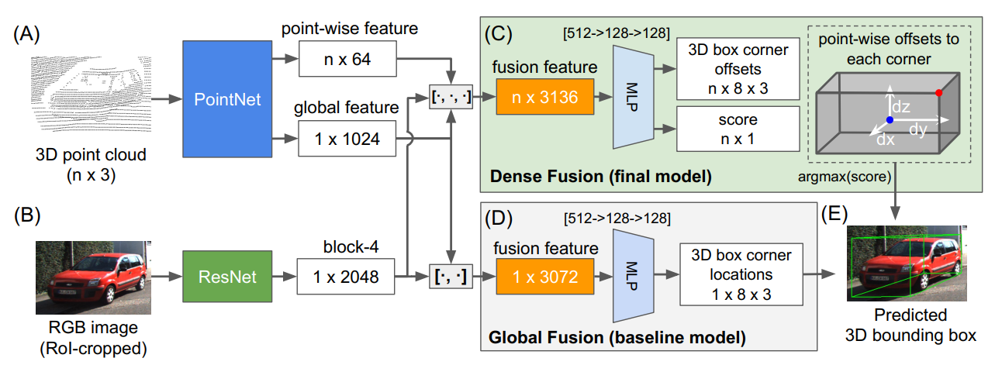
PointFusion
Global + point-wise feature

Slide 16
Multimodal Late Fusion
MV3D
AVOD
PointFusion

Slide 17
Detection
Efficient search in large 3D point cloud using selective search/inference (VoxelNet)
How to incorporate geometric information to help 2D detection or use geometric information as feedback(f-pointnet) for region proposal.
Recognition
Multimodal learning
Efficient model for point cloud understanding(kd-network, O-CNN, point supergraph, pointnet++)
How to recognize occluded or deformed point cloud models
2.5D->3D point cloud completion (inferring invisible points from perspective point cloud)
Notes:
There are some possible directions we can go.

Slide 18
RGB-D Object Recognition using Multi-modal Learning

Slide 19
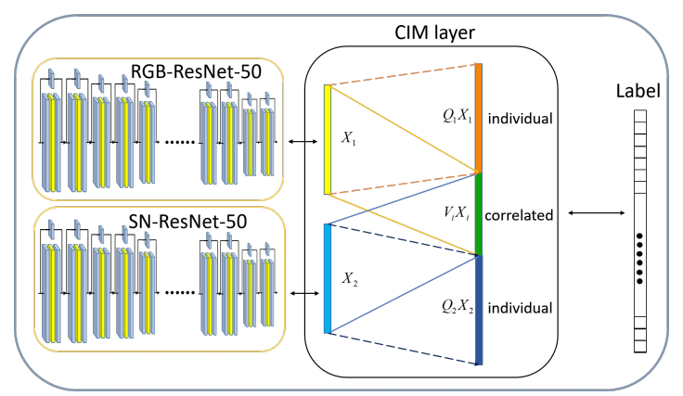
Project Introduction
Goal
RGB-D Object Recognition
Better Feature Representation
fully Utilize Multi-Modal Information
Method
Multi-Modal learning
Representation learning
Notes:
In this RGB-D object recognition project, our goal is to design a better feature representation for RGB-D objects by leveraging the multi-modal information from RGB and depth channel. In 2D visions, RGB can provide us with many information like color or texture while the information along the projection axis is missing. So RGB image solo can give rise to confusions and using depth as a complimentary for RGB image will definitely improve object recognition. However there are some shareable part in both RGB and depth, for instance shape. Thus simply combine the feature of RGB and depth is not wise which might cause the misuse of features from different modality. So we proposed a multi-modal deep learning algorithm for RGB-D object recognition.

Slide 20
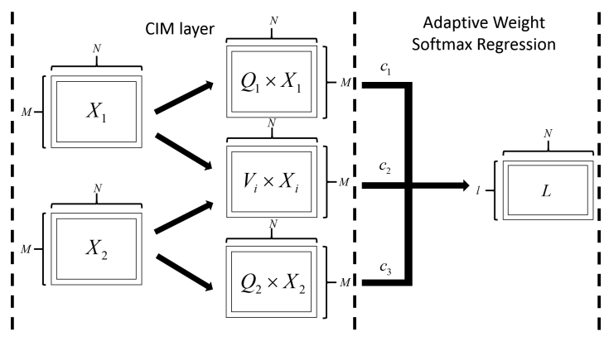

Project Introduction
Two-Stream CNN
Feature extraction
CIM Layer
Semi-supervised Training
Objectives
Notes:
What we do is to first implement a two stream convolutional neural network for RGB and Depth feature extraction.
Then we designed a CIM layer to generate better feature for RGB-D object by analyzing the correlated part as well as individual part of RGB and depth feature extracted. To generate a more powerful feature presentation, we come up with a cost function which can learn the mapping matrices of correlated space and individual space. To force the similarity between correlated part extracted from both modalities, we reduce L2 distance between those correlated parts. Additionally, two regularization terms are added to prevent information loss and retain modal specific information. Then we can get a more explicit expression of multi-modal feature by concatenating correlated part and individual part.

Slide 21
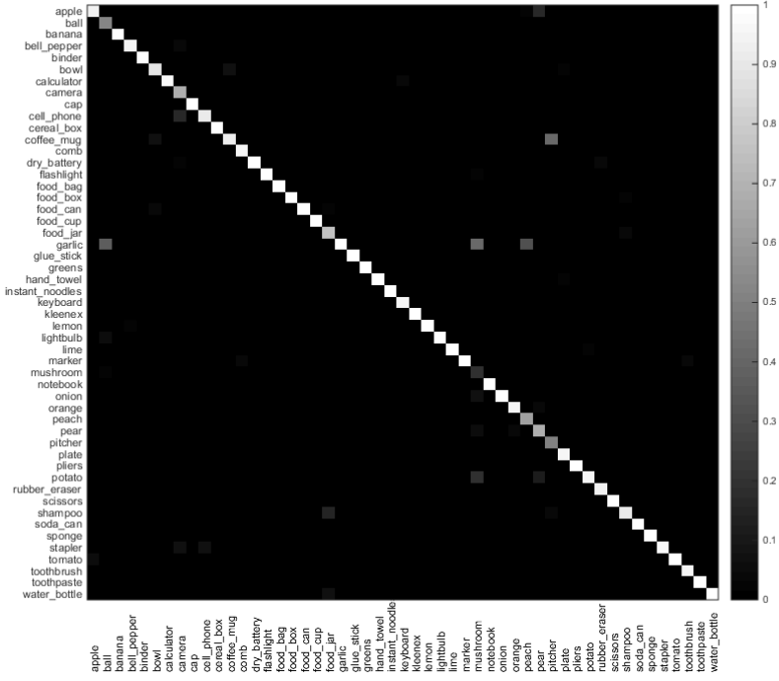
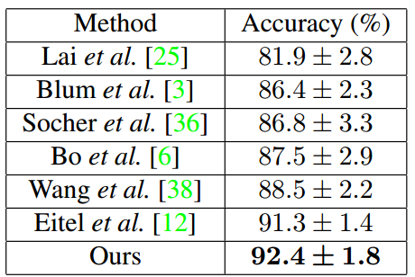
Project Introduction
Tested on two RGB-D object recognition datasets
Results on RGB-D Object Dataset
Notes:
We tested our method on two datasets and, at that time, outperformed most of those works under the same experimental settings.

Slide 22
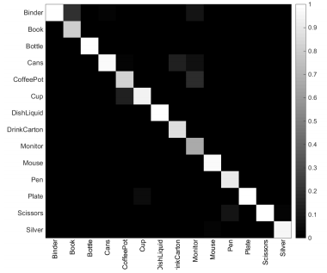
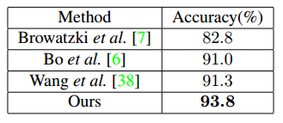
Project Introduction
Tested on two RGB-D object recognition datasets
Results on 2D3D Dataset

Slide 23
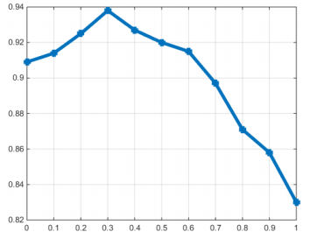
Project Introduction
Parameter Evaluation
Manually Tuned Ratios V.S. learnt Ratios
P stands for the weight of correlated part
Notes:
We also tested on effectiveness of various weights of different part of our feature.
In this section, we manually set the weight of correlated part and individual part of
the two features while in our proposed methods we learn our weight in training period.
And we get the same weight for the peak accuracy in both experiments.

Slide 24
AVOD

Slide 25
PointFusion

Slide 26
SqueezeSeg
Encode point cloud into

Slide 27
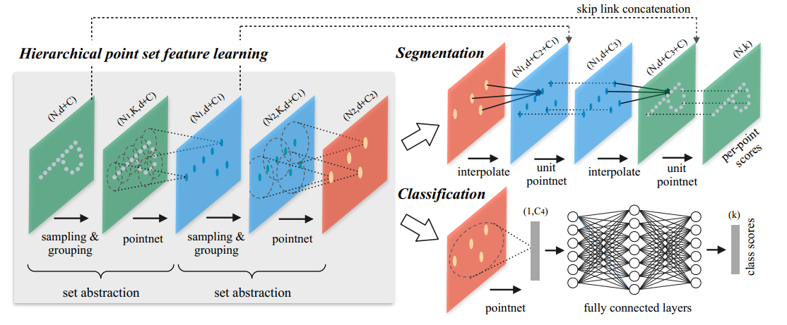
PointNet++
Goal
Point set understanding
Classification
segmentation
Innovations
Hierarchical feature learning
Structural input
Notes:
This is an incremental work of pointnet. The goal of this paper is still on point set understanding, but they emphasis more on the structure of a point set and proposed a hierarchical feature learning pipeline to encode the spatial information of a point set.

Slide 28
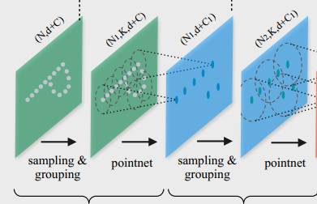
PointNet++
Basic modules
Sampling layer
farthest point sampling
Grouping layer
Ball query
PointNet layer
Feature generation
Point Feature Propagation
Feature interpolation using
K nearest neighbors
Notes:
Be more specific, pointnet++ has three basic parts. The first one is sampling layer which selects a subset of the whole point set as centroids. In this layer, they use farthest point sampling to better cover the whole set. Then, given those K centroids, the whole part is grouped into K subsets using ball query. Finally, pointnet is applied to learn a feature representation for each of those K groups.
For pointset classification, a fully connected layer is applied as a classifier. For segmentation, feature interpolation for each points is performed for upscaling.

Slide 29
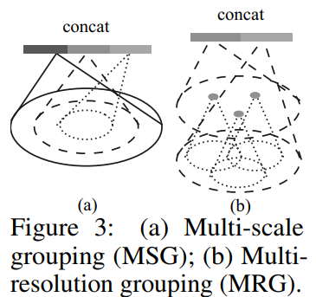
PointNet++
density adaptive PointNet layer
Multi-scale grouping (MSG)
Multi-resolution grouping (MRG)
Notes:
Considering that points are not evenly distributed and some area might have a higher density while some area might have a low density, they embed features from different scales and different resolutions.

Slide 30
3D detection
3D detection v.s. 2D detection
RGB-D(2.5D)/RGB, geometric data(3D) v.s. RGB data
3D position/orientation v.s. 2D position
Detection pipeline
Region proposal
(detection)
Classifier
(recognition)
Region proposal
Object
classification
Notes:
Recently years, there are great successes in the field of 2D detection. There are some similarities and discrepancies between 2D and 3D detection which are mostly caused by rise of dimension. For example, in 3D detection, we take both RGB and 3D or 2.5D data as input and predict 3D position as well as orientation of interested objects while, in 2D detection, we only take RGB as input data and only interested in 2D positions. Recent works on detection basically share a common hierarchy pipeline: region proposals for objectness area and a classifier built upon those proposals for recognition.

Slide 31
3D detection
3D detection benchmark
7481 training images and 7518 test images/point clouds/80256 labeled objects
Notes:
One of the most popular 3D detection benchmark is Kitti which contains 7481 training images, 7518 test images with corresponding point cloud, comprising a total of 80256 objects.

Slide 32
State-of-the-arts on Kitti 3D detection
Point Cloud Understanding
Frustum-PointNet
VoxelNet
Multimodal Fusion Methods
AVOD
SqueezeSeg
MV3D
PointFusion
Notes:
Several methods are proposed for kitti 3D detection challenge and here are some of the top methods that I roughly separate into two categories: methods based on point cloud understanding and multimodal fusion methods. I will, from my understanding, briefly cover the ideas of those papers.

Slide 33
Frustum-pointnet
Hierarchical architecture
Fast-rcnn for 2d detection
2d bbox -> 3d frustum using depth
3d segmentation & 3d box regression using pointnet
Notes:
This paper proposed a hierarchical pipeline for 3D detection using both RGB data and corresponding point cloud. There are 3 stages. In the first stage, they utilize off the shell method like faster-rcnn to get 2d proposals/detection. Then the 2D bbox are lifted to a frustum given the camera intrinsic and extrinsic.

Slide 34
Frustum-pointnet
3D instance segmentation
Binary classification per point
3D box estimation
Distance between predicted and GT corners
Classification Loss (recognition)
Both classification &
Regression Loss
(localization)
Joint optimization for box parameters
Notes:
In the second stage, instance segmentation is performed on the points in that frustum and finally a pointnet is introduced to regress the parameters of 3D boxes from points which are labeled as object.

Slide 35
Frustum-pointnet
Shortcomings
Strong reliance on 2D detection results
Using only semantics information(RGB) on extracting region proposals
Notes:
One of the main drawbacks of f-pointnet is that once the 2D detection failed, the whole pipeline are not able to work. And it only considers semantic information on generating proposals.

Slide 36
VoxelNet
Hierarchical architecture(only Lidar point)
Encode dense point clouds into sparse voxel-wise feature
Perform 3D box regression upon that feature using CNN
Notes:
The second method in this class is voxelnet. The main features of this method are that it only use lidar data as input and this method is very fast. Unlike f-pointnet, voxelnet directly generate 3D proposals from raw point cloud.

Slide 37
VoxelNet
Pointwise feature->voxel feature
3D box regression +
binary classification
Sparse tensor
Notes:
More specifically, voxelnet first separate the whole space evenly into grids and adopt a pointnet to learn feature for each bin. In this way, point-wise features are transferred into voxelized features which are more compact. Then a conventional CNN is applied to perform 3D box regression on voxelized features. Despite those improvements on algorithm, they implemented a sparse tensor representation from engineering aspect which greatly accelerate the whole procedure.

Slide 38
VoxelNet
Shortcomings
Misalignment of voxels -> fractions
No attention module
Notes:
The main drawbacks come from two folds. First, misalignment is inevitable in their method and might cause fractions of objects and further jeopardize the intrinsic structure of interested objects. On the other hand, more efficient learning method for proposal generating using point cloud is still remained to be proposed.

