Slide 1
Capstone
2/8/2018
Ziyan Wang

Slide 2
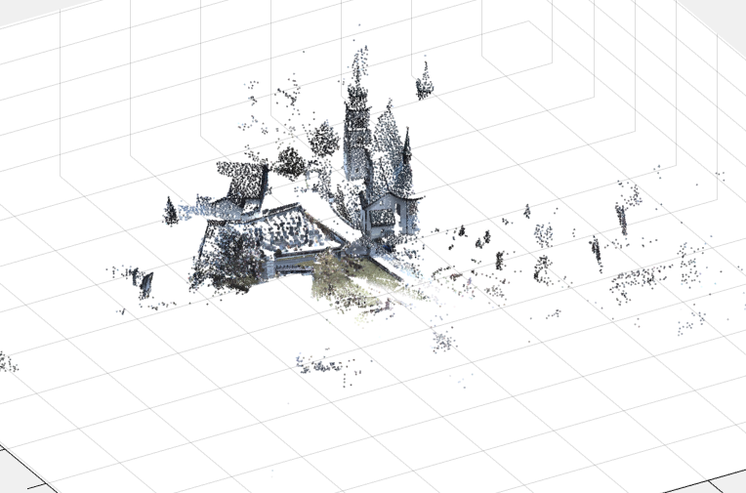
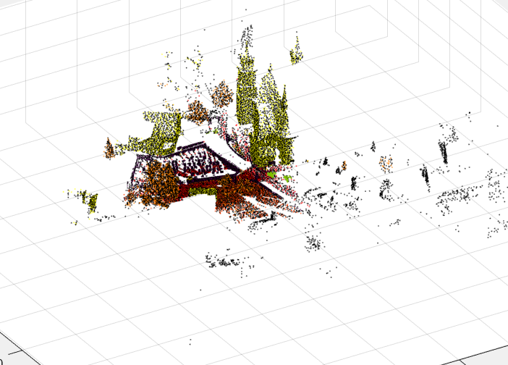
Point cloud visualization
RGB
Semantic label

