Slide 1
Velodyne Capstone Project
Week of 12th April 2018
Advisor- Dr. David Held
Students- Ankita Kalra
Ziyan Wang

Slide 2
Experiments
1

Slide 3
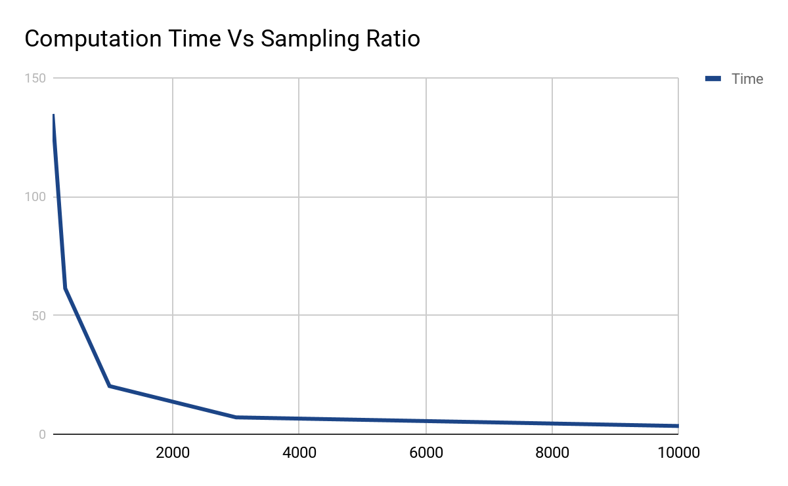
Overall Time vs Sampling Ratio of Car in Scene
Sampling Ratio of Car | 1
Sampling Ratio of Scene | Variable
Sampling Ratio of Car in Scene | 1

Slide 4
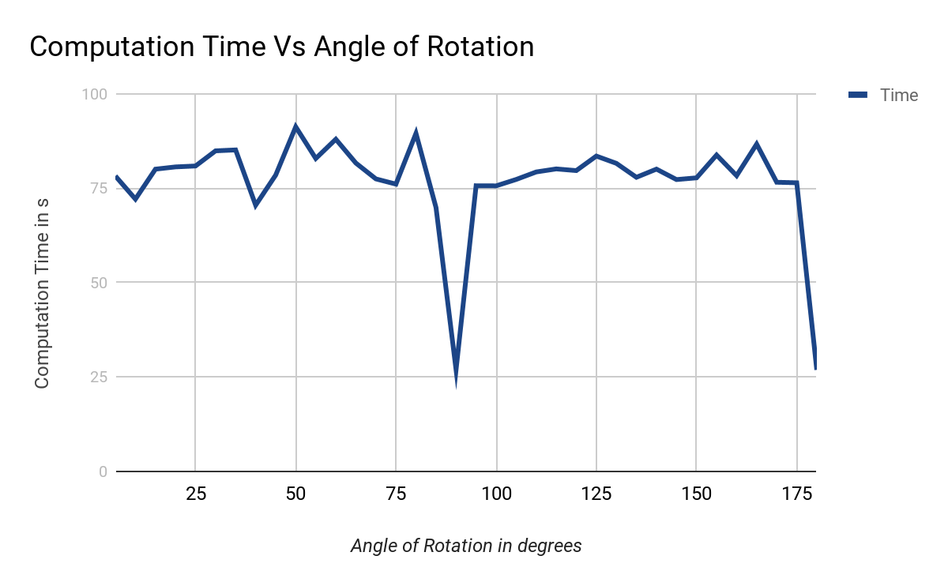
Accuracy vs Cut Ratio of Car in Scene
Sampling Ratio of Car | 1
Sampling Ratio of Scene | 1000
Sampling Ratio of Car in Scene | 1
Angle of Car in Scene | Variable

Slide 5
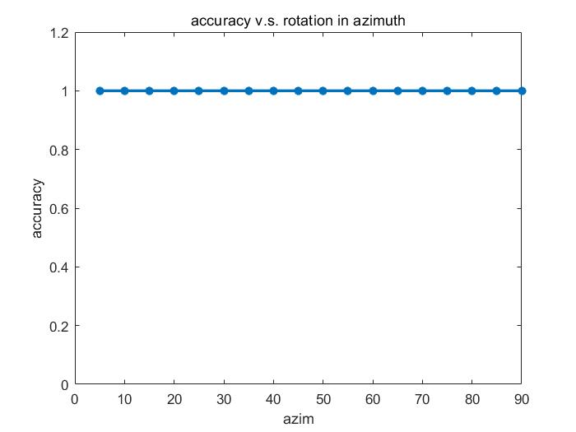
Sampling Ratio of Car | 1
Sampling Ratio of Scene | 1000
Sampling Ratio of Car in Scene | 1
Angle of Car in Scene | Variable

Slide 6
Screenshots for Different Angle of Rotations

Slide 7
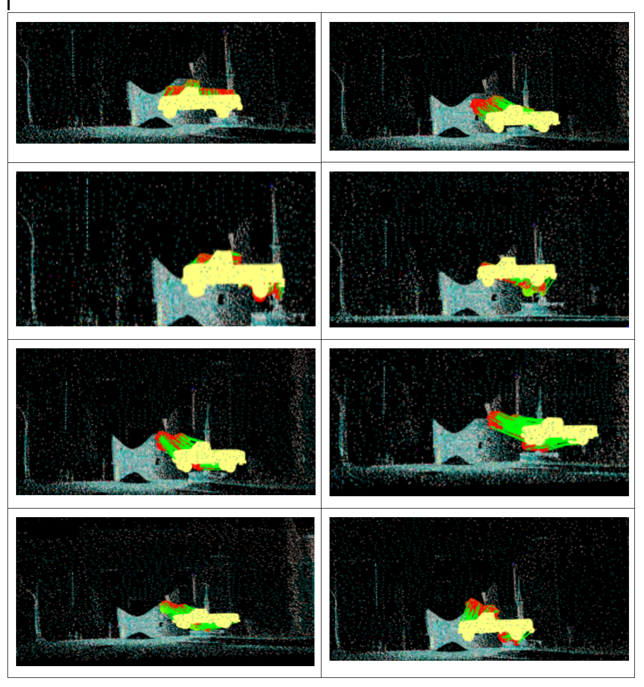
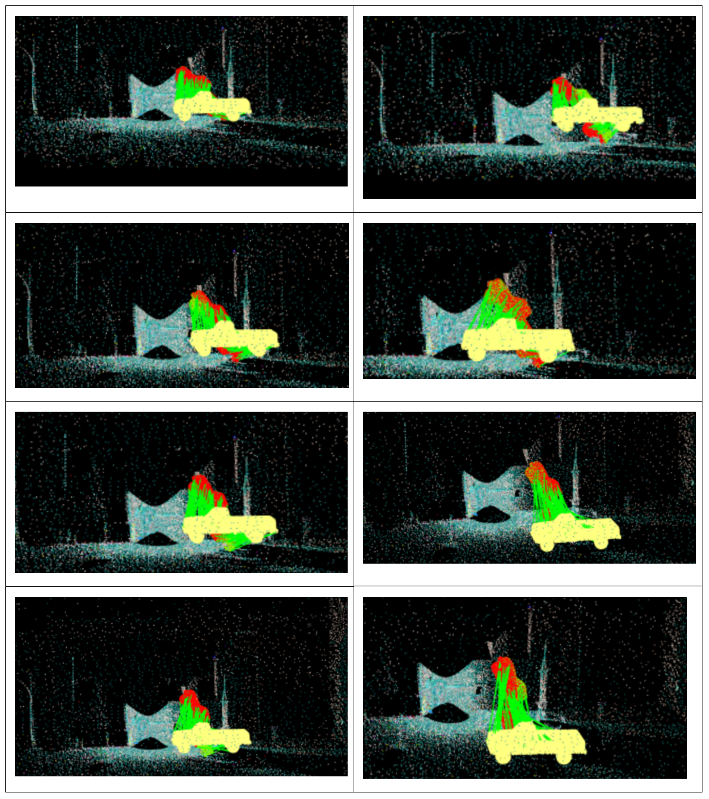

Slide 8
THANKS!
Any questions?

