Slide 1
Velodyne Capstone Project
Week of 19th April 2018
Advisor- Prof. David Held
Students- Ankita Kalra
Ziyan Wang

Slide 2
Experiments
1

Slide 3
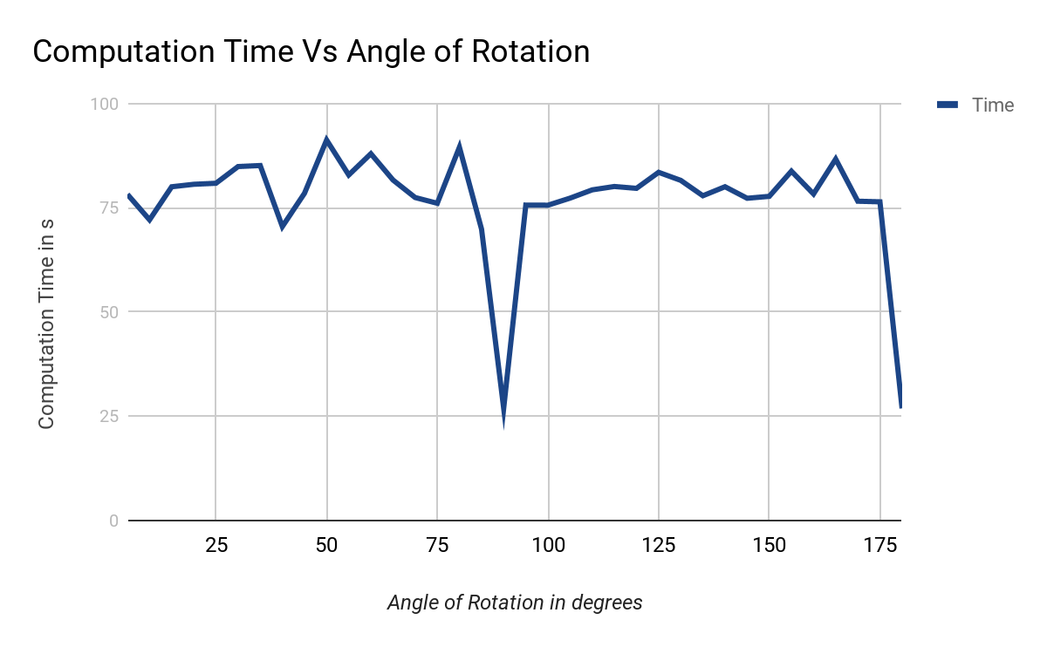
Overall Time vs Angle of Rotation of Car in Scene
Sampling Ratio of Car | 1
Sampling Ratio of Scene | 1000
Sampling Ratio of Car in Scene | 1
Angle of Car in Scene | Variable

Slide 4
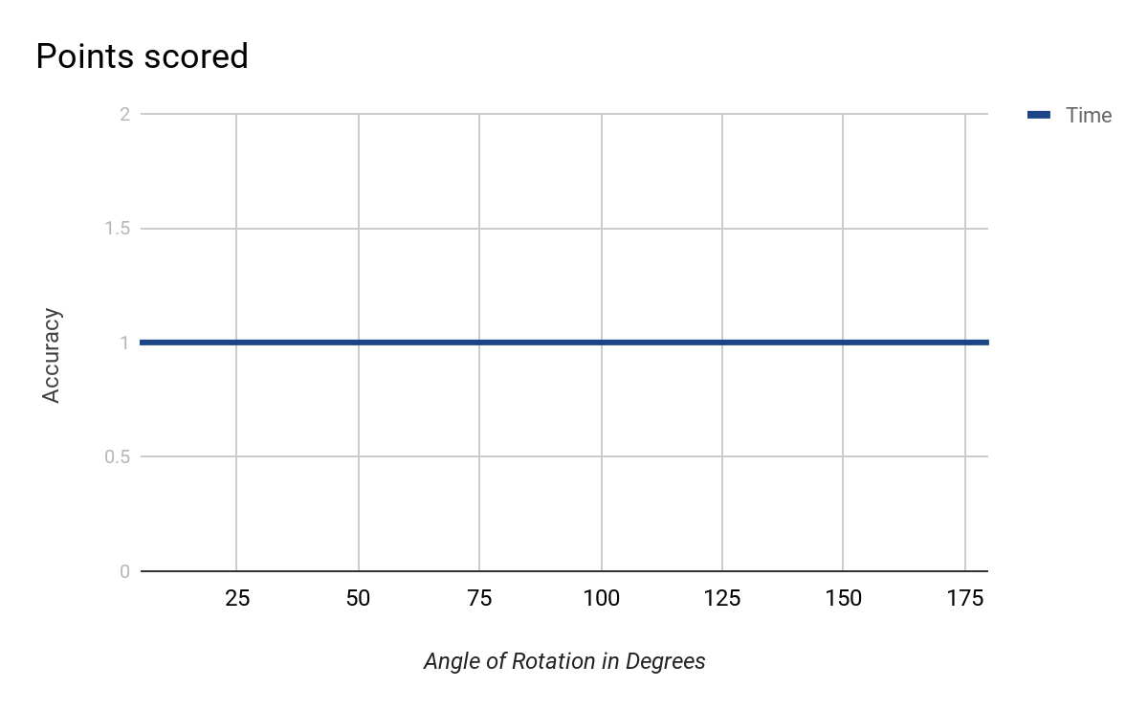
Accuracy vs Angle of Rotation of Car in Scene
Sampling Ratio of Car | 1
Sampling Ratio of Scene | 1000
Sampling Ratio of Car in Scene | 1
Angle of Car in Scene | Variable

Slide 5
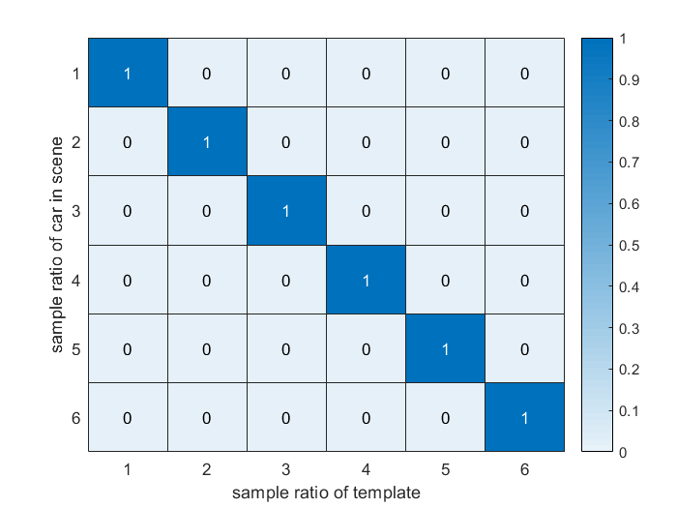
Sampling ratio of template v.s. Sampling ratio of car in scene

Slide 6
Demo
2

Slide 7
Demo for Cars at Occlusion

Slide 8
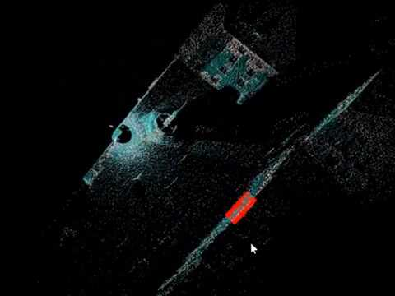

Slide 9
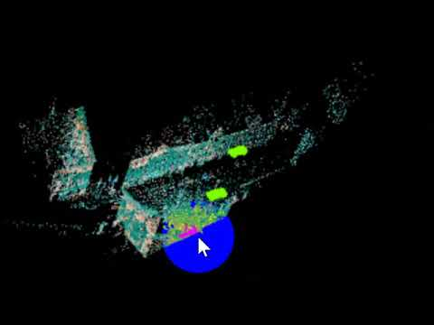

Slide 10
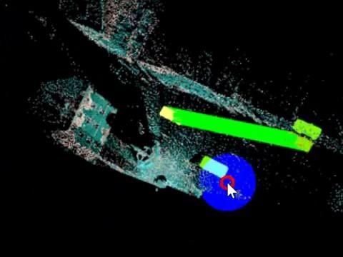

Slide 11
Next Steps
Working following the report-
Three-Dimensional Object Recognition and 6 DoF Pose Estimation
http://robotics.usc.edu/~potthast/06299166.pdf

Slide 12
THANKS!
Any questions?

