Slide 1

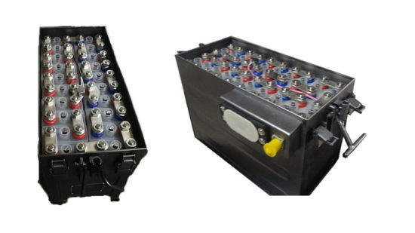

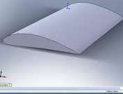
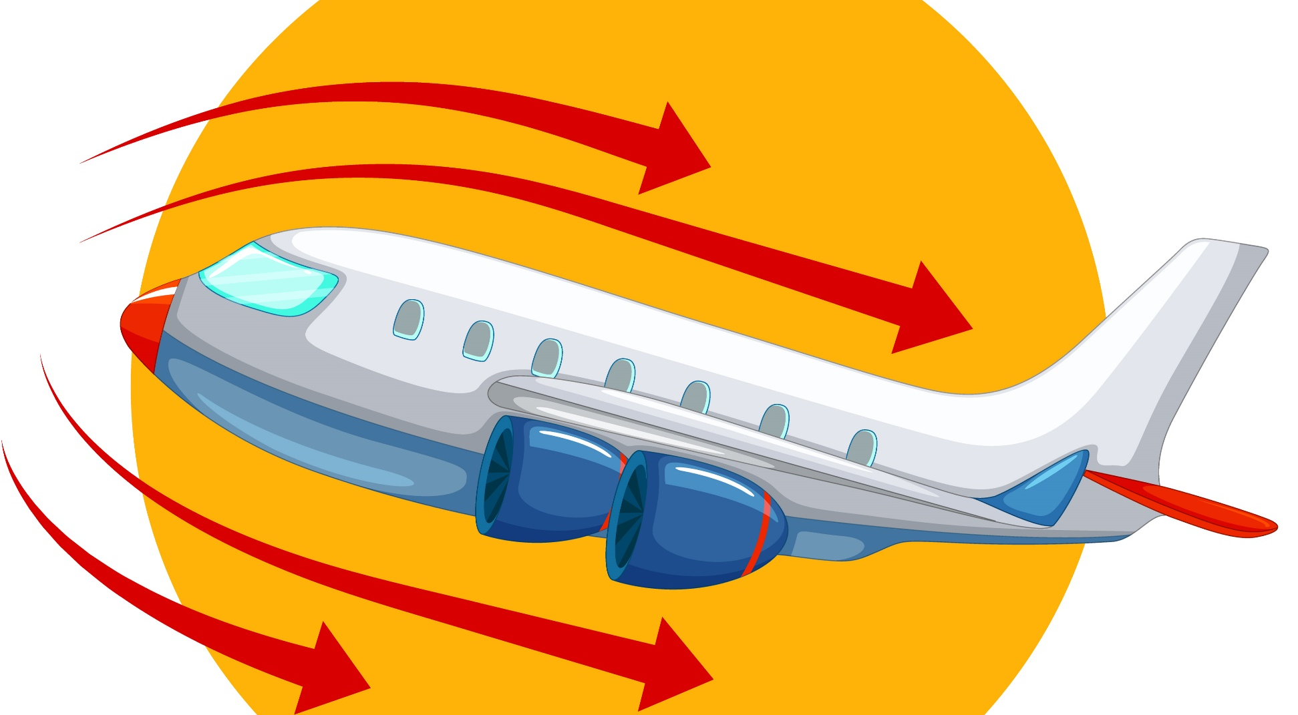
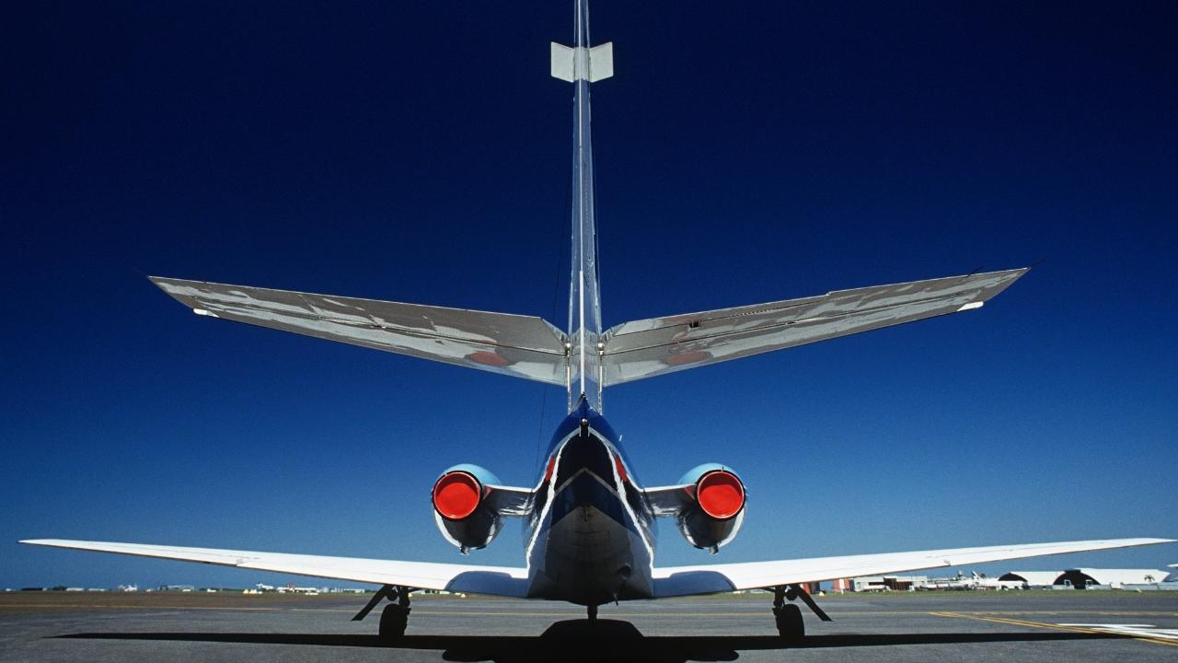
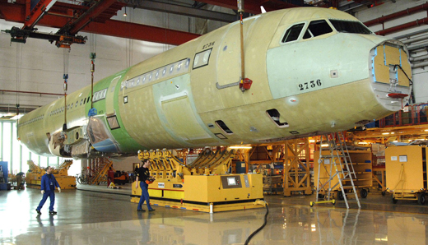
Design
Process

Slide 2

Design Process
The design process begins with a specific set of requirements established by the given constraints. An initial layout is analyzed to estimate the aerodynamics and weight fractions in comparison with previous designs. The results incorporate the approximate wing and tail geometries, fuselage shape, and major components positioning.
Given Constraints
The wingspan and chord length are taken as 1.4m and 100mm respectively (the maximum allowed value)
Endurance = 1 hours
Available Total Battery Energy <= 100Wh
Payload weight = 20% of Takeoff weight.
Design
Process
Assumptions
To start the design process certain parameters were taken from historical data. The data gives the general trend of these parameters. From the historical data, we have taken
W/S = 50 N/m2
AR = 9
V cruise = 20 m/s
L/D = 15 ( at assumed V cruise, that is 20 m/s )

Slide 3
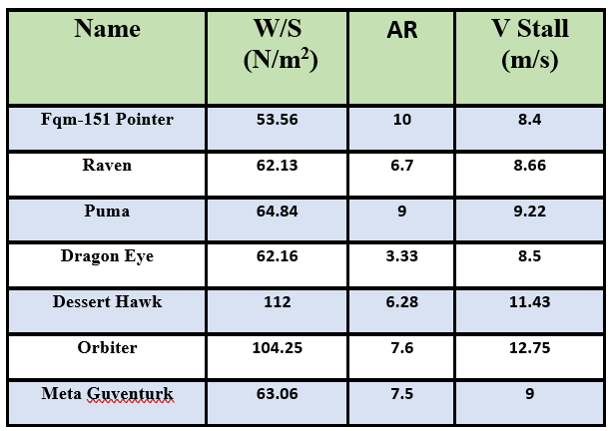
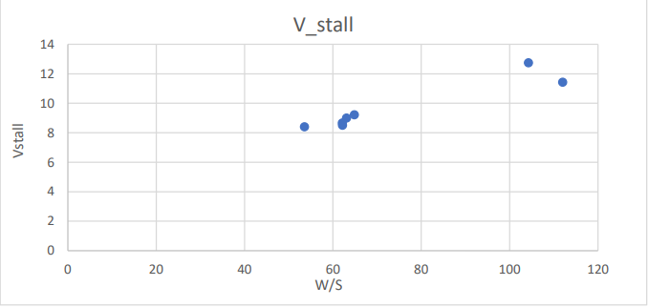
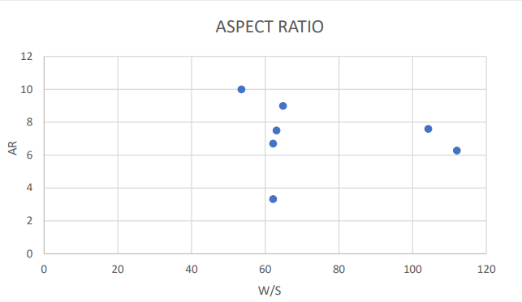
W/S Estimation
The data’s of similar electric aircrafts obtained from various sources are listed
Design
Process
The graph of V Stall vs W/S
The graph of AR vs W/S
W/S = 50 N/sqm (considered from the historical data)

Slide 4
Battery Weight Estimation and Battery Selection
To find the number of batteries required we did a survey of different batteries and found “HV Shorty 3S LiPo Battery” to be the best candidate for our design
From the mass of one battery is given to be 225 grams, hence we need to use 1 battery in our aircraft.
Design
Process
Battery model | HV shorty 3S LiPo
Application | Crawlers ,drag ,boats & Aircraft
Type | Silicon Graphene
Voltage | 11.4V nominal
Capacity @11.1V | 4300mAh
Capacity @11.4V | 4800mAh
Weight | 225g
Connector Type | T-style
Balance connector | 4 Pin XH
Number of Cells | 3 Cell
Configuration | 3S1P
Dimensions(W*L*H) | 43*93*25.7
Maximum Charge Rate | 10C(45A)
Burst Current | 130C
Watt Hour@11.4V | 54.7Wh

Slide 5
Aerofoil Selection
For our problem we need to find an airfoil that gives the best performance at a Reynolds number of 0.2 million.
Important characteristics to look into in an aerofoil
Low zero lift drag (𝐶𝑑0)
High lift curve slope (𝐶𝑙𝛼)
High aerodynamic efficiency( 𝐶𝑙 𝐶𝑑 ⁄ )
high max Lift coefficient(𝐶𝑙𝑚𝑎𝑥) angle of stall (𝛼𝑠𝑡𝑎𝑙𝑙)
Other features like drag bucket, low zero lift and moment coefficient (𝐶𝑚0 ) can also be desired
Design
Process
Based on the given selection criteria a set of airfoils are listed and compared among one another to find the best candidate.

Slide 6
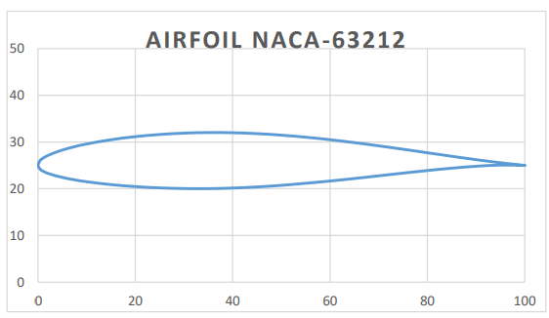
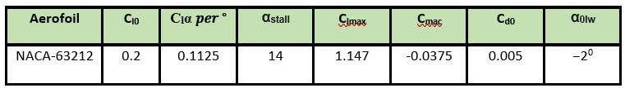
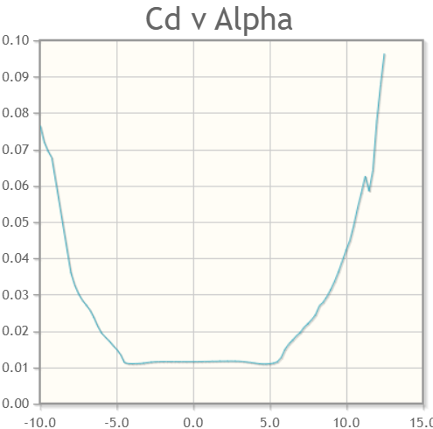
Brief On The Selected Aerofoil
The airfoil that we have selected for our design is NACA-63212.
The characteristics of the airfoil
Being a NACA 6 series airfoil it also forms drag bucket hence provide a large operating range with minimal drag.

Slide 7

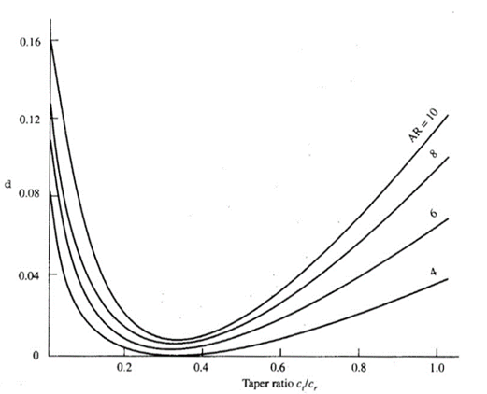
Wing Sizing
The wing planform is selected to be trapezoidal as it has better efficiency than a rectangular wing while is less complex to manufacture than an elliptical wing.
The wing parameters
ARw = 0.218
The next parameter essential for the design of the wing is the taper ratio λ. From the given plot we can see that a taper ratio of 0.5 gives almost the best performance as it has low value of induced drag factor and at the same time does not duffers from “Tip first stall” problem. Taper ratio = 0.5
C_{r} = 0.207619 m and C_{t} = 0.103809 m
𝐶_{mac} = 0.161481 m , this is important to calculate the Re for the aircraft
Re = 2.21145* 10⁵
𝐶𝑙_{crz}= 0.20408
Design
Process

Slide 8
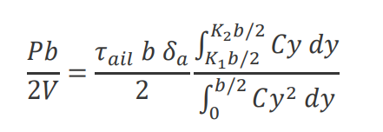
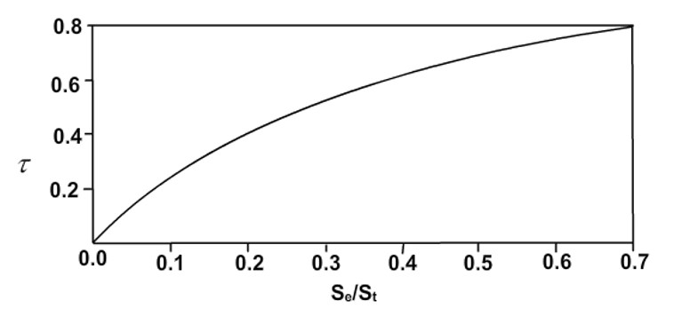
Aileron Sizing
Theory predicts that the size of aileron depends mainly on the chord distribution of the wing and aileron to wing area ratio. The aileron is designed using strip theory and the main parameter guiding our design process is the ratio 𝑃𝑏 /2𝑉 which is kept above 0.07 for most UAV. The value of 𝑃𝑏/ 2𝑉 as predicted from strip theory is given as
The parameter 𝜏𝑎𝑖𝑙 is the aileron effectiveness parameter and it depends on the aileron to wing area ratio.
𝛿𝑎 denotes the maximum aileron deflection possible. We assumed 𝛿𝑎 max to be 20 degrees.
𝐾1= 0.6 𝑎𝑛𝑑 𝐾2=0.95
Surface area of aileron= 0.05 m^2
𝑃𝑏/ 2𝑉= 0.0721
Design
Process

Slide 9
Tail Sizing

Slide 10
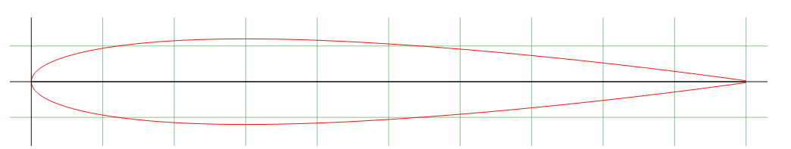
Horizontal Tail Sizing
Here we have used NACA 0012 airfoil as horizontal stabilizer
Horizontal stabilizers makes the plane statically stable in longitudinal direction

Slide 11
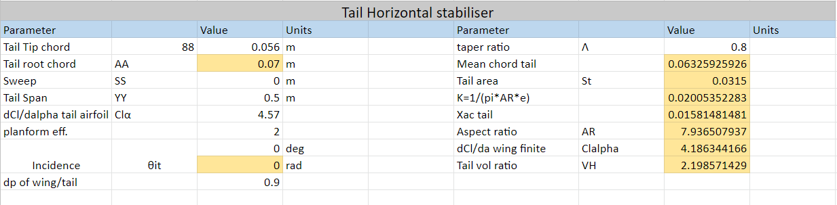
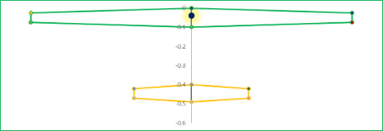

Slide 12
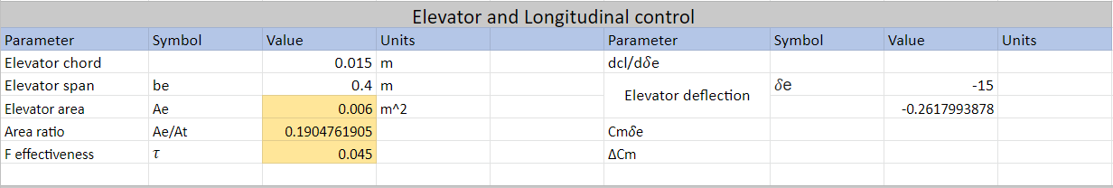
Elevator Design
We took the flap effective parameter as 0.045
The area of the elevator is found to be 0.006 m^2

Slide 13


Rudder Design
The primary role of the vertical tail is to provide yaw damping, which is the tendency of yaw oscillations of the aircraft to subside. The vertical tail also provides yaw stability, although this will be almost certainly ensured if the yaw damping is sufficient. One measure of the vertical tail’s effectiveness is the vertical tail volume coefficient
Most well-behaved aircraft typically have a Vv which falls in the following range:

Slide 14
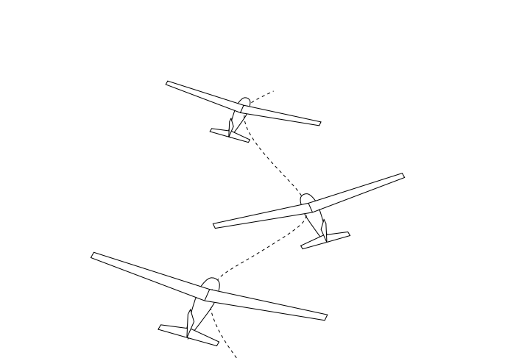
If Vv is too small, the aircraft will tend to oscillate or “wallow” in yaw as the pilot gives rudder or aileron inputs. This oscillation, shown in Figure , is called Dutch Roll, and makes precise directional control difficult. A Vv which is too small will also give poor rudder roll authority in an aircraft which uses only the rudder to turn. Picking suitable Vh and Vv values for any new aircraft design is partly a matter of experience. One common approach is to simply duplicate the Vh and Vv values of an existing aircraft which is known to have good stability and control characteristics

Slide 15
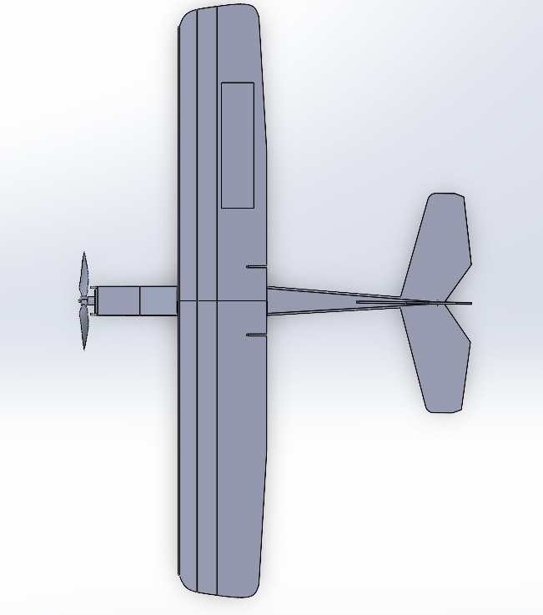
FUSELAGE:
To design the fuselage some existing UAVs are studied and an appropriate design is selected. Based on existing airframe design and 3d modeling that we have done in Solidworks the dimensions of the fuselage is evaluated.
The fuselage is designed to have sufficient volume to carry the payloads and other necessary equipment while having a minimum wetted area to minimize drag. The fuselage is made of two main sections, the first one being the front part dedicated to carry payloads and the second being the thin cylindrical second part that basically connects the main fuselage with the empennage.
The front part is made using two elliptical sections connected together by a cylindrical section. The front ellipse holds the motor and esc, the middle part houses the batteries and payload and the third section houses the electronics
Design of Fuselage

Slide 16
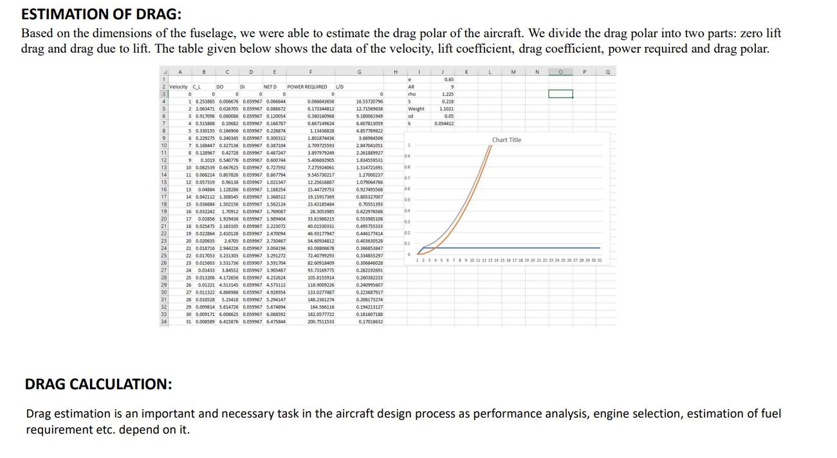

Slide 17
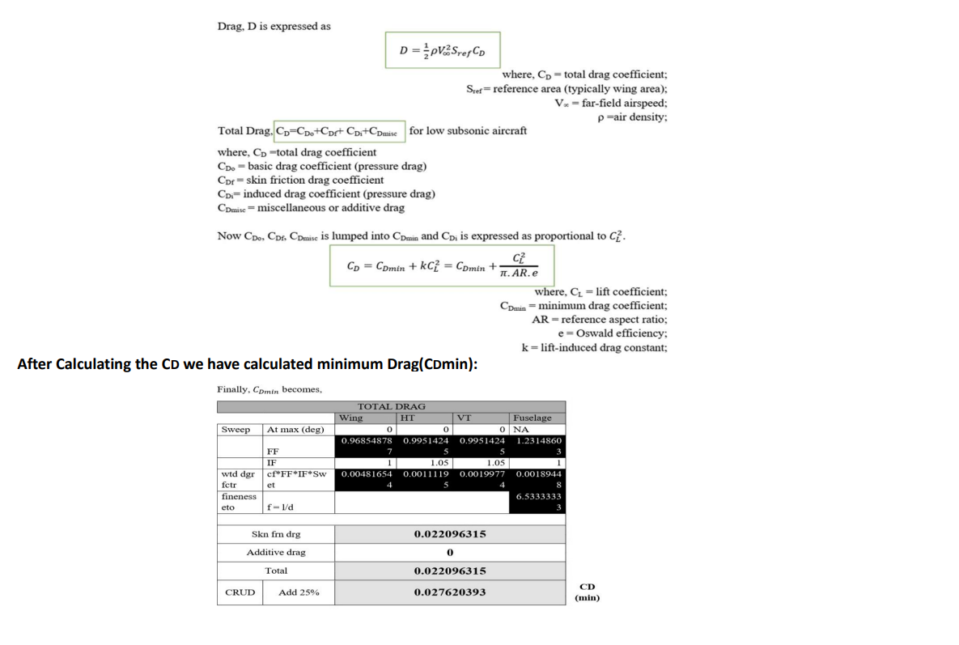

Slide 18
Propeller design and selection
A propeller is a rounded blade that rotates in a circle, helping to move a vehicle by pushing against water or air.
These characteristics are presented in terms of certain parameters. First these parameters are defined and then typical characteristics of propellers are presented. The procedures for selection of the propeller diameter and obtaining the propeller efficiency for given h, v, BHP and N.
From the internet we found “A2212” motor to best fit our design with rpm of 7000

Slide 19
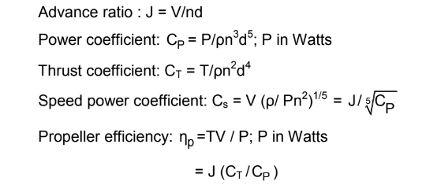
The propeller performance is expressed in terms of the following coefficients :-

Slide 20
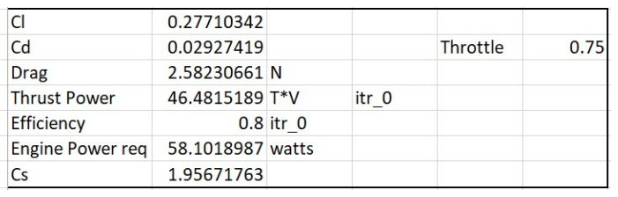
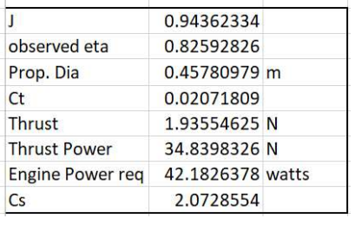
we choose the 3 bladed propeller for our aircraft.

Slide 21
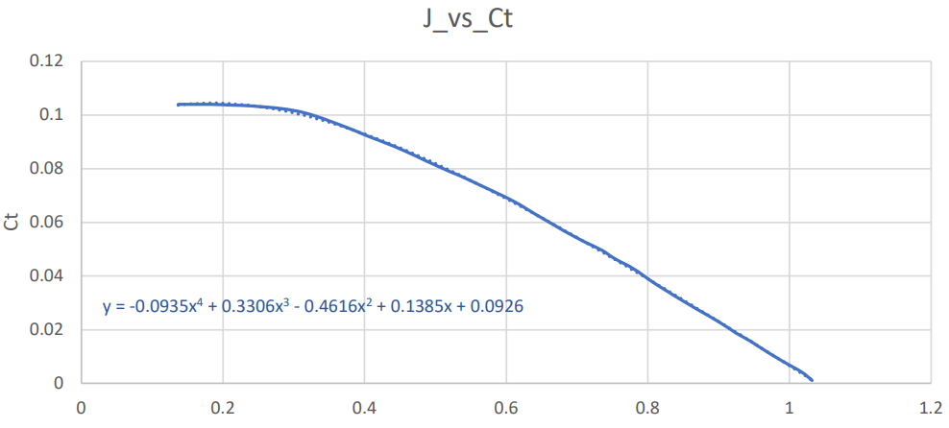
Output parameters :-
Pitch angle = 20 degree
Number blades = 3
Diameter = 0.45
Wind milling velocity
= 28.124

Slide 22

Performance Study:-
The performance parameters of the airplane are then evaluated to verify whether the airplane meets the required specifications or not.
i) Endurance:-
To calculate the endurance of the airplane we equate the maximum energy consumed by the airplane during its 1 hour journey and the maximum energy that can be stored in the battery
This gives Endurance= 1.0078 hrs. Thus the airplane achieves the desired Endurance of 1 hour.

Slide 23
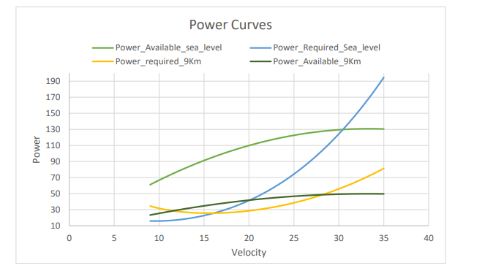

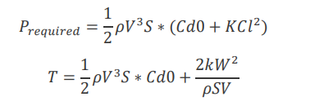
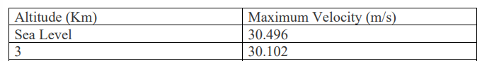
ii) Maximum Velocity:-
Maximum velocity of an airplane is an important parameter that needs to be considered to find the flight envelope of the airplane. When an aircraft flies at its maximum velocity the power required and power available curves cut each other on the high velocity side, representing both the power required and power available. Thus to find the maximum velocity we need to find the Power required and Power available for the aircraft.
Power available for the aircraft is given by
The thrust required by the aircraft is given by

Slide 24
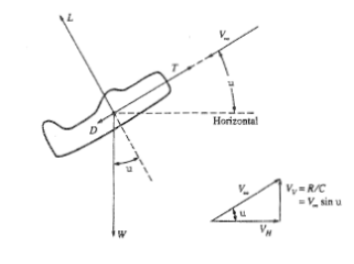
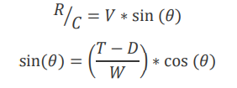
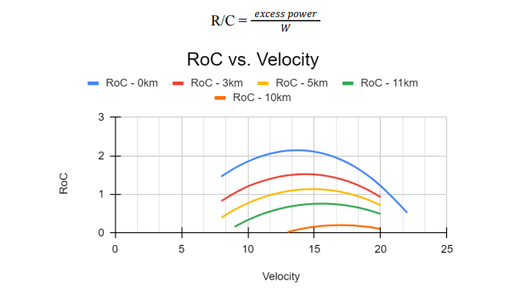
iii) Rate of Climb:-
The rate of climb of an airplane is an important parameter for any airplane as it gives an indication of how fast the airplane can reach its design altitude. Also it gives an indication of the maximum altitude at which the aircraft can fly.
Equation of motion is given by
𝑇 = 𝐷 + 𝑊𝑠𝑖𝑛(𝜃)
𝐿 = 𝑊𝑐𝑜𝑠(𝜃)
Now Rate of climb RC is given by
At a given altitude the rate of climb is estimated for different flight speeds ranging from𝑉𝑠𝑡𝑎𝑙𝑙 𝑡𝑜 𝑉𝑚𝑎𝑥. The value of 𝜃 is calculated using iterative methods to satisfy the above equation.

Slide 25
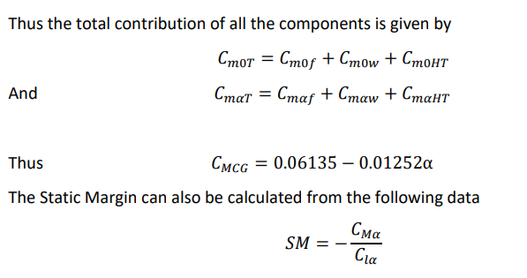
IV) Longitudinal Static Stability Analysis:-
The longitudinal Static stability of an airplane is an important parameter that helps in determining the response of the aircraft towards any disturbance. It also helps in determining the dynamic stability of the airplane.
determine the longitudinal static stability of the airplane we need to consider the contribution of the different parts individually and them add together to get the desired results.
Cmalpha =-0.70909
Clalpha= 0.0825*57.3
Which gives Sm as 14.91 which matches closely with the assumed value of 15%

Slide 26
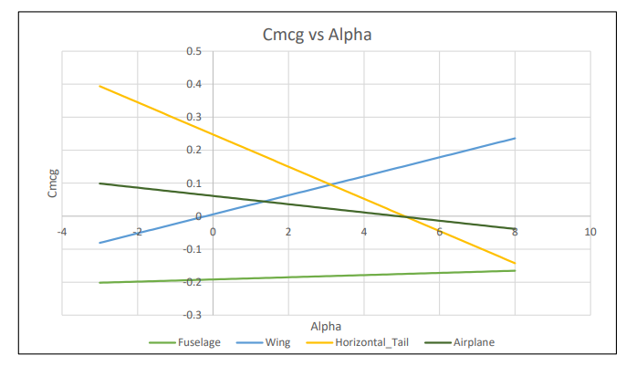
Also from the graph we find that the value of alpha required for trim is 4.64 degree

Slide 27
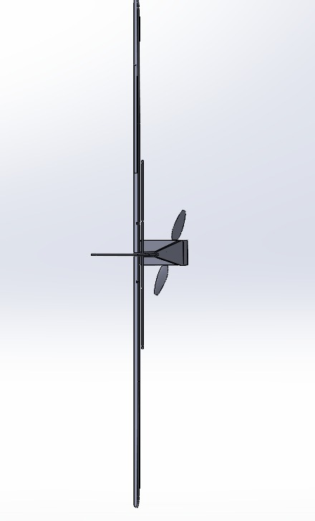
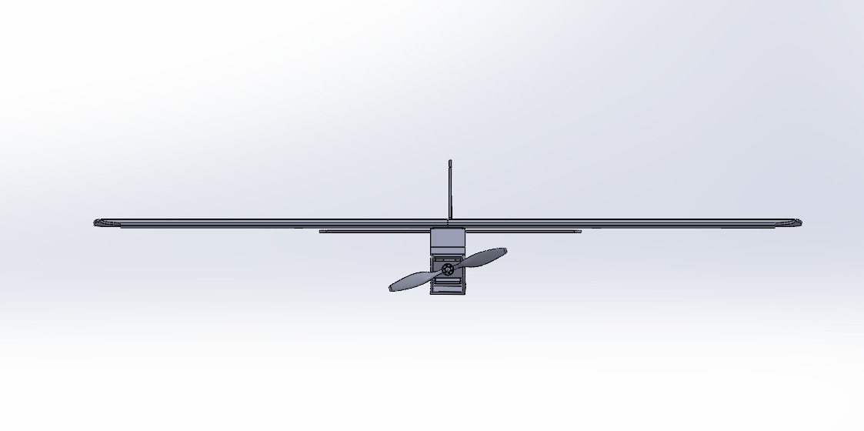
3D Model

Slide 28

Thanking You

