Slide 1
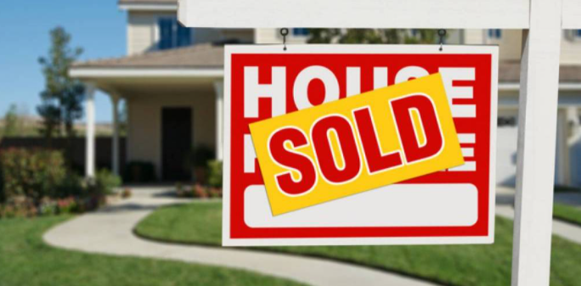

Slide 2
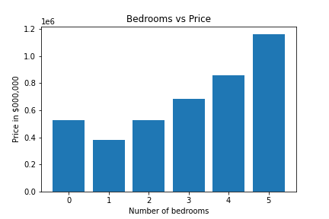
Average price of residential property with respect to number of bedrooms
Summary:
Average price of house increases with the increase in number of bedrooms.
Comparatively Average price of one bedroom is still cheaper than zero bedroom (Unit ).
Moving from 4 BR to 5 BR will increase the property cost significantly.

Slide 3

Price Trend in Victoria in relation with number of BR.

Slide 4
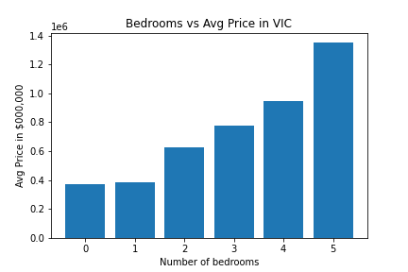
Average price of residential property with respect to number of bedrooms in VIC
Summary:
Average price of house increases with the increase in number of bedrooms.
Comparatively there is not much difference in average price in VIC when buying zero BR property and one BR property .
Also, again moving from 4 BR to 5 BR will increase the property cost significantly.

Slide 5
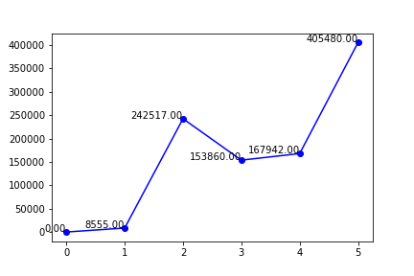
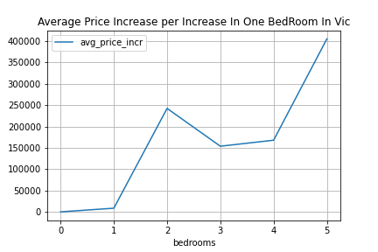
Difference in Price With Increase Of 1BR In Property

Slide 6
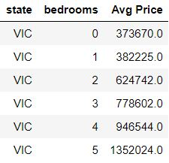
Overall Analyses :
In Victoria, the avg price of a zero BR property and 1BR property are almost same.
5-BR property price increases significantly compare to 4BR and 3BR property.

