Slide 1
Powerpoint using R Markdown
Ankita Mahadik

Slide 2
mtcars Dataset Analysis
The data was extracted from the 1974 Motor Trend US magazine, and comprises fuel consumption and 10 aspects of automobile design and performance for 32 automobiles (1973–74 models).
This is a data frame with 32 observations on 11 (numeric) variables.

Slide 3
Contents
Loading Libraries
Dataset Structure
Some Visualizations

Slide 4
Loading Libraries
library(tidyverse) library(ggplot2)

Slide 5
Dataset Structure
## 'data.frame': 32 obs. of 11 variables: ## $ mpg : num 21 21 22.8 21.4 18.7 18.1 14.3 24.4 22.8 19.2 ... ## $ cyl : num 6 6 4 6 8 6 8 4 4 6 ... ## $ disp: num 160 160 108 258 360 ... ## $ hp : num 110 110 93 110 175 105 245 62 95 123 ... ## $ drat: num 3.9 3.9 3.85 3.08 3.15 2.76 3.21 3.69 3.92 3.92 ... ## $ wt : num 2.62 2.88 2.32 3.21 3.44 ... ## $ qsec: num 16.5 17 18.6 19.4 17 ... ## $ vs : num 0 0 1 1 0 1 0 1 1 1 ... ## $ am : num 1 1 1 0 0 0 0 0 0 0 ... ## $ gear: num 4 4 4 3 3 3 3 4 4 4 ... ## $ carb: num 4 4 1 1 2 1 4 2 2 4 ...

Slide 6
Some Visualizations
Using ggplot :-
ggplot(mtcars, mapping = aes(x=mpg,y=hp))+ geom_point()+ theme_minimal()

Slide 7
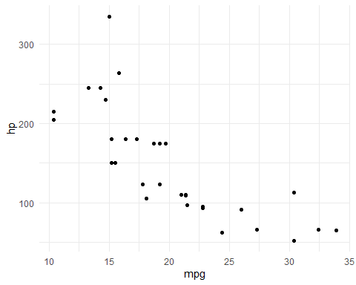

Slide 8
Some Visualizations
Pie chart of gear column :-
pie(table(mtcars$gear))

Slide 9
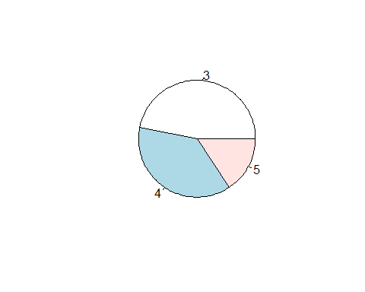

Slide 10
THANK YOU!

