Slide 1

Merchant Transaction Case study
Ankita Ghosh

Slide 2
Logical Flow
Situation
Finding out transaction trends of a Merchant
EDA
Explore overall trend and anomalies
Hypothesis Testing
Explore possible hypotheses and explain their possibility
Opportunities and Recommendation
Opportunities and recommending possible solutions

Slide 3


Date: 2020 Q4 - 2022 Q4
USA is leading with highest Approval rate
Summary
The Merchant has functions across 4 regions with USA leading in payment attempts(42%),Approved attempts(48%) and emerging with the highest approval rate(94.7%) across the board
India has second highest #attempts but has the least Approval rate
Every Country has higher than avg. Approval rate(83.6%) other than India(53.8%)
Opportunity: Improve India’s approval rate
Merchant Countries | Attempts | Attempts % Contribution | Approved Attempts | Approved Attempts % Contribution | Approval rate
USA | 3.4B | 42% | 3.2B | 48% | 94.7%
IND | 2.1B | 26% | 1.1B | 17% | 53.8%
None | 1.4B | 17% | 1.3B | 19% | 93.8%
NLD | 799.2M | 10% | 742.4M | 11% | 92.9%
AUS | 377.2M | 5% | 355.2M | 5% | 94.2%
Total | 8 B | 100% | 6.7B | 100% | 83.6%

Slide 4
India saw a 736% jump in transactions MoM in June 2022
Summary
The Jump in transaction is not supported in Approved attempts as abs Approved attempts dropped in June making India’s approval rate drop to 9% from an YTD monthly average of 91%,majority attempts from Indian Cards
MoM Credit card attempts alone increased by 7x while Approved attempts decreased by 17% bringing Approval rate down
Conclusion
This Increase in attempts not resulting into Approve attempts, suggest a possible BOT generated transactions in India
Exclude these Data points from Exploration to avoid further dilution
Exclude only the hour of the day when the transactions were fraudulent

Slide 5



Date: 2020 Q4 - 2022 Q4
Revised data revives India’s Approval rate to 91.2%
Summary
The Merchant has functions across 4 regions with USA leading in payment attempts(48%),Approved attempts(48%) and emerging with the highest approval rate(94.7%) across the board
With the Revised data India’s approval rate revived a lot and became 91.2%
Still India’s approval rate is lowest
Opportunity:
Improve India’s approval rate
Australia have second highest Approval rate but only 5% transactions , increase transaction
Merchant Countries | Attempts | Attempts % Contribution | Approved Attempts | Approved Attempts % Contribution | Approval rate
USA | 3.4B | 48% | 3.2B | 48% | 94.7%
None | 1.4B | 19% | 1.3B | 19% | 93.8%
IND | 1.1B | 16% | 1B | 16% | 91.2%
NLD | 799.2M | 11% | 742.4M | 11% | 92.9%
AUS | 377.2M | 5% | 355.2M | 5% | 94.2%
Total | 7 B | 100% | 6.6B | 100% | 93.7%

Slide 6
Since July 2022 overall Approval rate is declining
Summary
Since July 2022 overall approval rate has declined
Number of attempts have increased by 1% MoM since July onwards but Approved attempts remained same declining Approval rate
Opportunities
Investigate which country , mode of payment or Country of card issuance is causing the declining impact
Investigate if the Approval rate amongst other payment methods are also seeing a declining effect

Slide 7
Overall Approval rate declined by -1% MoM since July 2022
Removed fraudulent transactions in India
Summary
July 2022 onwards overall Approval rate trend has declined MOM by -1% for consecutive 2 months
In every country level approval rate declined compared to Avg Approval rate of 2022
Attempted along with Approved transactions in ‘None’ increased in Oct 2021 contributing to 25% of yearly trans
Opportunities
Look into strategies to increase Approval rate for major areas
Investigate the mode of payment that has led to the decline of Approval rate
Investigate the sudden increase in #Attempts in None ,Which countries are contributing in transactions

Slide 8
Date: 2020 Q4 - 2022 Q4
Credit card is dominating Payments with 51% contribution
Summary
Although in 2020 Debit card had the highest contribution , since 2021 June Credit card has taken the 1st spot in contribution and approval rate
Prepaid card has the least contribution and approval rate, with all the modes having declining approval rate from July 2022 Onwards
**Since majority contribution in India is from Credit card , removing fraudulent transactions in June 2022 reversed the contribution rate of Debit and Credit

Slide 9
Date: 2020 Q4 - 2022 Q4
8 card issuing countries seeing a declining trend in Approval rate
Row Labels | Credit Card | Debit Card | Prepaid Card | Approval Rate
AUS
2020 | 23% | 76% | 0% | 95%
2021 | 23% | 77% | 0% | 95%
2022 | 22% | 77% | 1% | 94%
CAN
2020 | 62% | 37% | 1% | 96%
2021 | 61% | 38% | 1% | 95%
2022 | 63% | 35% | 1% | 95%
CHL
2020 | 68% | 19% | 13% | 94%
2021 | 63% | 25% | 12% | 92%
2022 | 50% | 39% | 11% | 92%
CRI
2020 | 23% | 77% | 0% | 93%
2021 | 24% | 76% | 0% | 94%
2022 | 24% | 76% | 0% | 92%
ESP
2020 | 23% | 76% | 1% | 91%
2021 | 22% | 78% | 1% | 91%
2022 | 21% | 78% | 1% | 89%
GBR
2020 | 13% | 86% | 1% | 95%
2021 | 15% | 84% | 1% | 94%
2022 | 16% | 83% | 1% | 93%
IND
2020 | 98% | 1% | 1% | 93%
2021 | 99% | 0% | 1% | 92%
2022 | 99% | 0% | 1% | 91%
MEX
2020 | 46% | 54% | 0% | 92%
2021 | 90% | 10% | 0% | 96%
2022 | 91% | 9% | 0% | 95%
NZL
2020 | 31% | 69% | 0% | 96%
2021 | 28% | 72% | 0% | 96%
2022 | 25% | 75% | 0% | 95%
USA
2020 | 36% | 58% | 7% | 95%
2021 | 40% | 55% | 5% | 95%
2022 | 45% | 49% | 5% | 95%
Total | 51% | 45% | 3% | 94%
USA Approval rate remained same over the years , Mexico Approval rate increased
While the rest of the Countries see a declining Approval rate
Most of those countries have shifted towards Debit Card payment from Credit Card
**Since majority contribution in India is from Credit card , removing fraudulent transactions in June 2022 reversed the contribution rate of Debit and Credit

Slide 10
Summary and opportunities
Summary
Approval rate has declined across all the countries of business
USA is the major contributor in payments but American issued card didn’t cause approval rate decline
Most of the countries which shifted towards Debit card is seeing a declining Approval rate
India saw a Massive fraudulent transactions in June 2022
In 2021 October None labelled transactions were high from all the countries
Next Steps
Possible explanations towards declining approval rate could be shifting towards Debit card from Credit card
Also investigate types of error for decline in Approval rate e.g. OTP failure ,insufficient balance ,incorrect Merchant categorization etc.
Investigate into Weekly and Hourly data to find out specific patterns of approval rates and only remove the specific hours where fraud attempts happened
None labelled transactions could have increased due to higher awareness of GDPR and CCPA rules across the world, raising security concerns amongst consumers or due to Cross country travellers trying to avoid confusion
Investigate the avg. transaction amount in each transaction to understand the data patterns better
Require more data to reach a conclusion on improving Approval rate for future decision making

Slide 11

Appendix

Slide 12
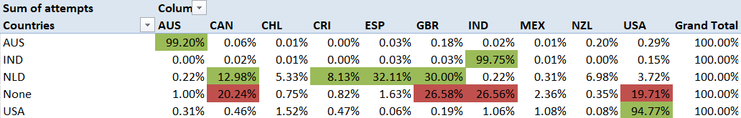
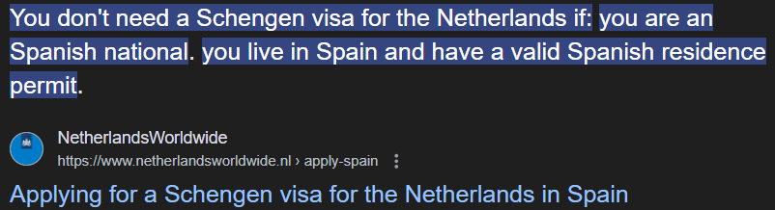
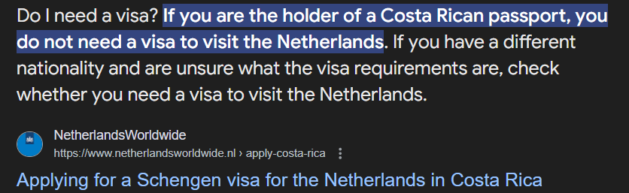

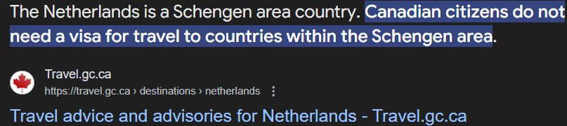
17% of Customers entered None as country in the payment form
Scenario:
Australia, USA and India seeing majority of the transacting card from their own country(>=95%)
Netherlands have majority transactions from Canada, Spain, Britain and Costa Rica
Majority of the None transactions are coming from Britain ,India, Canada and USA
Assumptions:
Britain and Canada might input None in the field as Merchant has not expanded in those two countries
India and USA could be putting None, as the field might not be mandatory to input
Also , cross country travellers might put None in the country field to avoid confusion
Canada, Spain, Britain and Costa Rica do not need a visa to visit Netherlands. So the tourists could be making a purchase later on/while visiting.
Netherland citizens might prefer some other payment method

