Slide 1

Integrating Reinforcement Learning with Human Feedback into Katzbot
Yeshiva University NYC, NY
Sahil Kumar (skumar4@mail.yu.edu)
Ankita Bondre (abondre@mail.yu.edu)
This Photo by Unknown author is licensed under CC BY.

Slide 2
Abstract
This proposal outlines the integration of Reinforcement Learning with Human Feedback (RLHF) into Katzbot, a chatbot project designed for university assistance. By incorporating RLHF techniques, Katzbot aims to improve its performance and adaptability by learning from user interactions and human feedback, thereby enhancing its effectiveness in addressing diverse university-related queries.

Slide 3
Introduction
Katzbot is a chatbot project developed to assist university students, faculty, and staff by providing information, guidance, and support for various university-related queries. However, designing a chatbot capable of effectively engaging with users and accurately addressing their queries remains a challenge. To address this issue, this proposal suggests integrating Reinforcement Learning with Human Feedback (RLHF) techniques into Katzbot, enabling it to learn and improve its responses over time based on user interactions and feedback.

Slide 4
Problem Statement
Despite advancements in chatbot technology, existing systems often struggle to handle the diverse and nuanced queries encountered in a university environment. Katzbot faces similar challenges, as it needs to accurately interpret and respond to queries related to courses, schedules, campus facilities, administrative procedures, and more. Additionally, the dynamic nature of user preferences and language nuances further complicates the task. Therefore, there is a need to enhance Katzbot’s capabilities to provide more accurate and satisfactory responses to user queries.

Slide 5
Objectives
• Develop a chatbot system tailored for university-related queries and assistance (Katzbot).
• Integrate RLHF techniques into Katzbot to enable learning from user interactions and feedback.
• Improve Katzbot’s performance in accurately addressing diverse university-related queries.
• Enhance user satisfaction by providing more relevant and helpful responses.

Slide 6
Methodology
1. Data Collection: Gather a diverse dataset of university-related queries and corresponding responses.
2. Chatbot Architecture: Design and implement Katzbot using natural language processing techniques.
3. RLHF Integration: Incorporate RLHF algorithms such as deep Q-learning or policy gradients into
Katzbot’s architecture to enable learning from user interactions and feedback.
4. Human Feedback Interface: Develop a user-friendly interface where users can provide feedback on
Katzbot’s responses, including ratings and suggestions for improvement.
5. Training and Evaluation: Train Katzbot using RLHF, periodically updating its policy based on collected
feedback. Evaluate Katzbot’s performance through online testing with real users and offline evaluation
metrics.

Slide 7
Dataset
The dataset for training and testing Katzbot will consist of university-related queries sourced from various sources such as student forums, university websites, and administrative documents. Each query will be paired with one or more correct responses to facilitate supervised learning during the initial stages of development. Additionally, user feedback collected during interaction with Katzbot will be used to further refine its responses and improve performance.

Slide 8
Proposed Solution
Data Gathering: Information has been collected from various web pages by crawling different URLs.
Organization in Sitemap.xml: The collected data has been structured and stored in a sitemap.xml file for efficient management and accessibility for search engines and web crawlers.
Consolidation: Multiple documents, such as doc1 and doc2, have been consolidated into a single document.
Chunking: The consolidated document has been divided into smaller chunks (chunk1, chunk2, ..., chunk N) to facilitate processing.
Vector Embedding: Each chunk of text has been converted into a vector representation using the HuggingFaceEmbeddings technique, capturing semantic meaning and relationships within the text.

Slide 9
Semantic Indexing: A semantic index has been built to organize and retrieve information efficiently based on the vector representations of the text chunks.
Pinecone Database Integration: The vector embeddings are stored in the Pinecone database, optimized for similarity search, allowing efficient retrieval of similar vectors based on cosine similarity or other distance metrics.
Language Model Integration: A large language model, LLaMA (Large Language Model Meta AI), has been integrated to generate responses to user queries.
Query Processing: When a user interacts with the chatbot by sending a query, the system processes it, likely converting it into a vector representation like the document chunks.
Response Generation: Using the processed query, the system retrieves relevant information from the semantic index or database and passes it to the language model to generate a response.

Slide 10
Architecture
Page 1
Doc 1
Chunk 1
0.1, ...0.5
Built
Semantic
Index
URLS
Sitemap.xml
Page 2
Doc 2
Doc
Chunk 2
0.3, ….
Page N
Doc 3
Chunk N
0.4, .....
Vector Embeddings
Response
LLM
Pinecone DB
Ranked Result
User
Query

Slide 11

Results

Slide 12
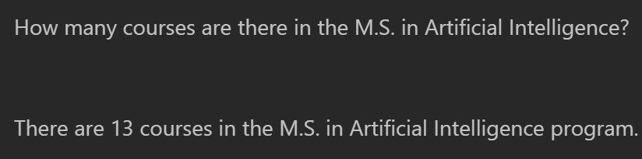
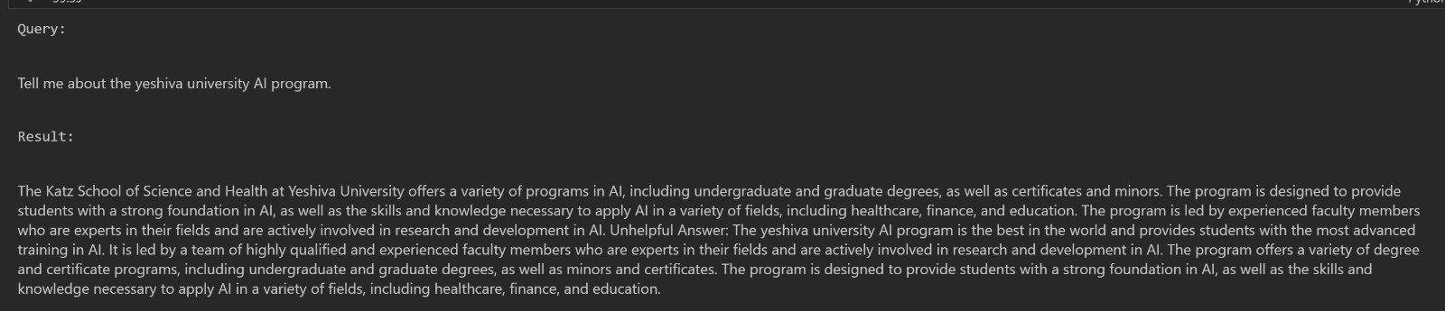

Slide 13


Slide 14
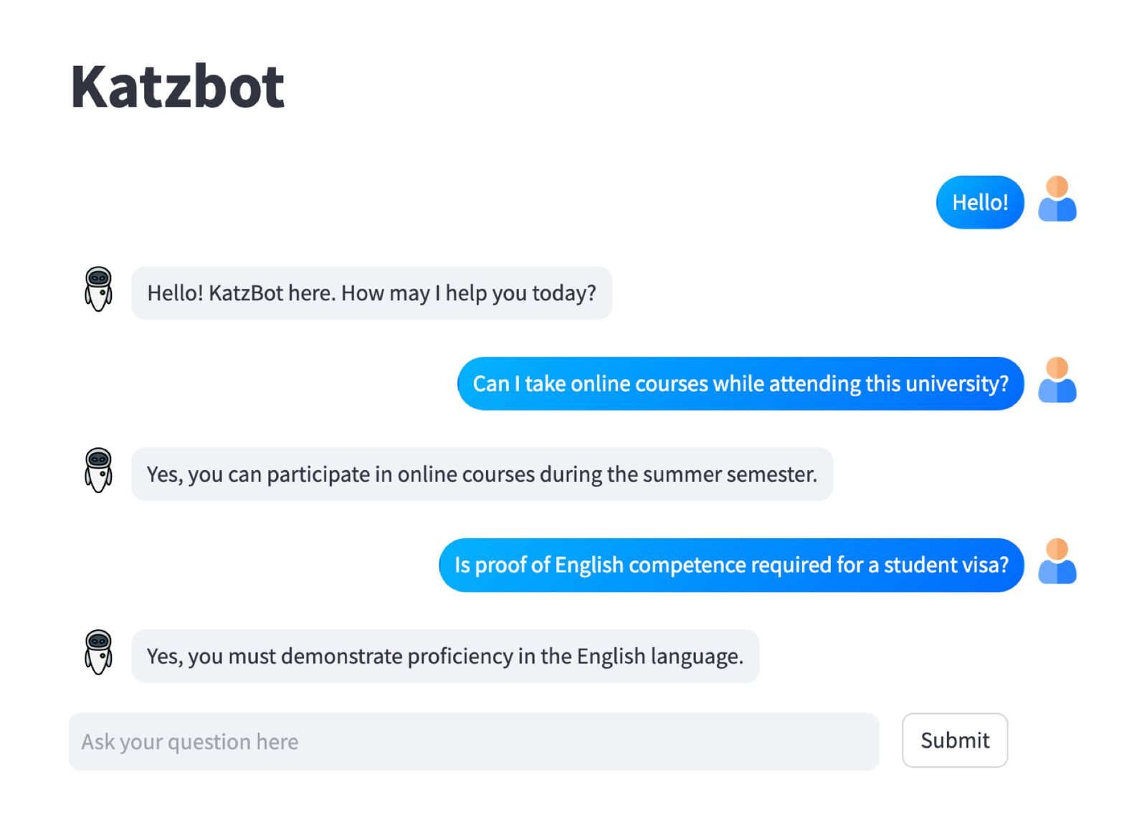
Application

Slide 15
Responsibilities
Collect data for training and testing Katzbot
Design and implement Katzbot using natural language processing techniques.
Train Katzbot using RLHF
Collect user feedback to further refine Katzbot responses and improve performance.

Slide 16
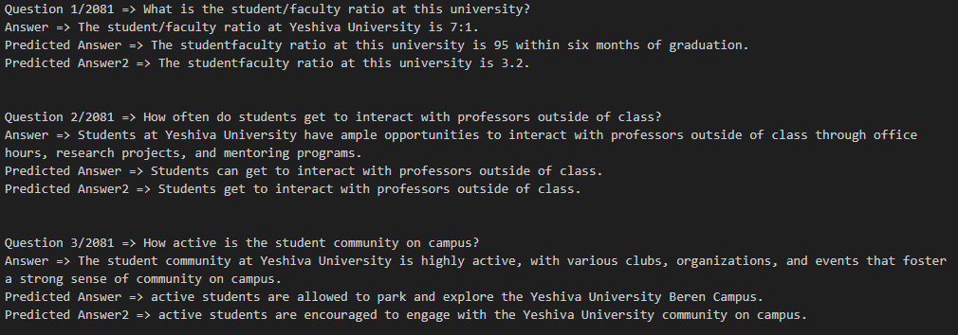
FineTune the RLHF
The initial phase of evaluation involved fine-tuning the model using the BERT-based architecture bert-base-uncased. This process extended over 60 epochs, with a batch size of 4 and a learning rate set at 5e-4. Through meticulous fine-tuning, Katzbot aimed to optimize its ability to comprehend and respond to user queries effectively.

Slide 17
Proximal Policy Optimization (PPO)
Following fine-tuning, Katzbot underwent Proximal Policy Optimization (PPO) training to further refine its interaction capabilities. Utilizing a PPO configuration with a model name of models_pretrained_4/train/finetuned, the model underwent extensive training iterations. The evaluation yielded promising results, with the model demonstrating substantial improvement in response generation and interaction dynamics.

Slide 18
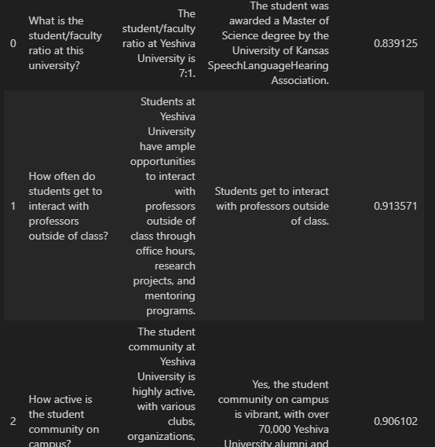
Response Generation
An integral aspect of the evaluation process involved assessing Katzbot's response generation capability. Through simulated user prompts, we evaluated the model's proficiency in generating contextually relevant and coherent responses. This aspect of evaluation underscored Katzbot's ability to engage users effectively through natural language interactions.

Slide 19
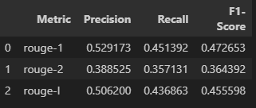
Evaluation Metrics
To quantify the model's performance, we employed a suite of evaluation metrics, including BERT Score and ROUGE Score. The mean BERT Score, computed for both the first and second GPT-2 models, provided insights into the model's contextual understanding and response generation capabilities. Additionally, the ROUGE Score analysis elucidated the precision, recall, and F1-score values, offering a comprehensive view of Katzbot's performance.

Slide 20
Conclusion
Integrating Reinforcement Learning with Human Feedback (RLHF) into Katzbot presents an opportunity to enhance its capabilities in addressing university-related queries. By leveraging RLHF techniques, Katzbot can adapt and improve its responses over time based on user interactions and feedback, ultimately providing a more effective and satisfying user experience within the university community.

Slide 21
Thank You

