Slide 1

Advanced NLP Project: Legal Case Document Summarization
Leveraging HuggingFace Models for Extractive Summarization
Team Members:
Ankita Bondre
Yashaswi Patki
Tanay Gawade

Slide 2

Introduction
Legal documents are lengthy and complex, requiring significant time to review.
This project utilizes advanced NLP techniques to summarize legal case documents.
Goals:
Provide extractive and abstractive summaries.
Assist legal professionals in reviewing documents efficiently.

Slide 3
Dataset
Dataset Sources:
1. IN-Abs: Indian Supreme Court cases with abstractive summaries.
2. IN-Ext: Extractive summaries created by legal experts.
3. UK-Abs: U.K. Supreme Court cases with abstractive summaries.
https://zenodo.org/records/7152317
Data Split:
Training: 2000 samples
Validation: 2000 samples

Slide 4
Model Architecture
HuggingFace BART Model:
- Pretrained transformer for summarization tasks.
- Encoder-decoder architecture.
• Tokenizer:
- Converts text to input IDs for model compatibility.
Fine-tuned on domain-specific data for better performance.

Slide 5
Implementation Steps
1. Data Preparation:
- Load and preprocess legal documents and summaries.
- Tokenize text using HuggingFace tokenizer.
2. Model Training:
- Fine-tune BART model with training dataset.
- Validate on evaluation dataset.
3. Deployment: Gradio-based UI for live summarization.

Slide 6

Evaluation Metrics
Metrics Used:
- ROUGE : Measures content overlap.
Results:
- High-quality summaries that retain essential legal information.

Slide 7
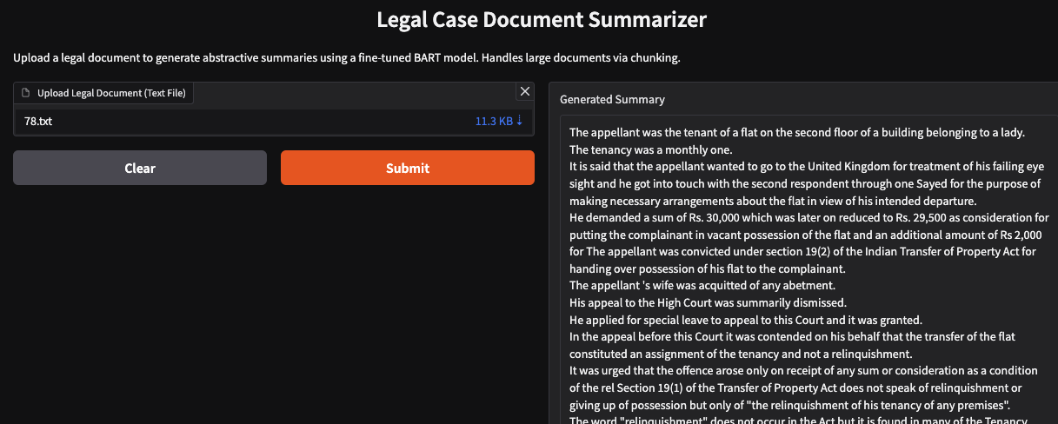
Gradio Interface
Features:
Upload a legal document for summarization.
Generate extractive summaries.
User-friendly design for real-time use and demonstrations.

Slide 8
Challenges and Future Work
• Handling complex legal jargon.
• Limited availability of annotated datasets.
Expand dataset with diverse legal cases.
Develop multilingual summarization capabilities.
3. Improve evaluation with expert feedback.

Slide 9
Conclusion
Successfully implemented summarization for legal documents.
Demonstrated the potential of NLP in assisting legal professionals.
Future improvements aim to enhance scalability and accuracy.

Slide 10

Thank You!

