Slide 1
Complete Business Analysis Project

Slide 2
Project Overview
Goal: 3 data set is given. I choose customer_churn.csv file.
🎯 Project Title:
Customer Churn Analysis & Retention Strategy.

Slide 3
PHASE 1: PROJECT PLANNING (Days 1–3)
🎯Business Problem:
Companies lose revenue when customers leave (churn).
We want to understand:
Why are customers churning and how can the company reduce churn?

Slide 4
Objectives & Success Metrics
Objectives:
•
Build a model to predict churn
Segment high-risk customers
Provide retention strategies
Identify key factors causing churn
Success Metrics
Business + Data metrics:
Type | Metric
Business | Reduce churn rate by X%
Model | Accuracy, Precision, Recall, F1-score
Financial | Estimated revenue saved

Slide 5
Phase 2: Data Collection & Preparation (Days 4–6)
• Data acquisition
• Cleaning & preprocessing
• Handling missing values
• Data quality documentation

Slide 6
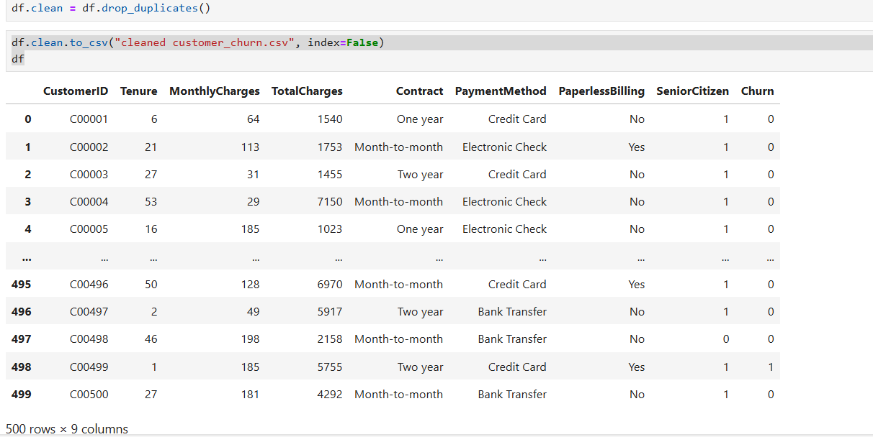
Dataset Summary
Total Customers: 500
Churn Rate: 10.60%

Slide 7
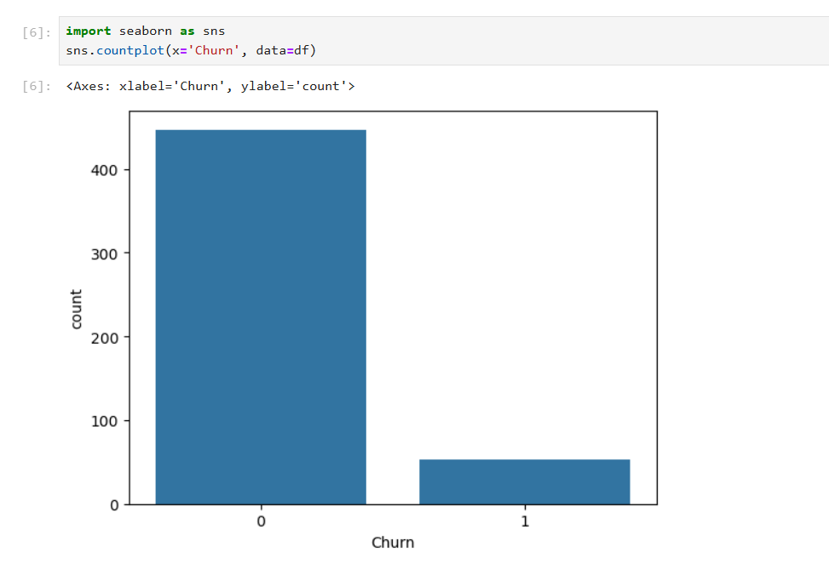
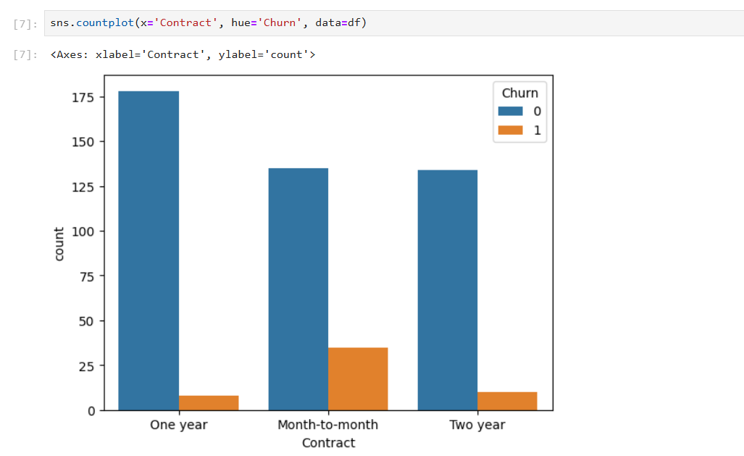
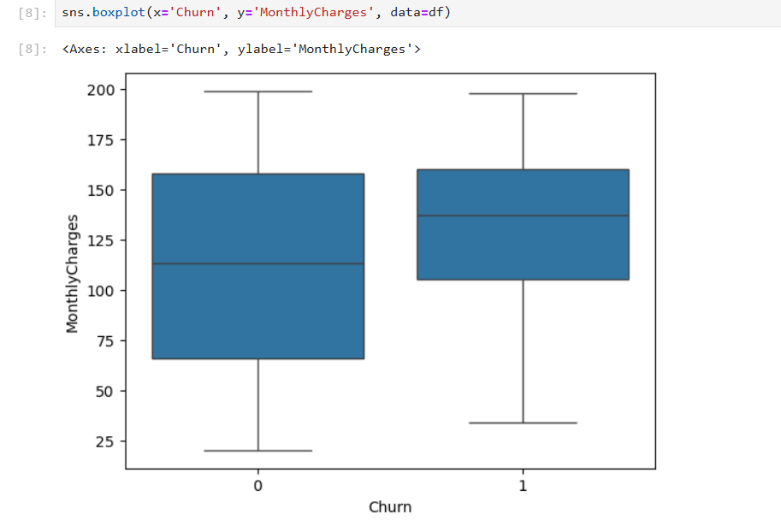
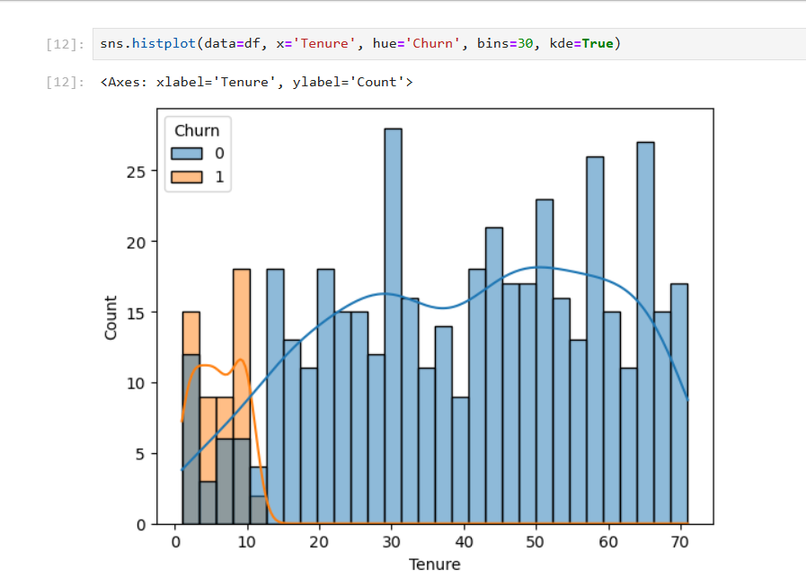
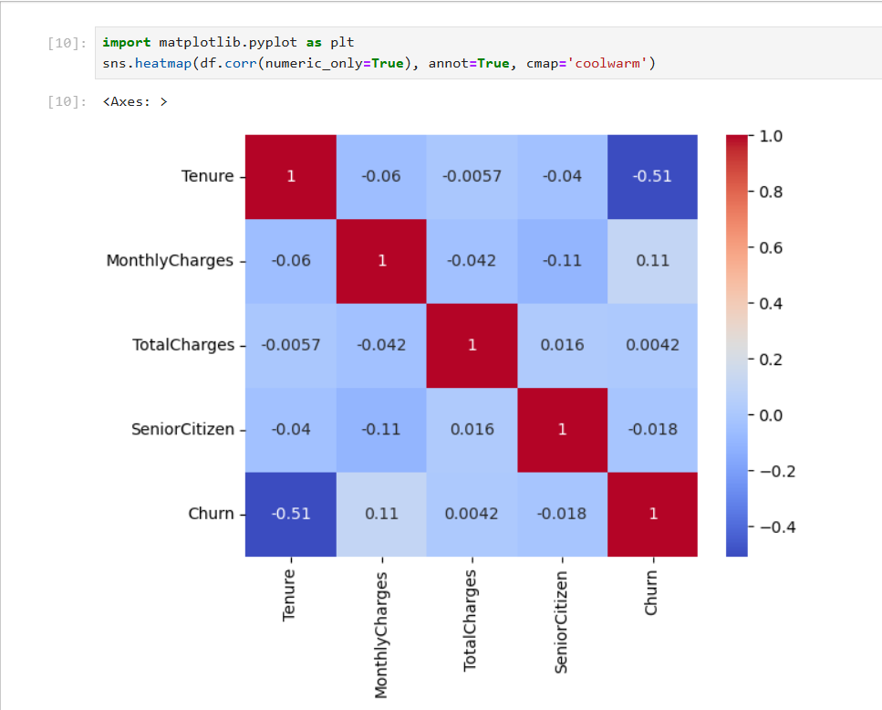
Phase 3: Exploratory Data Analysis (Days 7–9)
• Distribution analysis
• Correlation checks
• Visualization of churn patterns

Slide 8
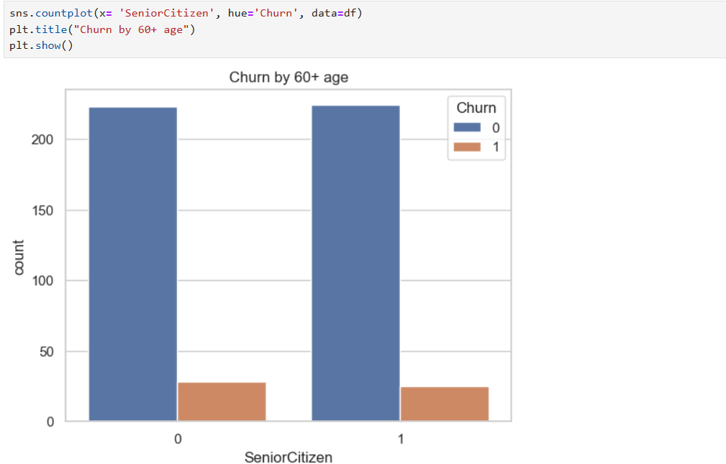
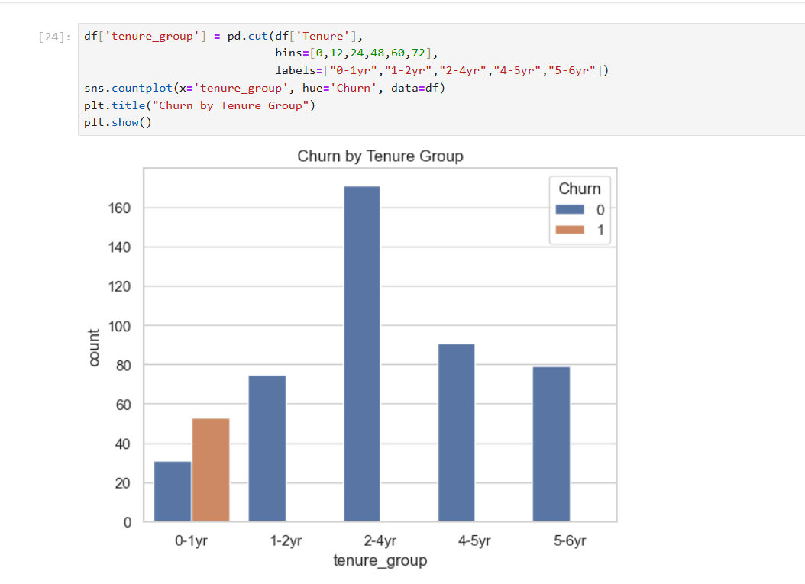
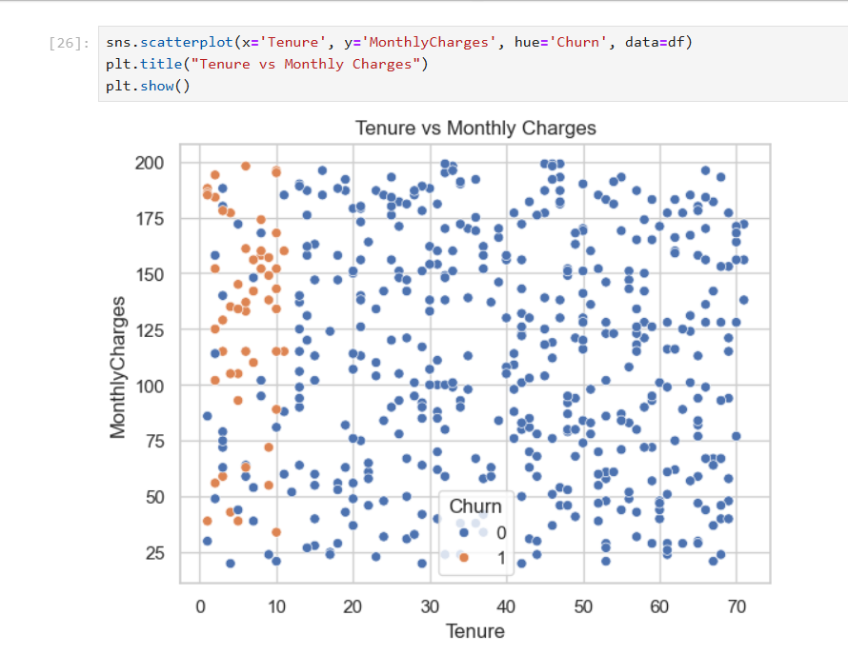
Key EDA Findings
• Certain customer segments show higher churn
• Usage and tenure correlate with churn
• Pricing sensitivity observed

Slide 9
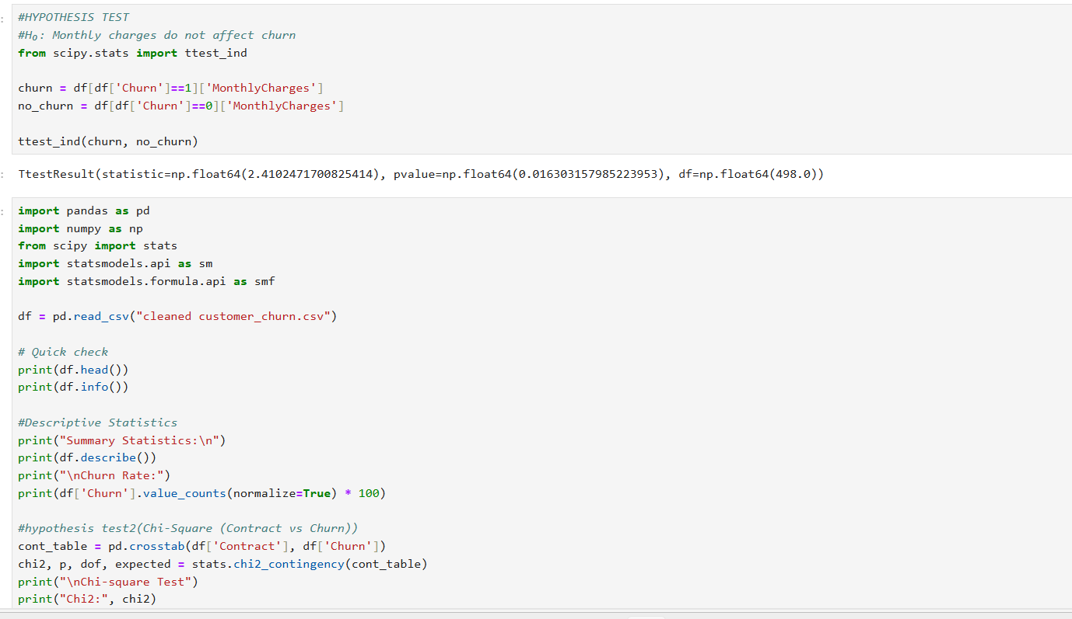
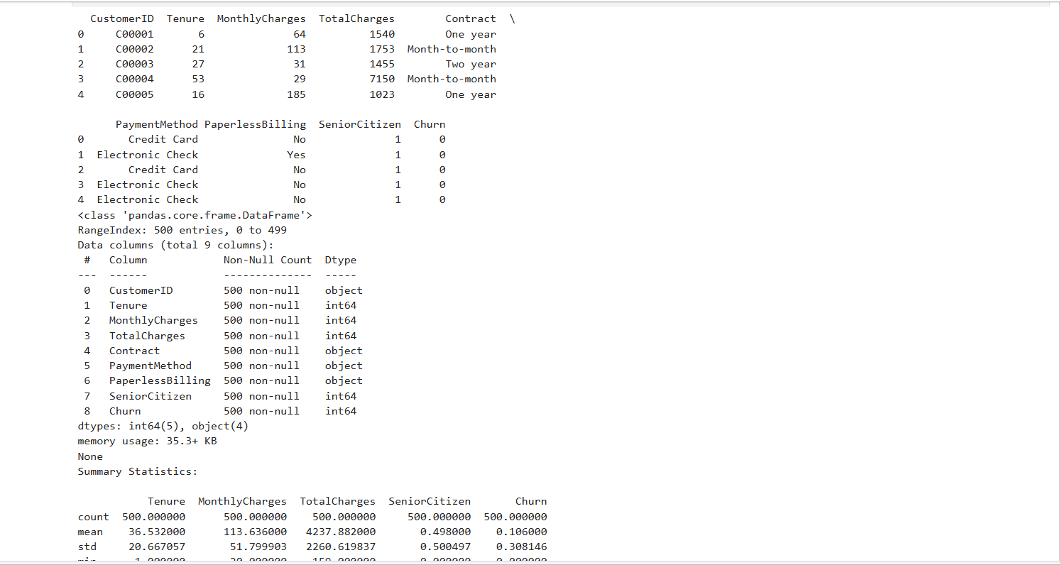
Phase 4: Advanced Analysis (Days 10–12)
• Hypothesis testing
• Statistical validation
• Feature impact analysis

Slide 10
Analytical Insights
• Statistically significant churn predictors identified
• Customer behavior patterns validated
• High-risk segments defined
📈 Implementation Plan
Month | Action
Month 1 | Identify high-risk customers
Month 2 | Offer retention discounts
Month 3 | Track churn reduction

Slide 11
Phase 5: Insights & Recommendations (Days 13–14)
• Business interpretation of results
• Actionable recommendations
• Presentation preparation

Slide 12
Key Recommendations
• Target high-risk segments with offers
• Improve onboarding experience
• Monitor churn KPIs regularly
Insight | Business Meaning
Short tenure customers churn more | Poor onboarding
Month-to-month contracts risky | No long-term commitment
High charges → high churn | Price sensitivity

Slide 13
Expected Business Impact
• Reduced churn rate
• Improved customer lifetime value
• Better data-driven decisions
Problem | Action
New customers leaving | 90-day onboarding program
Price-sensitive users | Discount bundles
Month-to-month churn | Incentivize annual contracts
High-risk segment | Proactive retention calls

Slide 14
Conclusion
Structured analytics approach delivered insights
Clear roadmap for customer retention
Next step: Predictive modeling

