Slide 1

Evaluation of Rust for Embedded Systems in terms of Security, Performance, and Usability
Ankita Kumari ge93vep@mytum.de Advisor: Andreas Finkenzeller Department of Electrical and Computer Engineering
Technical University of Munich

Slide 2
Contents
Introduction and Problem Statement
Security Vulnerabilities
Performance Evaluation
Comparison of Rust with C
Conclusion

Slide 3
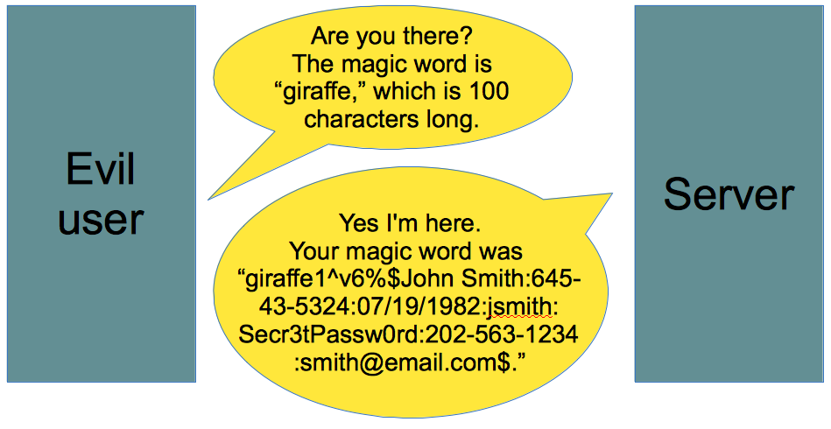



Introduction
The Heartbleed Vulnerability [1]
C for Embedded Systems
Example of Buffer overread [2]

Slide 4



Motivation
Defense mechanism
Address Space Layout Randomisation
Secure Coding
Performance overhead
Garbage Collector
Does not port to assembly
Memory safety
Bad cross-compiling

Slide 5

Aim
Rust [3]
Evaluate claims of Rust for Embedded Systems
Security provided by Rust
Performance of Rust compared to C
Compatibility of Rust with C libraries (Usability)
Low-level control
Speed
High level
Memory safety

Slide 6
Introduction to Rust
Suitable for embedded programming:
Produces predictable assembly
No garbage collection
Memory Safety
Type Safety
Ownership | Every value in Rust has a single owner at a given time
Borrowing | Used to pass the reference but keep the ownership
Mutability | Immutable by default. Makes sharing of data easier. Prevents overwriting

Slide 7
Security Vulnerabilities in Embedded System
Vulnerabilities
Vulnerabilities
Software Attacks
Hardware Attack
Software Attacks
Hardware Attack
Double Free
Buffer Overflow
Non-Invasive Attacks
Invasive Attacks
Invasive Attacks
Use after Free
Side-Channel Attacks
Reverse Engineering
DPA
Microprobing

Slide 8
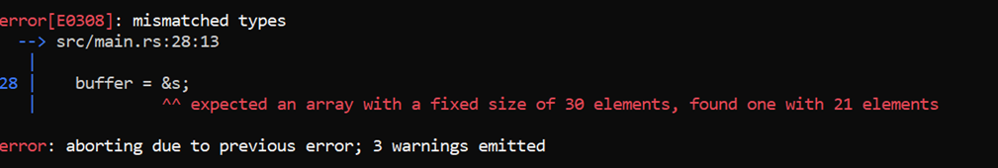
Software Attacks - Buffer Overflow
let mut a: [char; 2] = ['1', '2'];
let b: [char; 3] = ['1', '2', '3'];
a.copy_from_slice(&b);
Rust panics and terminates the program.
let buffer : [u8;30];
let s: [u8;21];
buffer = &s;

Slide 9
Heartbleed Vulnerability in Rust
If payload larger than the buffer input, additional data copied to the output
Payload is upper index of the slice to be copied
Rust panics if tried to access out of bound value from p [1]
memcpy(output, input, payload);
let payload:usize = ((input[1] as usize) << 8) + input[2] as usize;
let mut output: [u8;payload+PADDING]; //needs constant size of array
output.extend(input[3..payload].iter().cloned()); //copy of payload string happens here

Slide 10
Memory Exploits Using Unsafe Keyword
Calling functions from other languages
Bypass the compiler checks
Interact with hardware
Access Unions
Unsafe Keyword
1. Dereferencing a dangling pointer
unsafe allows dereferencing the pointer even when it is freed
let p;
{
let mut x: u8 = 1;
p = x as *const i32;
}
unsafe{
hprintln!("{}",*p);
}

Slide 11
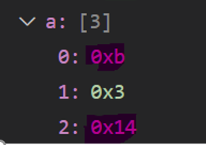
Buffer Overread and Immutability
2. Overread
3. Immutability
let mut a: [u8; 3] = [2,3,20];
let ptr: *mut [u8;3] = &mut a;
let big_ptr: *mut [u8;20] = ptr as *mut [u8;20];
unsafe {
let mut new_array: [u8;20] = *big_ptr;
new_array[10] = 10;
}
let a: [u8; 3] = [2,3,20];
let ptr: *const [u8;3] = &a;
let big_ptr: *mut [u8;20] = ptr as *mut [u8;20];
unsafe {
let mut new_array: &mut [u8;20] = &mut *big_ptr;
new_array[0] = 11;
}
hprintln!("{}",a[0]); \\ prints 11
*big_ptr copy the contents of big_ptr to new_array. Overread by reading the memory past the length of a

Slide 12
Security Vulnerabilities in Embedded System
Vulnerabilities
Vulnerabilities
Software Attacks
Hardware Attack
Software Attacks
Hardware Attack
Double Free
Buffer Overflow
Non-Invasive Attacks
Invasive Attacks
Invasive Attacks
Use after Free
Side-Channel Attacks
Reverse Engineering
DPA
Microprobing

Slide 13
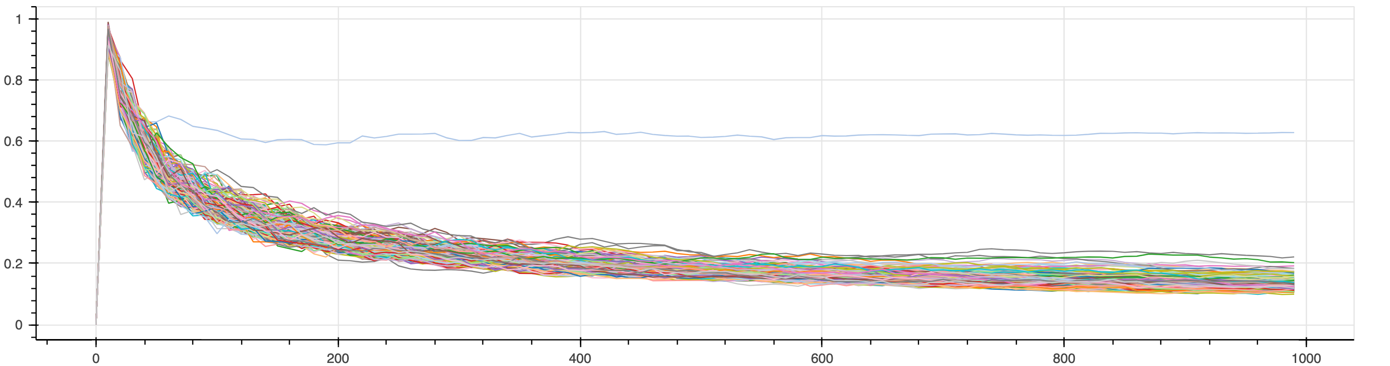
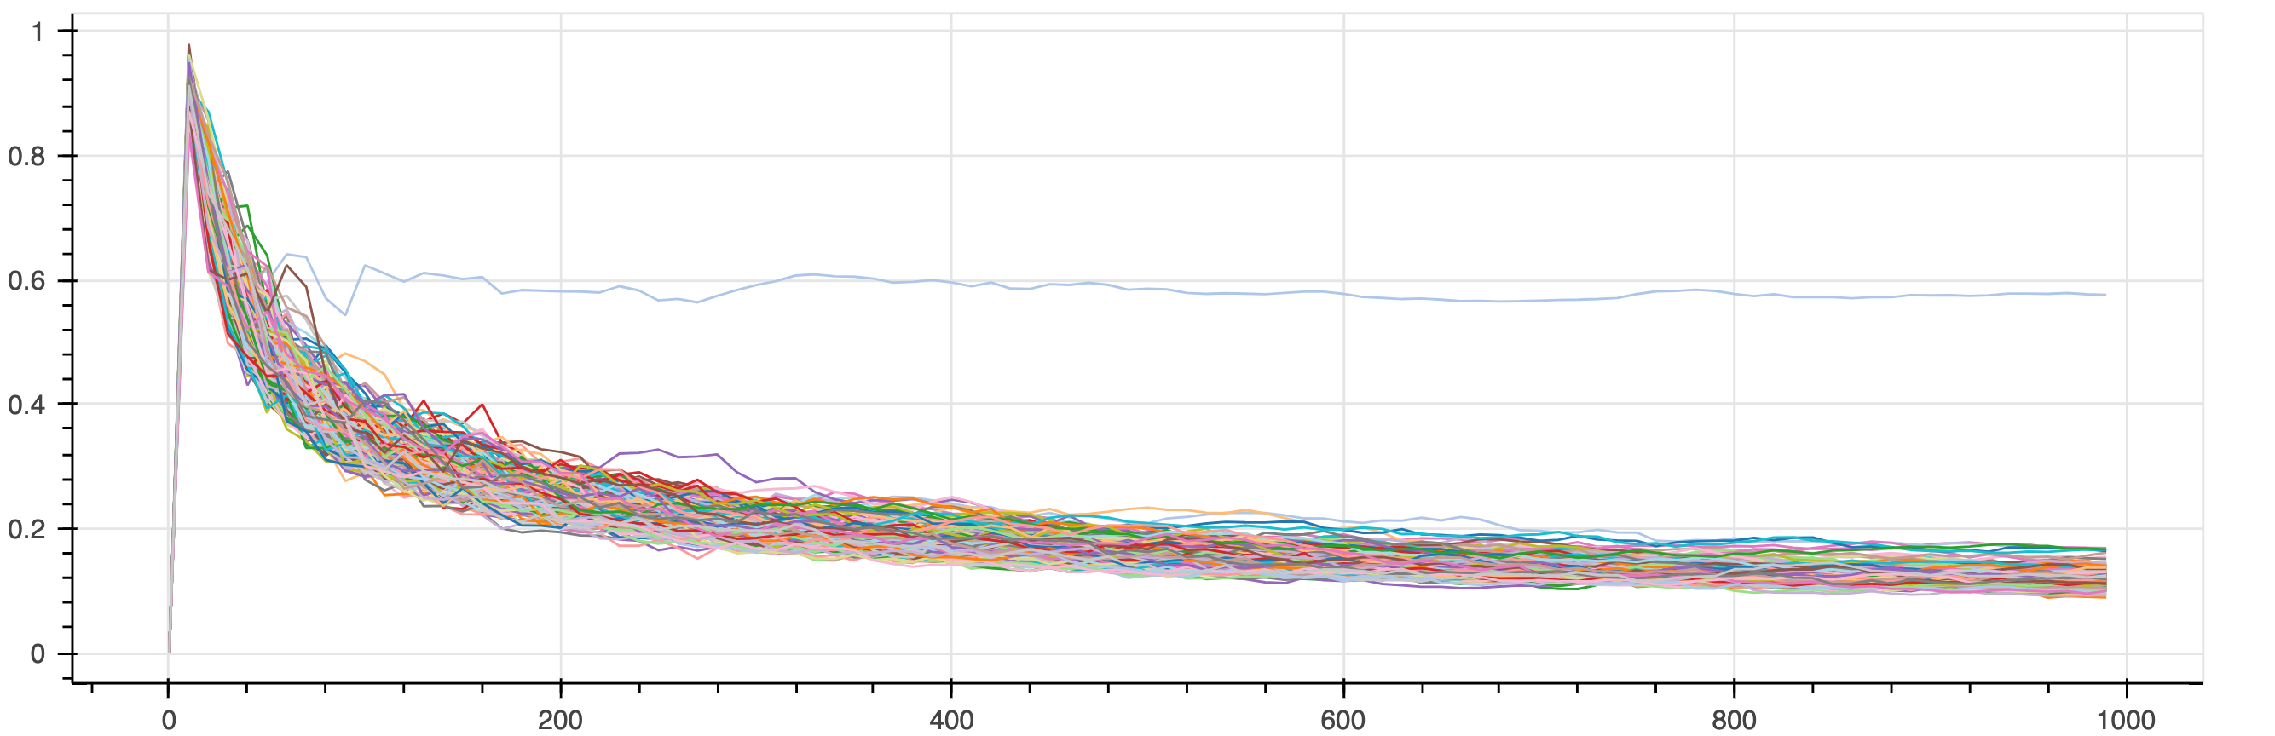
Non-Invasive Attacks - DPA
Power analysis of 255 different values of the key position 0 for 1000 traces
Rust
C
No additional safety against the side-channel attacks
Key read out in less than 100 power traces.

Slide 14
Security Vulnerabilities in Embedded System
Vulnerabilities
Vulnerabilities
Software Attacks
Hardware Attack
Software Attacks
Hardware Attack
Double Free
Buffer Overflow
Non-Invasive Attacks
Invasive Attacks
Invasive Attacks
Use after Free
Side-Channel Attacks
Reverse Engineering
DPA
Microprobing

Slide 15
Secure Coding patterns against Invasive Attacks
Secure Boolean
Non-zero values result in True
255 possibilities to flip a bit
Solution
Same hamming weight and distance
Use volatile
enum SecBool {
SecTrue = 0x9999, \\Hamming Weight(HW)=8 SecFalse = 0x3C3C, \\ HW = 8
SecInit = 0x5A5A \\ HW = 8
}
match unsafe { *core::ptr::read_volatile(&val)}
{
SecBool::SecTrue=> hprintln!("TRUE“),
SecBool::SecFalse =>hprintln!("FALSE),
_ => panic!()
};

Slide 16
Secure Coding patterns against Invasive Attacks
Secure Return parameter
Secure Branch Handling
Secure Loop

Slide 17


Performance Evaluation
AES algorithm → Used for the performance evaluation
Evaluation is done based on
Clock Cycles
NVM Size
Stack Usage
Optimization Level | O0, O1, O2, O3, Os, Oz

Slide 18
Evaluation of Clock cycles and NVM Size

Slide 19
CPU Cycles varying with NVM Size

Slide 20
Stack Usage

Slide 21
Summary
 | Security |  | Performance |  |  | Usability
 | Software Attacks | Hardware attacks | Execution Speed | NVM Size | RAM consumption | Inter-portability | Embedded Support | Learning Curve
Rust | ++ | - | ++ | - | ++ | ++ | ++ | -
C | -- | - | + | + | + | ++ | + | ++

Slide 22




Conclusion
Security
Performance
Usability

Slide 23
Future Work
Analysis of Oz optimization level
Dynamic memory allocation and run-time checks
Using Rust for multi-threaded programming

Slide 24
References
[1] “The Heartbleed Bug”, https://heartbleed.com/#:~:text=The%20Heartbleed%20Bug%20is%20a,used%20to%.
[2] “Buffer Overread“ https://www.vox.com/2014/6/19/18076318/heartbleed
[3] ‘The Rust Programming Language’. [Online]. Available: https://doc.rustlang.org/book/
[Accessed: 17-Feb-2016].

Slide 25

Questions?
29.04.2022 | Ankita Kumari | Technical University Munich

