Slide 1
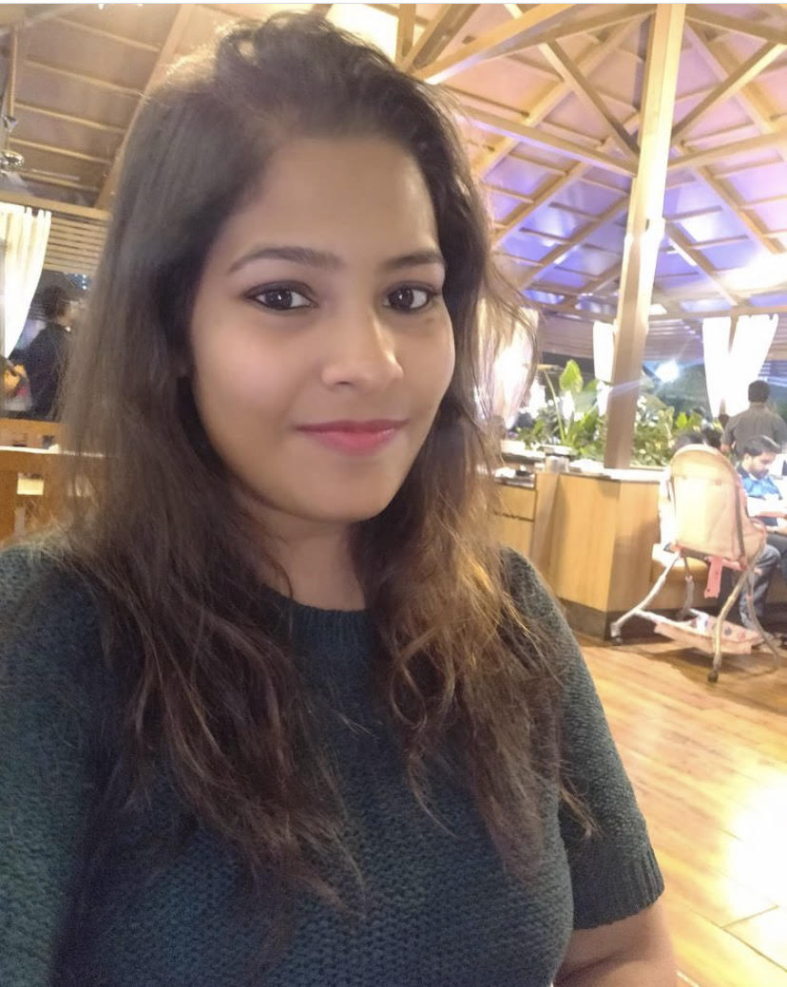
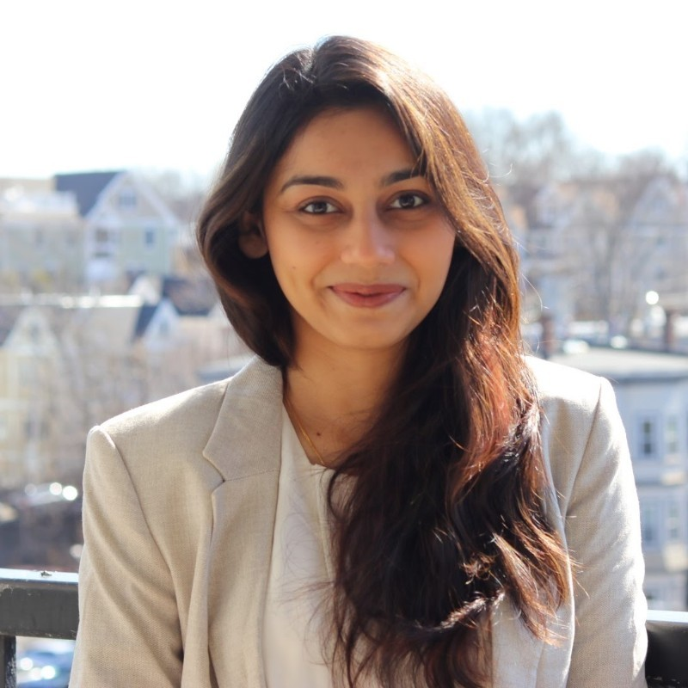
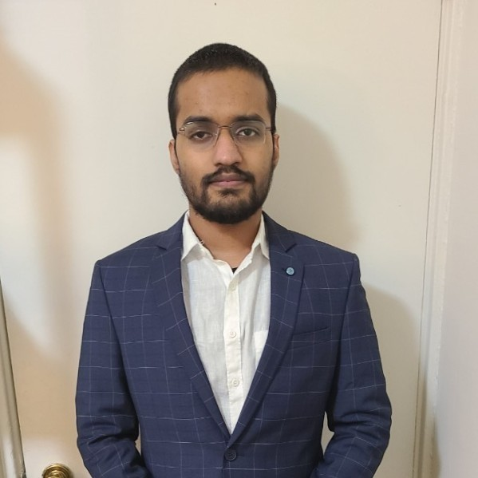
INTER UNIVERSITY CONNECT – TEAM ORION
DATABASE MANAGEMENT AND DATABASE DESIGN SPRING 2021
TEAM DETAILS-
Ankita Senapati
001003695
Priyanka Chaudhari
001007299
Aaradhy Sharma
001040799
<> with ♡ by Team Orion

Slide 2





PROBLEM STATEMENT AND PROPOSED SOLUTION
Using the database model, a portal can be designed which enables maintain profiles for students, alumni, and professors.
The Event table will have details about different types of events like Career Fairs, Speaker Sessions, Cultural or technical connections.
IS CONNECTING WITH UNIVERSITIES, ALUMNI AND PROFESSORS ACCESIBILITY?
The Student table will have details like Course Major information, which will help students to connect with other students having similar interests.
Professor table will have information about Professors from various Universities, therefore giving students a vast opportunity to associate with them.
Open Projects table will have all the data related to the open-source projects led by a University or Professor. Interested students will also have the opportunity to reach out to them if it interests them.
<> with ♡ by Team Orion

Slide 3
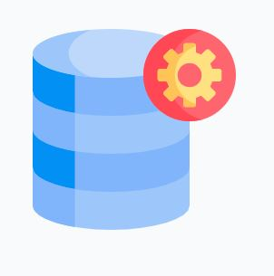


DATABASE FEATURES
FULLY AUTOMATED DATABESE DESIGN
Enables the user to access the database via SQL scripts which will initialize the database and help the user to be registered as a member in order to access the addition features.
HIGHLY SECURE DATABASE DESIGN with a dedicated database user for each new member with access restricted using roles.
USER FRIENDLY PROCESS
Defined scripts with process that will make the process easy for the user, with all the validations on the PASSWORD setting and case handling
<> with ♡ by Team Orion

Slide 4
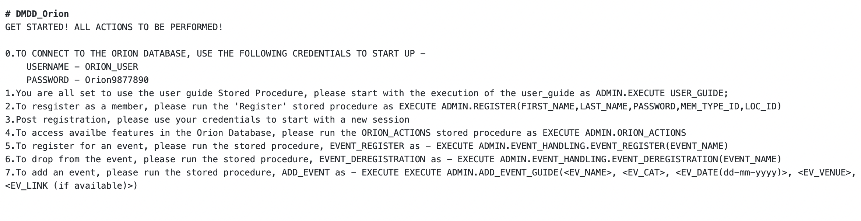
USER GUIDE
<> with ♡ by Team Orion

Slide 5
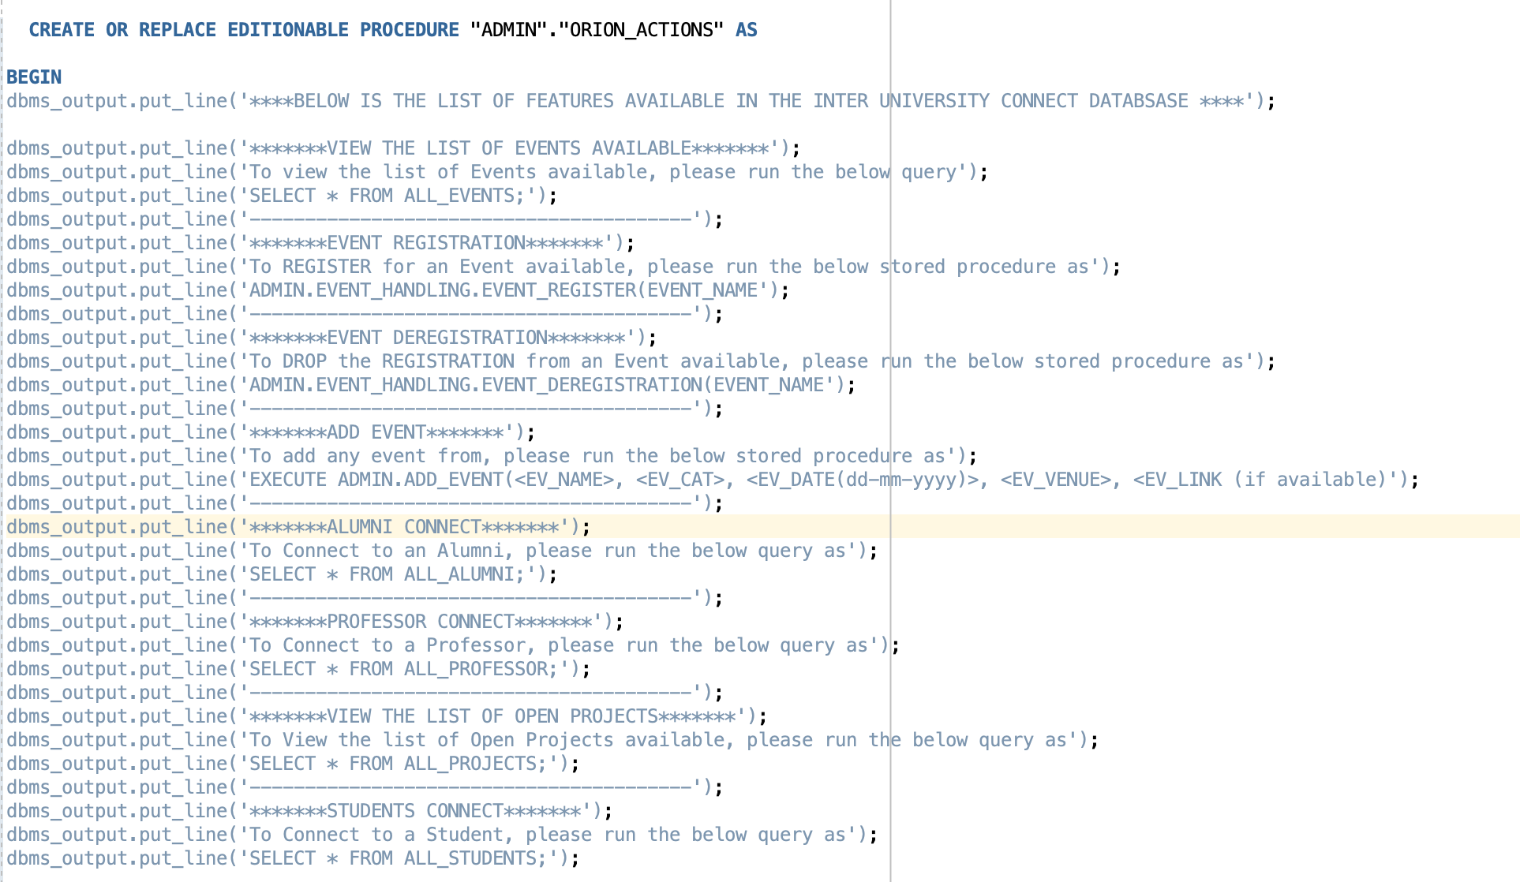
USER GUIDE
<> with ♡ by Team Orion

Slide 6
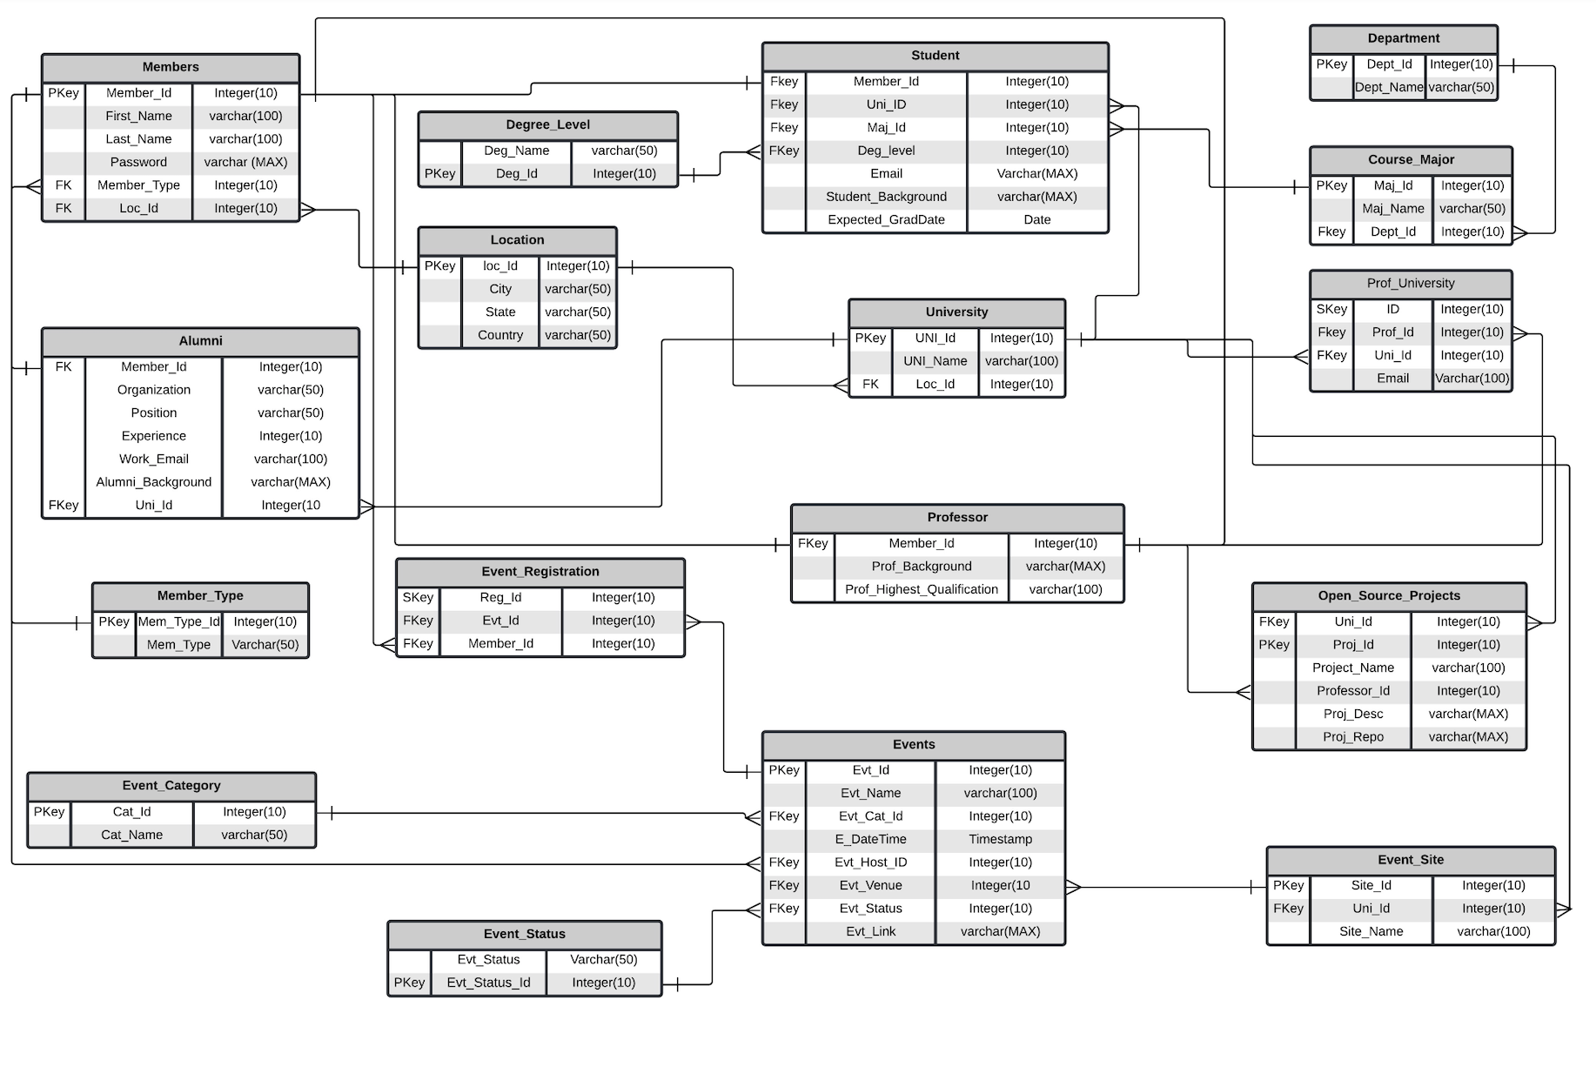
ER DIAGRAM
<> with ♡ by Team Orion

Slide 7
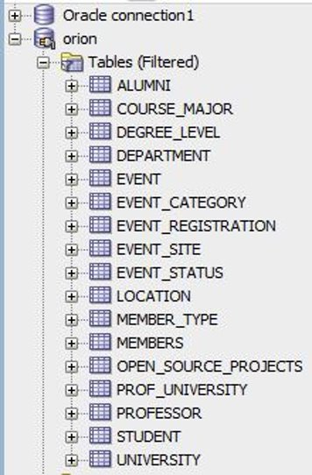
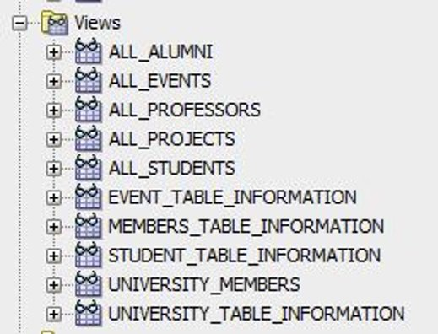
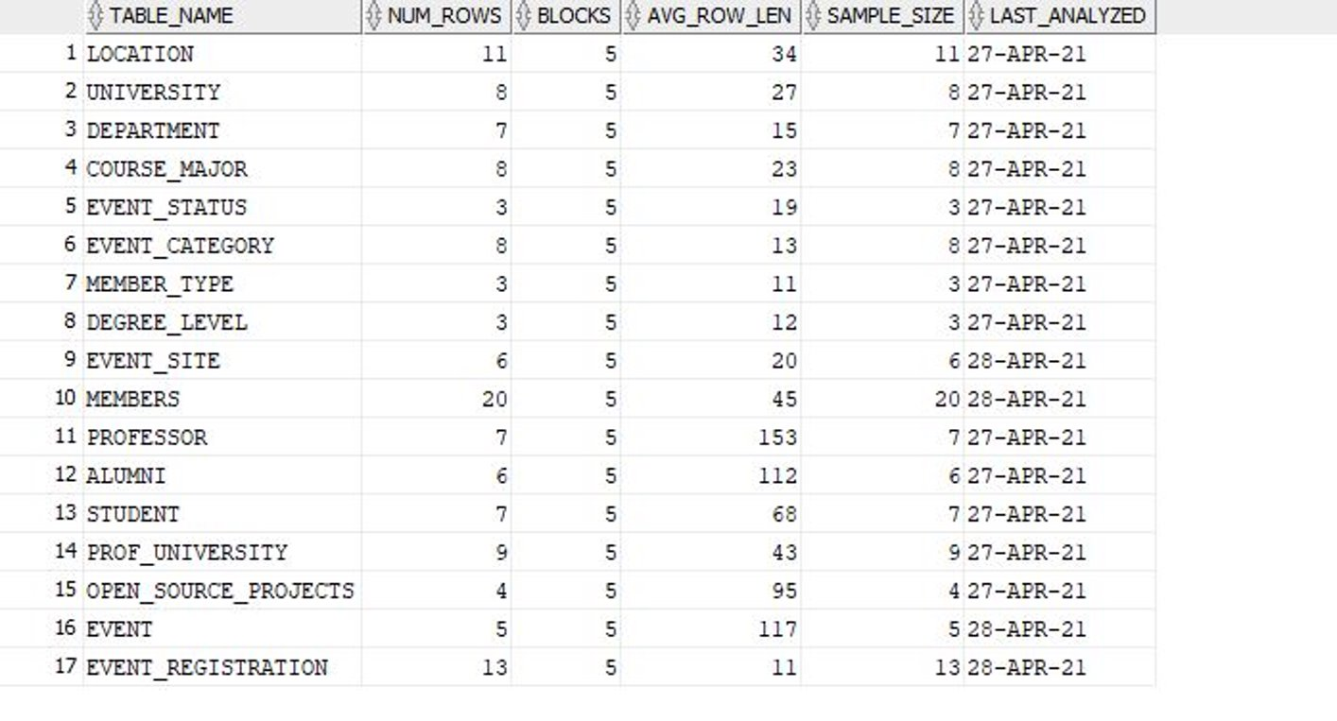
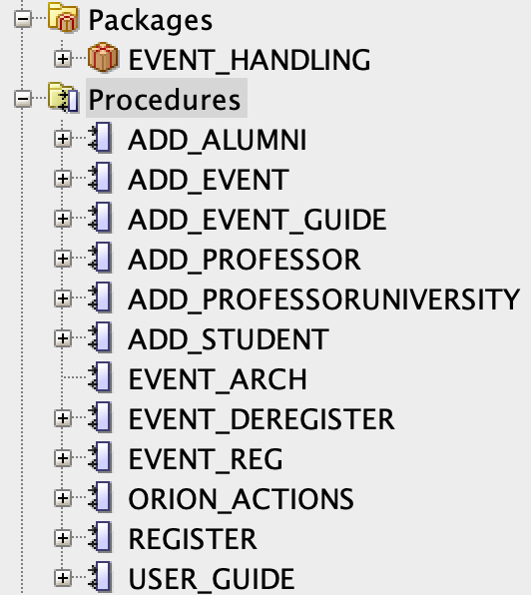

DATABASE OVERVIEW
<> with ♡ by Team Orion

Slide 8
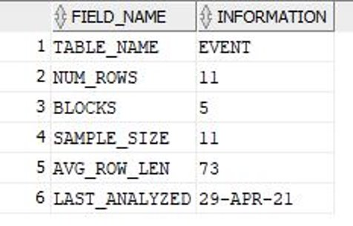
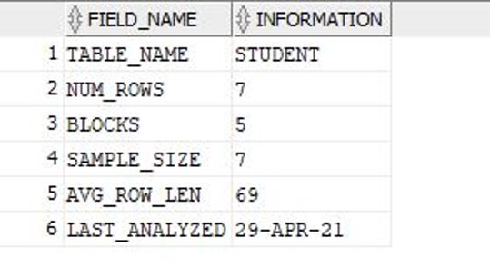
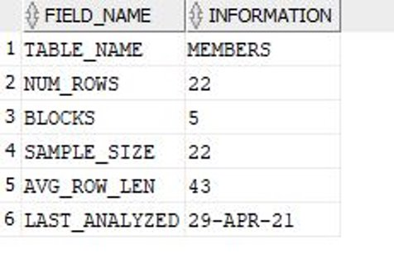
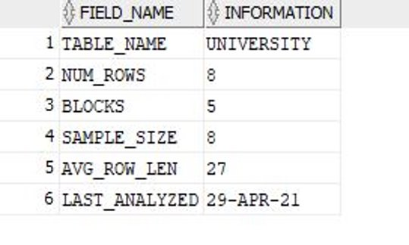
DATABASE STATISTICS REPORTS
EVENTS
STUDENTS
MEMBERS
UNIVERSITY
<> with ♡ by Team Orion

Slide 9
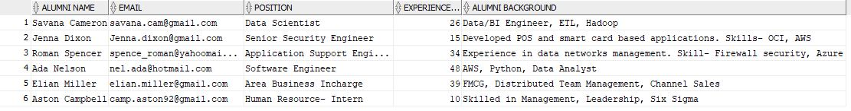
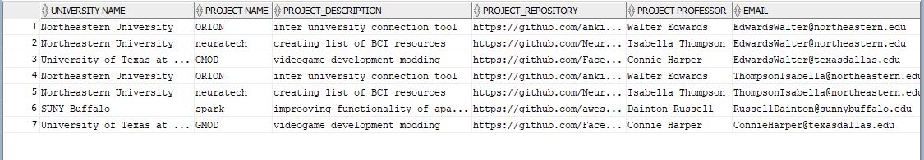
DATABASE REPORTS
ALUMNI
UNIVERSITIES
<> with ♡ by Team Orion

Slide 10
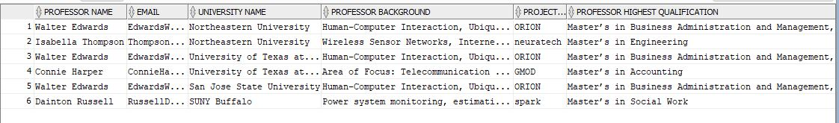
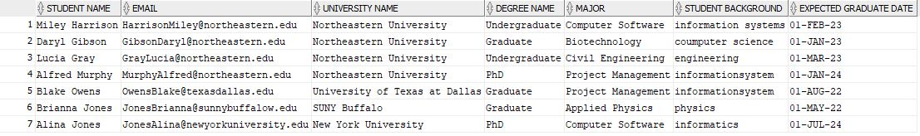
DATABASE REPORTS
PROFESSOR
STUDENTS
<> with ♡ by Team Orion

Slide 11
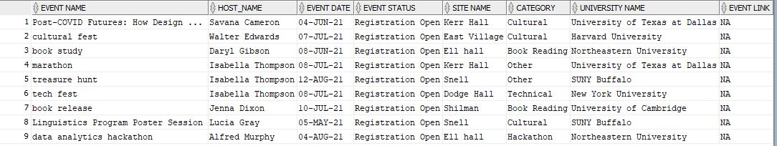
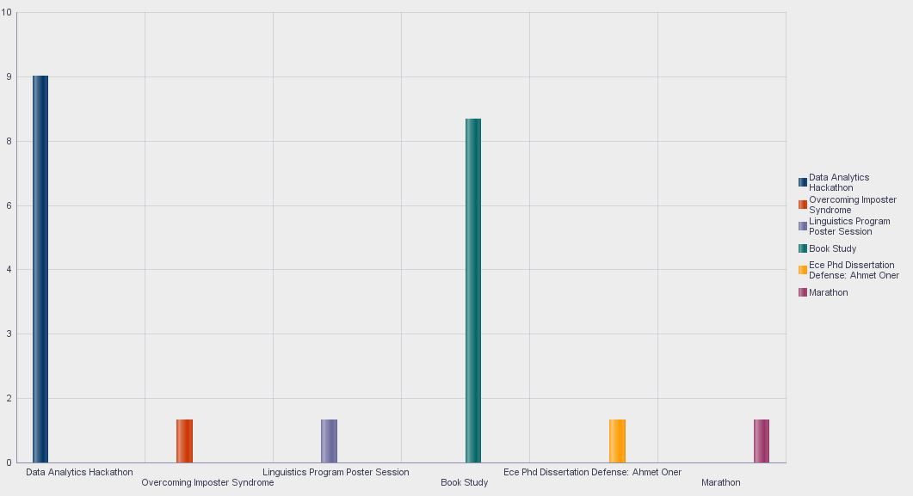
DATABASE REPORTS
EVENTS
<> with ♡ by Team Orion

Slide 12
Thank you!
<> with ♡ by Team Orion

