Slide 1
NetworkiNetworking Fundamentalsng Fundamentals
Topics Covered
• IP Addressing
• DHCP
• Subnetting
• DNS
• Ports & Protocols
• TCP & UDP
• OSI Model

Slide 2
Network Security
Topics Covered
IP Addressing
• DHCP
• Subnetting
• DNS
• Ports & Protocols
• TCP & UDP
• OSI Model

Slide 3
Network & Security Concepts
Concepts | Basic Undestanding
1 Firewall | Controls network traffic
2 NAT | Translates private/public IP addresses
3 VPN | Provides secure remote connectivity
4 Action Directory | Centralized identity & device management
5 LDAP | Directory access and authentication

Slide 4
Hands-on Cisco Networking Lab
Practical Activities
• Created basic network topologies
• Worked with routers and switches
• Configured IP addresses
• Tested device connectivity
• Practiced basic network troubleshooting
• Observed communication between network devices

Slide 5
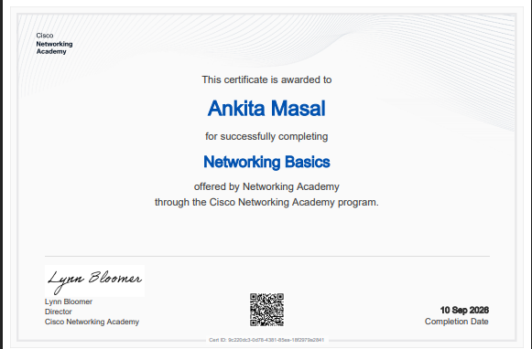
Certification

Slide 6
InstaSafe: VM & Product Exposure
Virtual Machine Setup
• Set up and configured the required VM environment
• Performed basic system/network configuration
• Tested connectivity
• Familiarized myself with the working environment
Product Exploration
• Went through product documentation
• Understood product components and features
• Followed technical documentation
• Explored the product to understand its functionality

