Slide 1
A comparison of Word Embedding for Clinical data
Introduction
Business Problem
Word embeddings have been prevalently used in healthcare natural language processing applications due to the ability of the vector representations being able to capture useful semantic properties and linguistic relationships between words.
Different textual resources have been utilized in healthcare NLP to train word embeddings and these embeddings have been commonly leveraged as feature input to downstream machine learning models.
The problem statement is to evaluate these word embeddings for a specific clinical notes dataset and find out the one working best in the process of information retrieval of clinical text.

Slide 2
A comparison of Word Embedding for Clinical data
Types of word embeddings for clinical data
Following are the kind of word embeddings that are to be evaluated to see which works better for the kind of data we are looking into:
Count vectorizer is the most basic model and does not take into account the context in which the word have been placed in the text. But word embeddings or vectors created from GloVe, skip-gram, Continuous bag of words, FastText, Bert are the ones that would include the context of data as well. And if pre trained embeddings from these sources are used, specially ClinicalBert, then they would provide even better embeddings as those models have been learnt on a dataset relevant to our study i.e. clinical data.
Using pre trained embeddings, is basically a work of transfer learning
Word2vec model has been utilized in this study as it has been shown that word2vec generates better word embeddings for most general NLP tasks.
GloVe is an unsupervised algorithm for obtaining vector representations for words. Training is performed on aggregated word-word co-ocurrence statistics from a corpus, and the resulting representations showcase interesting linear substructures of the word vector space. Glove basically allows us to take a corpus of text, and intuitively transform each word in that corpus into a position in a high dimensional space. This means that similar words will be placed together.
Compared to the popular word2vec model and GloVe, ClinicalBert more accurately captures clinical word similarity.

Slide 3
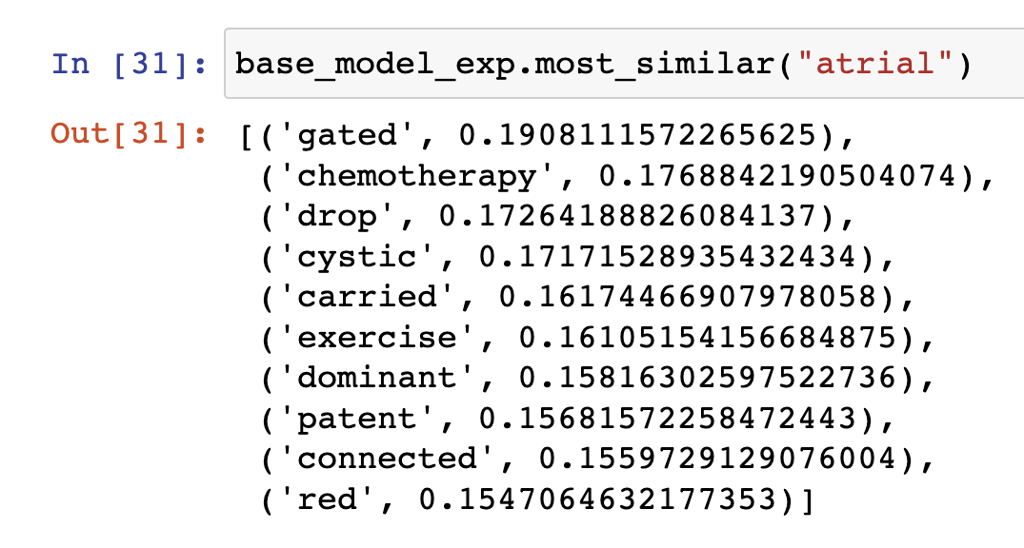
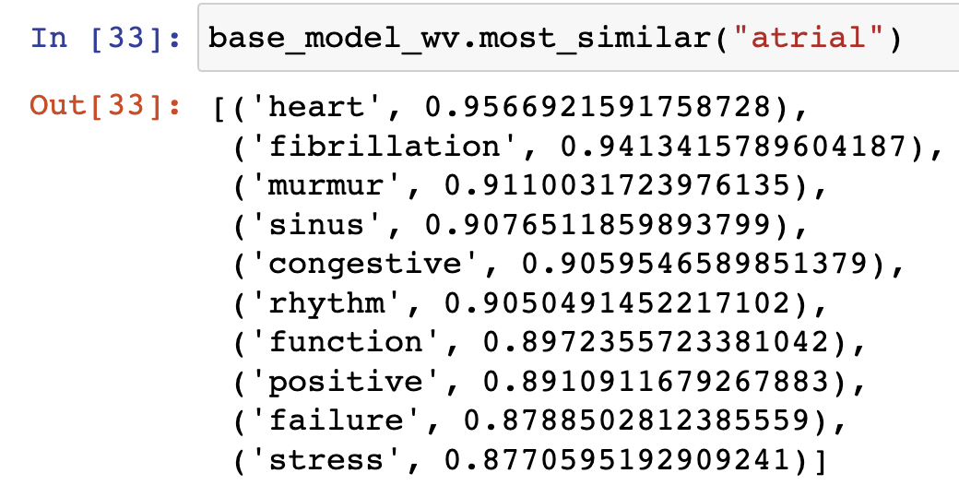
A Comparison of Word Embedding for Clinical data
Solution Proposal
In this study we discuss a popular method for representing the semantics of a word in text data, i.e. word embeddings, and focus on how this method can be best applied to represent clinical data. We will discuss model training methods, evaluation procedures, and application to clinical data.
Two ways have been proposed, one is qualitative and another quantitative.
Qualitative research – Evaluation of word embeddings by looking at similar words from the medconcepts data (assuming that it is the ground truth in the model) provides an insight into the model.
Another way to go about it is, for each embedding, and for top clinically relevant words from the corpus, if one looks at similar words and compare against another embeddings, a clear difference is seen.
Word2vec model trained on current data and pre trained embedding of word2vec trained on google news data have been compared to show such results. As shown below.
Word2vec model has been utilized in this study as it has been shown that word2vec generates better word embeddings for most general NLP tasks.
While using medconcepts data to perform qualitative research, similarity scores using cosine similarity can be calculated between the pair of words present in medconcepts dataset and if the pair is also present in the clinical notes dataset. This can be done for each of the embeddings used, take an average of the result and this would give an evaluation metric to compare.
Similar words from word2vec model trained on clinical notes data set
Similar words from pre trained word2vec model trained on google news data set

Slide 4
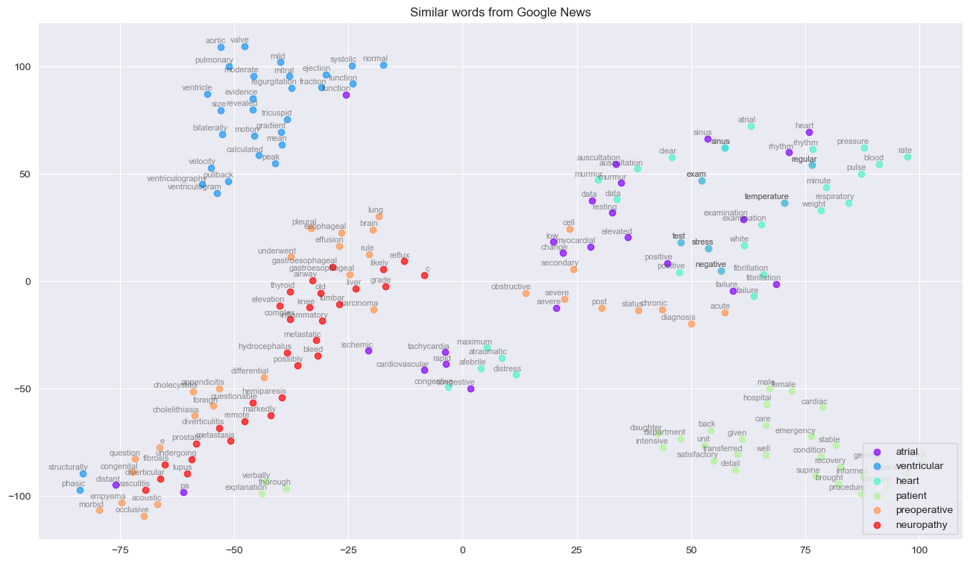
A Comparison of Word Embedding for Clinical data
Solution Proposal Qualitative method -- continued
For the bunch of words mentioned in the medconcepts data and existing in clinical notes, a visualization using T-SNE can be created.
For example, looking into a few words from the clinical notes data = [‘atrial’, ‘ventricular’, ‘heart’, ‘patient’, ‘preoperative’, ‘neuropathy’], and visualizing a T-SNE plot for similar words to each of these words gives a better view into the embedding’s capability to vectorize.
Following is a view into such an exploration using word2vec embedding (pre trained from google news) and transferred the learning on clinical notes to result into the similar words visualization of the above mentioned words. A quick zooming in into the map gives a clearer picture of how similar words have been scattered close together in the 2-dimensional space.
A quick recap to T-SNE –
T- distributed stochastic neighbor embedding is a technique for dimensionality reduction that very well suited for high dimensional vectors like the way word2vec has produced.

Slide 5
A Comparison of Word Embedding for Clinical data
Solution Proposal Qualitative method -- continued
Two ways have been proposed, one is qualitative and another quantitative. Looking at Quantitative approaches here.
A word embedding is real valued vector that represents a word in the context in which the word appears.
The distributional hypothesis states that the words with syntactically or semantically similar in meaning will appear closer to each other. This relatedness is dependent on the word embeddings from which these vectors have been derived.
Quantitative research work recommendation –
One way to go about quantitatively evaluating using an intrinsic approach for these models is a clustering method using Latent Dirichlet allocation and looking at visualizations using the library PyLDAvis.
Perform extrinsic evaluation by applying the word embeddings to downstream tasks like a classification model.
Build a classification model with categories like Cardiovascular, Gastroenterology and Neurology as the output variable. Since there would give a defined way of evaluating the classification models with metrics like the AUC values, this would also give an insight on which embedding worked better for the classification downstream task.

