Slide 1



Library
Management
System
Submitted by:
ANKITA(2013986002)
ANUBHAV(2013986018)
MAYANK(201398601 )

Slide 2
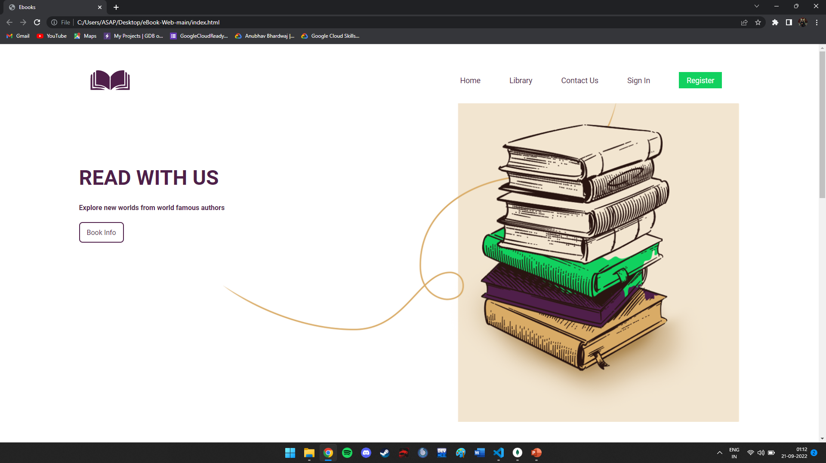
Home Page

Slide 3
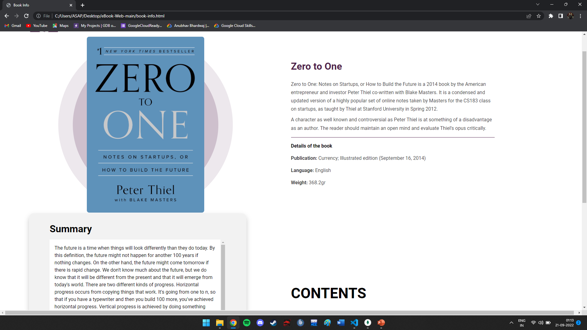
Library Page

Slide 4
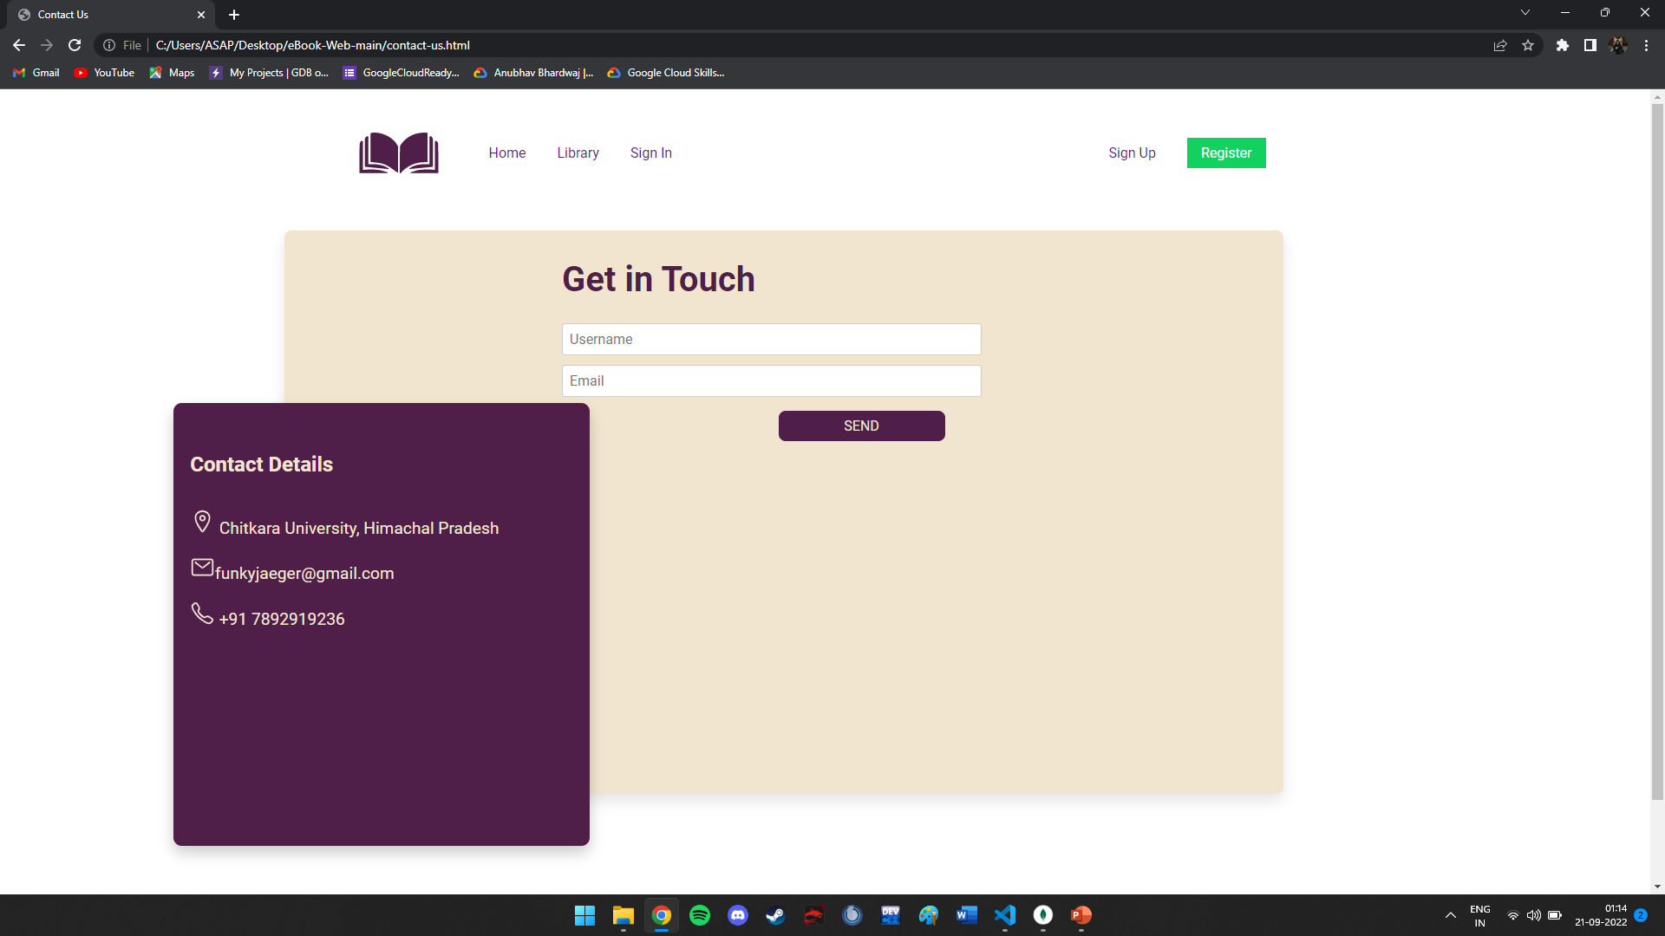
Contact Us

Slide 5
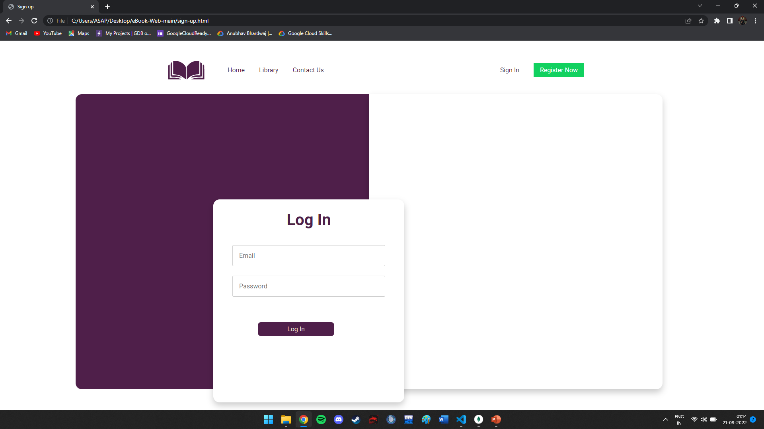
Login Page

Slide 6
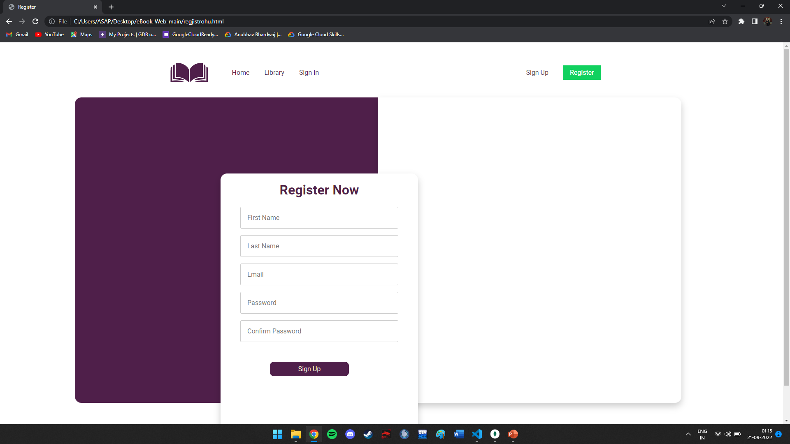
Registration Page

