Slide 1
Disaster Tweet Classification Using Machine Learning & NLP
Nexthikes IT Solutions
- Ankita Babar

Slide 2
INTODUCTION :-
Natural Language Processing (NLP)
Natural Language Processing (NLP) is a branch of Artificial Intelligence (AI) that enables computers to understand, process, and analyze human language. It converts unstructured text into meaningful information, allowing machines to perform tasks such as text classification, sentiment analysis, translation, and spam detection.
Disaster Tweet Classification
Disaster Tweet Classification is a Machine Learning application that automatically classifies tweets into two categories:
Disaster Tweet
Non-Disaster Tweet
This helps identify emergency-related information quickly and accurately from social media platforms.

Slide 3
Problem Statement :-
Millions of tweets are posted daily.
Manual identification is impossible.
Emergency services require quick identification.
ML helps classify tweets auto

Slide 4
Word Frequency Analysis :-
Show:
Most frequent words
Top Disaster words
Top Non-disaster words

Slide 5
Exploratory Data Analysis (EDA) :-
Include:
Target Distribution
Tweet Length Distribution
Keyword Frequency
Word Cloud

Slide 6
Feature Extraction :-
TF-IDF Vectorization
Explain:
Convert text into numbers.
Machine Learning cannot understand text directly.
TF-IDF gives importance to meaningful words.

Slide 7
TF-IDF Vectorization
Tweet
TF-IDF
Numeric Features
Machine Learning Model

Slide 8
Model Evaluation:-
Accuracy
Precision
Recall
F1 Score
Confusion Matrix screenshot
Classification Report screenshot

Slide 9
Deployment Architecture :-
User
Browser
Flask
Model.pkl
Prediction
Result

Slide 10
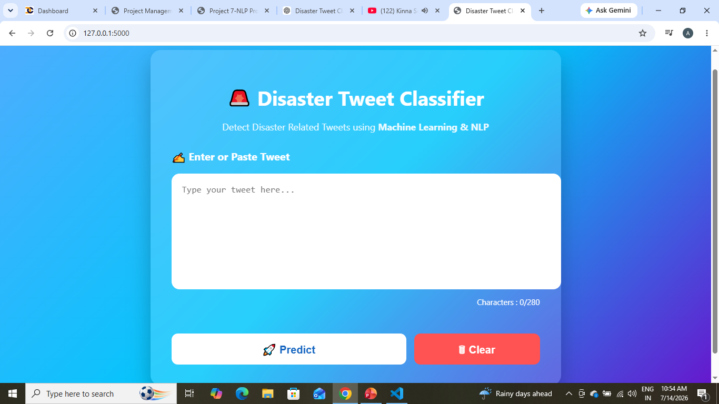
Disaster Tweet Classifier :-

Slide 11
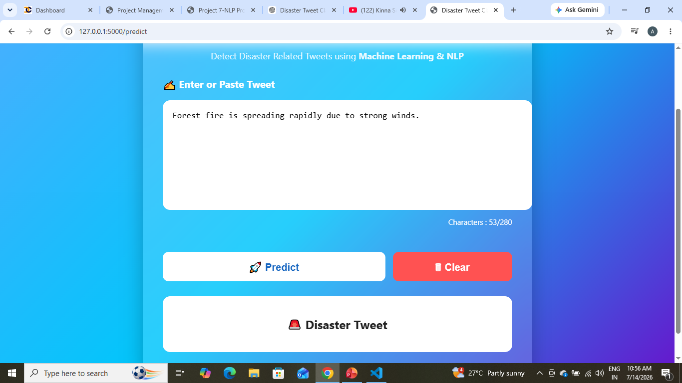
Prediction Demo
Disaster Tweet :-

Slide 12
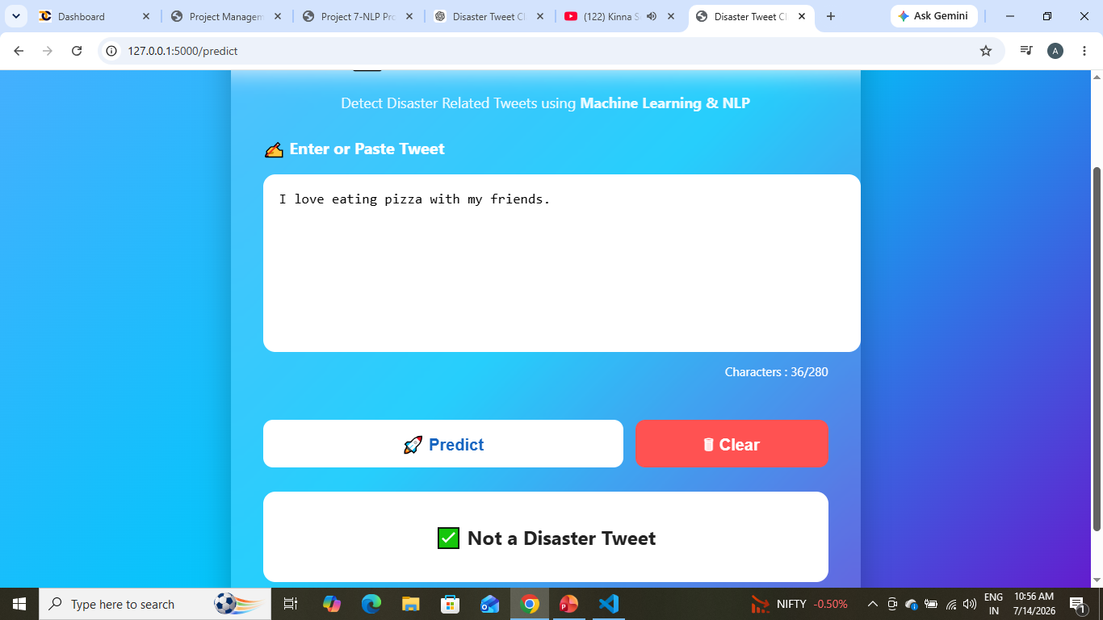
Non-Disaster :-

Slide 13
Streamlit Deployment :-
Since you mentioned Streamlit, explain it briefly.
Include:
Streamlit Dashboard screenshot (if you have one).
Why Streamlit is useful:
Easy deployment
Interactive UI
Shareable web app
If your final deployment is Flask only, you can instead title this slide Deployment Options and mention that Streamlit is an alternative.

Slide 14
Conclusion:-
NLP successfully classifies tweets.
Machine Learning improves disaster response.
Web deployment makes the model easy to use.
Future improvements can increase accuracy.

Slide 15
Thank you!!

