Slide 1

NovaRetail — Quarterly Business Review
Q2 2026 — Quarterly Business Review
$1.28B
+4.5%
53.2
Total Revenue
QoQ Revenue Growth
Weighted Customer NPS
EXECUTIVE SUMMARY
NovaRetail generated $1.28B in Q2 revenue, recovering 4.5% from the previous quarter. APAC delivered the strongest quarterly revenue increase and continues to lead customer experience. However, APAC's high warehouse utilization may constrain future growth. Latin America remains the most urgent concern, combining declining revenue with deteriorating customer satisfaction and operational risk.
ICON
Pick the icon that
best represents this
quarter's overall story
NovaRetail Quarterly Business Review — Capstone Template
1

Slide 2
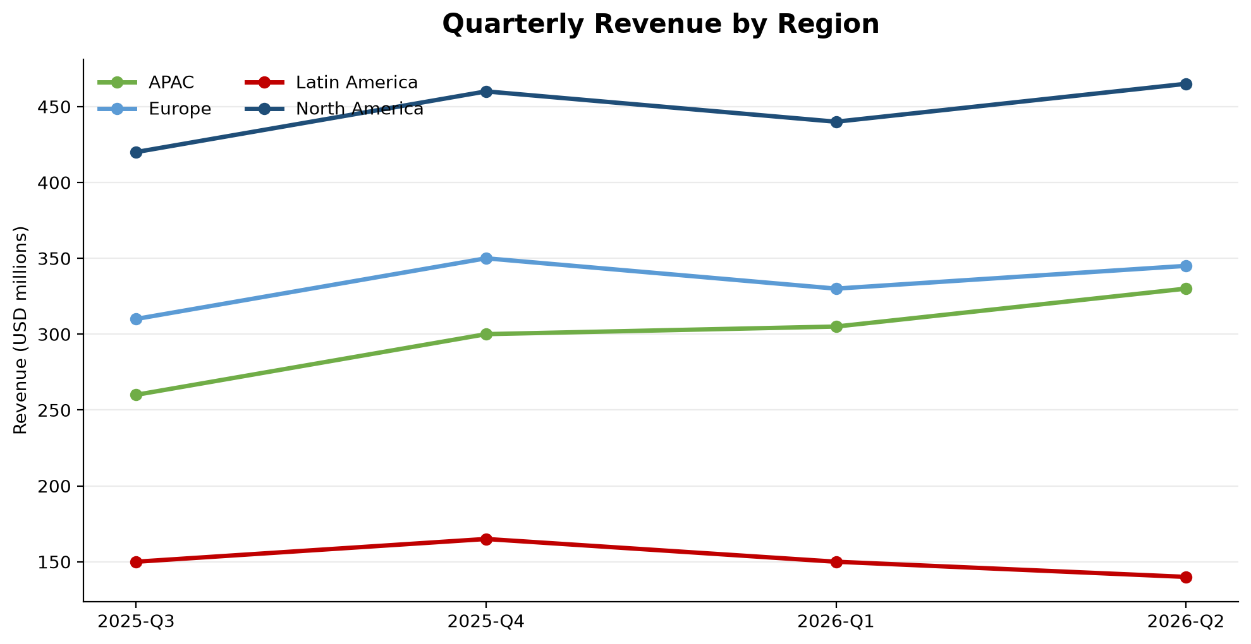

APAC Drives Growth While Latin America Continues to Decline
APAC revenue increased to $330M, the strongest quarterly increase across the four regions.
North America remained the largest contributor, reaching $465M in Q2 revenue.
Europe recovered to $345M after its Q1 decline.
Latin America fell to $140M as returns increased to 8.2%.
CHART
Insert your chart here.
Suggested: grouped/stacked
bar chart of Revenue by
Region across quarters
(Regional_Performance sheet)
ICON
Pick the icon for
growth / performance
NovaRetail Quarterly Business Review — Capstone Template
2

Slide 3
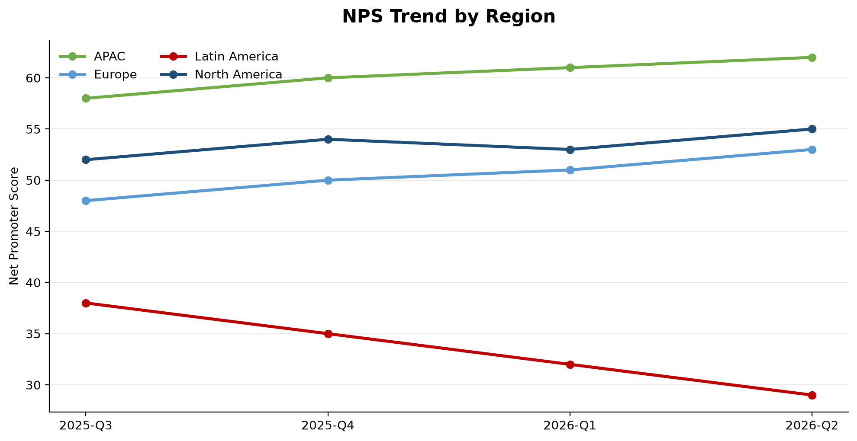

Customer Experience Improves Everywhere Except Latin America
APAC leads with 62 NPS, 92% CSAT and 2.2-day delivery.
North America increased to 55 NPS while reducing delivery time to 2.9 days.
Europe reached 53 NPS and 88% CSAT.
Latin America declined to 29 NPS as delivery time and support demand increased.
CHART
Insert your chart here.
Suggested: line chart of
NPS (or CSAT) by Region
over time
(Customer_Experience sheet)
ICON
Pick the icon for
customer experience
NovaRetail Quarterly Business Review — Capstone Template
3

Slide 4
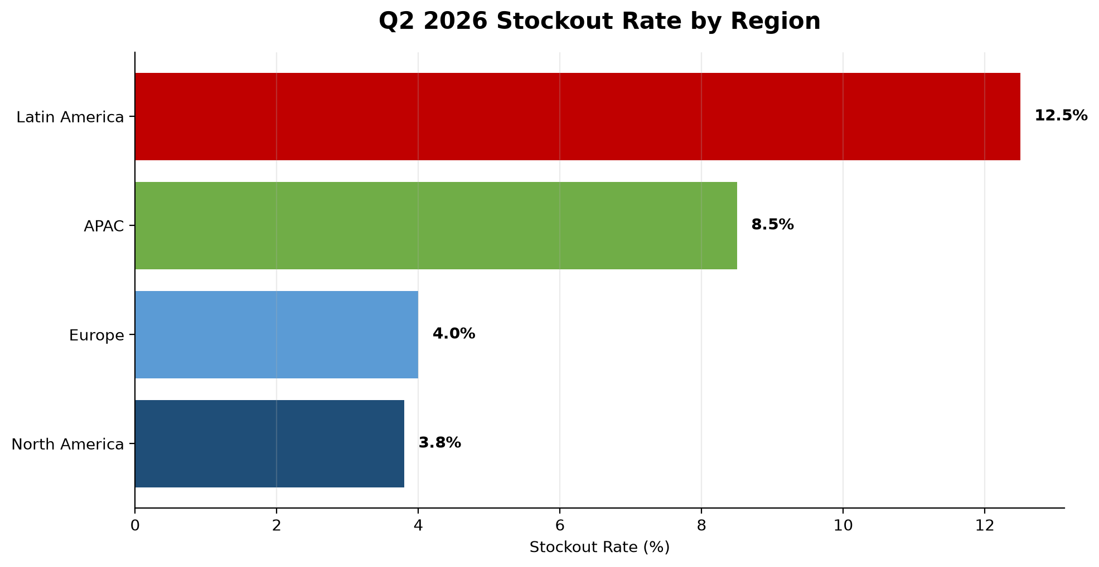

Latin America Faces Critical Risk as APAC Capacity Tightens
Latin America reached a 12.5% stockout rate, the highest across all regions.
Fraud incidents in Latin America increased to 30 in Q2.
Return processing in Latin America reached 10 days.
APAC warehouse utilization reached 92%, creating a capacity constraint.
CHART
Insert your chart here.
Suggested: bar or line chart
of Stockout Rate or Fraud
Incidents by Region
(Operational_Risk sheet)
ICON
Pick the icon for
risk / alert
NovaRetail Quarterly Business Review — Capstone Template
4

Slide 5

Recommended Actions & Next Steps
Stabilize Latin America inventory and delivery performance through an immediate recovery plan.
Strengthen fraud monitoring and exception controls in Latin America.
Expand or rebalance APAC warehouse capacity before utilization limits growth.
Protect growth in North America and Europe while monitoring returns and service quality.
ICON
Pick the icon for
action / recommendation
Act now on concentrated regional risks while protecting APAC's growth momentum.
NovaRetail Quarterly Business Review — Capstone Template
5

