Slide 1

PROJECT BASICS AND RELATED WORK

Slide 2
MAIN TASKS
Data retrieval
Preprocessing
Fruit detection
Fruit counting
Fruit tracking, merging

Slide 3
Data retrieval
Type of data
RGB, Thermal
Resolution
Form and amount of data
Positioning of camera: above, front, back
Number of pictures

Slide 4
Preprocessing
Scaling
Smoothing
Shadow reduction
Increasing contrast
Converting to other color spaces

Slide 5
Fruit detection - problems
Occlusions
Overlapping objects
Picture quality
Environmental conditions
Size of dataset

Slide 6
Fruit detection - approaches
Thresholding techniques with color/shape
Edge detectors
Clustering: k-means
Classification: SVM, CRF
Segmentation with NNs
Detection and counting by NN

Slide 7
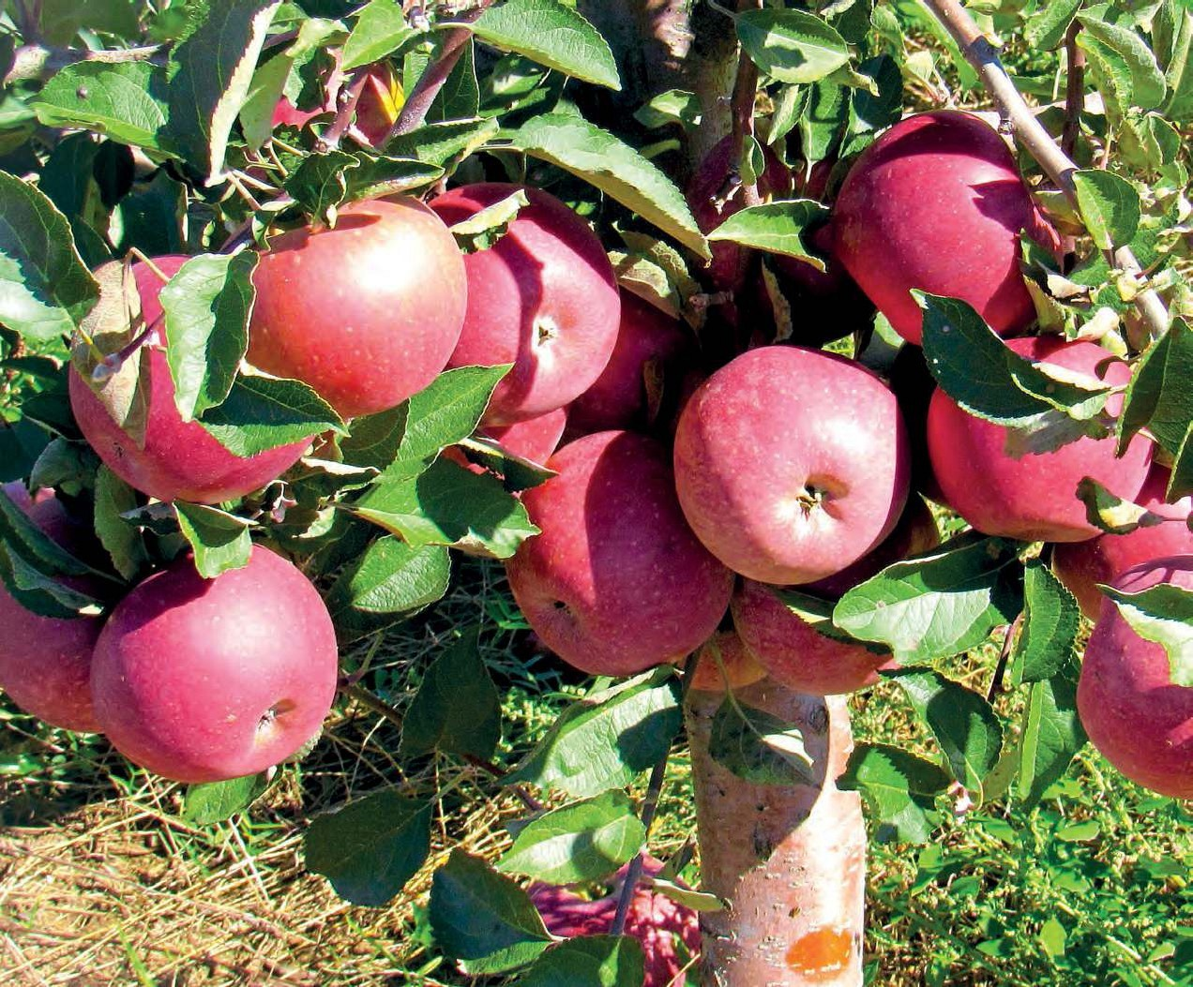
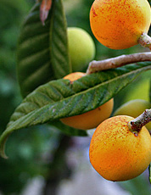
Fruit counting - problems
Counting blobs as one fruit
Counting same fruit multiple times
Counting partly occluded fruit as multiple fruits

Slide 8
Fruit counting
Object-detection based counting
Contours and edges
Circular Hough Transform (CHT)
Watershed Transform
Template matching
NNs

Slide 9
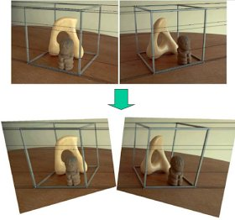
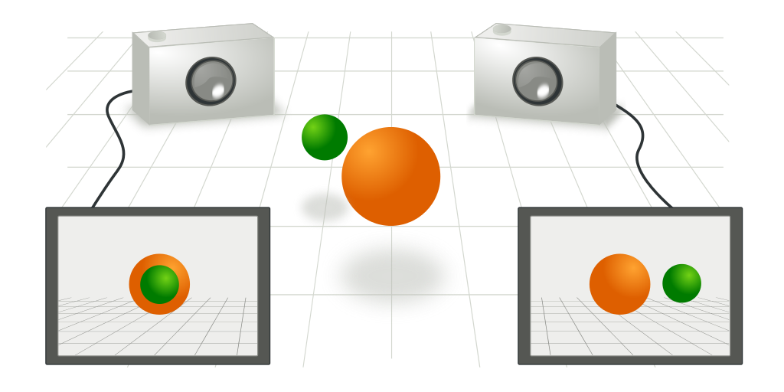
Fruit tracking
Avoid overlapping images
Stereo block matching and GPS information
Epipolar geometry and GPS position
Mulit-sensor and optical flow
Affine tracking and SFM (Structure from motion)

Slide 10
Ressources
Häni et al., A Comparative Study of Fruit Detection and Counting Methods for Yield Mapping in Apple Orchards, 2018
Fu et al., Kiwifruit yield estimation using image processing by an Android mobile phone, 2018
Mohammed et al., Color-Based for Tree Yield Fruits Image Counting, 2017
Malik et al., Detection and Counting of On-Tree Citrus Fruit for Crop Yield Estimation, 2016
Gongal et a., Apple crop-load estimation with over-the-row machine vision system, 2016
Gan et al., Immature green citrus fruit detection using color and thermal images, 2018
Stajnko et al., Estimation of number and diameter of apple fruits in an orchard during the growing season by thermal imaging, 2004
Behera et al., Yield Estimation of Pomegranate Using Image Processing Techniques, 2019

