Slide 1

TOPIC : FINGERPRINT VOTING SYSTEM [VOTEHUB]
Done By:
1] Akshitha N (PES2UG20CS033)
2] Akshitha R (PES2UG20CS034)
3] Ankita Sahoo (PES2UG20CS053)

Slide 2
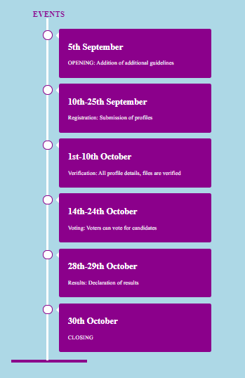
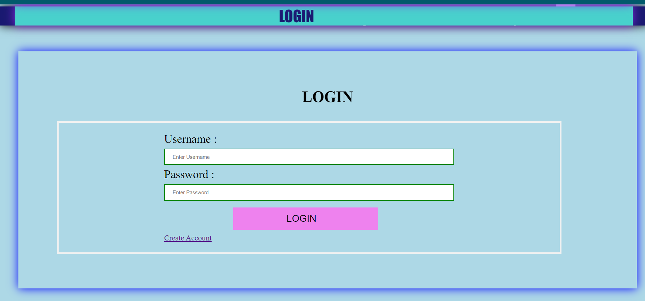
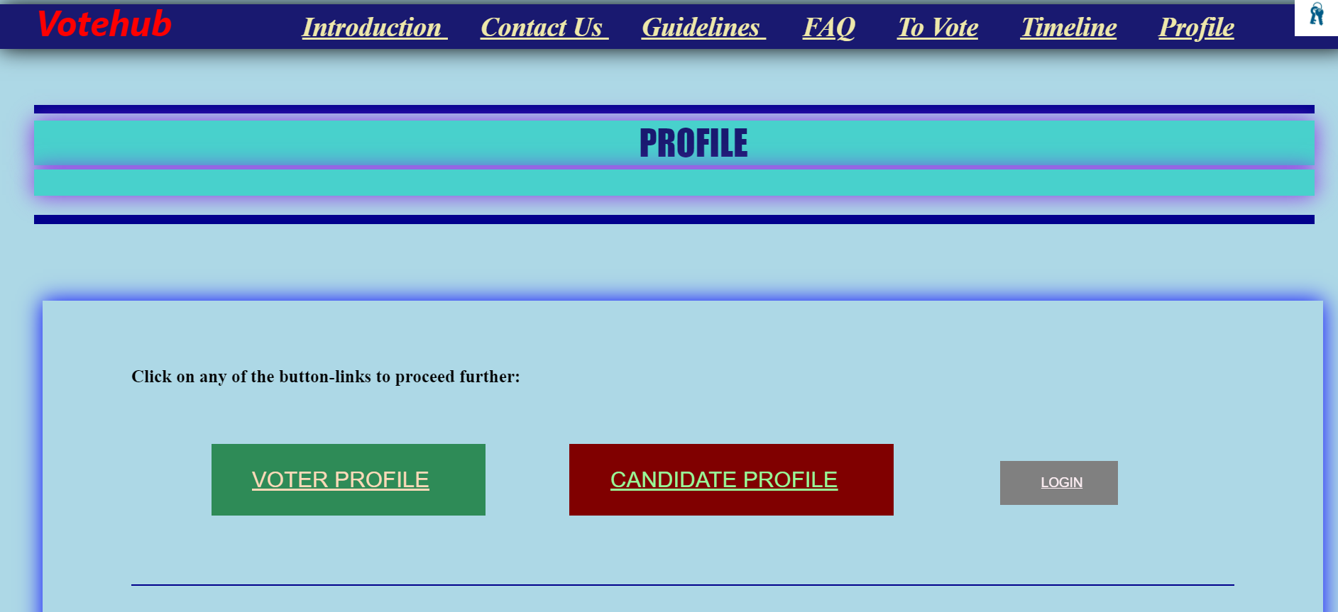
INTRODUCTION
This project is about making a website that assists users to conduct voting online; ie- submitting profiles, verification, and voting.
The unique feature is that both candidates and voters can use this website.
As many things are moving online, we tried to make a completely online based voting process.
To complete this project we have used :
nodejs, reactjs, html,mongodb, etc…

Slide 3
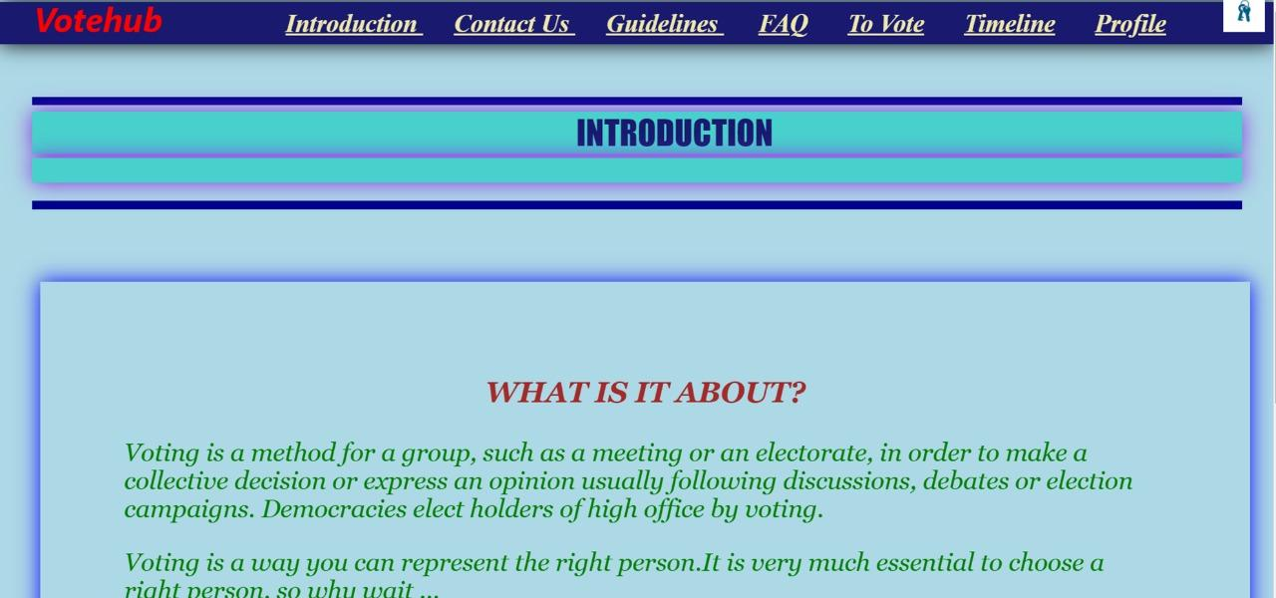
REACT-JS and HTML
REACT-JS and HTML
React-JS is the front end library which is used to create dynamic client-side applications.
HyperText Markup Language is a standardized system for tagging text files.
It is used for font, colour, graphic, and hypereffects on world wide web pages.
In this project we have used mostly React-js and little html to create a client-side framework(front-end framework).

Slide 4
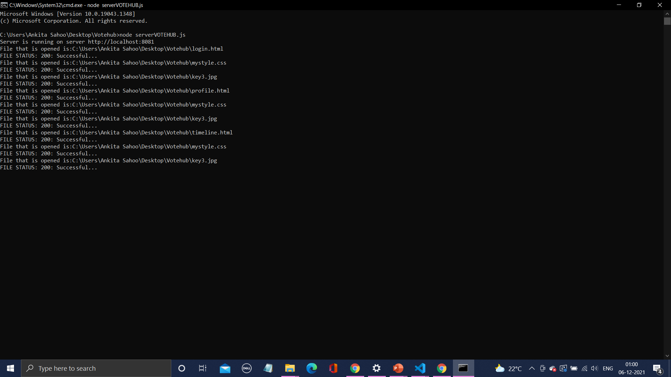
NODE-JS
Usually any normal website uses many web pages. Due to this the web pages load at a slower rate.
To avoid, this buffering Nodejs is used.
It is an open-source, cross-platform,back-end js runtime environtime.
It runs on V8 engine and execute js code outside the web browser.
We used Nodejs as it is single-threaded mechanism, and hence using it makes it easier, faster and efficient to switch between web pages.

Slide 5
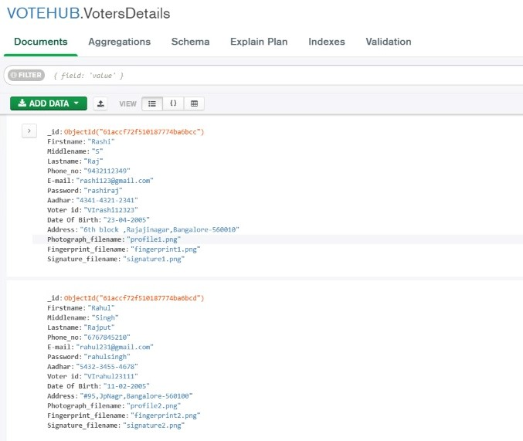
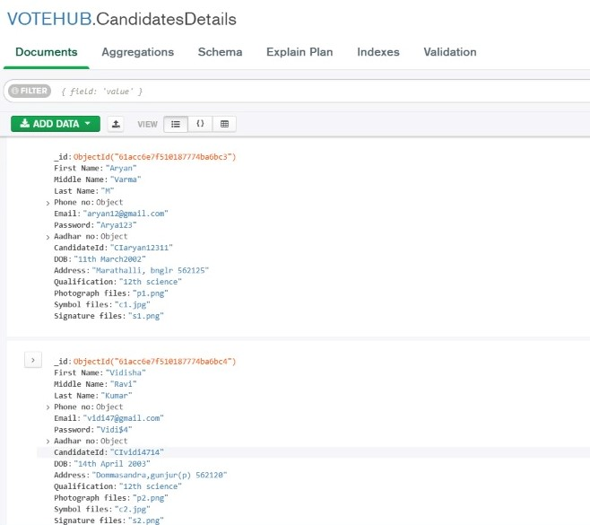
MONGO-DB
MONGO-DB
MongoDB is an open source, document-oriented, NoSQL database used for high volume data storage.
Instead of using tables and rows as in the databases, MongoDB makes use of collections & documents.
In this project we have used 2 databases to store Candidate details and Voter details.
THANK
YOU….

