Slide 1

DupliQuest
Unraveling Duplicate Question Pair Detection in Natural Language Processing (NLP)

Slide 2



Ankit Kumar Aggarwal
Kanchan Maurya
Shengjie Zhao
Avinash Rajaraman Swaminathan

Slide 3
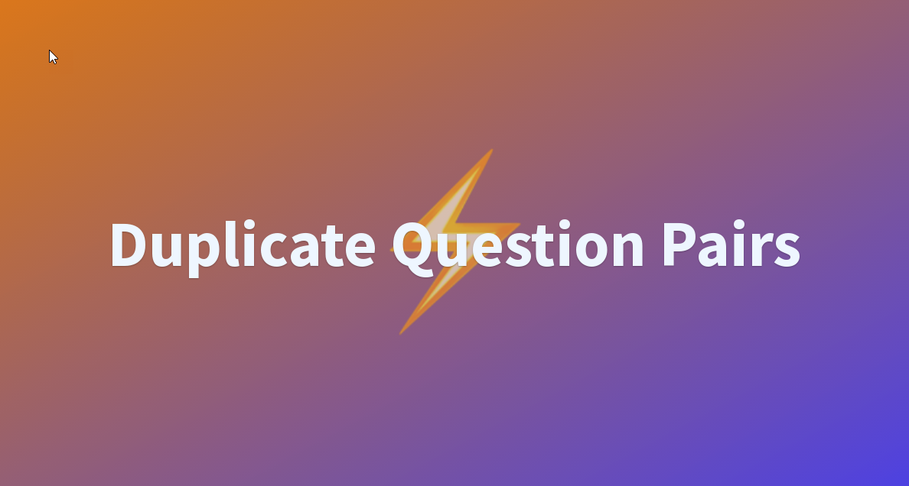
Problem statement
Online platforms like Quora, Yahoo, Stack Overflow and Grapple with a significant issue i.e., questions with identical intents spread across separate pages. For example, consider these queries: "Most populous US state?" and "Which state has the most people in the United States?" Such duplication hampers efficient knowledge-sharing.
Solution Approach: Create a single canonical page for each unique question. This enhances accessibility for knowledge seekers, consolidating answers in one spot.

Slide 4
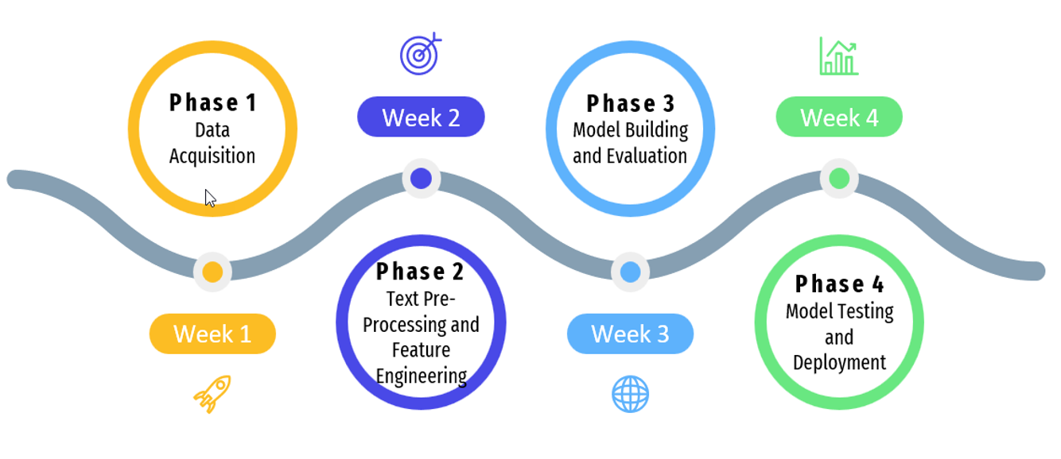
Project timeline

Slide 5

Source of Data
Question Pairs Dataset
Quora's first public dataset is related to the problem of identifying duplicate questions.
Dataset consists of over 400K lines of potential question duplicate pairs.
There are total 6 columns in the dataset:
Id: the id for each question pair
Qid1: the id for each question pair
Qid2: the id for question 2 in the pair
Question1: the full text for question1
Question2: the full text for question2
is_duplicate: yes(1) ; no(0)

Slide 6
Research Approach
Traditional Machine Learning Models
Random Forest
Sentence BERT using Siamese Networks
Python framework for state-of-the-art sentence, text and image embeddings.
DistilBERT
It is a distilled form of the BERT model.
XGBoost
Logistic Regression
Decision Tree
Bagging
AdaBoost
Gradient Boosting
It can be used to compute sentence / text embeddings for more than 100 languages.
These embeddings can then be compared e.g., with cosine-similarity to find sentences with a similar meaning.
It is small, fast, cheap and light transformer.
It has 40% less parameters and runs 60% faster while preserving over 95% of BERT’s performance.

Slide 7
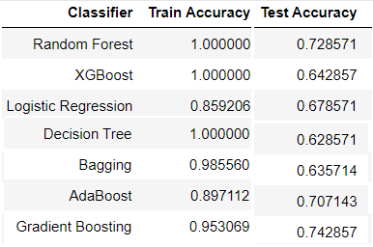
Traditional Machine learning Models & Results
Machine Learning Model
Architecture & Process Flow
Data Acquisition
Model Development
Web
Deployment
Text Preprocessing
Feature Engineering
Inference
From the above results, we can see that some of the models like Random Forest, XGBoost, and Decision Tree are overfitting, as indicated by a perfect training accuracy of 1.0 but significantly lower test accuracy. This discrepancy between training and testing accuracy implies that these models are memorizing the training data and failing to generalize well to unseen data.

Slide 8
Opportunity to explore advanced techniques
Given the overfitting observed in some models and the relatively low-test accuracy across all models, it can be effective way to utilize advanced techniques like:
Transformers
BERT
Sentence BERT
DistilBERT
These models provide a good contextual and semantic understanding of the text data.

Slide 9
Unleashing the Power of Transformer Models – Sentence BERT
Sentence BERT
Sentence BERT is a modification of the popular BERT (Bidirectional Encoder Representations from Transformers) model that allows it to derive semantically meaningful sentence embeddings.
It is trained with Siamese and triplet network structures to generate meaningful sentence embeddings that can be compared using cosine-similarity.
Generates fixed-length vector representations for variable length sentences.
Good for tasks like semantic textual similarity, semantic search, document classification, clustering and more.
Provide significant performance gains over earlier approaches
Versatile pretrained models available in various languages.
Architecture
Data Acquisition
Model Development
Web
Deployment
Sentence BERT
Text Preprocessing

Slide 10
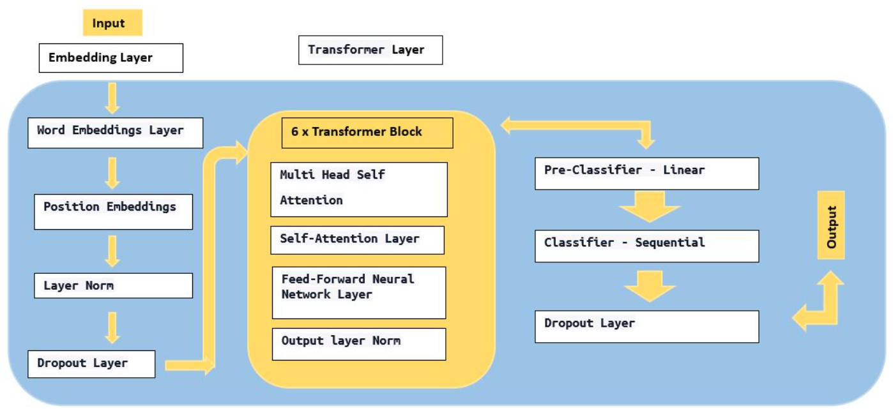
Unleashing the Power of Transformer Models – DISTILT BERT
DistilBERT
DistilBERT is a smaller, faster, cheaper and lighter version of BERT.
DistilBERT is 6 layers deep whereas BERT-base is 12 layers.
It leverages word and position embeddings, a transformer architecture with self-attention mechanisms, and a final classification layer to process and classify input sequences effectively.
The distillation is done by training a transformer encoder stack to predict the output of the larger BERT teacher model.
Provides a nice trade-off between compute resources and model accuracy.
Architecture

Slide 11
Hyperparameters - Transformers
DistilBERT Model:
Optimizer (AdamW):
Learning rate: 0.00001
Weight decay: 1 (used for regularization)
Learning Rate Scheduler (CosineAnnealingLR):
Maximum number of iterations (T_max): 10
Minimum learning rate (eta_min): 0
Training Configuration:
Number of epochs: 50
Early stopping patience: 3 (training will stop if no improvement is observed for 3 consecutive epochs)
Batch Size for Training and Validation Data Loaders:
Batch size: 512
Number of worker processes for parallel loading: 4
K-Fold Cross-Validation:
Number of splits (folds): 5
Shuffle: True (ensures that the data is randomly shuffled before splitting)
Pre-trained Sentence-BERT model:
Dropout rate: 0.1
First fully connected layer size: 512
Second fully connected layer size: 1
Training Configuration:
Learning rate for AdamW optimizer: 0.001
Number of epochs: 50
Batch size for training and validation Data Loaders: 64
Loss Function:
Binary Cross-Entropy with Logits Loss (BCE With Logits Loss)
Learning Rate Scheduler:
ReduceLROnPlateau scheduler with mode set to 'min' (reduces learning rate when a metric has stopped improving)
Data Splitting:
Test size for train-validation split: 0.2 (20% of the data is used for validation)
Random state for train-validation split: 42 (ensures that the splits are reproducible)

Slide 12
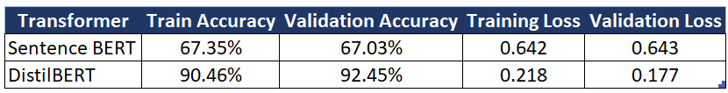
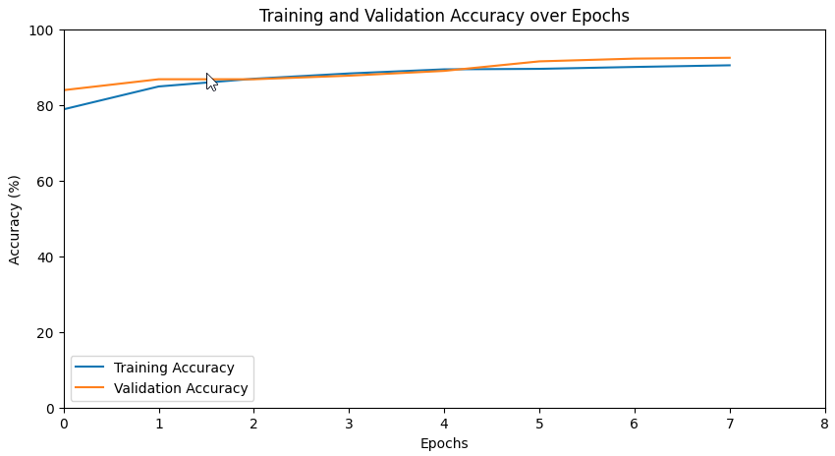
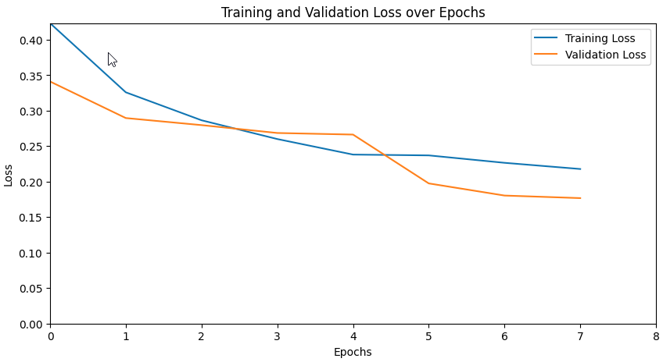
Results
Sentence BERT & DistilBERT Train and Validation Results
Final Research Conclusion:
Best Model : DistilBERT
Test Accuracy : 91.96%
Test Loss : 0.187
Test F1 Score : 0.921

Slide 13
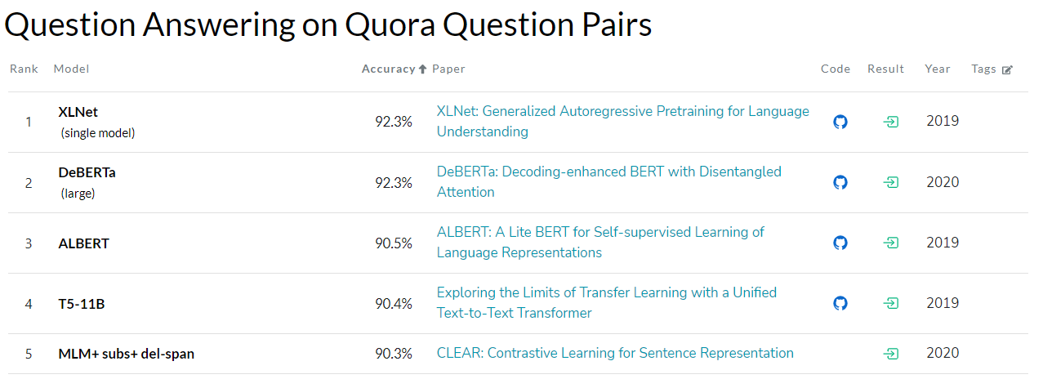
BenchMarkING
Source: Benchmarks for Question Answering Pairs

Slide 14
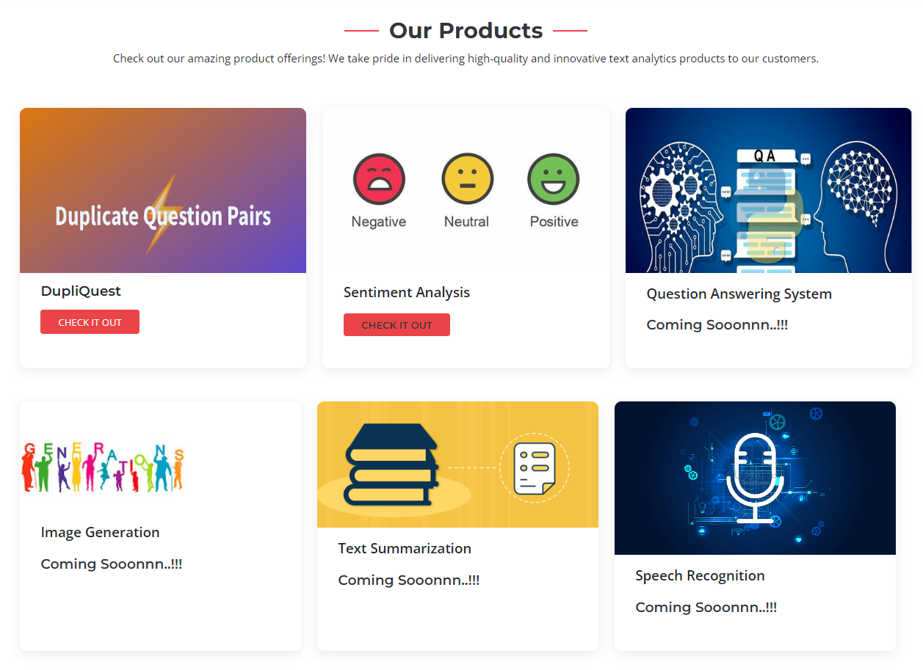
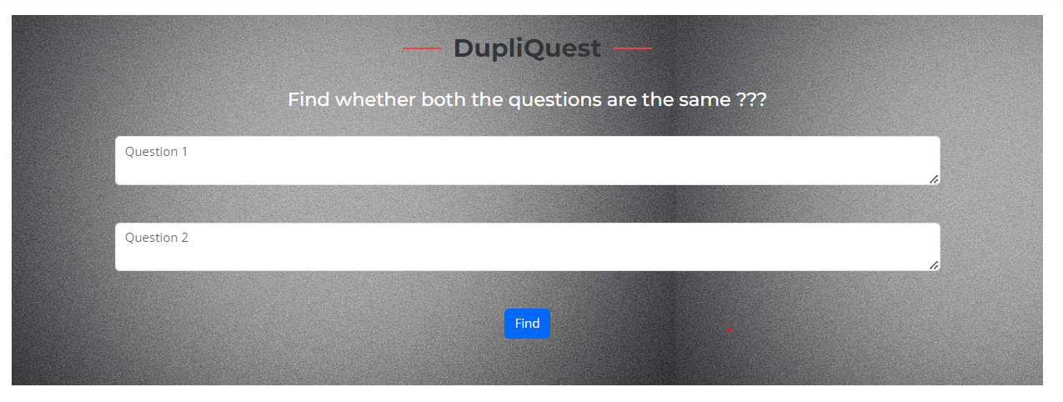
Product Integration
Click Here to Access Website

Slide 15
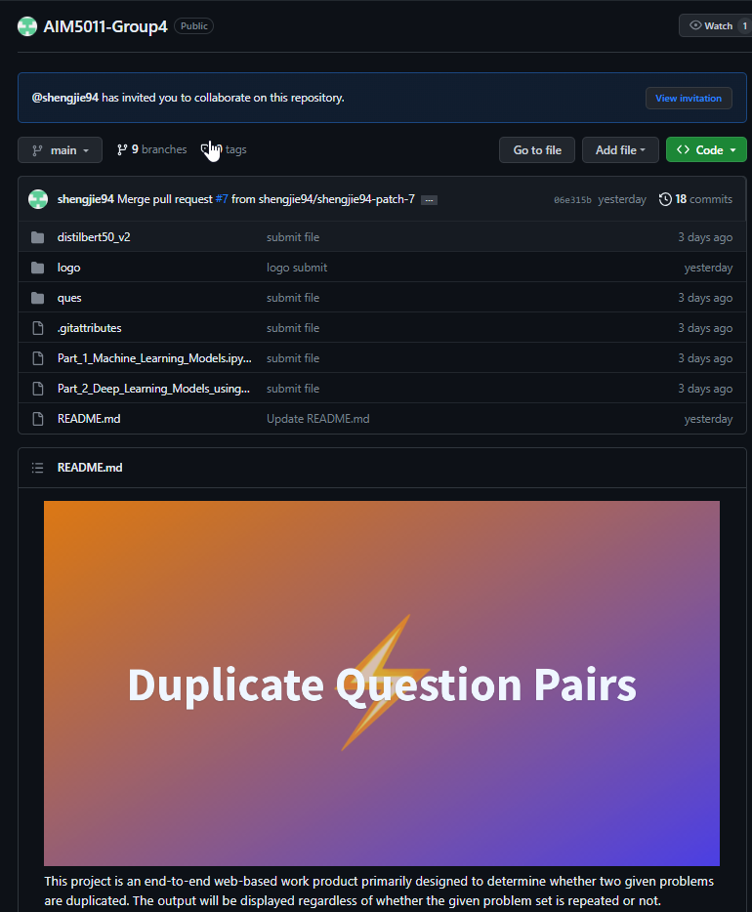
Deliverables
Click Here to Access GIT Repository
Branch: Main
Repository Name: AIM5011-Group4
Contents:
Readme.md
IPYNB Code Files
Dataset
Website Code
Images
Research Paper PDF

Slide 16

FUTURE WORK
Research More On Advanced Transformer Architecture
Deployment Using Cloud Technologies
Integrate Other Products

Slide 17

Thank You

