Slide 1
NYC Complaints and Events Analytics
Team Members:
Ankit Kumar Aggarwal
Aravind Raju
Sameer Beloshe
Venkata Sai Surya Athuluru

Slide 2

Project Description
The aim of this project is to build a cloud based Datawarehouse system to analyse New York Complaints and Events Data.
The end product will be a monitoring dashboard that provides detailed analytics on crime in specific areas in New York.
This application will be a valuable resource for New York department of security to analyse certain crime patterns and their relations with the events
By bringing in multiple information like location, victim and suspect statistics it will be easier for the security departments to plan their operation.
This will be achieved by building a data warehouse leveraging AWS for end-to-end deployment.

Slide 3
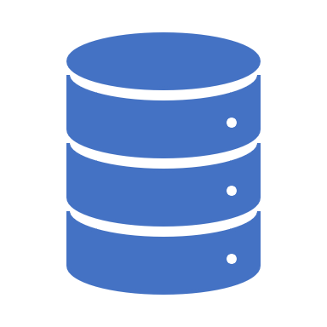
Datasets
NYPD Complaint Data Historic
Database consists of 8.91 Millions records; each row is complaint. It can be downloaded using API provided by NYC Open Data.
Dataset of 35 different fields, separated by ‘:’ colon.
Ready NYC Events
The dataset consists of 4237 rows with 19 columns where each row is a New York Event.
Data available in CSV format.
US Zip Codes from 2013 Government Data
This dataset consists of 3 columns i.e., latitude, longitude and pincode.
It is opensource data available over github.
Sources Include
NYC Complaint Data Historic
Ready NYC Events
US Zip Codes from 2013 Government Data

Slide 4

Roles and Responsibilities
The project team will consist of the following members:
Ankit Kumar Aggarwal
Overall Project Management
Cloud Architecture Design
ETL, Datawarehouse Design
Monitoring Dashboard Design
Quality Assurance
Aravind
Data Acquisition– Source 1
Datawarehouse Development
Unit Testing and UAT
Sameer
Overall ETL Development
Reports & Dashboard Development
Unit Testing and UAT
Venkat
Data Acquisition – Source 2
Cloud Integration
Unit Testing and UAT
In addition to these specific roles, all the team members will discuss and make sure to check or validate the project plan at every step of the way to keep in line with the feasibility of the project.

Slide 5
Project Timeline
Requirement Phase (2 Weeks)
1. Requirement Gathering
2. Data Acquisition
3. Data Understanding
4. Hardware/Software Finalization
1
Design Phase (2 Weeks)
1. Overall Architecture Design
2. Data Preparation
3. Datawarehouse Architecture Design
2
Production Deployment (2 Weeks)
1. Deploy all the components on Cloud.
2. Perform UAT.
Development Phase (3 Weeks)
1. Development : Data Acquisition Scripts
2. Development : ETL
3. Development : DWH
4. Development : Reports and Dashboards
3
Testing Phase (2 Weeks)
1. Unit Testing of each developed component.
2. Perform Integration Testing
4

Slide 6
Current Scope:
At present, the project primarily aims to build an end-to-end real monitoring system using data warehousing and cloud technology.
However, based on the feasibility of the time, cost and resources, we will try to include only the necessary data.
Future Development Opportunities:
As a part of future development, this can be extended to include:
Whole Historical Data
6

Slide 7
Thank
You!!

