Slide 1

New York Crime Analytics Insights for Safer Communities
Project Team:
Ankit Kumar Aggarwal
Aravind Raju
Sameer Beloshe
Venkata Sai Surya Athuluru

Slide 2

Agenda
Project Overview
Datasets
Project Timelines
Project RACI
Cloud Architecture
Implementation Overview Demo
DWH Star Schema
NYC Crime Analytics Dashboard Demo
Project Deliverables
Scope

Slide 3

Project Overview
The aim of this project is to build an AWS cloud based Datawarehouse solution to analyse New York Complaints and Events Data.
The end product will be a monitoring dashboard that provides insights on crimes during events in New York area.
This application will be a valuable resource for New York department of security to analyse certain crime patterns during events.
By bringing in multiple information like location, victim and suspect statistics it will be easier for the security departments to plan their operation.
This will be achieved by building a data warehouse leveraging AWS cloud based tools for end-to-end deployment.

Slide 4

Datasets
NYC Complaint Historic Dataset
Database consists of 8.91 Millions records; each row is complaint. It can be downloaded using API provided by NYC Open Data.
Dataset of 35 different fields, separated by ‘:’ colon.
NYC Events Dataset
The dataset consists of 4237 rows with 19 columns where each row is a New York Event.
Data available in CSV format.
US Zip Codes from 2013 Government Data
This dataset consists i.e., latitude, longitude and pincode.
It is opensource data available over github.
Links
NYC Complaint Data Historic
Ready NYC Events
US Zip Codes from 2013 Government Data

Slide 5
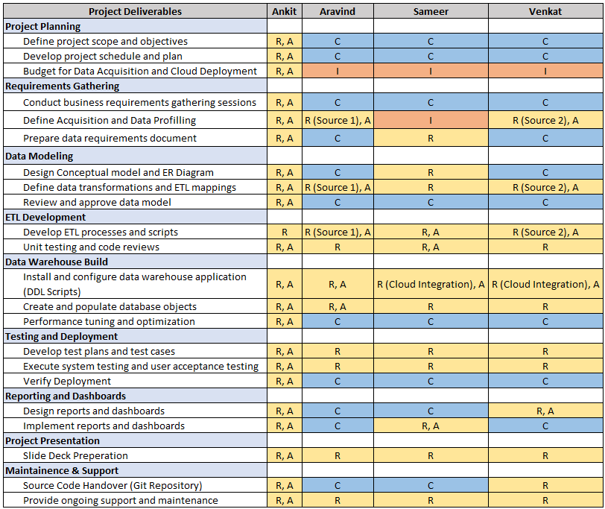
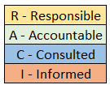
Project RACI

Slide 6
Project Timeline
Requirement Phase
(02/13 – 03/05)
1. Requirement Gathering
2. Data Acquisition
3. Data Understanding
4. Hardware/Software Finalization
1
Design Phase
(03/06 – 03/20)
1. Data Preparation
2. Conceptual Architecture Design
3. Datawarehouse Architecture Design
4. Data Profiling
5. Physical Data Modelling
2
Production Deployment & Delivery
(04/22 – 05/06)
1. Deploy all the components on Cloud.
2. Perform UAT.
3. Handover Project and Documentation
Development Phase
(03/21 – 04/11)
1. Development : Data Acquisition Scripts
2. Development : ETL
3. Development : DWH
4. Development : Reports and Dashboards
3
Testing Phase
(04/05 – 04/19)
1. Unit Testing of each developed component.
2. Perform Integration Testing
4

Slide 7

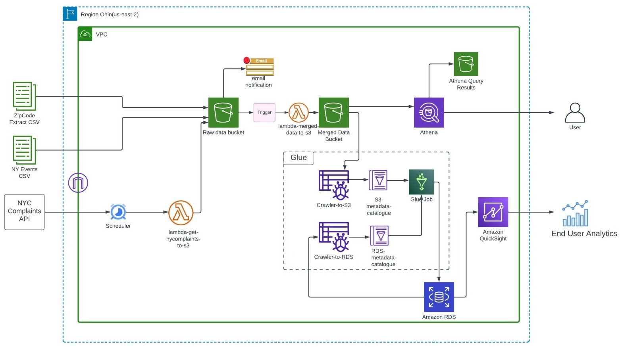
Cloud Architecture

Slide 8

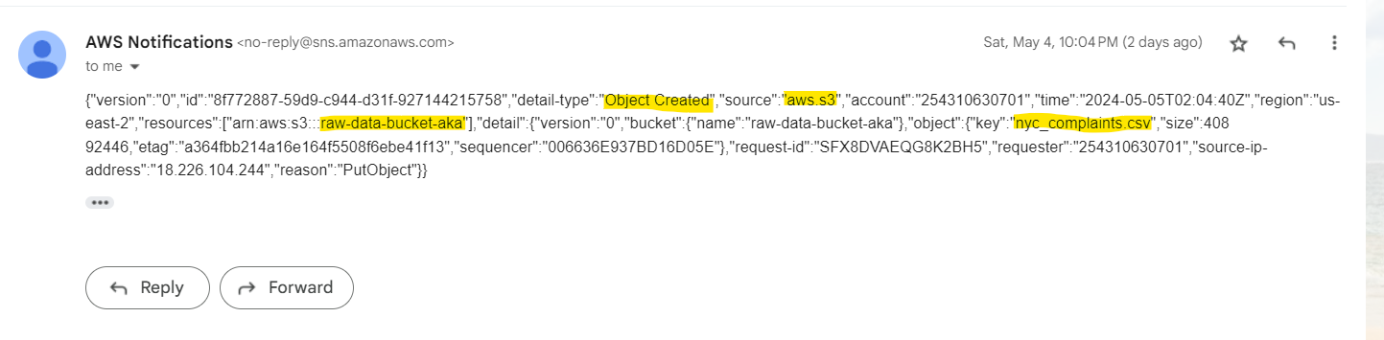
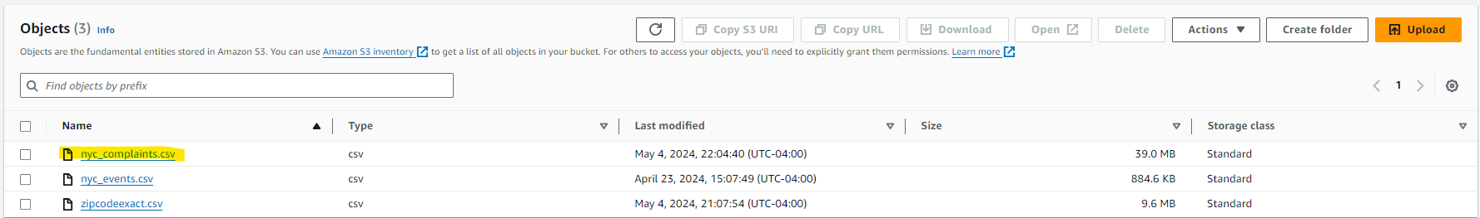
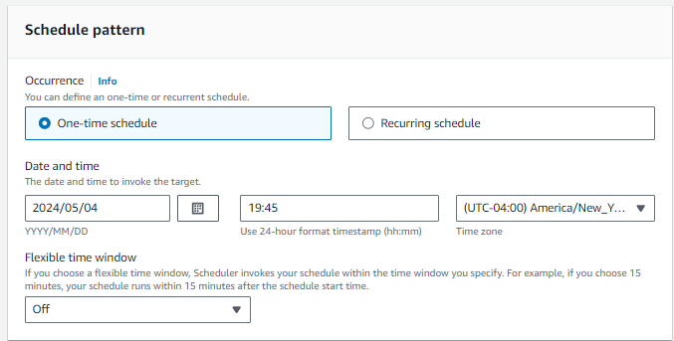
PUT – Email Notification

Slide 9
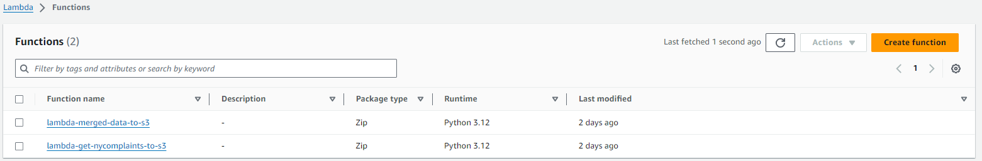
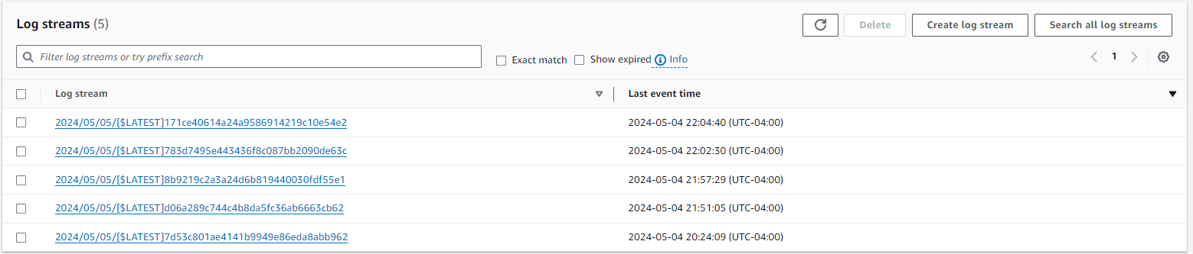
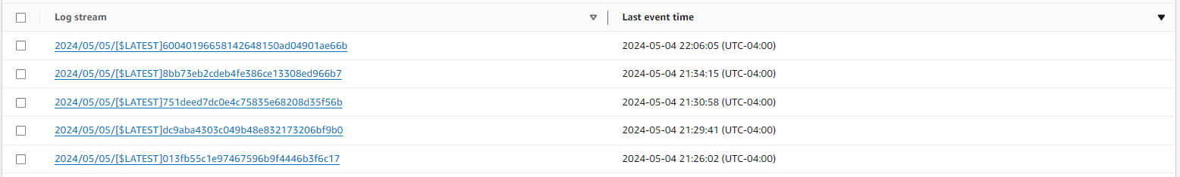
Lambda – Function and Logs

Slide 10
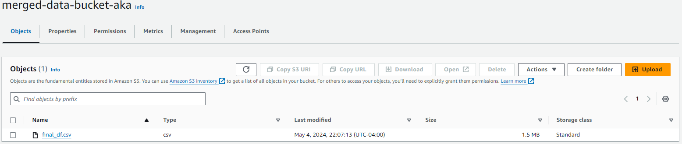
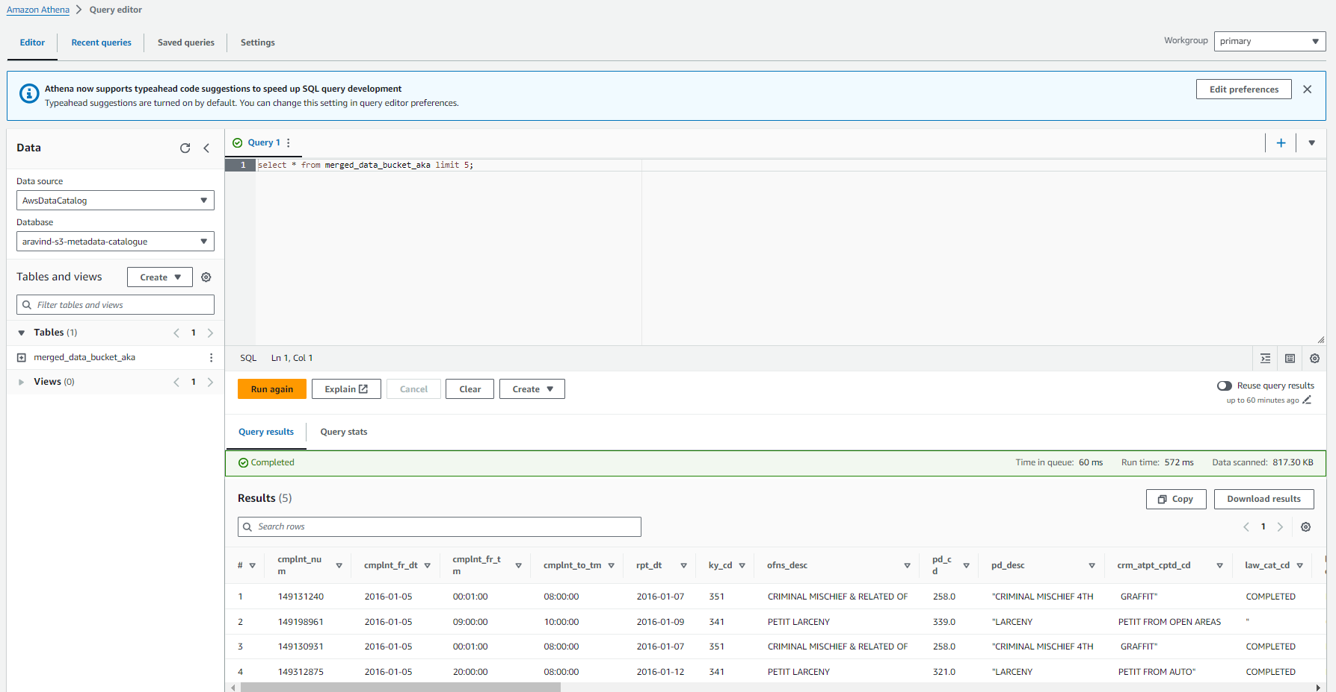
Merged Data and Athena Output

Slide 11
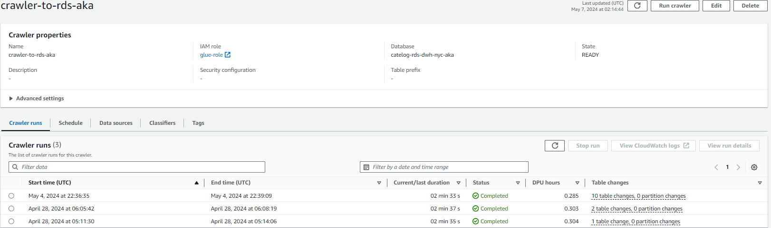
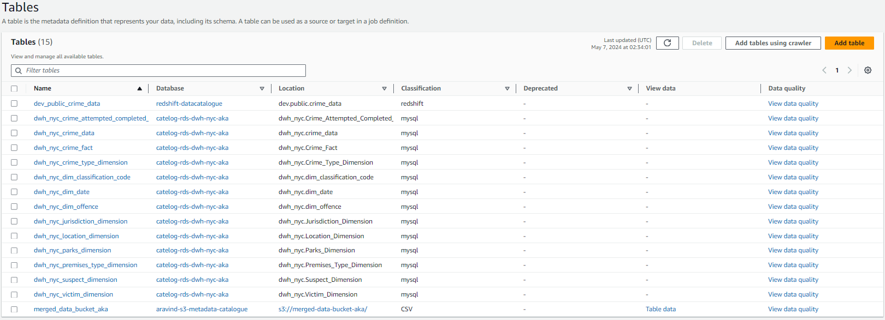
Glue – Crawler

Slide 12
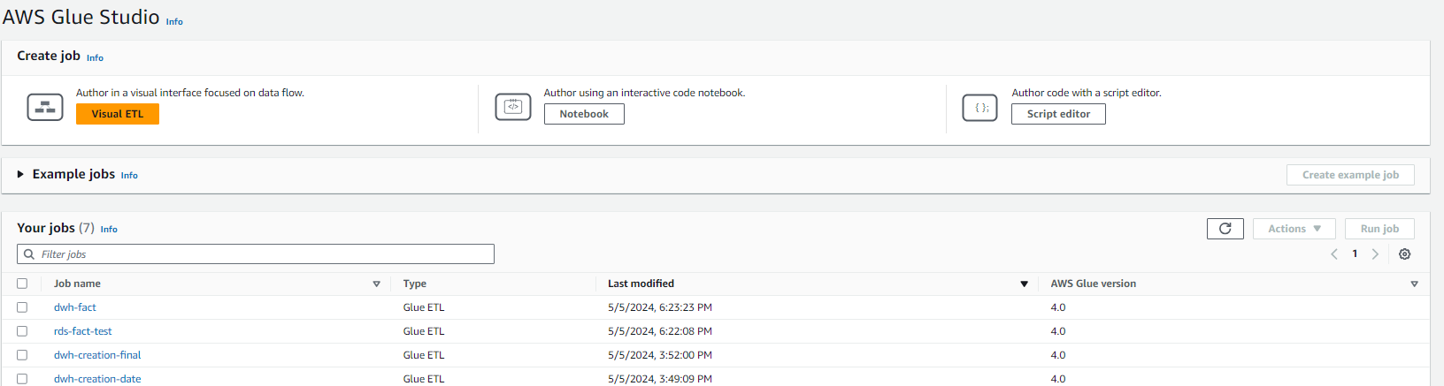
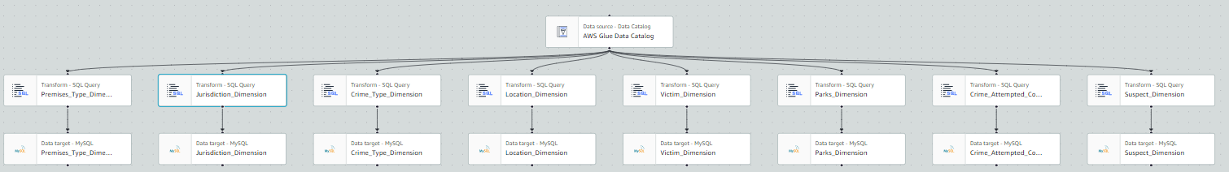
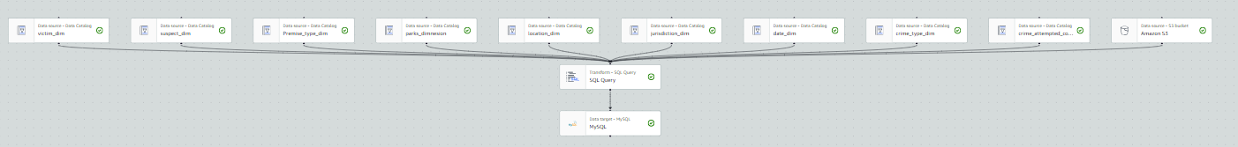
Glue – ETL Jobs

Slide 13
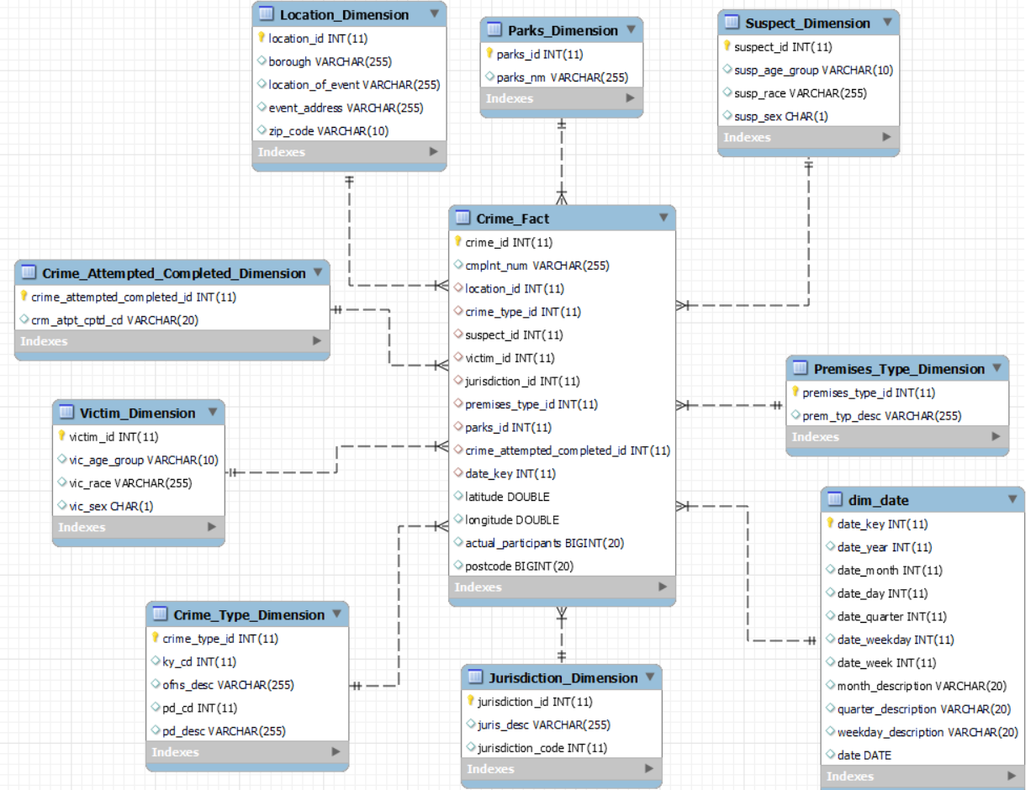
DWH - Star Schema

Slide 14
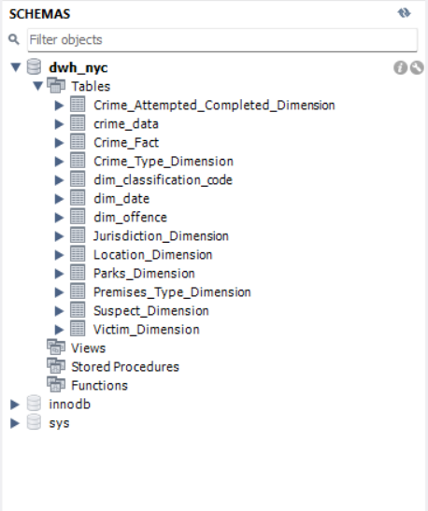
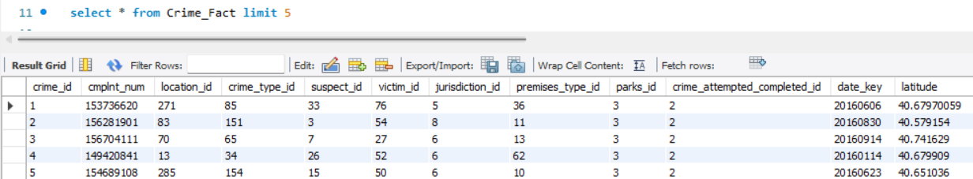
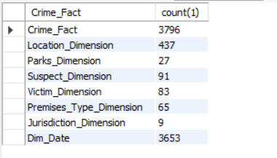

OLAP - DWH NYC

Slide 15
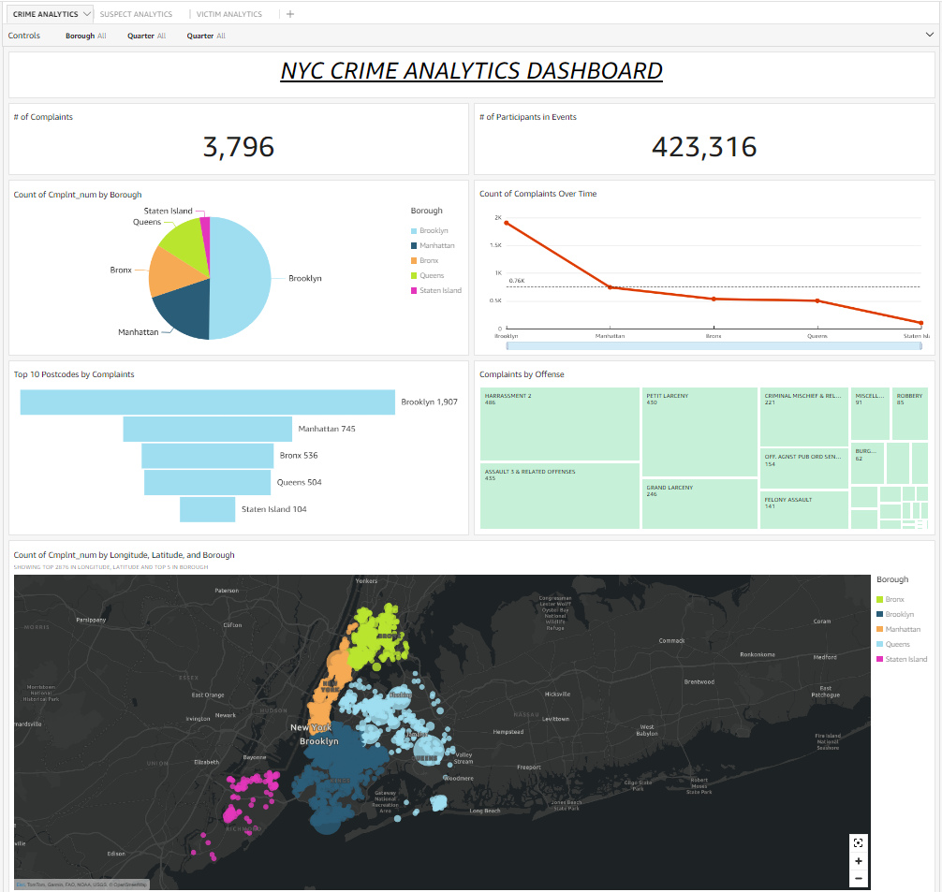
NYC Crime Analytics Dashboard

Slide 16
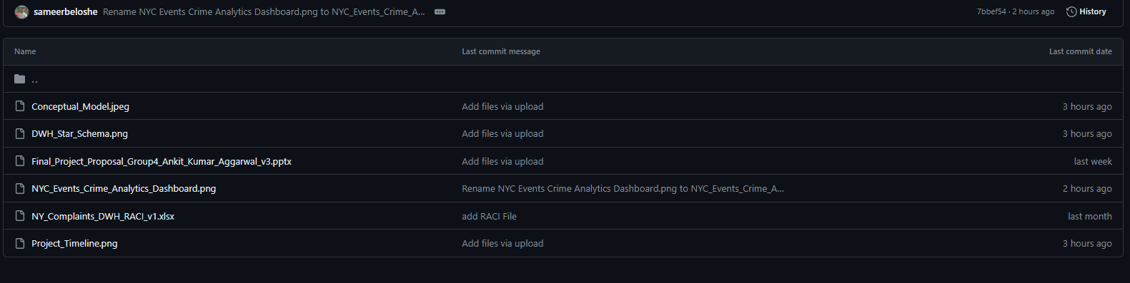
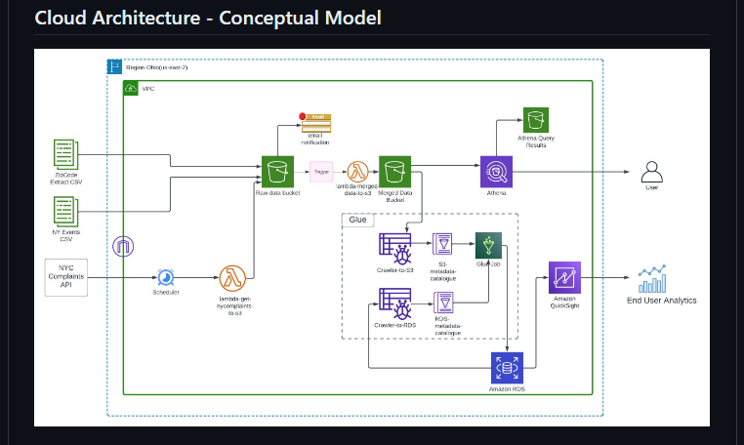
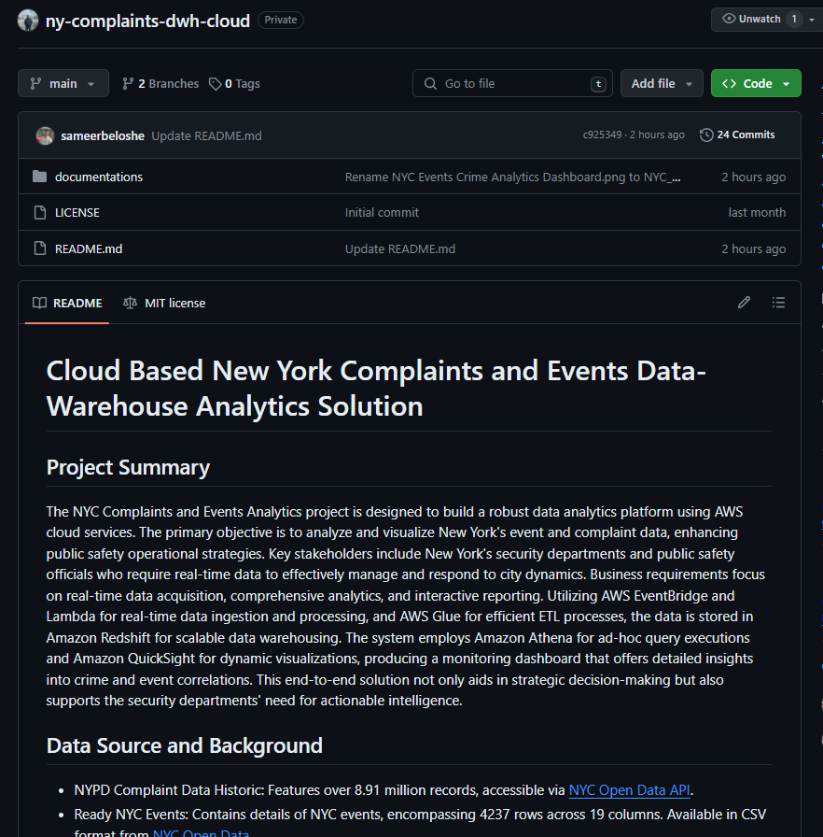
Project Deliverables (Git Repository)
16

Slide 17
Scope:
At present, the project primarily aims to build an end-to-end real monitoring system using data warehousing and cloud technology.
However, based on the feasibility of the time, cost and resources, we have considered only 100K records from complaints API.
Future Development Opportunities:
As a part of future development, this can be extended to include:
Complete Historical Data
17

Slide 18
Thank
You!!

