Slide 1

(Mis)Information Dissemination in WhatsApp
Seminar On Data Driven Approaches On Understanding Disinformation 2020
WWW ’19, May 13–17, 2019, San Francisco, CA, USA
ANKIT AGRAWAL (2581532)

Slide 2
Objective
What kind of content is shared in WhatsApp groups? Are there fake news or misinformation on them?
What is the interplay between the messages shared among WhatsApp and the Web?
ANKIT AGRAWAL (2581532)

Slide 3

The Problem!
“By 2022, most people in mature economies will consume more false information than true information mainly via social media platforms” -Gartner
Social media is the main hub for misinformation spread.
1.5 billion active users in WhatsApp.
AI bot spreading misinformation (GPT -2 and Deepflakes).
ANKIT AGRAWAL (2581532)

Slide 4
Motivation
Lot of studies on misinformation spread in Twitter and Facebook.
Twitter acquired FabulaAI.
Facebook collaborating with third party organisations.
WhatsApp groups as a major source for misinformation.
ANKIT AGRAWAL (2581532)

Slide 5
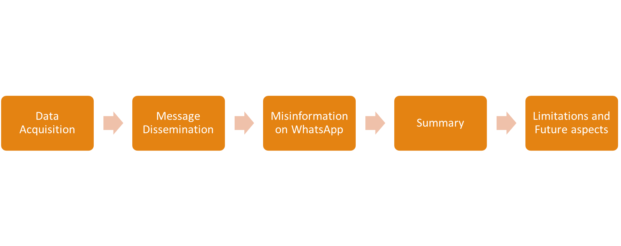
Overview
ANKIT AGRAWAL (2581532)

Slide 6
Data Acquisition
Events:
National truck drivers’ strike (May 21st to June 2nd , 2018)
First round of the 2018 Brazilian general elections campaign (August 16th to October 7th, 2018)
ANKIT AGRAWAL (2581532)

Slide 7
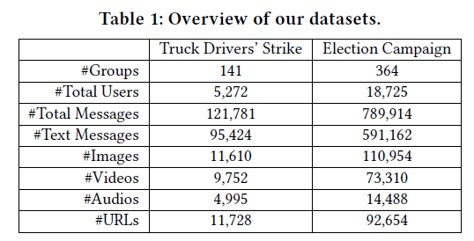
Data Acquisition
Collection:
https://chat.whatsapp.com/HHD59MyPBaszjkcnjzvn1T9Nx
ANKIT AGRAWAL (2581532)

Slide 8
Overview
ANKIT AGRAWAL (2581532)

Slide 9
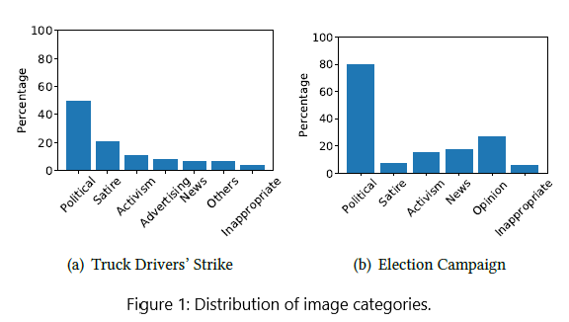
Message Dissemination
WhatsApp Images Characterization:
ANKIT AGRAWAL (2581532)

Slide 10
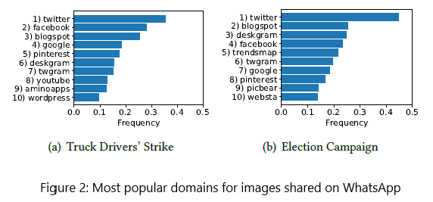
Message Dissemination
WhatsApp Images Characterization:
ANKIT AGRAWAL (2581532)

Slide 11
Message Dissemination
Propagation Dynamics:
Lifetimes:
  20% -> less than 1 hour
  40% -> less than 20 hours
  30% -> more than 100 hours
ANKIT AGRAWAL (2581532)

Slide 12
Message Dissemination
Propagation Dynamics:
Burst Times:
  40% -> reshared within up to 100-120 minutes.
  20% -> reshared within 2-5 days.
ANKIT AGRAWAL (2581532)

Slide 13
Message Dissemination
Propagation Dynamics:
To and from the Web:
  80% -> shared on web first
  14% -> shared on same day
  6% -> shared on WhatsApp first
ANKIT AGRAWAL (2581532)

Slide 14
Overview
ANKIT AGRAWAL (2581532)

Slide 15
Misinformation on WhatsApp
Identification:
Fact Checking Agency “Lupa” (Manual):
  36.2% -> misinformation
  53.2% -> misleading
  10.6% -> true
Automatic Method:
  Google image search
ANKIT AGRAWAL (2581532)

Slide 16
Misinformation on WhatsApp
Propagation Dynamics:
70% of the misinformation images remained in the system for up to 100 hours
60% of the misinformation images was reshared within 100 minutes.
45% -> shared on web first
20% -> shared on same day
35% -> shared on WhatsApp first
ANKIT AGRAWAL (2581532)

Slide 17
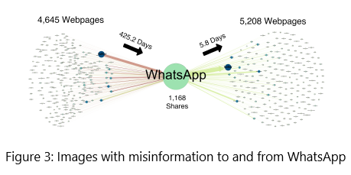
Misinformation on WhatsApp
Propagation Dynamics:
ANKIT AGRAWAL (2581532)

Slide 18
Overview
ANKIT AGRAWAL (2581532)

Slide 19
Summary
WhatsApp may have been a relevant source of images with misinformation to the Web.
Images with misinformation tend to be reshared within shorter time intervals.
Images with misinformation are much more often shared first on WhatsApp and then on the Web.
WhatsApp Monitor
ANKIT AGRAWAL (2581532)

Slide 20

Objective
What kind of content is shared in WhatsApp groups? Are there fake news or misinformation on them?
What is the interplay between the messages shared among WhatsApp and the Web?
ANKIT AGRAWAL (2581532)

Slide 21
Limitations
Manual data collection.
WhatsApp being end to end encrypted.
Cannot be generalized.
ANKIT AGRAWAL (2581532)

Slide 22
Future aspects
Misinformation in Videos and Audio hoaxes.
Content based fact checking.
Diffusion based learning.
Collaboration with WhatsApp for data analysis.
ANKIT AGRAWAL (2581532)

Slide 23

Questions?
ANKIT AGRAWAL (2581532)

