Slide 1
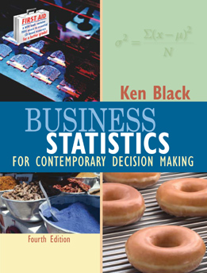
Business Statistics, 4e by Ken Black
Chapter 3
Descriptive Statistics

Slide 2
Learning Objectives
Distinguish between measures of central tendency, measures of variability, measures of shape, and measures of association.
Understand the meanings of mean, median, mode, quartile, percentile, and range.
Compute mean, median, mode, percentile, quartile, range, variance, standard deviation, and mean absolute deviation on ungrouped data.
Differentiate between sample and population variance and standard deviation.
Notes:
2

Slide 3
Learning Objectives -- Continued
Understand the meaning of standard deviation as it is applied by using the empirical rule and Chebyshev’s theorem.
Compute the mean, median, standard deviation, and variance on grouped data.
Understand box and whisker plots, skewness, and kurtosis.
Compute a coefficient of correlation and interpret it.
Notes:
3

Slide 4
Measures of Central Tendency: Ungrouped Data
Measures of central tendency yield information about “particular places or locations in a group of numbers.”
Common Measures of Location
  Mode
  Median
  Mean
  Percentiles
  Quartiles
Notes:
4

Slide 5
Mode
The most frequently occurring value in a data set
Applicable to all levels of data measurement (nominal, ordinal, interval, and ratio)
Bimodal -- Data sets that have two modes
Multimodal -- Data sets that contain more than two modes
Notes:
5

Slide 6
Mode -- Example
The mode is 44.
There are more 44s
than any other value.
35
41
44
45
37
41
44
46
37
43
44
46
39
43
44
46
40
43
44
46
40
43
45
48
Notes:
6

Slide 7
Median
Middle value in an ordered array of numbers.
Applicable for ordinal, interval, and ratio data
Not applicable for nominal data
Unaffected by extremely large and extremely small values.
Notes:
7

Slide 8
Median: Computational Procedure
First Procedure
  Arrange the observations in an ordered array.
  If there is an odd number of terms, the median is the middle term of the ordered array.
  If there is an even number of terms, the median is the average of the middle two terms.
Second Procedure
  The median’s position in an ordered array is given by (n+1)/2.
Notes:
8

Slide 9
Median: Example with an Odd Number of Terms
Ordered Array
3 4 5 7 8 9 11 14 15 16 16 17 19 19 20 21 22
There are 17 terms in the ordered array.
Position of median = (n+1)/2 = (17+1)/2 = 9
The median is the 9th term, 15.
If the 22 is replaced by 100, the median is 15.
If the 3 is replaced by -103, the median is 15.
Notes:
9

Slide 10
Median: Example
with an Even Number of Terms
Ordered Array
3 4 5 7 8 9 11 14 15 16 16 17 19 19 20 21
There are 16 terms in the ordered array.
Position of median = (n+1)/2 = (16+1)/2 = 8.5
The median is between the 8th and 9th terms, 14.5.
If the 21 is replaced by 100, the median is 14.5.
If the 3 is replaced by -88, the median is 14.5.
Notes:
10

Slide 11
Arithmetic Mean
Commonly called ‘the mean’
is the average of a group of numbers
Applicable for interval and ratio data
Not applicable for nominal or ordinal data
Affected by each value in the data set, including extreme values
Computed by summing all values in the data set and dividing the sum by the number of values in the data set
Notes:
11

Slide 12
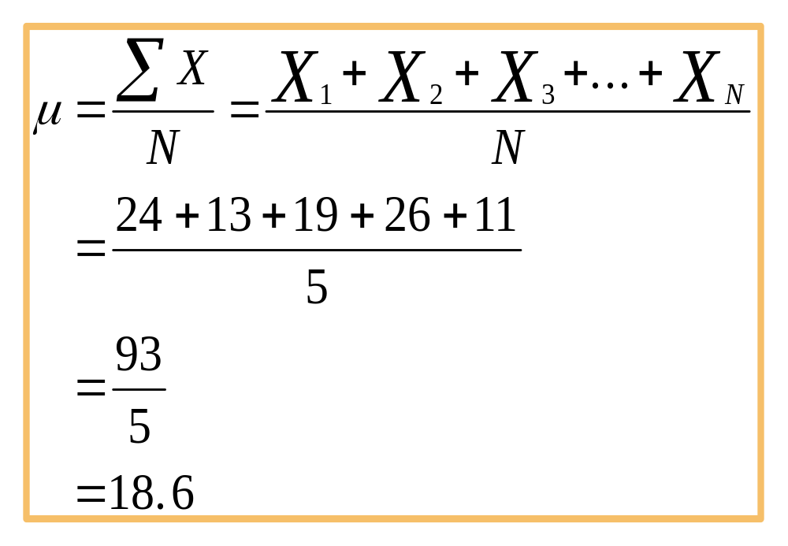
Population Mean
Notes:
12

Slide 13
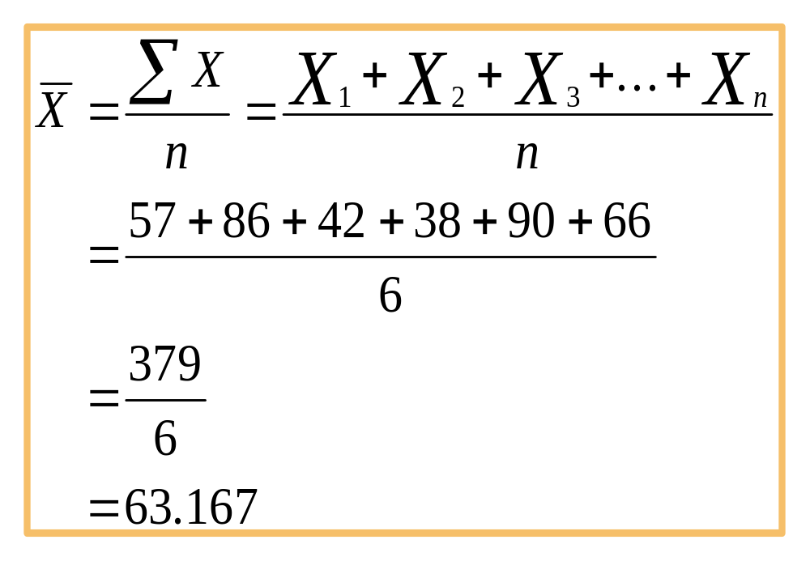
Sample Mean
Notes:
13

Slide 14
Percentiles
Measures of central tendency that divide a group of data into 100 parts
At least n% of the data lie below the nth percentile, and at most (100 - n)% of the data lie above the nth percentile
Example: 90th percentile indicates that at least 90% of the data lie below it, and at most 10% of the data lie above it
The median and the 50th percentile have the same value.
Applicable for ordinal, interval, and ratio data
Not applicable for nominal data
Notes:
14

Slide 15
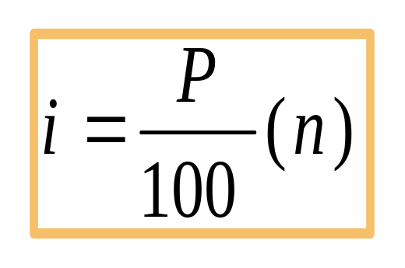
Percentiles: Computational Procedure
Organize the data into an ascending ordered array.
Calculate the percentile location:
Determine the percentile’s location and its value.
If i is a whole number, the percentile is the average of the values at the i and (i+1) positions.
If i is not a whole number, the percentile is at the (i+1) position in the ordered array.
Notes:
15

Slide 16
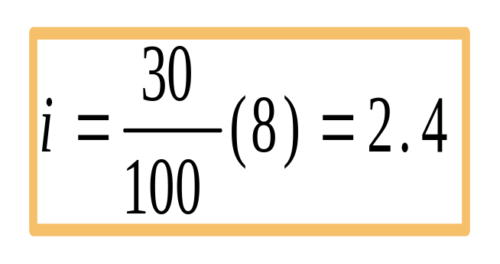
Percentiles: Example
Raw Data: 14, 12, 19, 23, 5, 13, 28, 17
Ordered Array: 5, 12, 13, 14, 17, 19, 23, 28
Location of 30th percentile:
The location index, i, is not a whole number; i+1 = 2.4+1=3.4; the whole number portion is 3; the 30th percentile is at the 3rd location of the array; the 30th percentile is 13.
Notes:
16

Slide 17
Quartiles
Measures of central tendency that divide a group of data into four subgroups
Q₁: 25% of the data set is below the first quartile
Q₂: 50% of the data set is below the second quartile
Q₃: 75% of the data set is below the third quartile
Q₁ is equal to the 25th percentile
Q₂ is located at 50th percentile and equals the median
Q₃ is equal to the 75th percentile
Quartile values are not necessarily members of the data set
Notes:
17

Slide 18
Quartiles
Q₁
Q₂
Q₃
25%
25%
25%
25%
Notes:
18

Slide 19
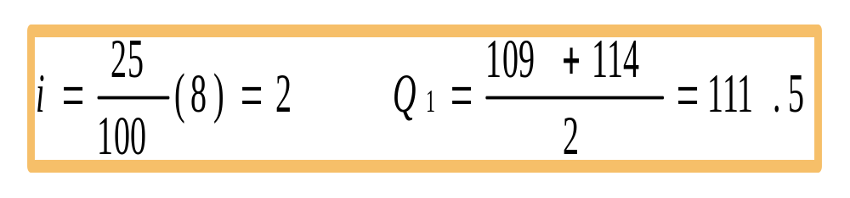
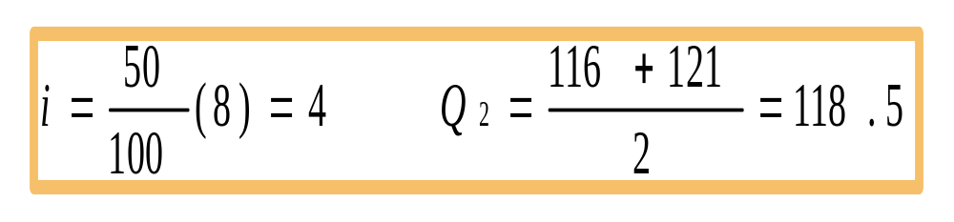
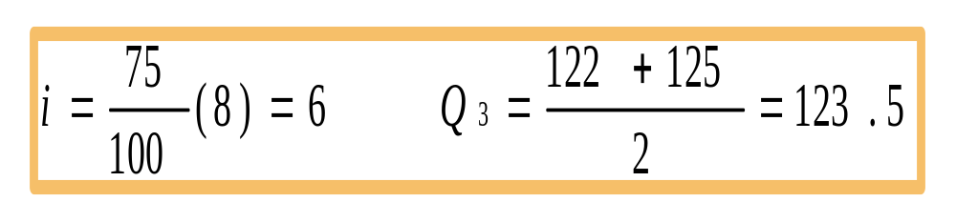
Quartiles: Example
Ordered array: 106, 109, 114, 116, 121, 122, 125, 129
Q₁
Q₂:
Q₃:
Notes:
19

Slide 20





Variability
No Variability in Cash Flow
Mean
Mean
Variability in Cash Flow
Mean
Mean
Notes:
20

Slide 21
Variability
Variability
No Variability
Notes:
21

Slide 22
Measures of Variability:
Ungrouped Data
Measures of variability describe the spread or the dispersion of a set of data.
Common Measures of Variability
  Range
  Interquartile Range
  Mean Absolute Deviation
  Variance
  Standard Deviation
  Z scores
  Coefficient of Variation
Notes:
22

Slide 23
Range
The difference between the largest and the smallest values in a set of data
Simple to compute
Ignores all data points except the two extremes
Example: Range = Largest - Smallest = 48 - 35 = 13
35
41
44
45
37
41
44
46
37
43
44
46
39
43
44
46
40
43
44
46
40
43
45
48
Notes:
23

Slide 24
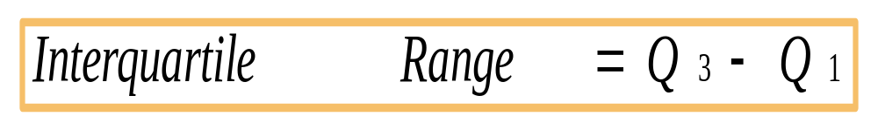
Interquartile Range
Range of values between the first and third quartiles
Range of the “middle half”
Less influenced by extremes
Notes:
37

Slide 25
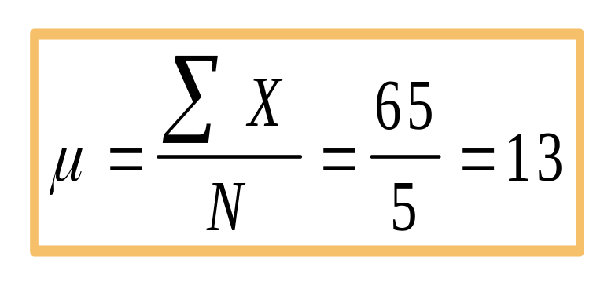
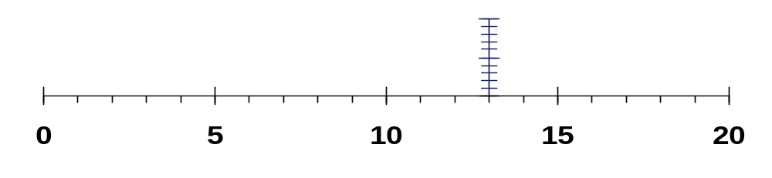

Deviation from the Mean
Data set: 5, 9, 16, 17, 18
Mean:
Deviations from the mean: -8, -4, 3, 4, 5
-4
+5
-8
+4
+3
Notes:
24

Slide 26
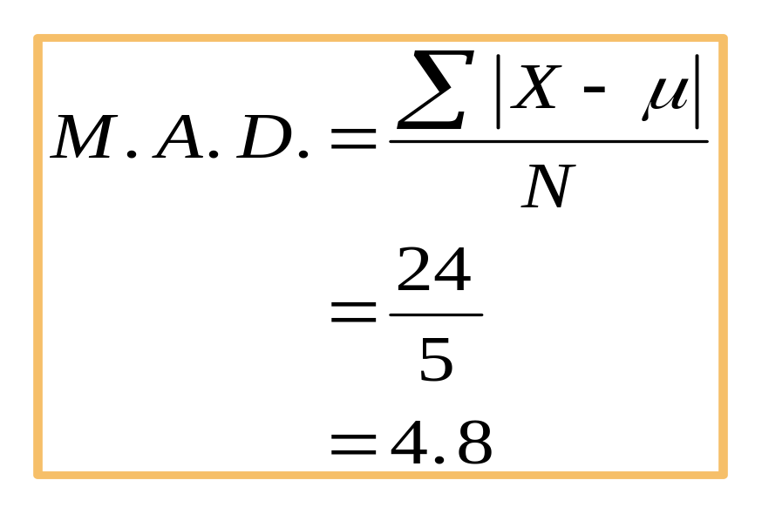
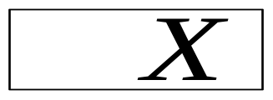
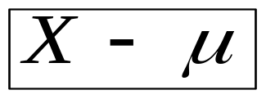
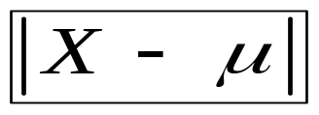
Mean Absolute Deviation
Average of the absolute deviations from the mean
5
9
16
17
18
-8
-4
+3
+4
+5
0
+8
+4
+3
+4
+5
24
Notes:
25

Slide 27
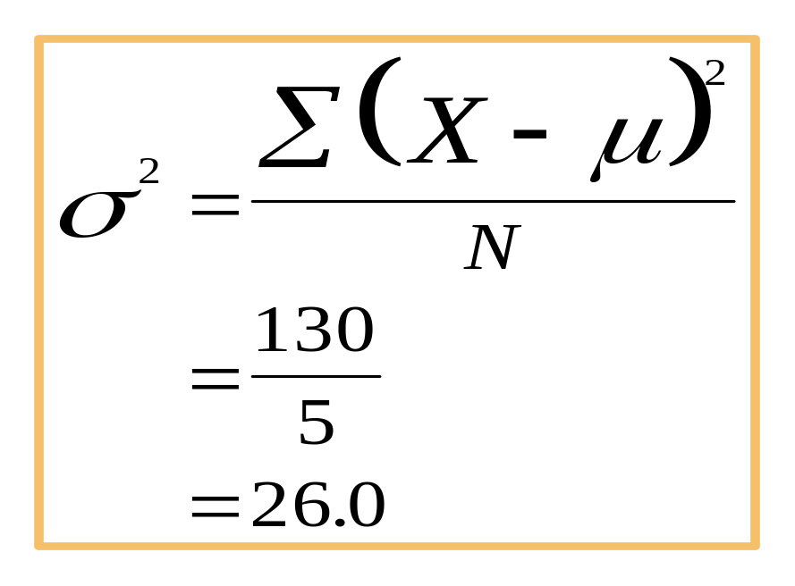
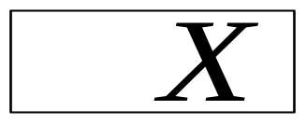
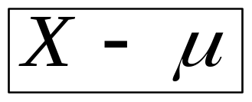
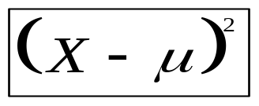
Population Variance
Average of the squared deviations from the arithmetic mean
5
9
16
17
18
-8
-4
+3
+4
+5
0
64
16
9
16
25
130
Notes:
26

Slide 28
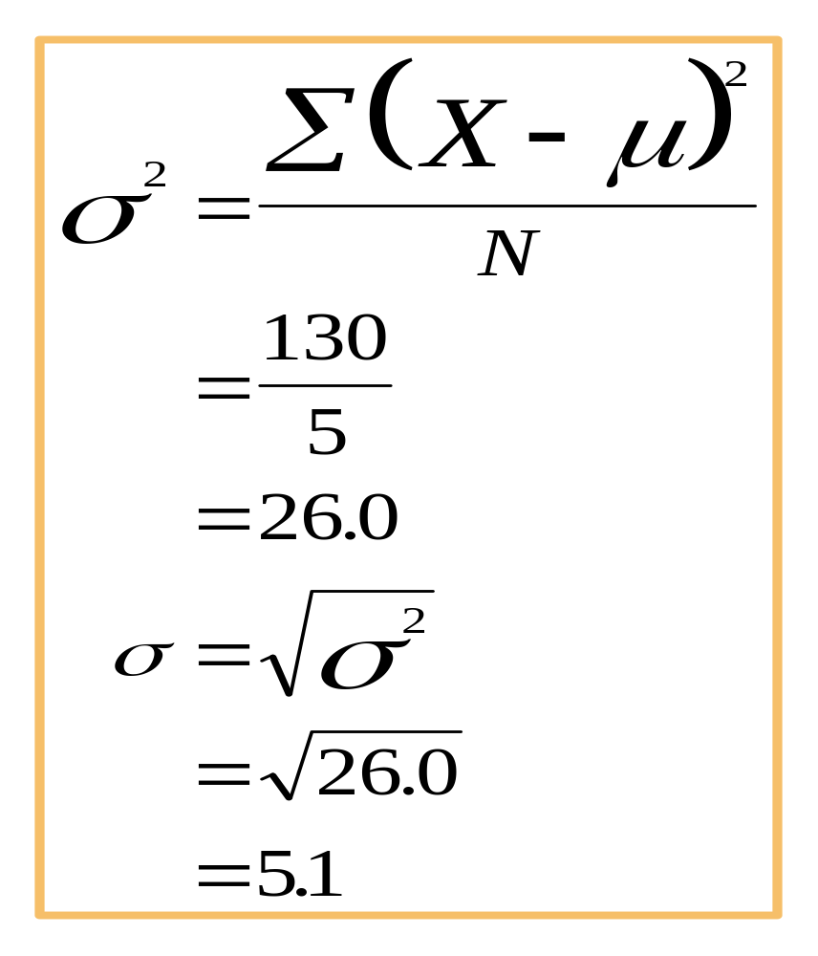
Population Standard Deviation
Square root of the variance
5
9
16
17
18
-8
-4
+3
+4
+5
0
64
16
9
16
25
130
Notes:
27

Slide 29
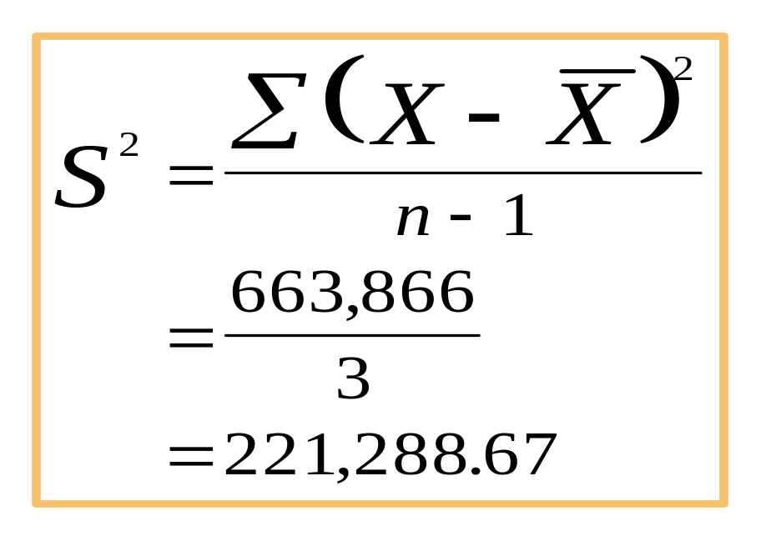

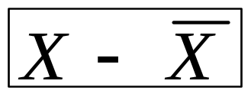
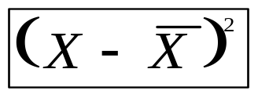
Sample Variance
Average of the squared deviations from the arithmetic mean
2,398
1,844
1,539
1,311
7,092
625
71
-234
-462
0
390,625
5,041
54,756
213,444
663,866
Notes:
28

Slide 30
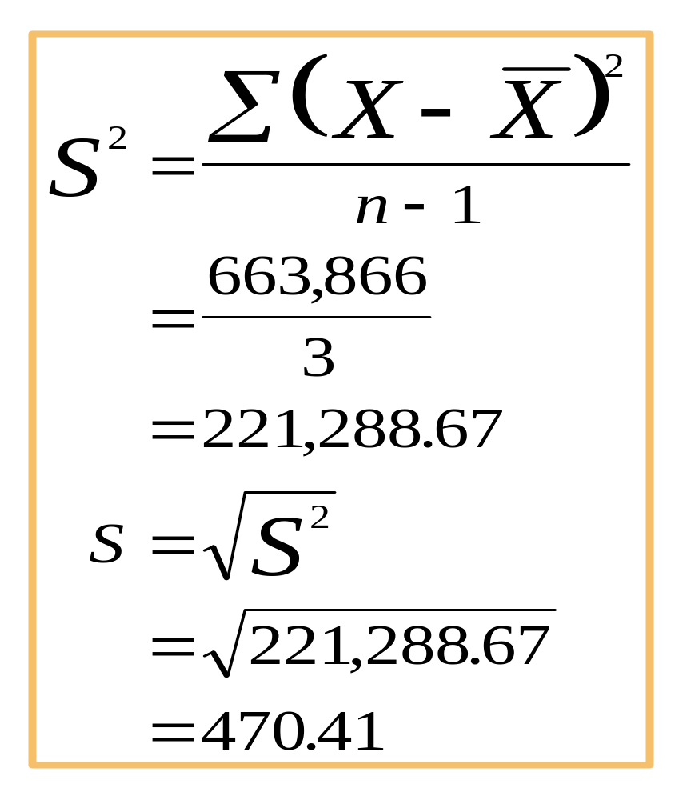
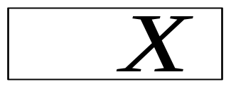
Sample Standard Deviation
Square root of the sample variance
2,398
1,844
1,539
1,311
7,092
625
71
-234
-462
0
390,625
5,041
54,756
213,444
663,866
Notes:
29

Slide 31
Uses of Standard Deviation
Indicator of financial risk
Quality Control
  construction of quality control charts
  process capability studies
Comparing populations
  household incomes in two cities
  employee absenteeism at two plants
Notes:
30

Slide 32
Standard Deviation as an
Indicator of Financial Risk
Annualized Rate of Return
Financial
μ
σ
Security
A
15%
3%
B
15%
7%
Notes:
31

Slide 33
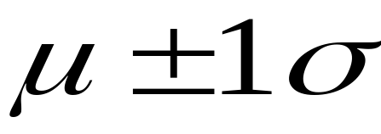
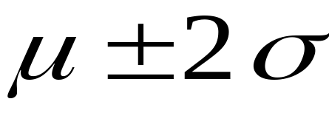
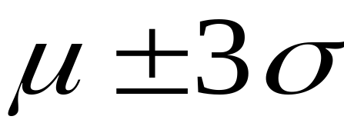
Empirical Rule
Data are normally distributed (or approximately normal)
Distance from
the Mean
Percentage of Values
Falling Within Distance
68
95
99.7
Notes:
32

Slide 34
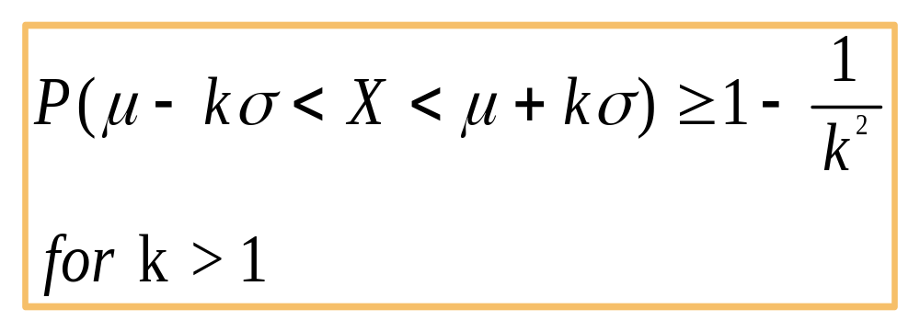
Chebyshev’s Theorem
Applies to all distributions
Notes:
33

Slide 35
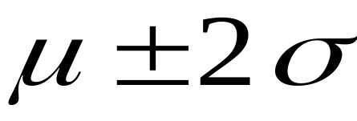
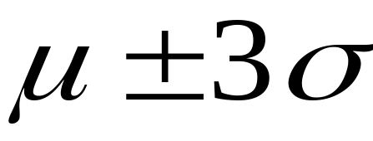
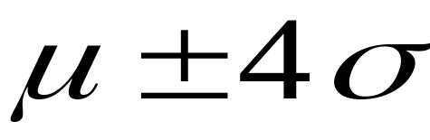
Chebyshev’s Theorem
Applies to all distributions
Number of
Standard
Deviations
Minimum Proportion
of Values Falling
Within Distance
Distance from
the Mean
K = 2
1-1/2² = 0.75
K = 3
1-1/3² = 0.89
K = 4
1-1/4² = 0.94
Notes:
34

Slide 36
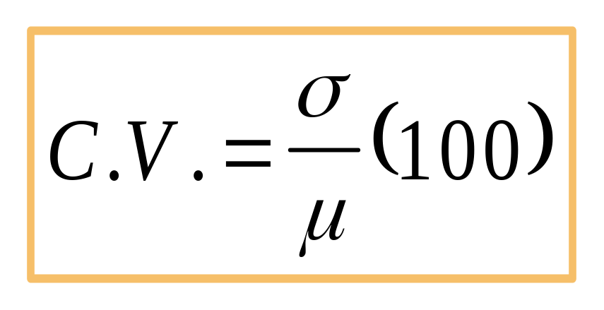
Coefficient of Variation
Ratio of the standard deviation to the mean, expressed as a percentage
Measurement of relative dispersion
Notes:
35

Slide 37
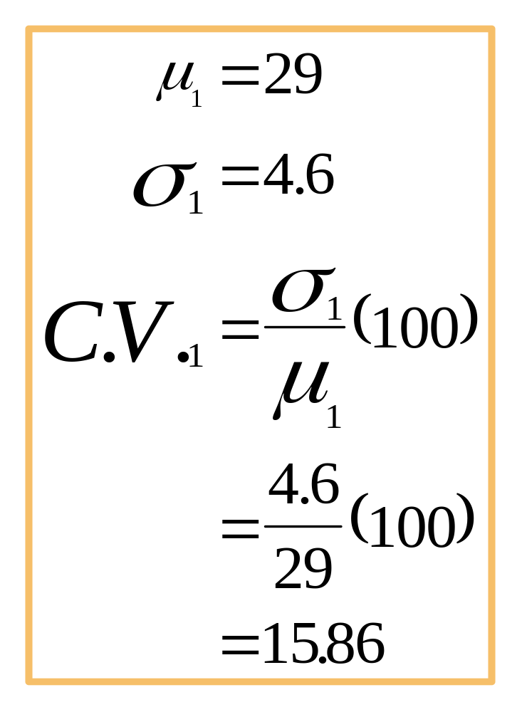
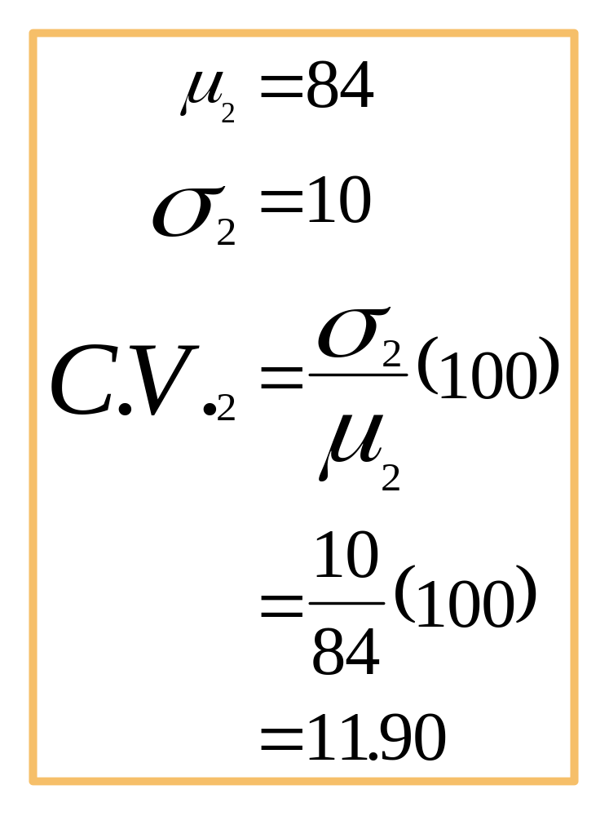
Coefficient of Variation
Notes:
36

Slide 38
Measures of Central Tendency and Variability: Grouped Data
Measures of Central Tendency
  Mean
  Median
  Mode
Measures of Variability
  Variance
  Standard Deviation
Notes:
38

Slide 39
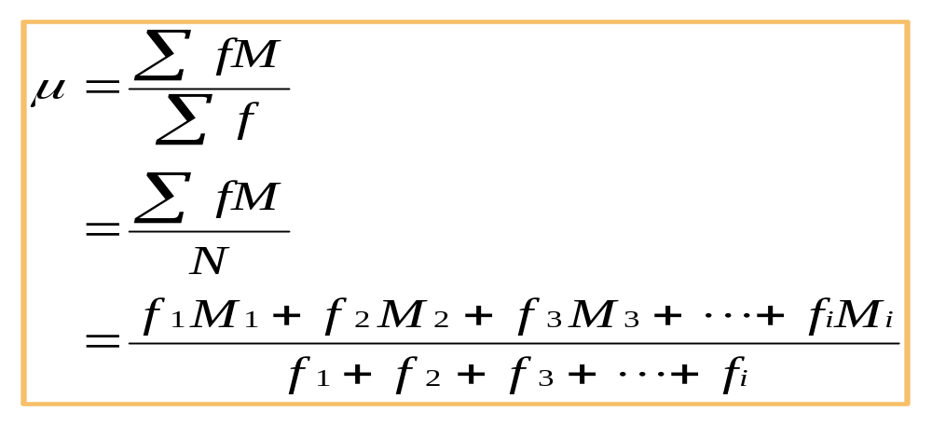
Mean of Grouped Data
Weighted average of class midpoints
Class frequencies are the weights
Notes:
39

Slide 40
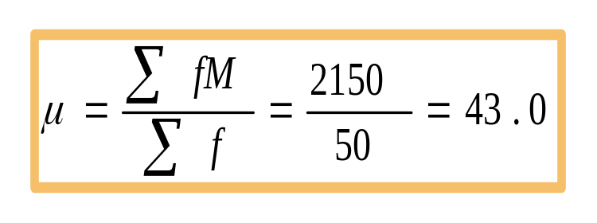
Calculation of Grouped Mean
Class Interval Frequency Class Midpoint fM
20-under 30 6 25 150
30-under 40 18 35 630
40-under 50 11 45 495
50-under 60 11 55 605
60-under 70 3 65 195
70-under 80 1 75 75
50 2150
Notes:
40

Slide 41
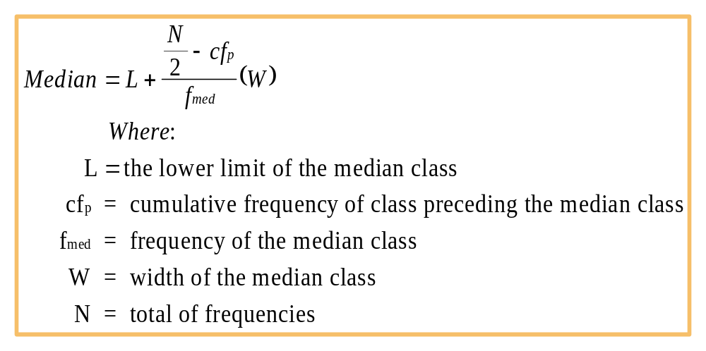
Median of Grouped Data
Notes:
41

Slide 42
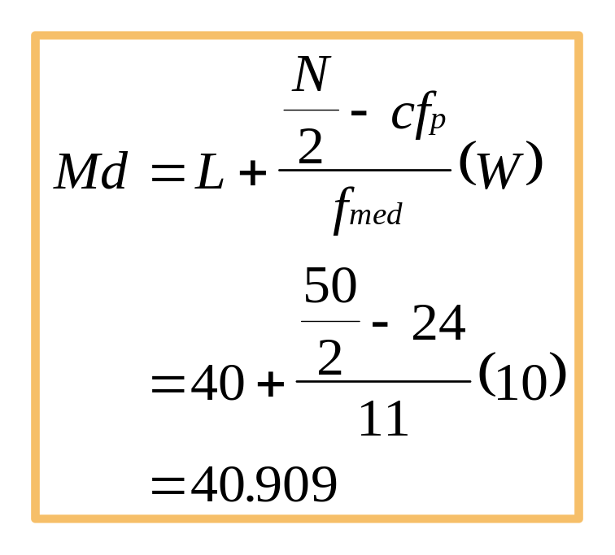
Median of Grouped Data -- Example
Cumulative
Class Interval Frequency Frequency
20-under 30 6 6
30-under 40 18 24
40-under 50 11 35
50-under 60 11 46
60-under 70 3 49
70-under 80 1 50
N = 50
Notes:
42

Slide 43
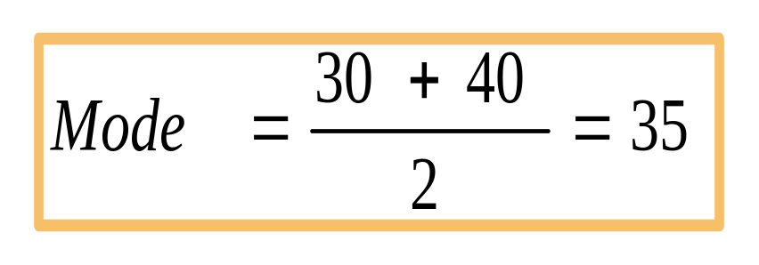
Mode of Grouped Data
Midpoint of the modal class
Modal class has the greatest frequency
Class Interval Frequency
20-under 30 6
30-under 40 18
40-under 50 11
50-under 60 11
60-under 70 3
70-under 80 1
Notes:
43

Slide 44
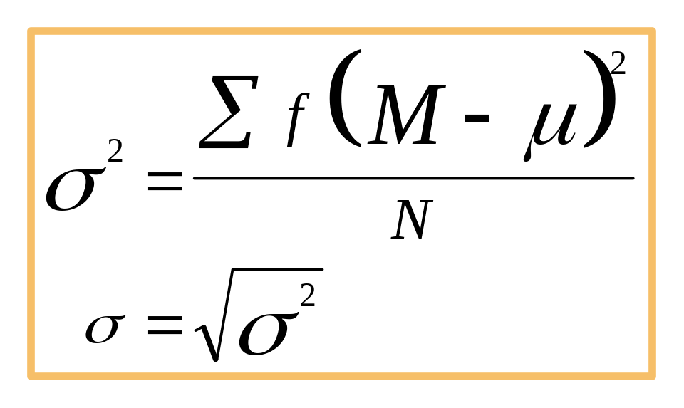
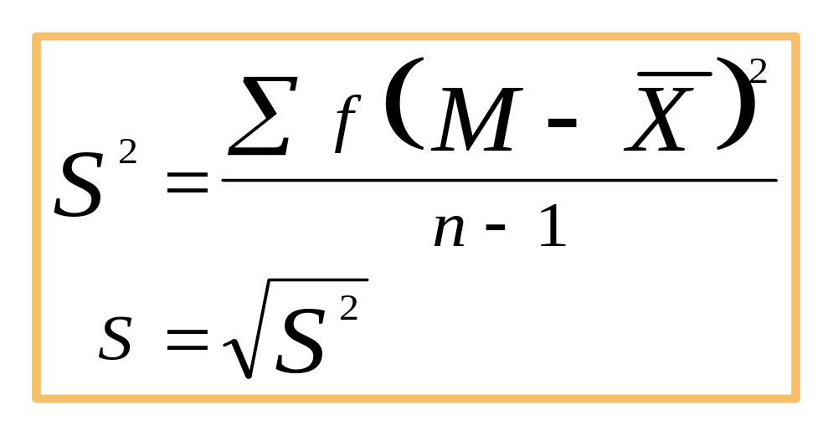
Variance and Standard Deviation of Grouped Data
Population
Sample
Notes:
44

Slide 45




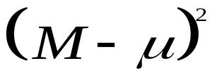
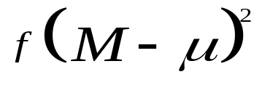

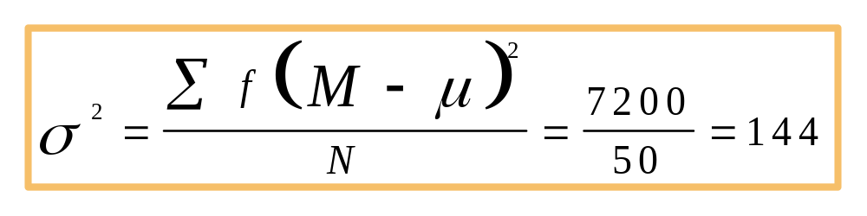
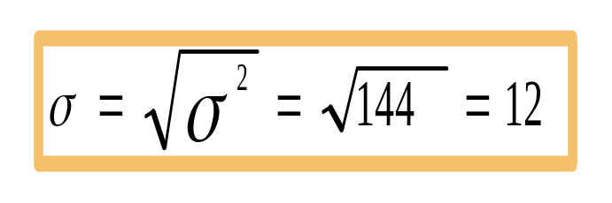
Population Variance and Standard Deviation of Grouped Data
20-under 30
6
25
150
-18
324
1944
30-under 40
18
35
630
-8
64
1152
40-under 50
11
45
495
2
4
44
50-under 60
11
55
605
12
144
1584
60-under 70
3
65
195
22
484
1452
70-under 80
1
75
75
32
1024
1024
50
2150
7200
Notes:
45

Slide 46
Measures of Shape
Skewness
  Absence of symmetry
  Extreme values in one side of a distribution
Kurtosis
  Peakedness of a distribution
  Leptokurtic: high and thin
  Mesokurtic: normal shape
  Platykurtic: flat and spread out
Box and Whisker Plots
  Graphic display of a distribution
  Reveals skewness
Notes:
46

Slide 47
Skewness
Negatively
Skewed
Symmetric
(Not Skewed)
Positively
Skewed
Notes:
47

Slide 48
Skewness
Mean
Mode
Mean
Median
Mode
Mode
Mean
Median
Median
Negatively
Skewed
Symmetric
(Not Skewed)
Positively
Skewed
Notes:
48

Slide 49
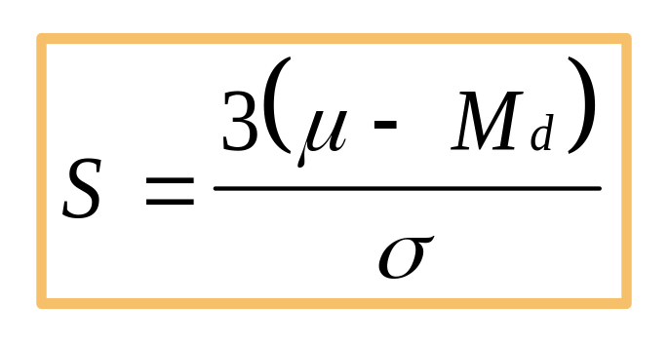
Coefficient of Skewness
Summary measure for skewness
If S < 0, the distribution is negatively skewed (skewed to the left).
If S = 0, the distribution is symmetric (not skewed).
If S > 0, the distribution is positively skewed (skewed to the right).
Notes:
49

Slide 50
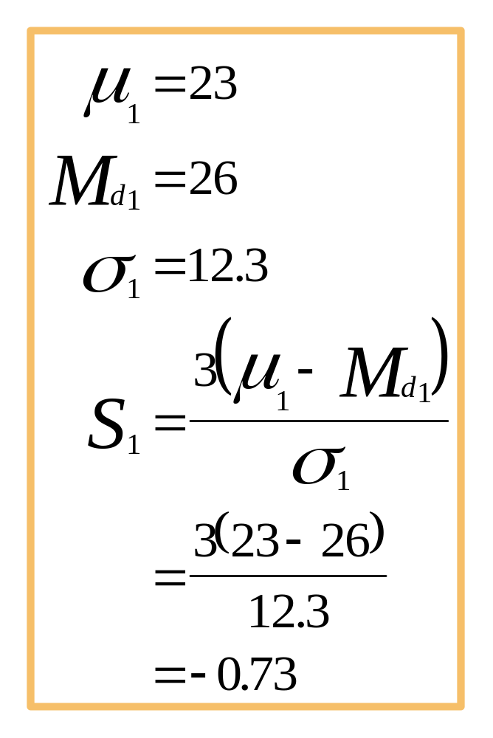
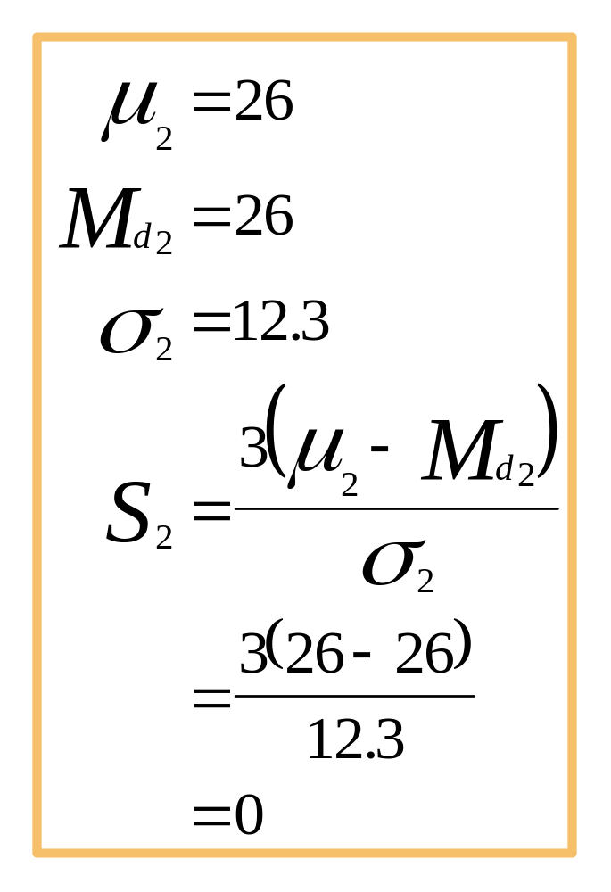
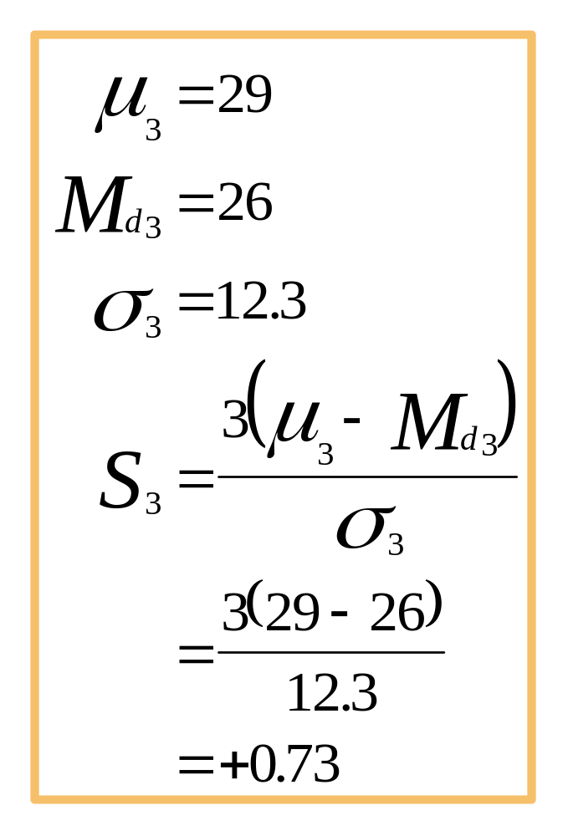
Coefficient of Skewness
Notes:
50

Slide 51
Kurtosis
Peakedness of a distribution
  Leptokurtic: high and thin
  Mesokurtic: normal in shape
  Platykurtic: flat and spread out
Leptokurtic
Mesokurtic
Platykurtic
Notes:
51

Slide 52
Box and Whisker Plot
Five secific values are used:
  Median, Q₂
  First quartile, Q₁
  Third quartile, Q₃
  Minimum value in the data set
  Maximum value in the data set
Inner Fences
  IQR = Q₃ - Q₁
  Lower inner fence = Q₁ - 1.5 IQR
  Upper inner fence = Q₃ + 1.5 IQR
Outer Fences
  Lower outer fence = Q₁ - 3.0 IQR
  Upper outer fence = Q₃ + 3.0 IQR
Notes:
52

Slide 53
Box and Whisker Plot
Minimum
Q₁
Q₂
Q₃
Maximum
Notes:
53

Slide 54
Skewness: Box and Whisker Plots, and Coefficient of Skewness
S < 0
S = 0
S > 0
Negatively
Skewed
Symmetric
(Not Skewed)
Positively
Skewed
Notes:
54

Slide 55


Pearson Product-Moment Correlation Coefficient
Notes:
39

Slide 56
Three Degrees of Correlation
r < 0
r > 0
r = 0
Notes:
40

Slide 57
Computation of r for the Economics Example (Part 1)
Futures
Index
Y
Interest
X
Day
X²
Y²
XY
1
7.43
221
55.205
48,841
1,642.03
2
7.48
222
55.950
49,284
1,660.56
3
8.00
226
64.000
51,076
1,808.00
4
7.75
225
60.063
50,625
1,743.75
5
7.60
224
57.760
50,176
1,702.40
6
7.63
223
58.217
49,729
1,701.49
7
7.68
223
58.982
49,729
1,712.64
8
7.67
226
58.829
51,076
1,733.42
9
7.59
226
57.608
51,076
1,715.34
10
8.07
235
65.125
55,225
1,896.45
11
8.03
233
64.481
54,289
1,870.99
12
8.00
241
64.000
58,081
1,928.00
Summations
92.93
2,725
720.220
619,207
21,115.07
Notes:
41

Slide 58

Computation of r for the Economics Example (Part 2)
Notes:
43

Slide 59
Scatter Plot and Correlation Matrix for the Economics Example
245
240
235
230
Futures Index
225
220
7.40
7.60
7.80
8.00
8.20
Interest
Interest
Futures Index
Interest
1
Futures Index
0.815254
1

