Slide 1


Chapter 2
Descriptive
Charts and
Graphs

Slide 2
Learning Objectives
Construct a frequency distribution
Determine the class midpoints, relative frequencies, and cumulative frequencies of a frequency distribution.
Construct a histogram, a frequency polygon, an ogive, a pie chart.
Notes:
2

Slide 3
Ungrouped vs Grouped Data
Ungrouped data
  have not been summarized in any way
  are also called raw data
Grouped data
  have been organized into a frequency distribution
Notes:
7

Slide 4
Example of Ungrouped Data
42
26
32
34
57
Ages of a Sample
of Managers
from Urban
Child Care
Centers in the
United States
30
58
37
50
30
53
40
30
47
49
50
40
32
31
40
52
28
23
35
25
30
36
32
26
50
55
30
58
64
52
49
33
43
46
32
61
31
30
40
60
74
37
29
43
54
Notes:
8

Slide 5
Frequency Distribution of Child Care Manager’s Ages
Class Interval Frequency
20-under 30 6
30-under 40 18
40-under 50 11
50-under 60 11
60-under 70 3
70-under 80 1
Notes:
9

Slide 6
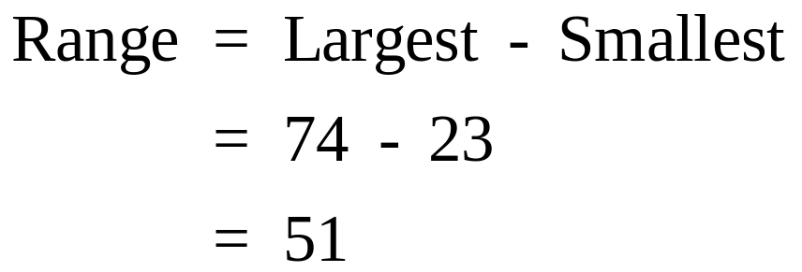
Data Range
42
26
32
34
57
30
58
37
50
30
53
40
30
47
49
50
40
32
31
40
52
28
23
35
25
30
36
32
26
50
Smallest
55
30
58
64
52
49
33
43
46
32
61
31
30
40
60
Largest
74
37
29
43
54
Notes:
10

Slide 7
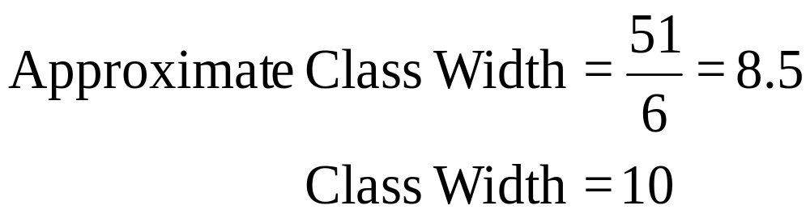
Number of Classes and Class Width
The number of classes should be between 5 and 15.
  Fewer than 5 classes cause excessive summarization.
  More than 15 classes leave too much detail.
Class Width
  Divide the range by the number of classes for an approximate class width
  Round up to a convenient number
Notes:
11

Slide 8

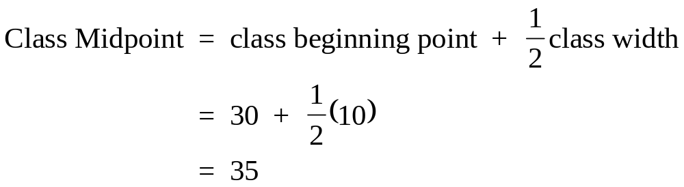
Class Midpoint
Notes:
12

Slide 9
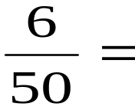
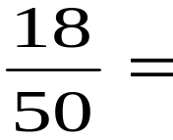
Relative Frequency
Relative
Class Interval Frequency Frequency
20-under 30 6 .12
30-under 40 18 .36
40-under 50 11 .22
50-under 60 11 .22
60-under 70 3 .06
70-under 80 1 .02
Total 50 1.00
Notes:
13

Slide 10


Cumulative Frequency
Cumulative
Class Interval Frequency Frequency
20-under 30 6 6
30-under 40 18 24
40-under 50 11 35
50-under 60 11 46
60-under 70 3 49
70-under 80 1 50
Total 50
Notes:
14

Slide 11
Class Midpoints, Relative Frequencies, and Cumulative Frequencies
Relative Cumulative
Class Interval Frequency Midpoint Frequency Frequency
20-under 30 6 25 .12 6
30-under 40 18 35 .36 24
40-under 50 11 45 .22 35
50-under 60 11 55 .22 46
60-under 70 3 65 .06 49
70-under 80 1 75 .02 50
Total 50 1.00
Notes:
15

Slide 12
Cumulative Relative Frequencies
Cumulative
Relative Cumulative Relative
Class Interval Frequency Frequency Frequency Frequency
20-under 30 6 .12 6 .12
30-under 40 18 .36 24 .48
40-under 50 11 .22 35 .70
50-under 60 11 .22 46 .92
60-under 70 3 .06 49 .98
70-under 80 1 .02 50 1.00
Total 50 1.00
Notes:
16

Slide 13
Common Statistical Graphs
Histogram -- vertical bar chart of frequencies
Frequency Polygon -- line graph of frequencies
Ogive -- line graph of cumulative frequencies
Pie Chart -- proportional representation for categories of a whole
Notes:
17

Slide 14
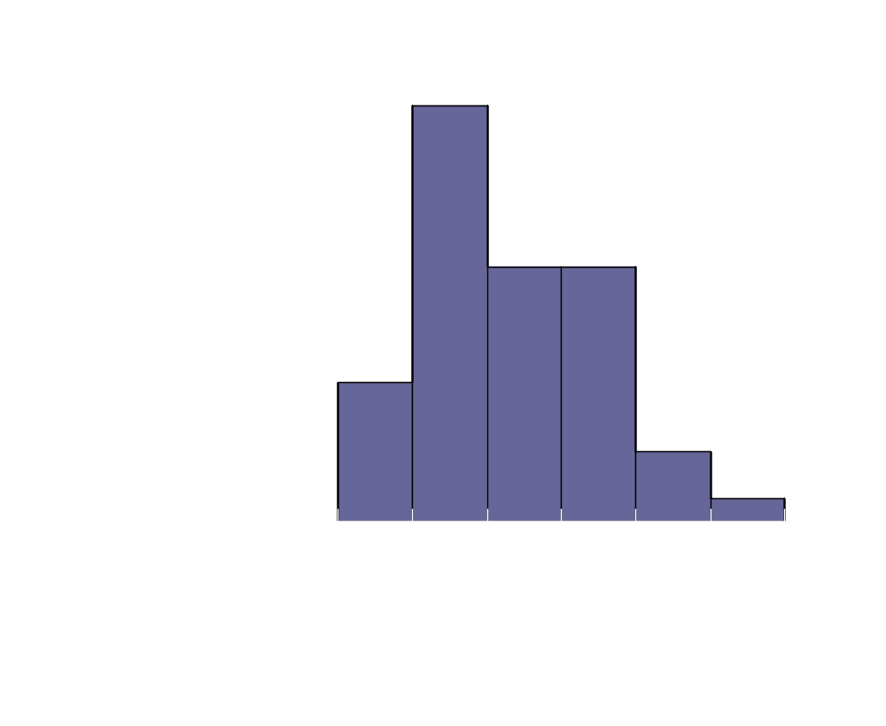
Histogram
Class Interval Frequency
20-under 30 6
30-under 40 18
40-under 50 11
50-under 60 11
60-under 70 3
70-under 80 1
Notes:
18

Slide 15

Histogram Construction
Class Interval Frequency
20-under 30 6
30-under 40 18
40-under 50 11
50-under 60 11
60-under 70 3
70-under 80 1
Notes:
19

Slide 16

Frequency Polygon
Class Interval Frequency
20-under 30 6
30-under 40 18
40-under 50 11
50-under 60 11
60-under 70 3
70-under 80 1
Notes:
20

Slide 17

Ogive
Cumulative
Class Interval Frequency
20-under 30 6
30-under 40 24
40-under 50 35
50-under 60 46
60-under 70 49
70-under 80 50
Notes:
21

Slide 18

Relative Frequency Ogive
Cumulative
Relative
Class Interval Frequency
20-under 30 .12
30-under 40 .48
40-under 50 .70
50-under 60 .92
60-under 70 .98
70-under 80 1.00
Notes:
22

Slide 19
Complaints by Amtrak Passengers
COMPLAINT
NUMBER
PROPORTION
DEGREES
Stations, etc.
28,000
.40
144.0
Train
14,700
.21
75.6
Performance
Equipment
10,500
.15
50.4
Personnel
9,800
.14
50.6
Schedules,
7,000
.10
36.0
etc.
Total
70,000
1.00
360.0

Slide 20
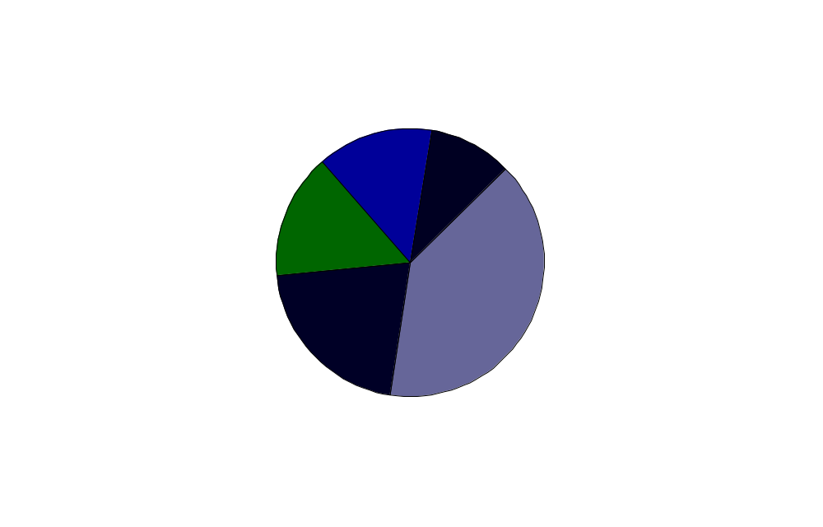
Complaints by Amtrak Passengers

Slide 21
Second Quarter Truck Production in the U.S. (Hypothetical values)
Company
2d Quarter
Truck
Production
A
B
C
D
E
  Totals
357,411
354,936
160,997
34,099
12,747
920,190
Notes:
25

Slide 22
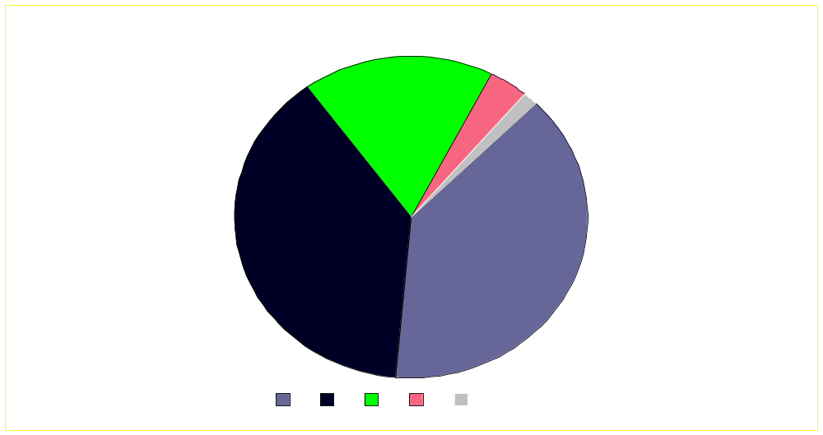
Second Quarter
U.S. Truck Production
Notes:
26

Slide 23
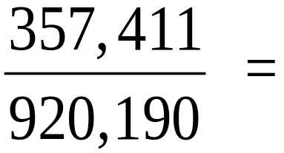

Pie Chart Calculations for Truck Producer Company A
Company
2d Quarter
Truck
Production
Proportion
Degrees
A
B
C
D
E
  Totals
357,411
354,936
160,997
34,099
12,747
920,190
.388
.386
.175
.037
.014
1.000
140
139
63
13
5
360
Notes:
27

