Slide 1
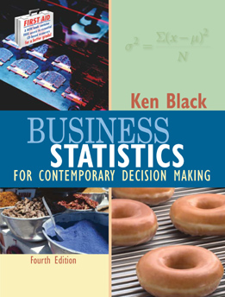
Business Statistics, 4e by Ken Black
Chapter 4
Probability

Slide 2
Learning Objectives
Comprehend the different ways of assigning probability.
Understand and apply marginal, union, joint, and conditional probabilities.
Select the appropriate law of probability to use in solving problems.
Solve problems using the laws of probability including the laws of addition, multiplication and conditional probability
Revise probabilities using Bayes’ rule.
Notes:
2

Slide 3
Methods of Assigning Probabilities
Classical method of assigning probability (rules and laws)
Relative frequency of occurrence (cumulated historical data)
Subjective Probability (personal intuition or reasoning)
Notes:
3

Slide 4
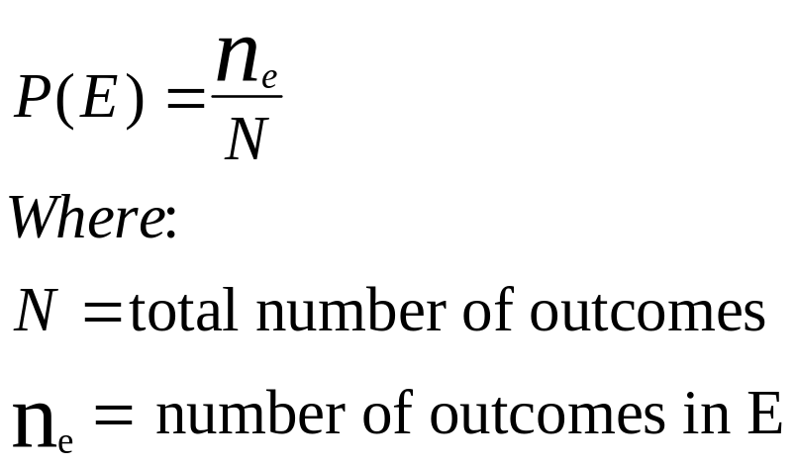
Classical Probability
Number of outcomes leading to the event divided by the total number of outcomes possible
Each outcome is equally likely
Determined a priori -- before performing the experiment
Applicable to games of chance
Objective -- everyone correctly using the method assigns an identical probability
Notes:
4

Slide 5
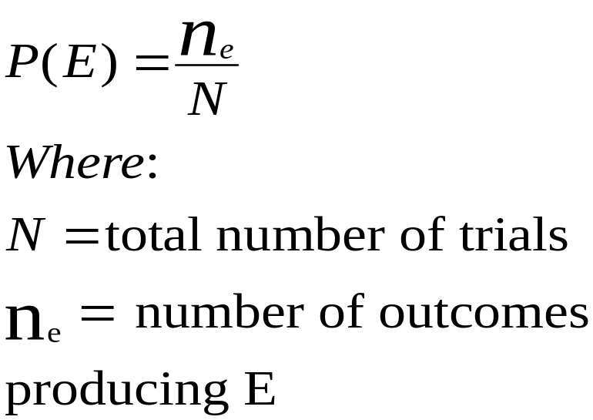
Relative Frequency Probability
Based on historical data
Computed after performing the experiment
Number of times an event occurred divided by the number of trials
Objective -- everyone correctly using the method assigns an identical probability
Notes:
5

Slide 6
Subjective Probability
Comes from a person’s intuition or reasoning
Subjective -- different individuals may (correctly) assign different numeric probabilities to the same event
Degree of belief
Useful for unique (single-trial) experiments
  New product introduction
  Initial public offering of common stock
  Site selection decisions
  Sporting events
Notes:
6

Slide 7
Structure of Probability
Experiment
Event
Elementary Events
Sample Space
Unions and Intersections
Mutually Exclusive Events
Independent Events
Collectively Exhaustive Events
Complementary Events
Notes:
7

Slide 8
Experiment
Experiment: a process that produces outcomes
  More than one possible outcome
  Only one outcome per trial
Trial: one repetition of the process
Elementary Event: cannot be decomposed or broken down into other events
Event: an outcome of an experiment
  may be an elementary event, or
  may be an aggregate of elementary events
  usually represented by an uppercase letter, e.g., A, E₁
Notes:
8

Slide 9
An Example Experiment
Experiment: randomly select, without replacement, two families from the residents of Tiny Town
Elementary Event: the sample includes families A and C
Event: each family in the sample has children in the household
Event: the sample families own a total of four automobiles
Tiny Town Population
Family
Children in Household
Number of Automobiles
A
B
C
D
Yes
Yes
No
Yes
3
2
1
2
Notes:
9

Slide 10
Sample Space
The set of all elementary events for an experiment
Methods for describing a sample space
  roster or listing
  tree diagram
  set builder notation
  Venn diagram
Notes:
10

Slide 11
Sample Space: Roster Example
Experiment: randomly select, without replacement, two families from the residents of Tiny Town
Each ordered pair in the sample space is an elementary event, for example -- (D,C)
Family
Children in Household
Number of Automobiles
Listing of Sample Space
(A,B), (A,C), (A,D),
(B,A), (B,C), (B,D),
(C,A), (C,B), (C,D),
(D,A), (D,B), (D,C)
A
B
C
D
Yes
Yes
No
Yes
3
2
1
2
Notes:
11

Slide 12
Sample Space: Tree Diagram for Random Sample of Two Families
B
A
C
D
A
B
C
D
A
C
B
D
A
D
B
C
Notes:
12

Slide 13
Sample Space: Set Notation for Random Sample of Two Families
S = {(x,y) | x is the family selected on the first draw, and y is the family selected on the second draw}
Concise description of large sample spaces
Notes:
13

Slide 14
Sample Space
Useful for discussion of general principles and concepts
Listing of Sample Space
Venn Diagram
(A,B), (A,C), (A,D),
(B,A), (B,C), (B,D),
(C,A), (C,B), (C,D),
(D,A), (D,B), (D,C)
Notes:
14

Slide 15
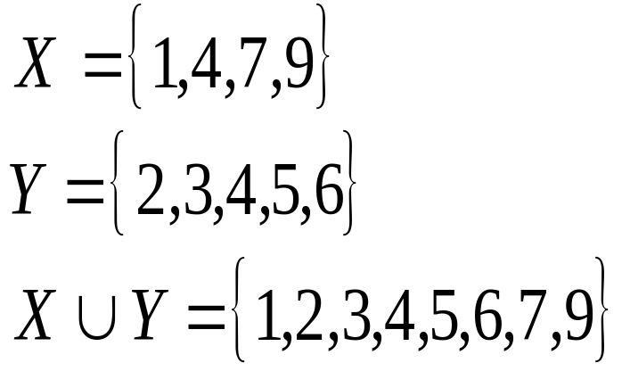
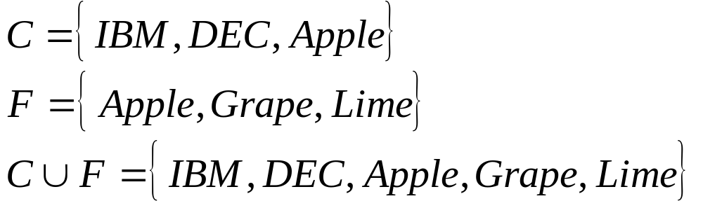
Union of Sets
The union of two sets contains an instance of each element of the two sets.
X
Y
Notes:
15

Slide 16
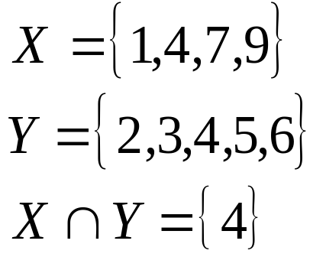
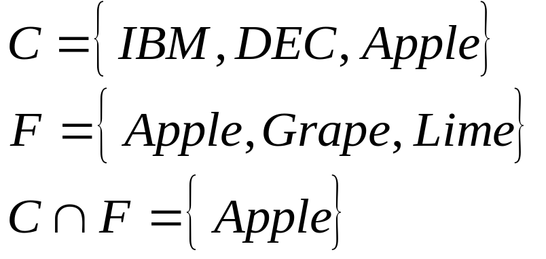
Intersection of Sets
The intersection of two sets contains only those element common to the two sets.
X
Y
Notes:
16

Slide 17
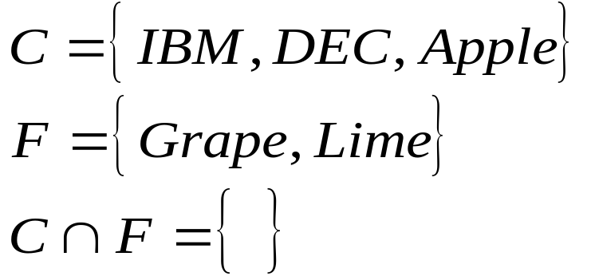
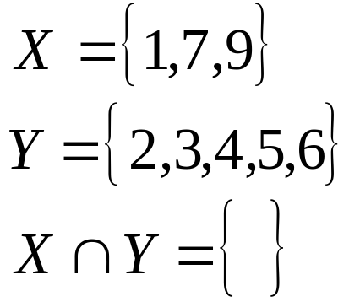
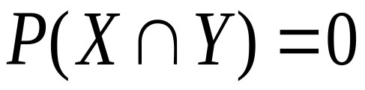
Mutually Exclusive Events
Events with no common outcomes
Occurrence of one event precludes the occurrence of the other event
X
Y
Notes:
17

Slide 18
Independent Events
Occurrence of one event does not affect the occurrence or nonoccurrence of the other event
The conditional probability of X given Y is equal to the marginal probability of X.
The conditional probability of Y given X is equal to the marginal probability of Y.
Notes:
18

Slide 19
Collectively Exhaustive Events
Contains all elementary events for an experiment
E₁
E₂
E₃
Sample Space with three
collectively exhaustive events
Notes:
19

Slide 20
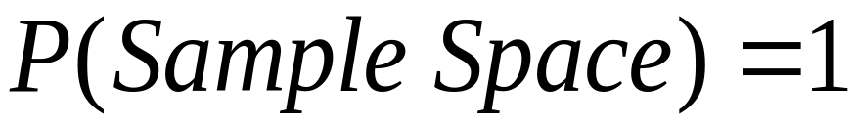

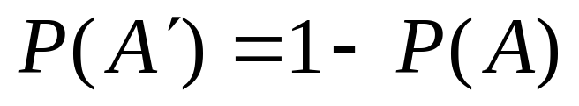
Complementary Events
All elementary events not in the event ‘A’ are in its complementary event.
Sample
Space
A
Notes:
20

Slide 21
Counting the Possibilities
mn Rule
Sampling from a Population with Replacement
Combinations: Sampling from a Population without Replacement

Slide 22
mn Rule
If an operation can be done m ways and a second operation can be done n ways, then there are mn ways for the two operations to occur in order.
A cafeteria offers 5 salads, 4 meats, 8 vegetables, 3 breads, 4 desserts, and 3 drinks. A meal is two servings of vegetables, which may be identical, and one serving each of the other items. How many meals are available?

Slide 23
Sampling from a Population with Replacement
A tray contains 1,000 individual tax returns. If 3 returns are randomly selected with replacement from the tray, how many possible samples are there?
(N)^{n} = (1,000)³ = 1,000,000,000

Slide 24
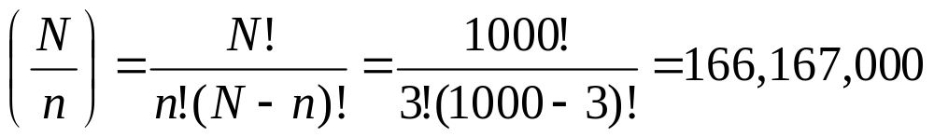
Combinations
A tray contains 1,000 individual tax returns. If 3 returns are randomly selected without replacement from the tray, how many possible samples are there?

Slide 25
Four Types of Probability
Marginal Probability
Union Probability
Joint Probability
Conditional Probability
Notes:
21

Slide 26
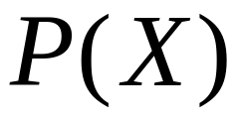



Four Types of Probability
Marginal
Union
Joint
Conditional
The probability of X occurring
The probability of X or Y occurring
The probability of X and Y occurring
The probability of X occurring given that Y has occurred
X
X
Y
X
Y
Y
Notes:
22

Slide 27
General Law of Addition
X
Y
Notes:
23

Slide 28
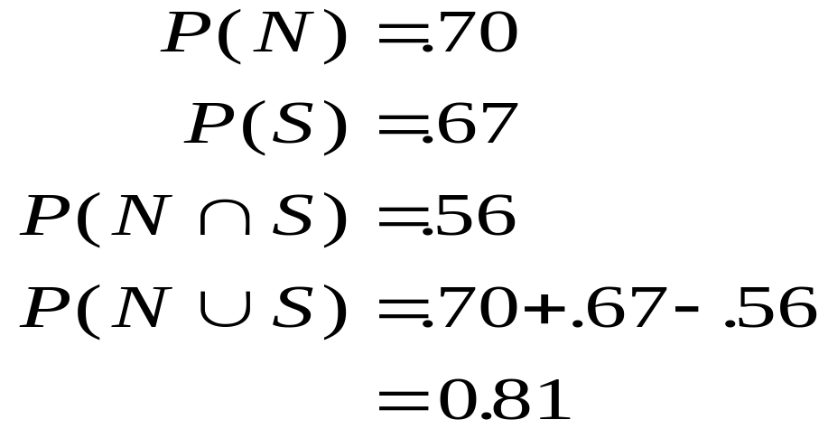
General Law of Addition -- Example
N
S
.70
.56
.67
Notes:
24

Slide 29
Office Design Problem
Probability Matrix
Increase
Storage Space
Yes
No
Total
Noise
Reduction
Yes
.56
.14
.70
No
.11
.19
.30
Total
.67
.33
1.00
Notes:
25

Slide 30
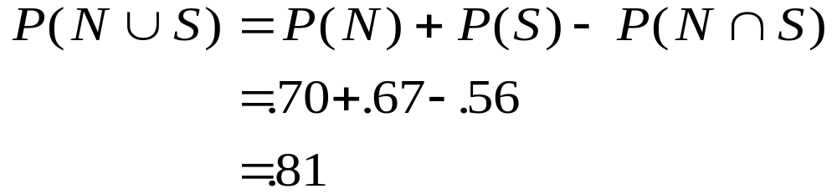
Office Design Problem
Probability Matrix
Increase
Storage Space
Yes
No
Total
Noise
Reduction
Yes
.56
.14
.70
No
.11
.19
.30
Total
.67
.33
1.00
Notes:
26

Slide 31
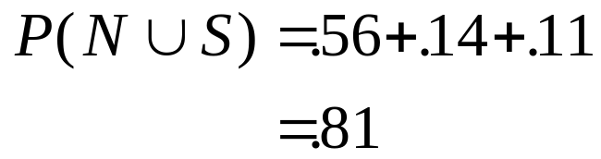
Office Design Problem
Probability Matrix
Increase
Storage Space
Yes
No
Total
Noise
Reduction
Yes
.56
.14
.70
No
.11
.19
.30
Total
.67
.33
1.00
Notes:
27

Slide 32
Venn Diagram of the X or Y but not Both Case
X
Y

Slide 33
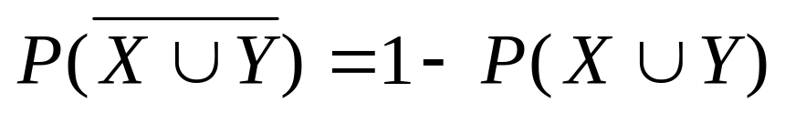
The Neither/Nor Region
X
Y

Slide 34
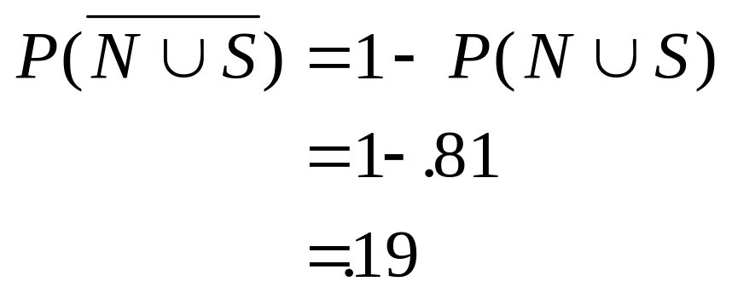
The Neither/Nor Region
N
S

Slide 35
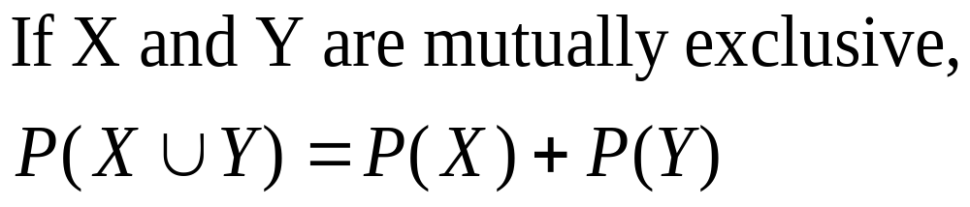
Special Law of Addition
Y
X
Notes:
31

Slide 36
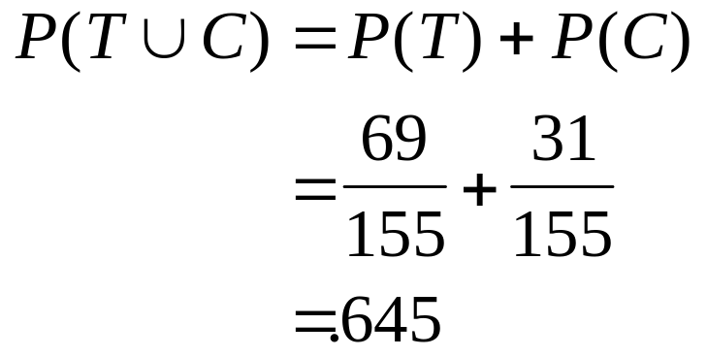
Demonstration Problem 4.3
Type of
Gender
Position
Male
Female
Total
Managerial
8
3
11
Professional
31
13
44
Technical
52
17
69
Clerical
9
22
31
Total
100
55
155

Slide 37
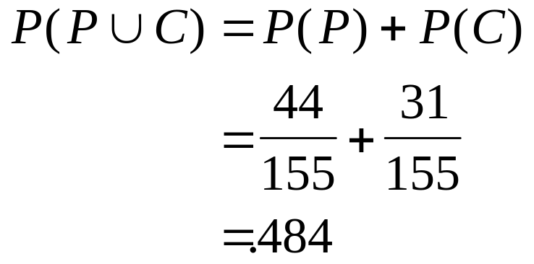
Demonstration Problem 4.3
Type of
Gender
Position
Male
Female
Total
Managerial
8
3
11
Professional
31
13
44
Technical
52
17
69
Clerical
9
22
31
Total
100
55
155

Slide 38
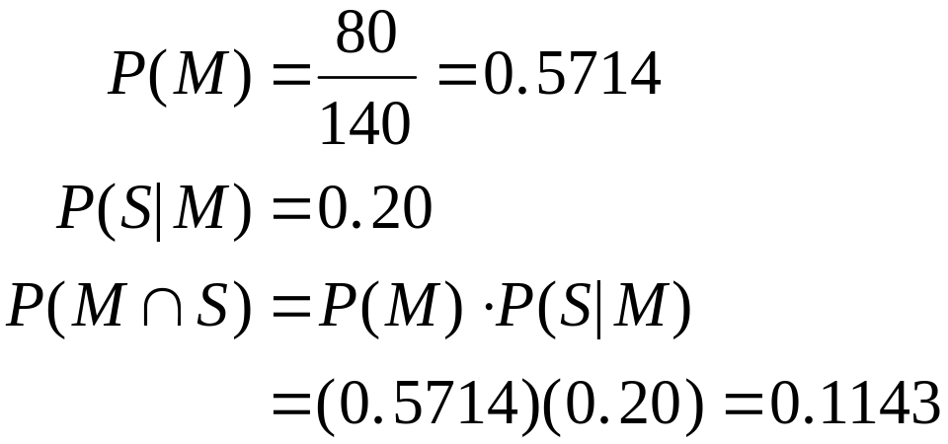
Law of Multiplication
Demonstration Problem 4.5
Notes:
34

Slide 39
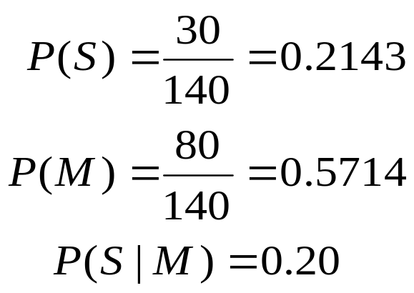
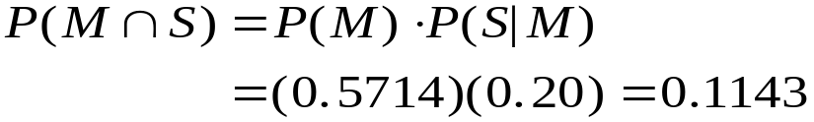
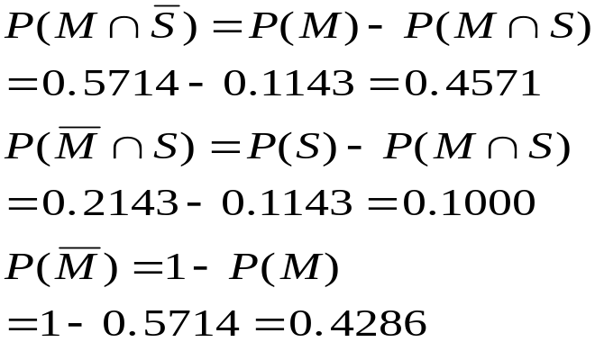
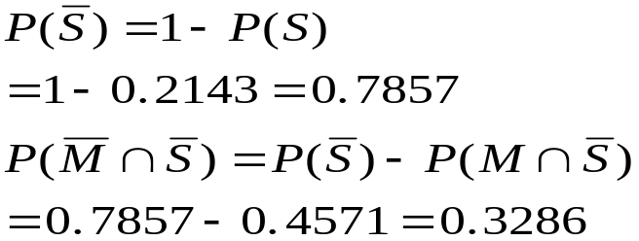
Law of Multiplication
Demonstration Problem 4.5
Probability Matrix
of Employees
Married
Supervisor
Yes
No
Total
Yes
.1143
.1000
.2143
No
.4571
.3286
.7857
Total
.5714
.4286
1.00
Notes:
35

Slide 40
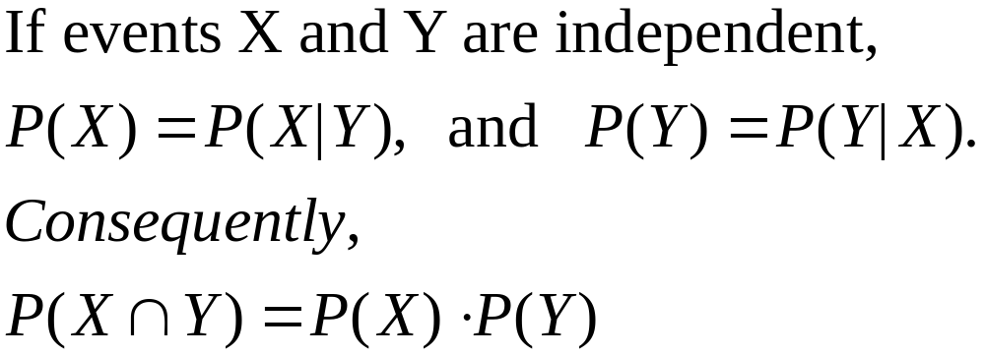
Special Law of Multiplication for Independent Events
General Law
Special Law
Notes:
36

Slide 41
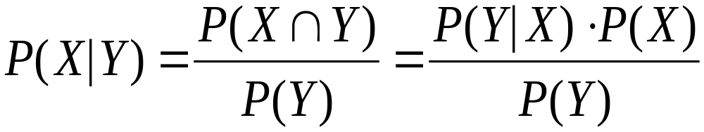
Law of Conditional Probability
The conditional probability of X given Y is the joint probability of X and Y divided by the marginal probability of Y.
Notes:
37

Slide 42
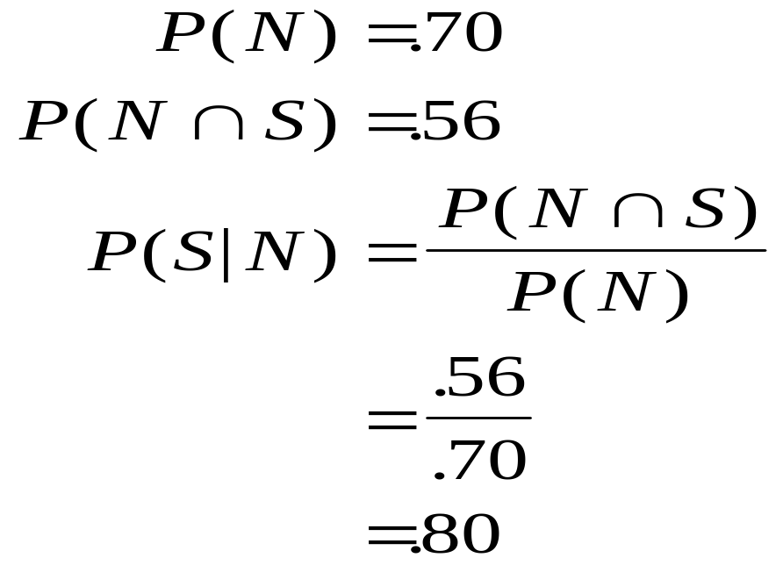
Law of Conditional Probability
S
N
.56
.70
Notes:
38

Slide 43
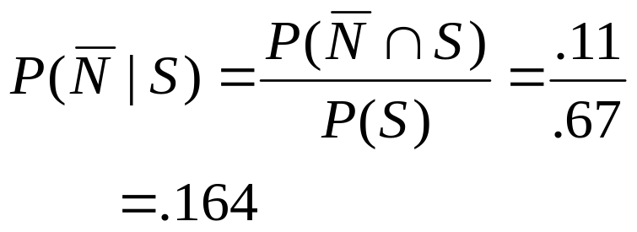
Office Design Problem
Increase
Storage Space
Yes
No
Total
Noise
Reduction
Yes
.56
.14
.70
No
.11
.19
.30
Total
.67
.33
1.00
Reduced Sample Space for “Increase Storage Space” = “Yes”
Notes:
39

Slide 44
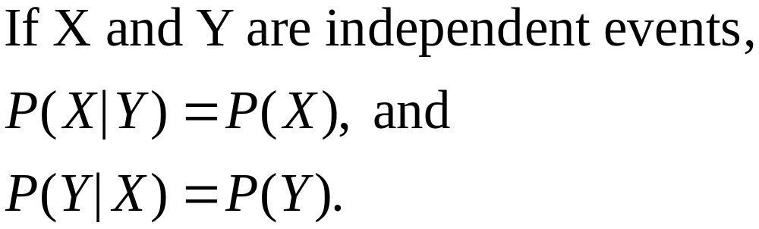
Independent Events
If X and Y are independent events, the occurrence of Y does not affect the probability of X occurring.
If X and Y are independent events, the occurrence of X does not affect the probability of Y occurring.
Notes:
40

Slide 45
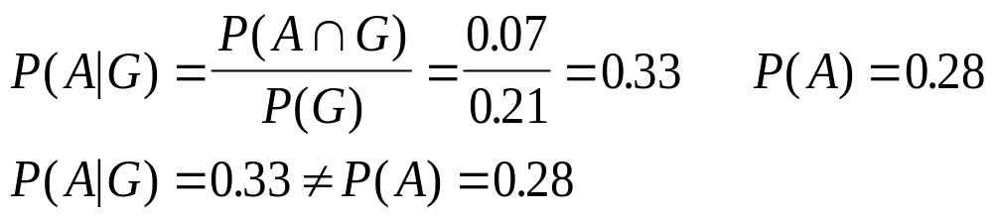
Independent Events
Demonstration Problem 4.10
Geographic Location
Northeast
Southeast
Midwest
West
D
E
F
G
Finance A
.12
.05
.04
.07
.28
Manufacturing B
.15
.03
.11
.06
.35
Communications C
.14
.09
.06
.08
.37
.41
.17
.21
.21
1.00

Slide 46
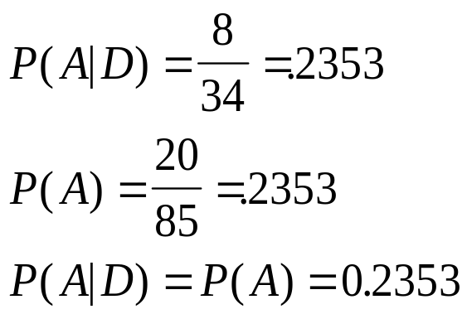
Independent Events
Demonstration Problem 4.11
D
E
A
8
12
20
B
20
30
50
C
6
9
15
34
51
85

Slide 47
Revision of Probabilities: Bayes’ Rule
An extension to the conditional law of probabilities
Enables revision of original probabilities with new information
Notes:
43

Slide 48
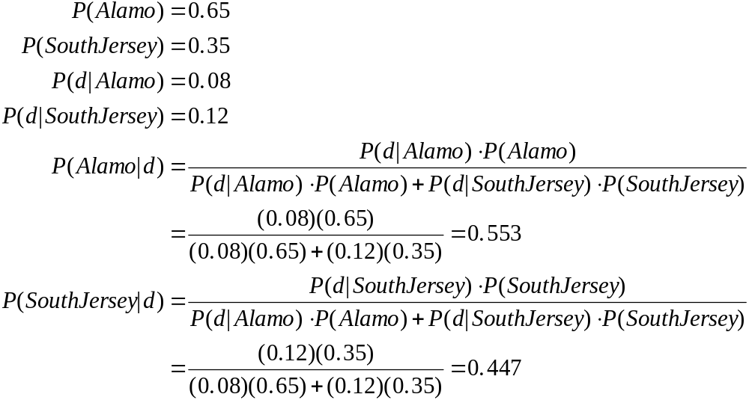
Revision of Probabilities with Bayes' Rule: Ribbon Problem
Notes:
44

Slide 49

Revision of Probabilities with Bayes’ Rule: Ribbon Problem
Event
Prior Probability
Conditional Probability
Joint Probability
Revised Probability
P
(
d
|
E
)
P
(
E
∩
d
)
P
(
E
|
i
d
)
i
i
Alamo
South Jersey
0.65
0.35
0.08
0.12
0.052
0.042
0.094
0.052
0.094
=0.553
0.042
0.094
=0.447
Notes:
45

Slide 50
Revision of Probabilities with Bayes' Rule: Ribbon Problem
Defective
0.08
0.052
Alamo
0.65
Acceptable
0.92
+
0.094
Defective
0.12
0.042
South
Jersey
0.35
Acceptable
0.88
Notes:
46

Slide 51
Probability for a Sequence of Independent Trials
25 percent of a bank’s customers are commercial (C) and 75 percent are retail (R).
Experiment: Record the category (C or R) for each of the next three customers arriving at the bank.
Sequences with 1 commercial and 2 retail customers.
  C₁ R₂ R₃
  R₁ C₂ R₃
  R₁ R₂ C₃
Notes:
47

Slide 52
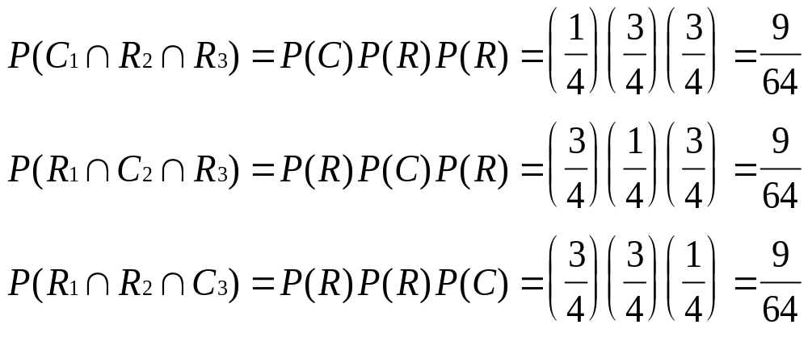
Probability for a Sequence of Independent Trials
Probability of specific sequences containing 1 commercial and 2 retail customers, assuming the events C and R are independent
Notes:
48

Slide 53
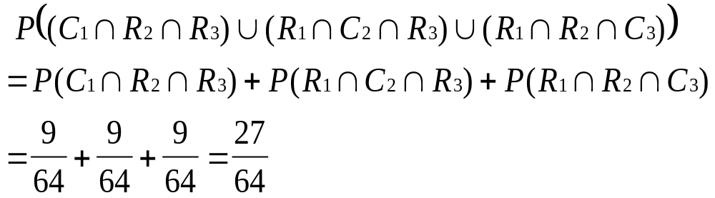
Probability for a Sequence of Independent Trials
Probability of observing a sequence containing 1 commercial and 2 retail customers, assuming the events C and R are independent
Notes:
49

Slide 54
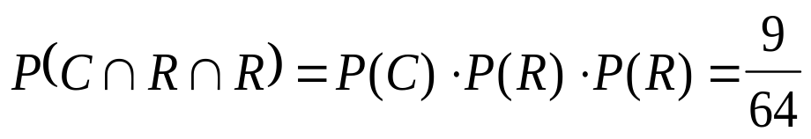
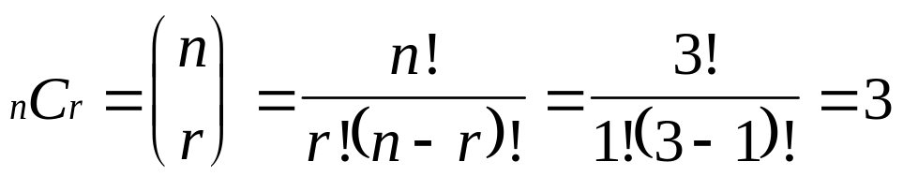
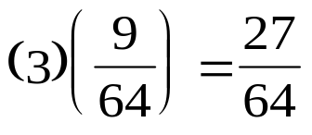
Probability for a Sequence of Independent Trials
Probability of a specific sequence with 1 commercial and 2 retail customers, assuming the events C and R are independent
Number of sequences containing 1 commercial and 2 retail customers
Probability of a sequence containing 1 commercial and 2 retail customers
Notes:
50

Slide 55
Probability for a Sequence of Dependent Trials
Twenty percent of a batch of 40 tax returns contain errors.
Experiment: Randomly select 4 of the 40 tax returns and record whether each return contains an error (E) or not (N).
Outcomes with exactly 2 erroneous tax returns
  E₁ E₂ N₃ N₄
  E₁ N₂ E₃ N₄
  E₁ N₂ N₃ E₄
  N₁ E₂ E₃ N₄
  N₁ E₂ N₃ E₄
  N₁ N₂ E₃ E₄
Notes:
51

Slide 56
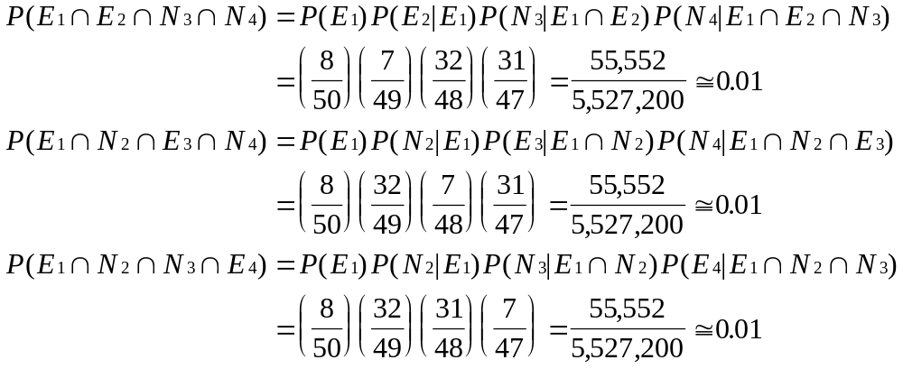
Probability for a Sequence of Dependent Trials
Probability of specific sequences containing 2 erroneous tax returns (three of the six sequences)
Notes:
52

Slide 57
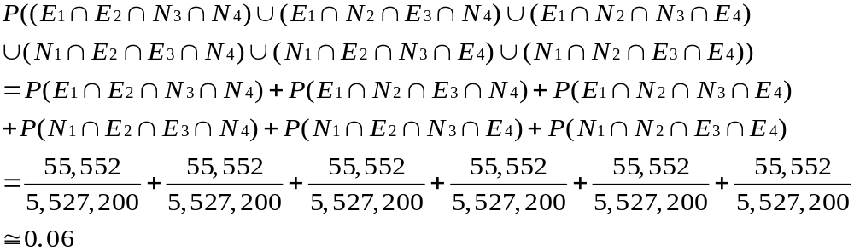
Probability for a Sequence of Independent Trials
Probability of observing a sequence containing exactly 2 erroneous tax returns
Notes:
53

Slide 58
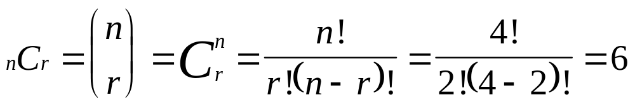
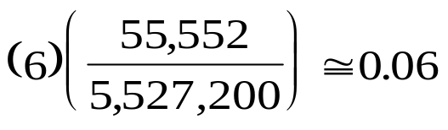
Probability for a Sequence of Dependent Trials
Probability of a specific sequence with exactly 2 erroneous tax returns
Number of sequences containing exactly 2 erroneous tax returns
Probability of a sequence containing exactly 2 erroneous tax returns
Notes:
54

